Slide 1
UCP-125597 / I-159 WS Award Balance Adjustment Work Study Process Map
Refer to [UCP-162712] SCT changes for work study - Correct WS Award / Balance Adjustment logic – Jira for SCT test scenarios.
WS distribution results in split refusal (AltAcct X) when award balance is negative.
Location
I-159 Files
SCT Transactions
UC_SCT_DIST
Payroll
WS Awards Amount
- New
- Adjustments
Display negative award balance
I-159
WS Award Inbound
UC_I159_WSIN
E716 WS Redistribution
UC_WS_FD
I-158 WS Award Outbound
UC_I158_WSOB
UC_WS_AWARD_TBL
Allow and recalculate negative award balances
Remove repeated data from errors and show negative balance records in the log
DR Transactions
UC_WS_DR
Retires 7/1/25
Location
Labor Ledger
Location
I-158 Files
WS Award
Table
Display negative award balances
Display EFFDT rows in descending order (The most current EFFDT on the top)

Slide 2
What changes to test?
I-159 Work Study Award Inbound
Negative balance is accurately calculated
Log file shows negative balance record details
Log file do not show skipped record details
Log file shows number of skipped records
I-158 Work Study Award Outbound
Negative balance is shown
(Optional) downstream testing with local SIS or FA System
Work Study Award Table page
Page displays negative balance
Page displays EFFDT in descending order (most current EFFDT on the top)
E-716 WS Redistribution
WS redistribution results in split refusal with Alt Acct ‘X’ when award balance is negative

Slide 3
UAT Logistics
UT1 Link: https://drppuat.universityofcalifornia.edu/
UT1 Data: PRD copy as of 12/3/2024
Run IDs for I-158 files: 241031M0X, 241123B1X 250215B1X, 250331M0X
A link for location specific UCOP Box folder for file exchanges has been emailed. Please let UCPC know if you need to modify access list or any issues.
Locations to fill out test resource list in the Box folder.
UCPC to assist providing UT1 access to the test resource.
I-159 and I-158 file exchanges will be manual. Please notify UCPC once you uploaded test files.
UCPC will run I-159 process manually. Locations to validate the results.
Once locations have negative earnings test subjects, UCPC will run I-158 process and save output files in the Box folder.
Select test subjects from employees who had WS distributions in 241031M0X or 241123B1X 250215B1X or 250331M0X, so they’ll show up on I-158 files.
Locations to report any issues on UCP-125597 Jira
For any questions or requests with WS files, please feel free to contact UCPC at chie.tuller@ucop.edu.

Slide 4
UAT Logistics
UT1 Link: https://drppuat.universityofcalifornia.edu/ (VPN connection required)
UT1 Data: PRD copy as of 12/3/2024
On-cycle Run IDs (E-716 WS distribution and I-158 WS Outbound): 250215B1X, 250331M0X
UAT Schedule: UCPath_ITSS-Location_Status042425.pptx (slide 6)
Manual File Exchange Folders:
BKCMP: https://ucop.box.com/s/99tnbvn9aqvezxc0zw0zfveibsmdbeyy
DVCMP: https://ucop.box.com/s/vqo5fjtlaiwl6usj0vl4yf8pmzt96snx
HACMP: https://ucop.box.com/s/qccbbuolv40sqblby009v1dwytbhsn6f
IRCMP: https://ucop.box.com/s/0pt85ri6ihxnard27wmfwgw6o4gxo64i
LACMP: https://ucop.box.com/s/fn7d1vdznvvm43qajj1adfk51hjnxs32
MECMP: https://ucop.box.com/s/v7omtoscwtmzdvtnazl7p0118frpxtwh
RVCMP: https://ucop.box.com/s/t3carb52rfwg9ygsbstmfngijd3gl2hg
SBCMP: https://ucop.box.com/s/fhe2dhmxh93ylem49ulp1j1p3iakzcat
SCCMP: https://ucop.box.com/s/dpqhe3f3hvt8drwz28lqqjdcmpsgr7t4
SDCMP: https://ucop.box.com/s/e46lzi6t2cx5fd8baeqhu93hlwqyzgdx
SFCMP: https://ucop.box.com/s/9hxsamw8gbwabnvnieopjg45pmqxebzt

Slide 5
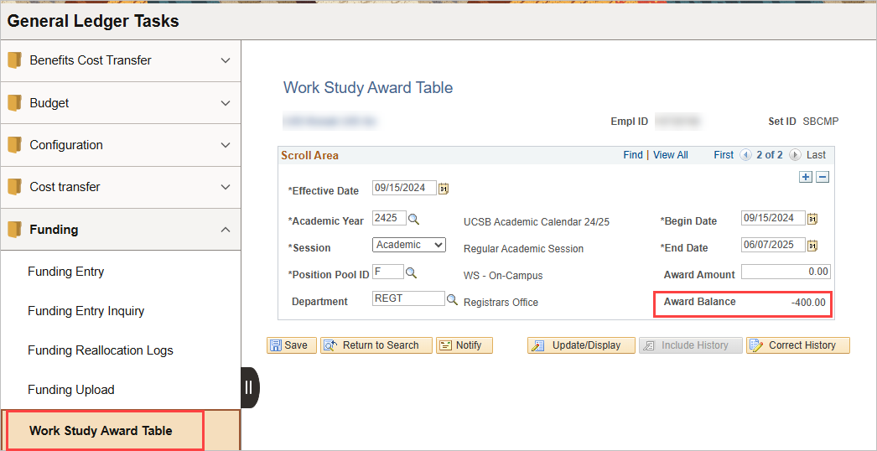
Work Study Award Table
Navigation: Menu > Set Up HCM > Product Related > Commitment Accounting > UC Customizations > Work Study Award Table
Data Table: UC_WS_AWARD

Slide 6
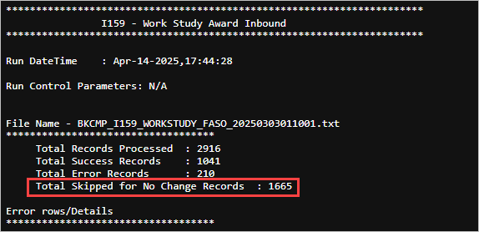
I-159 WS Inbound Process Log
The count of skipped records due to no changes to the WS Award Table is shown at the top.
No details will be displayed for those records.
Details of negative balance records will be shown under Warnings section.

Slide 7
I-158 WS Outbound File
Balance column will show negative balances

Slide 8
E-716 Work Study Distribution
Once WS award balance becomes negative, E-716 Work Study Distribution will result in split refusal with Alt Account “X” for both positive and negative earnings. WS award balance will not be updated.
For reversed WS checks, E-716 Work Study Distribution will credit reversed amount to the WS award balance even when it is negative (the same as existing behavior).

