Slide 1
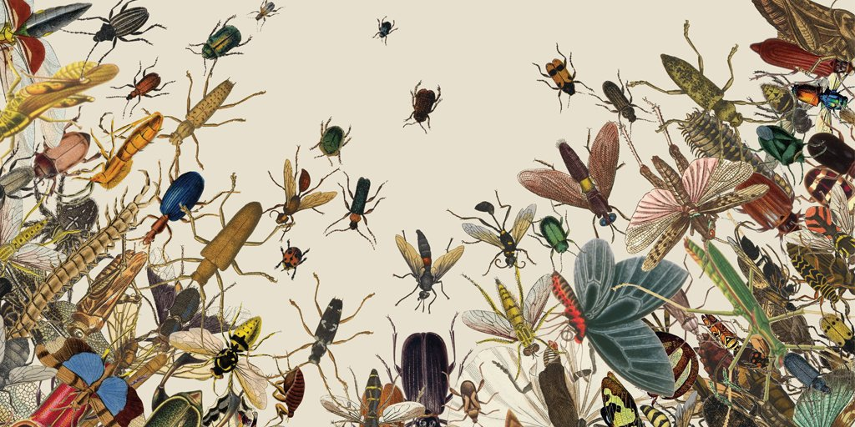
Bio 159:
Insect Ecology & Evolution
Class: T/Th 10.30-11.45am
Lab: Fri. 10.00-1.00pm
Insects are the most abundant and diverse animals on the planet.
(…even more diverse than plants!)
Come learn about this diversity and its global importance!
To learn about these extraordinary animals, students will collect, identify, and curate their own insect collections.

