Slide 1
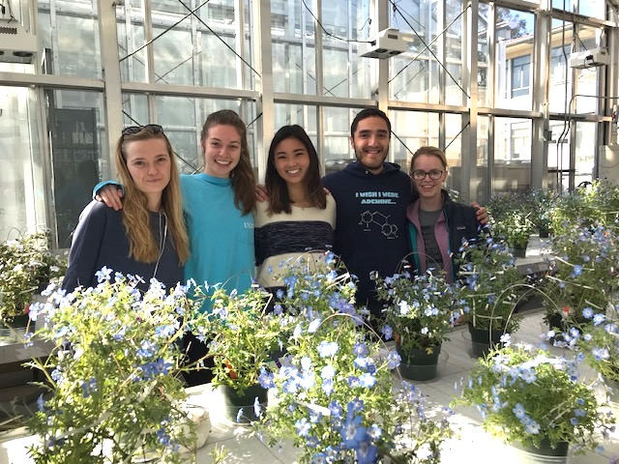
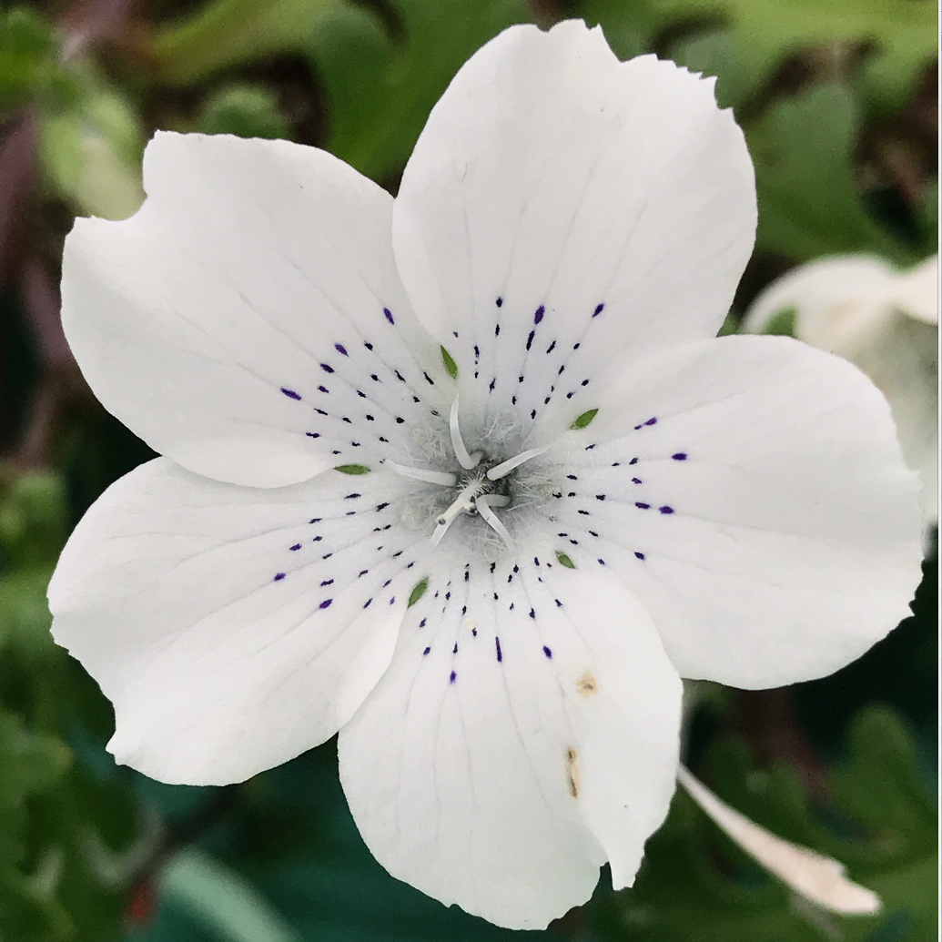
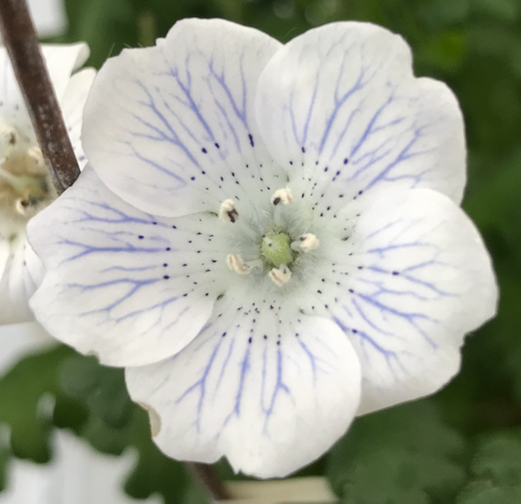
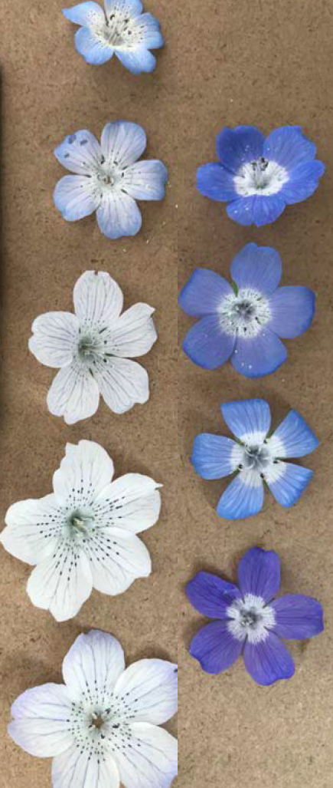
Research Experience for Undergraduates (REU) in Plant Ecology and Evolution
At the University of California, Santa Barbara; Sponsored by the National Science Foundation,
Interested in gaining hands-on experience in ecological and evolutionary research? Apply to join our research team for summer 2019 as we investigate the process of natural selection in four populations of the widespread California native wildflower, Baby Blue Eyes (Nemophila menziesii). We’re investigating wild populations along the length of the state to gain insight into the effects of rainfall and temperature regimes on the strength and direction of natural selection on life history and reproductive traits. Participants in this REU project will spend the summer at UCSB, conducting a combination of greenhouse-and lab-based activities. Join us!
Eligibility and Preferred Qualifications
U.S. citizens or permanent residents who are currently enrolled as undergraduates at any U.S. institution (In Fall 2019, you must be enrolled at your home institution).
Students with a strong interest in ecology and evolution; previous course work in Biology is preferred.
Students with a strong desire to obtain hands-on experience in plant evolution and ecology.
We particularly welcome women and members of under-represented groups.
Start date: June 1, 2019 – July 1, 2019 (expected end date will be 12 weeks later, and there is flexibility in the duration of each student’s REU.
What do REU participants receive?
A $7000 summer stipend (for 12 weeks of full-time participation @$600/week)
Housing supplement of $400/month for 3 months
The opportunity to conduct an independent research project while working on an ongoing collaborative project
Experience in a variety of skills, including: plant cultivation and breeding, data management, image analysis, germination treatments, hypothesis-testing, statistical analysis, and discussion of the scientific literature in plant evolutionary ecology.
To apply:
Please send the following to Professor Susan Mazer (sjmazer@ucsb.edu) before March 15, 2019.
Statement of interest: Please describe why this opportunity is a good match for your personal, scholarly, and professional interests; why you believe that you’re a great fit for this project; and how your perspective and experiences may contribute to the diversity of the scientific community.
Transcript (an unofficial transcript is acceptable)
Reference: The name, email address, and phone number of a faculty member or mentor who knows you well.

