Slide 1
Material for review
Prepared for Quidnet Energy
May 2021
LDES Research Team

Slide 2
Disclaimer and requests
The data, text and plots provided in this presentation are for communication purpose only and subject to further revision
Please review these materials and propose any comments or revision.
Please pay special attention to the text in red

Slide 3
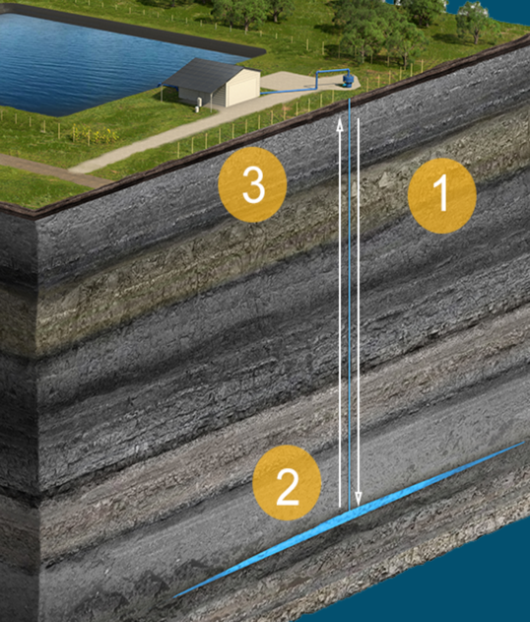



Technology introduction and description
In the related section we wrote:
  “Another approach to reduce the cost of the reservoir is to utilize existing reservoirs, like a decommissioned coal mine and underground rock layers. Quidnet Energy, a geomechanical PSH provider had four projects under development in 2020 in New York, Texas, Ohio and Alberta.”
  We would like to include a number of illustrative figures in our paper and will consider using one from Quidnet if space constraints allow and adds to the message. We prefer a schematic that helps us show the footprint Quidnet needs.

Slide 4
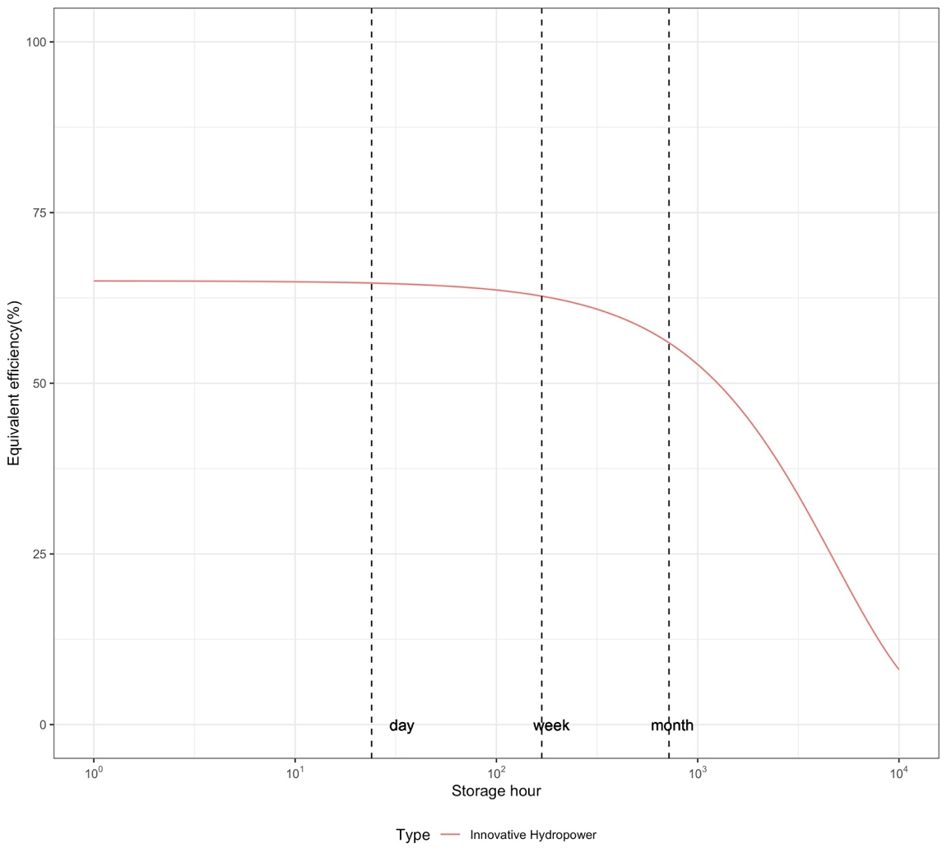
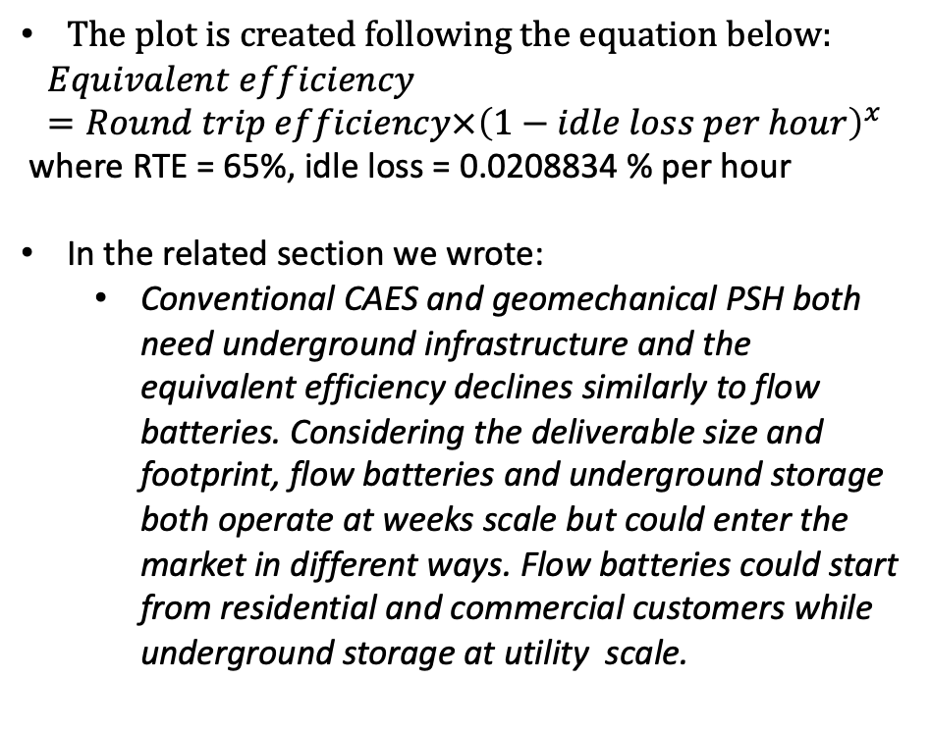
Equivalent efficiency curve
The plot is created following the equation below:
$$Equivalent efficiency=Round trip efficiency×{\left(1−idle loss per hour\right)}^{x}$$
where RTE = 65%, idle loss = 0.0208834 % per hour
In the related section we wrote:
  Conventional CAES and geomechanical PSH both need underground infrastructure and the equivalent efficiency declines similarly to flow batteries. Considering the deliverable size and footprint, flow batteries and underground storage both operate at weeks scale but could enter the market in different ways. Flow batteries could start from residential and commercial customers while underground storage at utility scale.
Notes:
Sarah: We could truncate after month

Slide 5
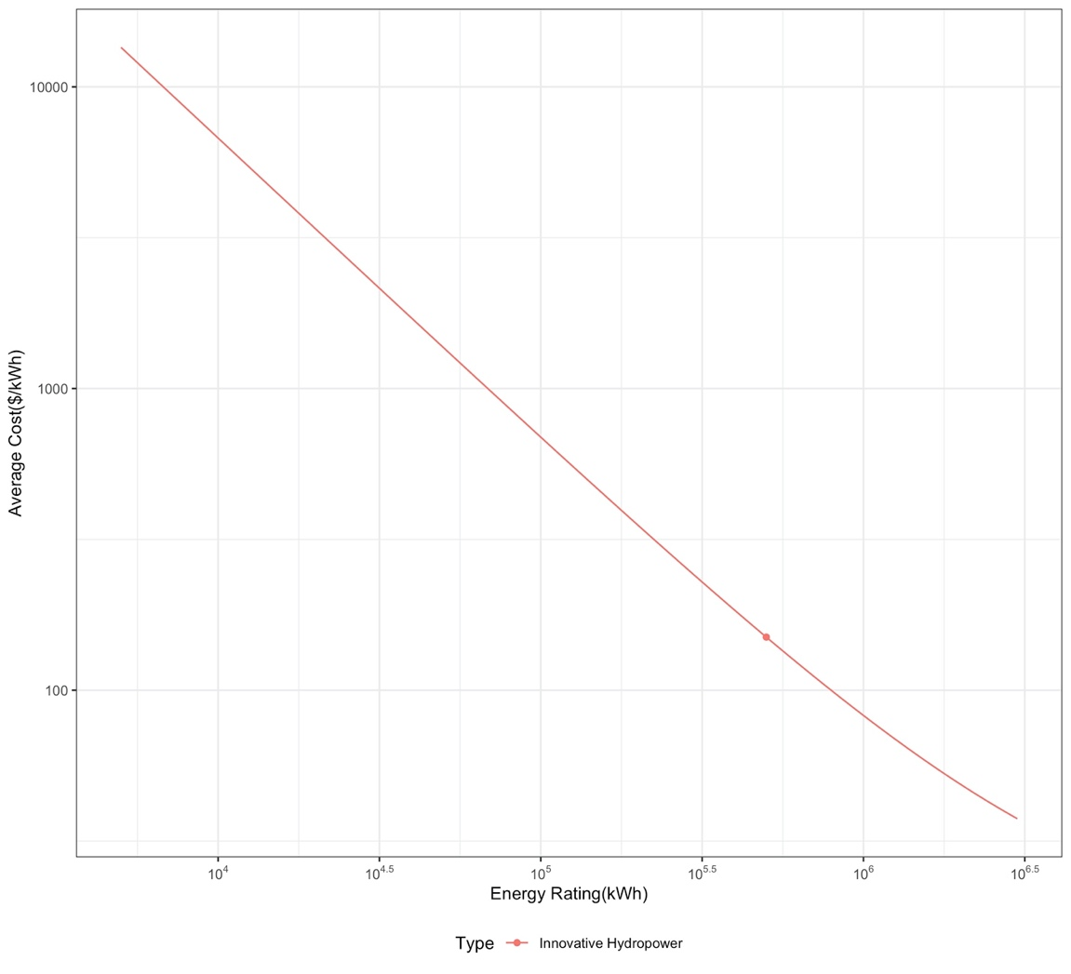
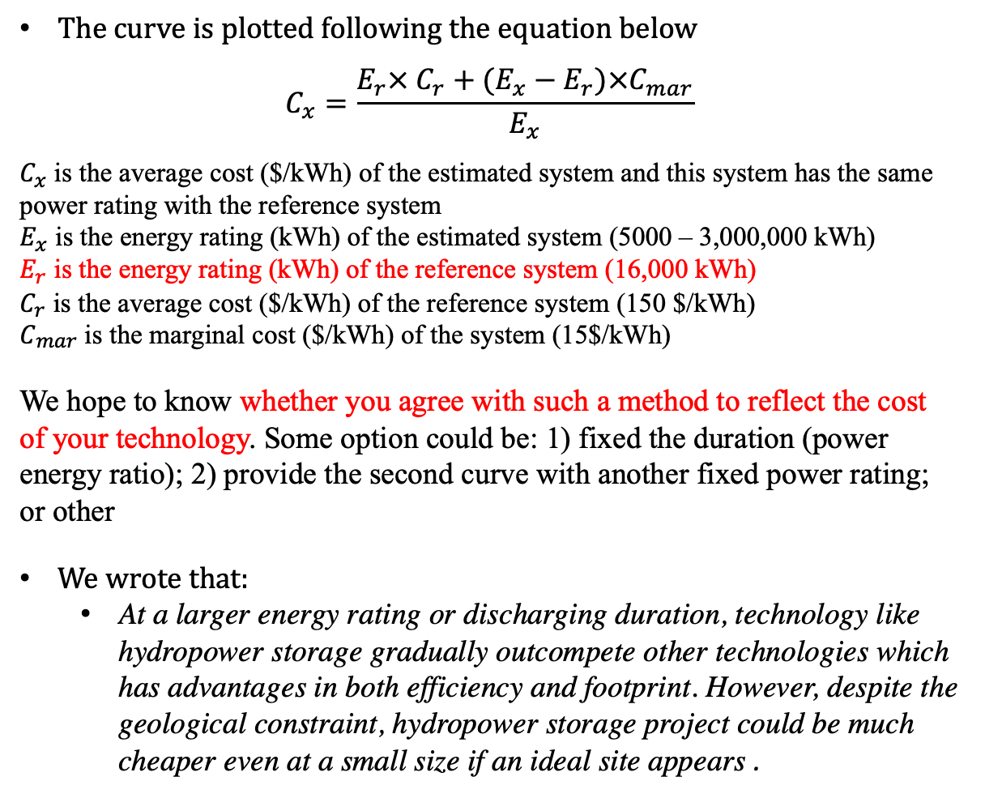
Average Capex
The curve is plotted following the equation below
$$C_{x}=\frac{E_{r}× C_{r}+(E_{x}−E_{r})×C_{mar}}{E_{x}}$$
$C_{x}$ is the average cost ($/kWh) of the estimated system and this system has the same power rating with the reference system
$E_{x}$ is the energy rating (kWh) of the estimated system (5000 – 3,000,000 kWh)
$E_{r}$ is the energy rating (kWh) of the reference system (16,000 kWh)
$C_{r}$ is the average cost ($/kWh) of the reference system (150 $/kWh)
$C_{mar}$ is the marginal cost ($/kWh) of the system (15$/kWh)
We hope to know whether you agree with such a method to reflect the cost of your technology. Some option could be: 1) fixed the duration (power energy ratio); 2) provide the second curve with another fixed power rating; or other
We wrote that:
  At a larger energy rating or discharging duration, technology like hydropower storage gradually outcompete other technologies which has advantages in both efficiency and footprint. However, despite the geological constraint, hydropower storage project could be much cheaper even at a small size if an ideal site appears .
Notes:
Maybe more of s-curve or inflection at longer duration
Er = 16,000 kWh

Slide 6
Company specific data displayed in table
Company | Type | Discharging duration(hr) | Energy Density (kWh/m3) | Land footprint (m2/MW) | Land footprint (m2/MWh) | Energy capacity (MWh) | Discharging power capacity (MW) | Lifetime (years) | Self-discharge rate (%/day) | Roundtrip efficiency (%) | Response time(s) | Marginal Energy Capital cost ($/kWh) | Average capital cost ($/kW) | Average capital cost ($/kWh) | Fixed O&M ($/kW-yr) | Variable O&M ($/kWhr)
Quidnet | Innovative Hydropower | ~10 |  | NA | NA | 160~3200 | 16~320 | 40 | 0.5 | 65~75 | ~300-900 | 5~10 | 500~1000 | 50~100 | 10~20 (~2% of capital cost)
Could you review these data for accuracy – we propose this as a primary way to communicate about Quidnet’s capabilities.

