Slide 1
SB100 report
https://www.energy.ca.gov/sb100
https://efiling.energy.ca.gov/GetDocument.aspx?tn=237167&DocumentContentId=70349

Slide 2
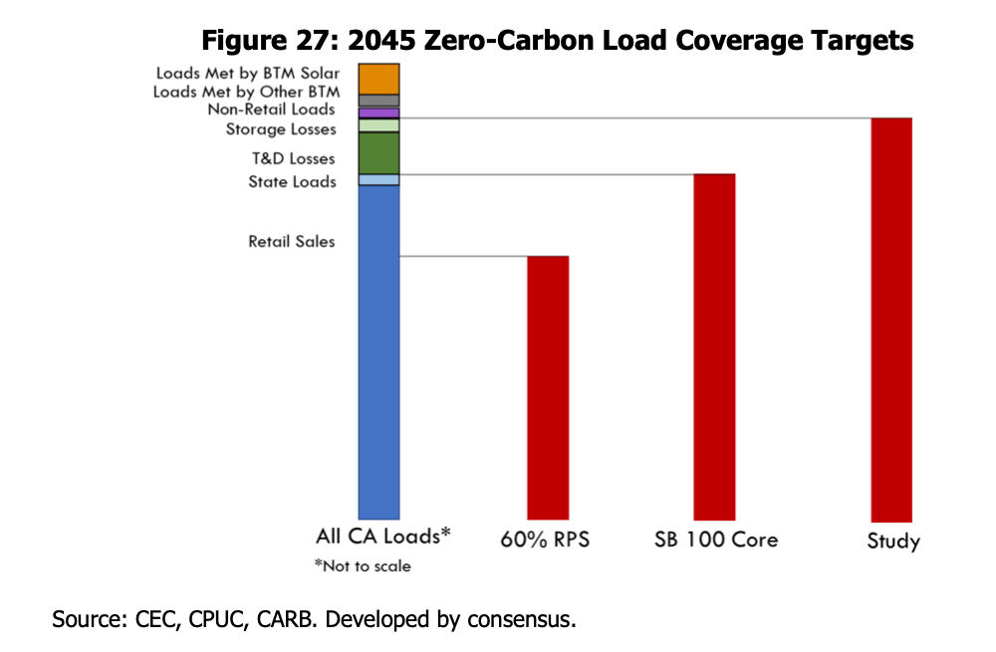
This analysis still chooses to exclude line losses from the zero-carbon target
SB100 core analysis allows carbon emissions for the line losses;
we have chosen to require no emissions for the line losses – in line with the “Study” scenario on the right

Slide 3
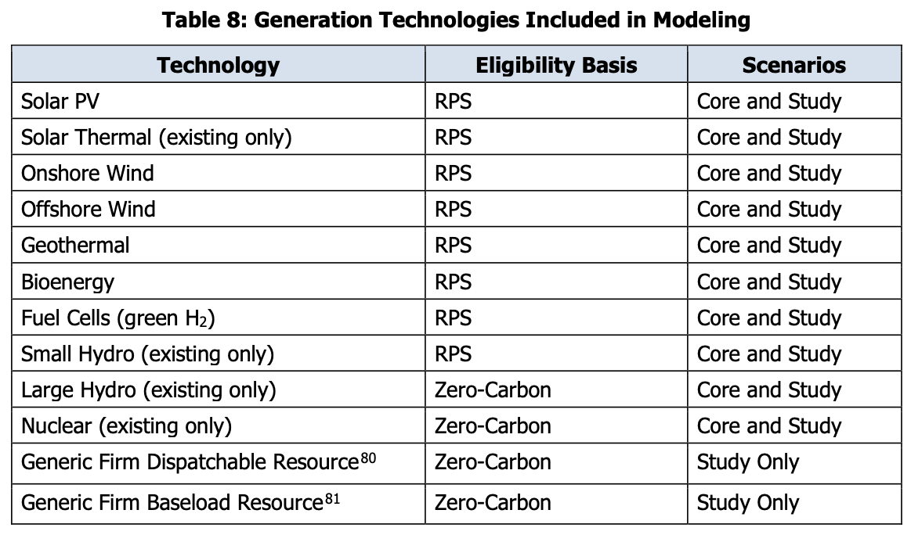

Slide 4
Changes made to RESOLVE
Increasing the geographic footprint from the California ISO to include all balancing authority areas in California.
Updating baseline resources to reflect the supply provided by additional balancing authority areas included in the geographic footprint.
Updating the resource cost assumptions to the reflect the most current datasets available at the time of modeling. Details on cost assumptions are described in the Resource Assumptions section and in the Input and Assumptions documentation.
Page 64 – as indicated by the page number at the bottom of the page

Slide 5
Changes made to RESOLVE
Removing the GHG constraint to evaluate the impact of the 100 percent clean electricity policy without the impact of a potentially more stringent constraint.97
Adding hydrogen fuel cells to the candidate resource options. Hydrogen was assumed to be produced off-grid by electrolyzers powered by renewables.
Expanding the out-of-state (OOS) wind potential to 12 gigawatts (GW) and offshore wind potential to 10 GW.
Changing how storage is constrained to a feasible dispatch pattern by placing a daily cycling limitation on battery energy storage and removing storage losses from the load portion of the compliance accounting method. For more details, please refer to the Inputs and Assumptions documentation.
Page 65

Slide 6
Limitations of RESOLVE
RESOLVE optimizes California as one zone. It does not reflect the impacts of separate balancing authority or load-serving entity requirements or policy objectives or evaluate local reliability needs. Furthermore, the model does not address land-use and spatial constraints that could limit the areas that are assumed by the model to be available for renewable or zero-carbon energy development.
RESOLVE independently simulates dispatch for 37 representative days of any modeled year. These representative days, sampled from historical meteorological data from 2007 through 2009, are assigned weights to create a reasonable representation of the complete distribution of potential conditions in a full 8,760-hour (the number of hours in a year) simulation. While this representation is sufficient for the primary function of RESOLVE, capacity-expansion modeling, a model with more geographic and temporal granularity is necessary to simulate full dispatch operations and determine the reliability of the selected portfolio.
Page 65

Slide 7
Limitations of RESOLVE
RESOLVE includes minimal demand-side resource options for selection. This version of RESOLVE includes customer-side solar and shed demand response (DR). Resources such as energy efficiency, shift DR, and customer-side battery storage are not candidate resources. As such, a sensitivity exploring the potential value of load flexibility was included in the analysis.
As configured for this study, RESOLVE optimizes only storage resources within each modeled 24-hour day, so as long duration storage resources cannot be optimized across days and are thus not fully valued by the model. Tool development is underway to better evaluate the benefits of and compare types of long-duration storage in RESOLVE. RESOLVE also does not represent hybrid resources, such as solar plus battery storage.
Page 66

Slide 8
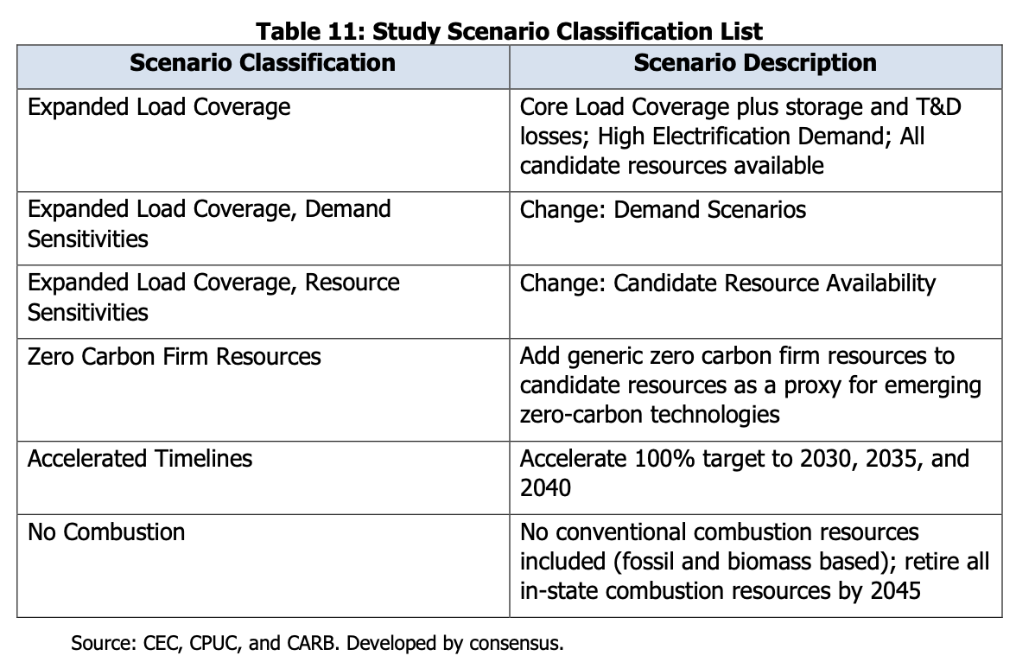
SB100 Scenarios studied

Slide 9
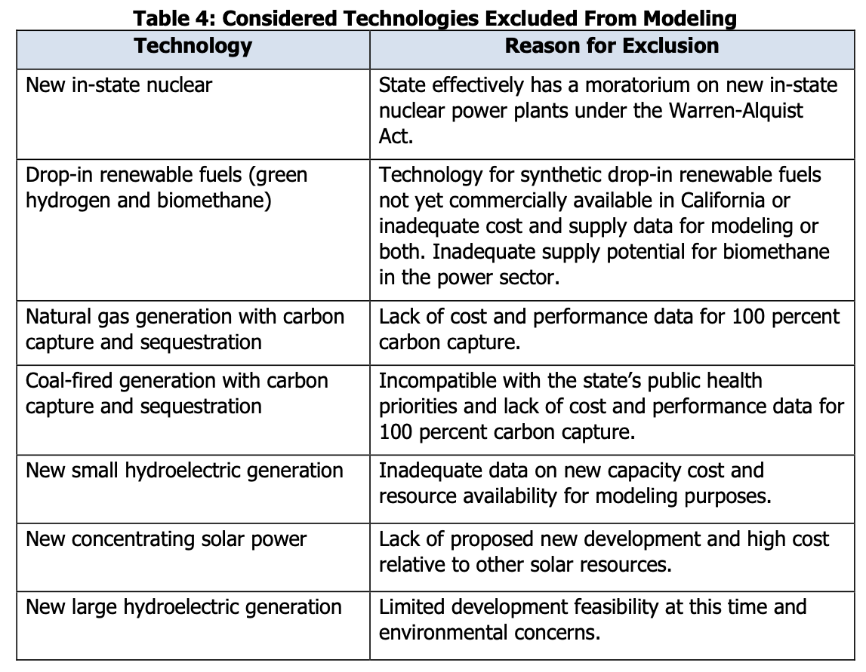

Slide 10
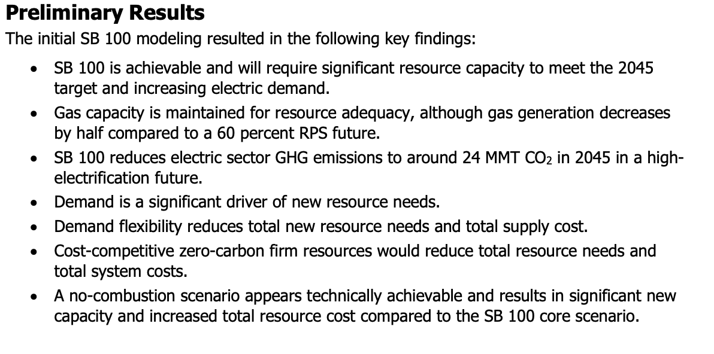
Results

Slide 11
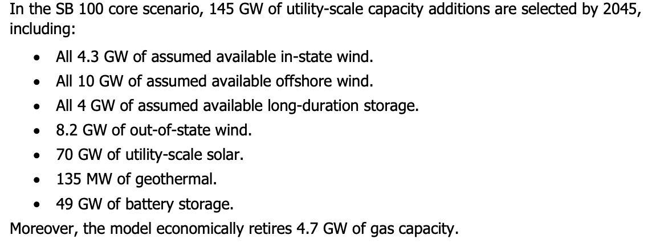
SB100 Core scenario

Slide 12
“Study” scenario (zero emissions for all)
In the study scenario (expanded load coverage), 173 GW of utility-scale capacity additions are selected by 2045, including:
All 4.3 GW of assumed available in-state wind.
All 10 GW of assumed available offshore wind.
All 4 GW of assumed available long-duration storage.
11.9 GW of out-of-state wind.
86 GW of utility-scale solar.
2.3 GW of geothermal.
55 GW of battery storage.
Furthermore, the model economically retires 7.2 GW of gas capacity.
Note: they also gave a firm, zero-carbon option

Slide 13
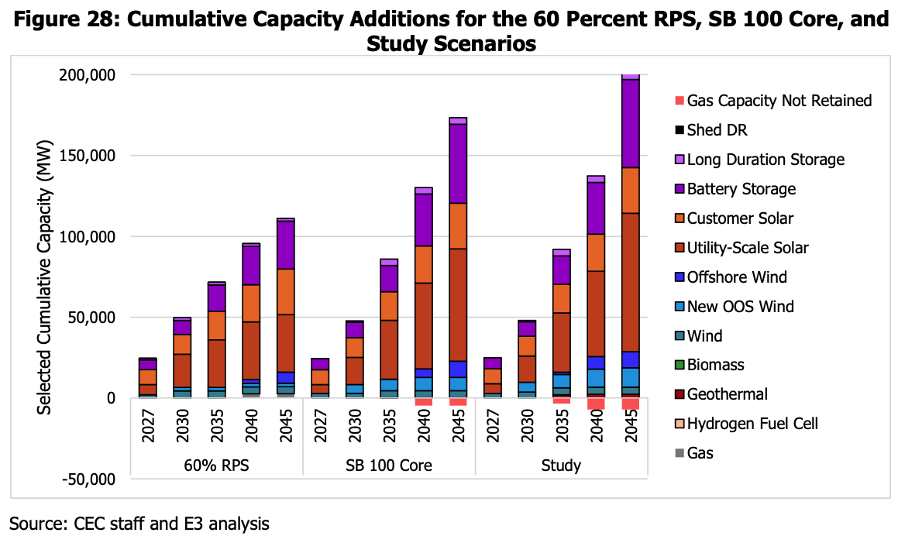

Slide 14
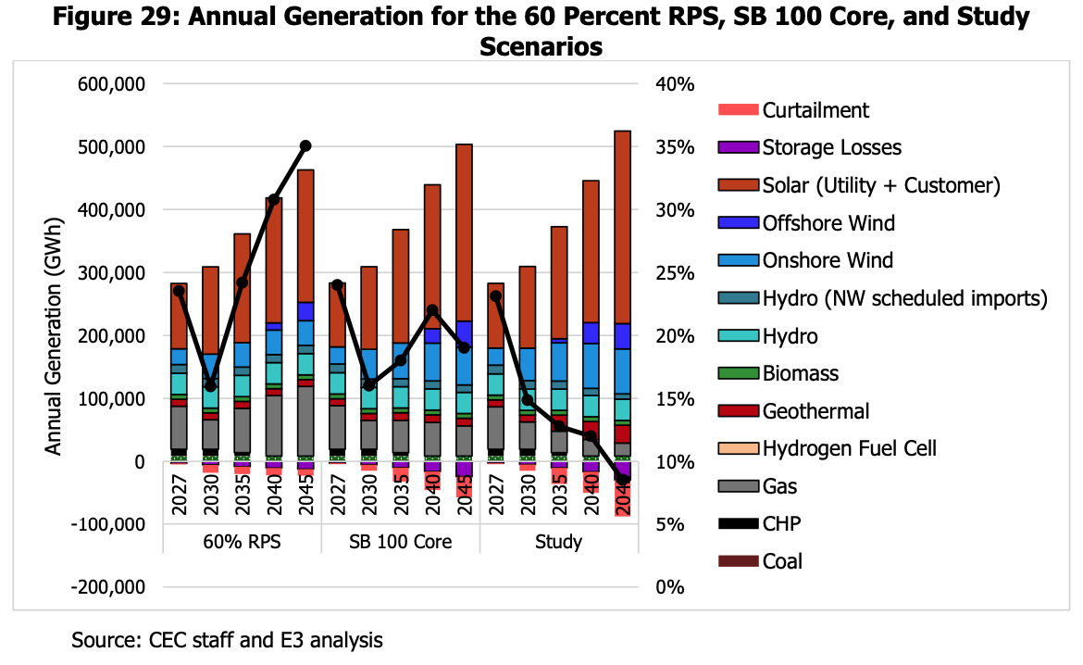

Slide 15
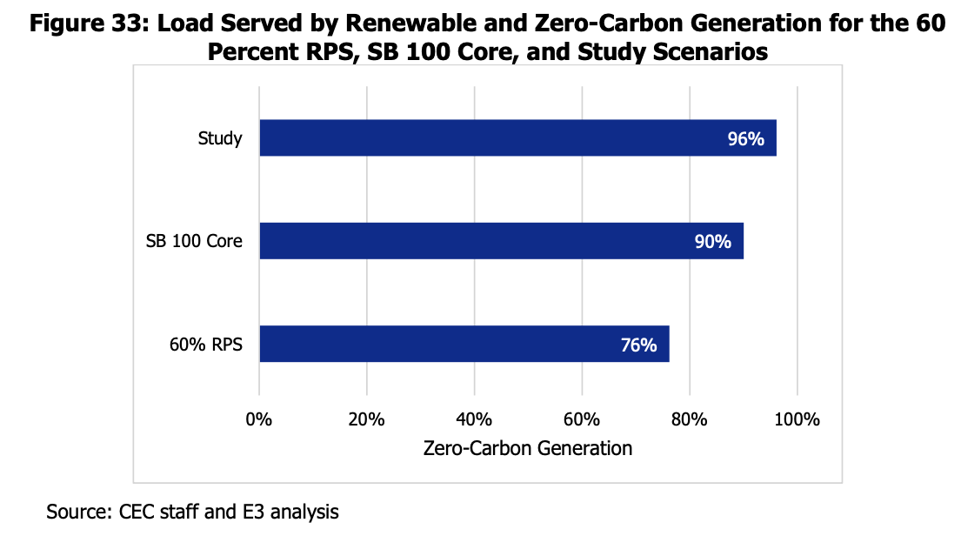

Slide 16
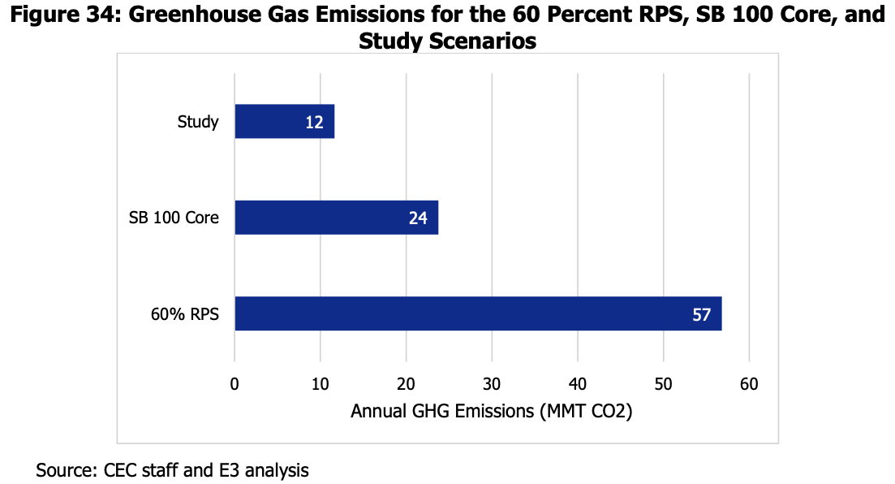

Slide 17
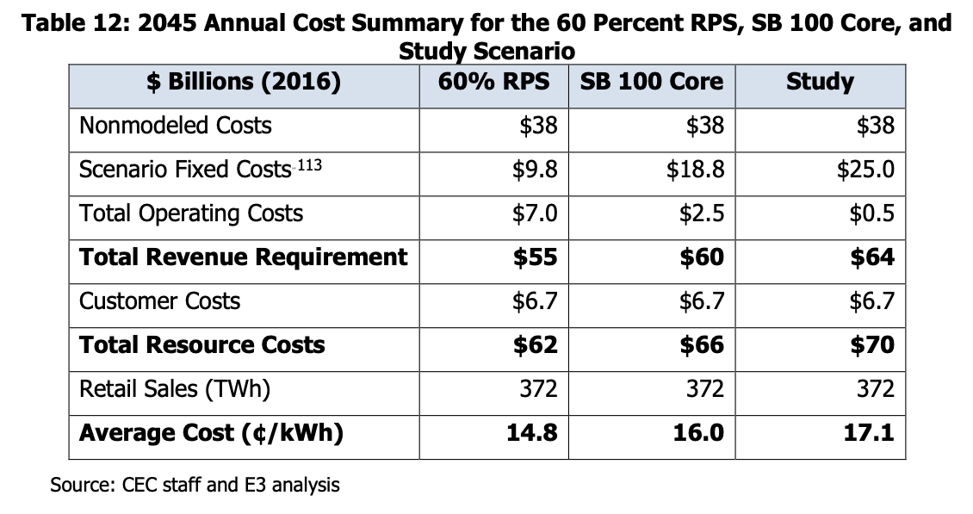

Slide 18

Comparison of SWITCH and RESOLVE baselines
Reflects restriction to CAISO (no imports) and increased load for hydrogen and EVs

Slide 19
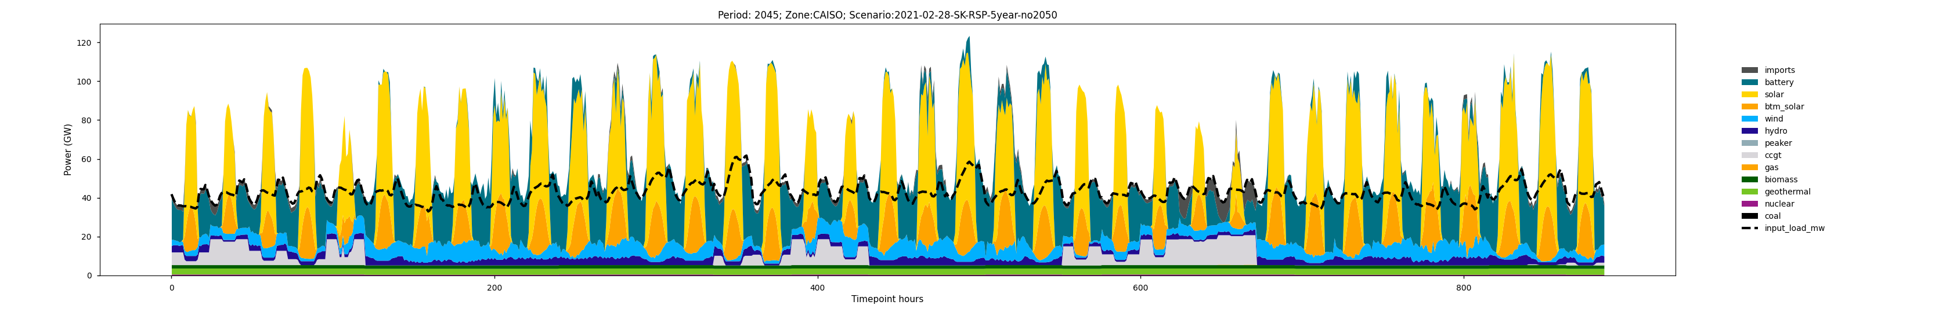
Reason for the large buildout – Days 27&28

Slide 20
Discussion points
1. Resource adequacy constraints. Shall we move away to ELCC and start incorporating NQC? To decide this, we need to explore what are the local capacity needs for each LSE.
2. They increased the geographical resolution for RESOLVE and updated generators in out-of-state load zones. Shall we look at how does it compares with previous results? I did not see a mention on how the additional resolution changes the results.
3. There is a current ruling to replace the capacity of DCNP with geothermal (~ 1 GW). However, on SB 100 core, we only see 135 MW of additional capacity for geothermal compared to 2.3 GW in the study scenario. Shall we explore what will happen if we allow more geothermal?

