Slide 1
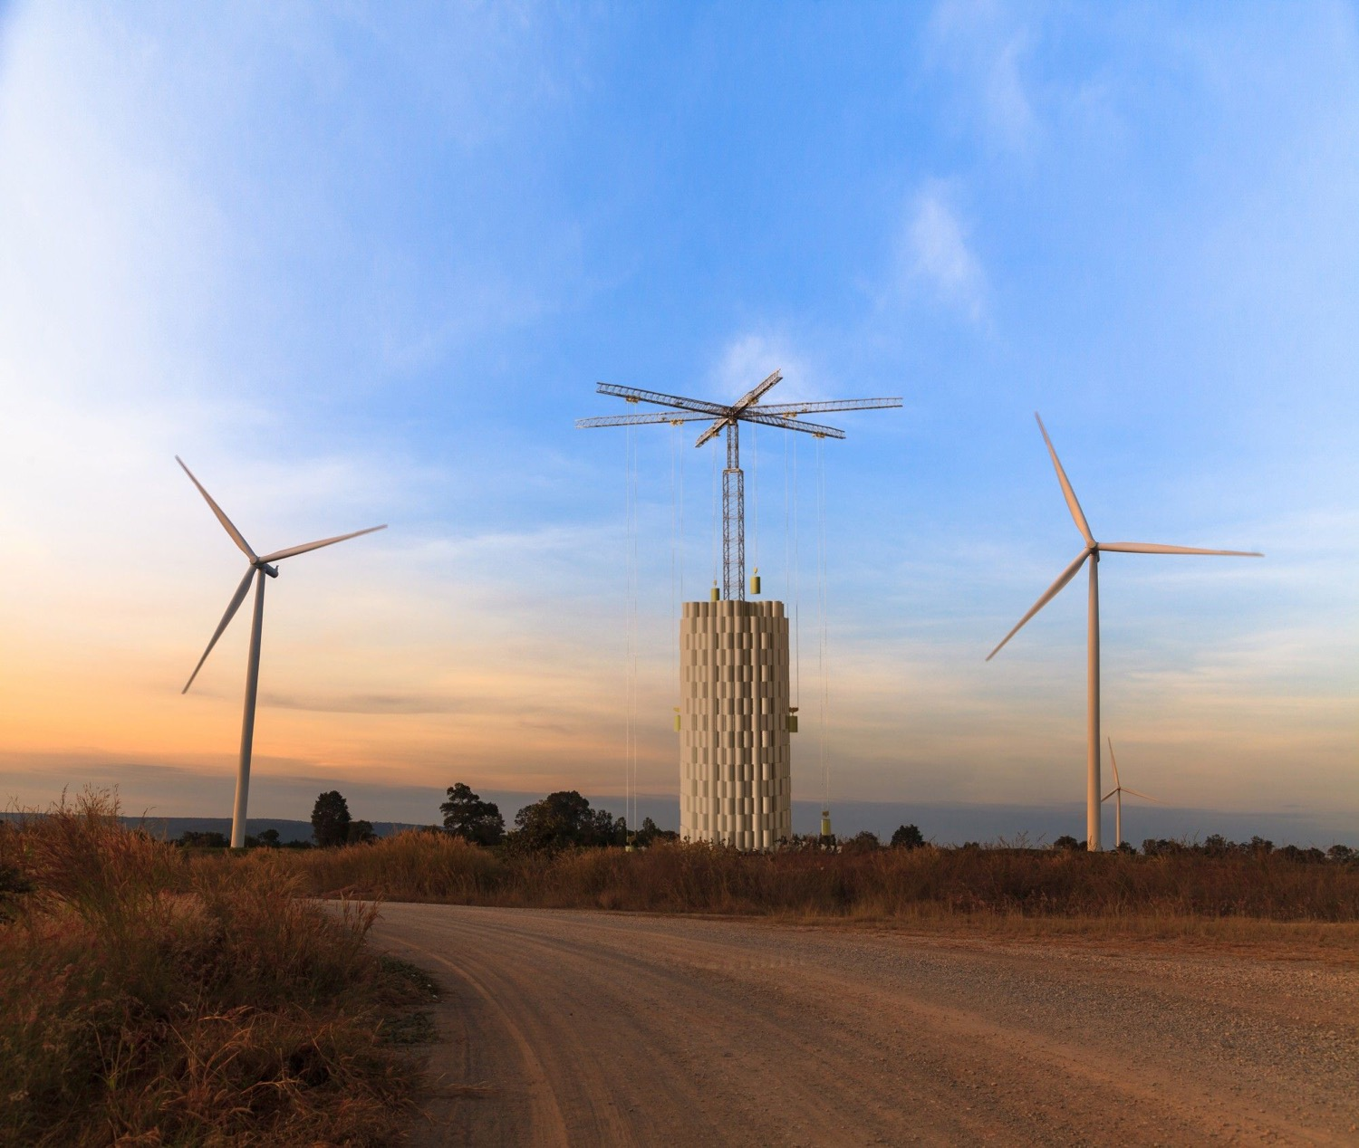

Alternative pathway for Mechanical Storage
Rui Shan

Slide 2

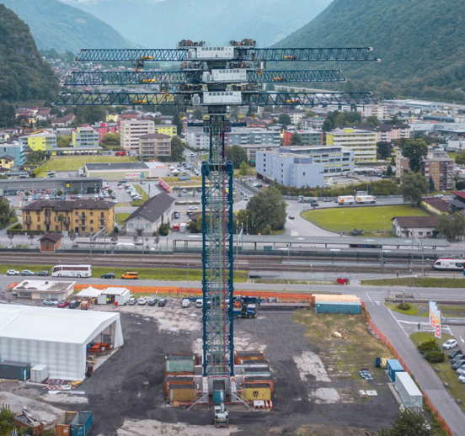
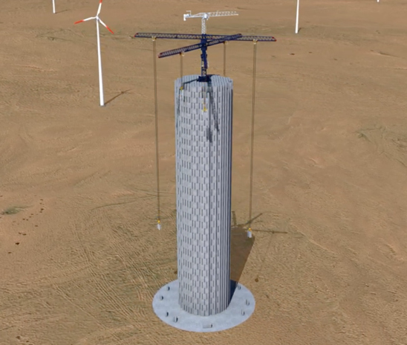
Basic Mechanism
Moving concrete bricks up and down
Commercial Demonstration Unit (CDU) in Switzerland, completed construction in July 2020, now under final testing and software commissioning.
3D demonstration

Slide 3
Public available parameters
20-80MWh, with 35MWh as default (CDU)
35 tons composite bricks
4-8MW for 8-16hr
30+ year life with zero degradation
85% (80-90%) round trip efficiency (RTE)
Also developing a more modular and flexible product with faster response time and wider range of capacity (1MWh-GWh)
200-250 $/kWh¹ (Capex or LCOE or LCOS?)
1. https://www.greentechmedia.com/articles/read/energy-vault-stacks-concrete-blocks-to-store-energy

Slide 4
Other info we might need
Details of capex and opex; (PCS, BOP etc.)
Their growth with the single project size
Construction time and estimated permitting time
Quantity of the bricks (at least) for CO2 accounting
Jobs per project by phases
Wind proof, stability and resilience to disaster
Response time (start-up, ramp, mode switching)
Capability of blackstart, voltage support and other services
Expected value position and revenue composition

Slide 5
Other Gravity Storage Technologies
From lab demonstrations to pilot projects

Slide 6
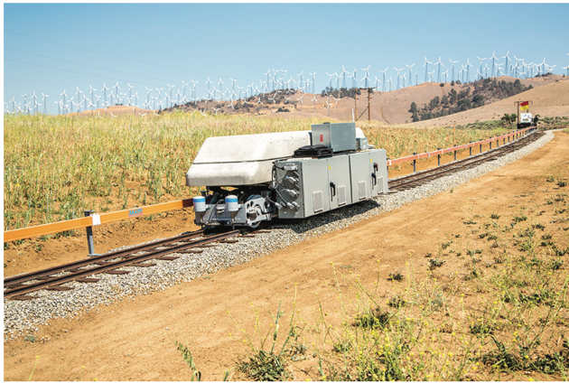
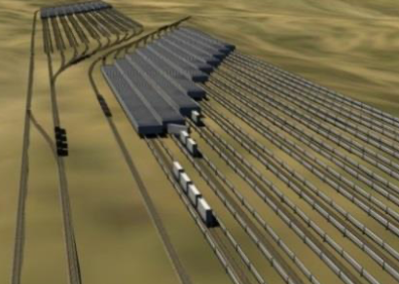
Advanced Rail Energy Storage
https://www.aresnorthamerica.com
A heavily loaded locomotive that drives up and down a hill to storage and generate energy;
Founded in 2010; Complete demonstration project in 2013 Tehachapi, CA; Began a commercial project in 2016 at Pahrump, NV, 2.5 yrs to get land and other permits , planned operation in 2020, participating CAISO.

Slide 7
Advanced Rail Energy Storage
General Specification
Scalability: 100-3000MW
Storage duration: 2-24hr
Response time:
Charging from 0-100%:5 sec
Discharging from 0-100%:25 sec
Full charge to full discharge:7-34 sec
RTE: 80%
VAR capability: 25 – 125% of rated power
System life: 40+yr
Able to provide frequency response
~1350$/kW, ~168$/kWh

Slide 8
Advanced Rail Energy Storage
Specification of the NV project
Electric:
Energy: 12.5 MWh,
Charging 56.7 MW,
Discharging: 44.1MW
Power factor of load: 0.95
RTE: 80%
Plant and Train
Length of track: 5.5mi
Elevation Differential: 2000 ft
Max Grade: 8%
Area: 43 acre
Total train weight: 9280 tons
0 to full charge: 10s
0 to full discharge:15s
Average speed: 18mph
Social Economic
Project cost: 55 mm$
Construction: 100-125 full time equivalent (FTE) for eight months
Operation:16 FTE for 30-40 yrs

Slide 9
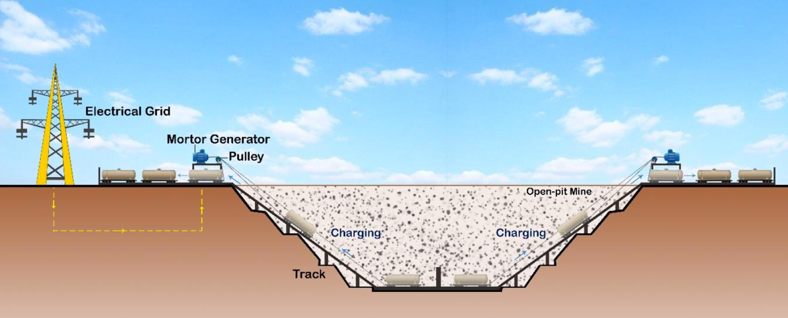
EarthPumpStore
Backed by Prof. Saffa Riffat from University of Nottingham. Got patent in 2019.
Estimated cost ~50$/kWh
Estimated RTE as 90%

Slide 10
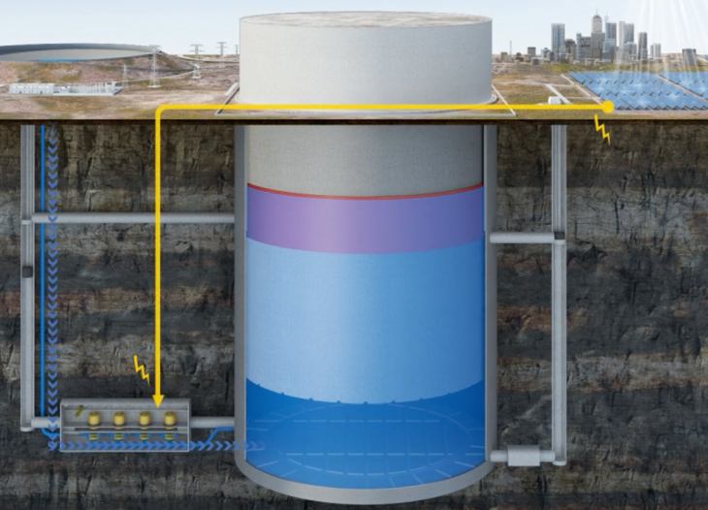
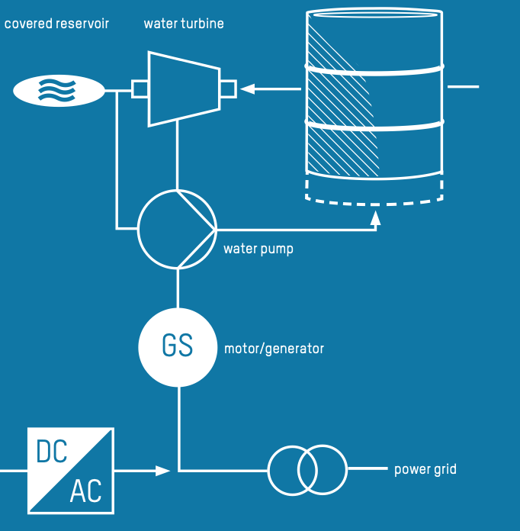
Heindl Energy
https://heindl-energy.com
Underground pumped storage with a large rock
Just filed for insolvency in 2020, IP and some engineering work sold to an interim investor. Still looking for investor for a pilot project.

Slide 11

Heindl Energy
General Specification
Scalability: 1-10 GWh
Duration: 6-14 hrs
Life span: 60yrs
Rock piston should have a diameter of at least 100 meters/ 300 ft to be economic competitive
8GWh~ 250m diameter
Capex: 120-380 $/kWh
Opex: 1% of Capes per year
RTE: $≤$80%
Services: Blackstart, Voltage support, frequency regulation etc.
Already identified 54 sites from 117 available sites internationally

Slide 12
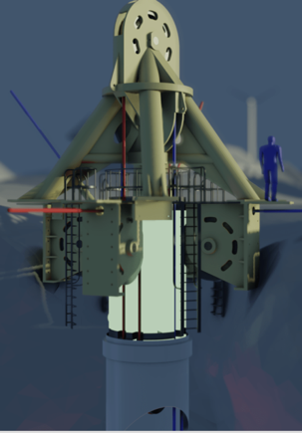
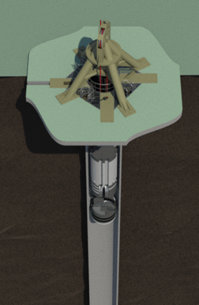
Energy SRS
https://energysrs.com
Lifting mass in a deep vertical shaft or borehole.
Funded by UK Research and Innovation and five UK companies from Jan 2017 to Mar 2020.
It is currently exploring commercial opportunities in Sub-Saharan Africa and South Asia

Slide 13
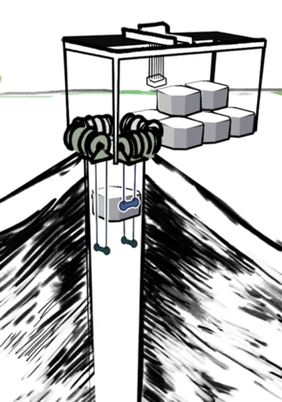
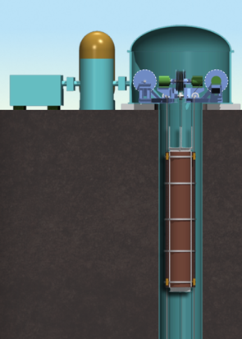
Gravitricity
https://www.gravitricity.com/
Similar to Energy SRS.
Start Building 250kw proof of concept in Edinburgh, Aug 2020. Around 1.1 million Euro.
Plan first full-scale 4MW project commence in 2021.
1-20MW, 15min-8hr,80-90% RTE, zero to full power~1s

Slide 14
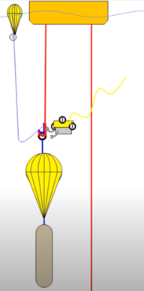
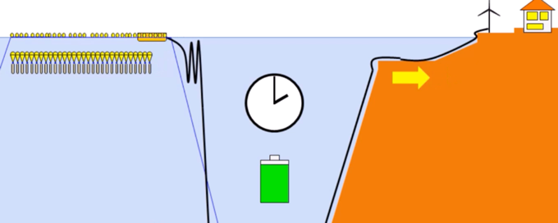
Sink Float Solutions
http://sinkfloatsolutions.com/
Put similar system in ocean
Capex 250-500 € /kW, 15-60 €/kWh
Underwater Powerline: 1 k€/MW/km (>50MW)
Lifespan: 15yr for some components, 20yr for floats

