Slide 1
Introduction to Malta
September 2019

Slide 2
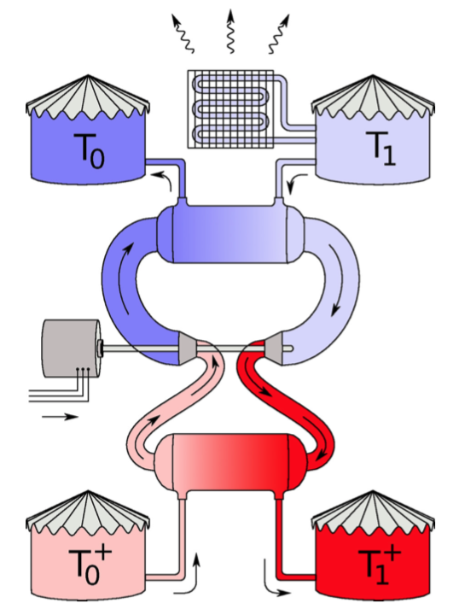
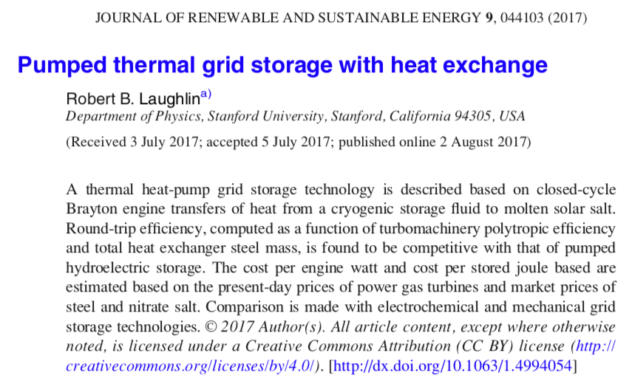
Origin of Malta’s ideas
Robert Laughlin – Nobel laureate

Slide 3
Malta history
Original concept: Robert Laughlin – Nobel laureate
Incubated at Google X, Alphabet’s Moonshot Factory
Based on demonstrated potential, Malta was created as separate company
Breakthrough Energy is lead investor
We are scheduled to talk with:
  Ty Jagerson – VP Commercialization
  Jonathan Milley – Energy Strategy Resources (may be a consultant – not listed on Malta’s website currently)

Slide 4
Recent news
2-minute overview: https://www.youtube.com/watch?v=6_Dy9Fl8Nog
Hourlong overview: https://www.youtube.com/watch?t&v=aeSzu3S66uY

Slide 5
Malta specifications (from CESA presentation)
4-24 hours; initial design is for 10 hours
100+ MW (utility scale)
Molten salt is used for high temperature storage
Technology leverages existing thermal technology (turbines)
Safe, reliable, scalable, low cost
Custom charge/discharge
Applications:
  Renewables firming (24/7 renewable energy; coincident renewable energy)
  Grid-balancing
  Transmission deferral
  Waste heat

Slide 6






Malta: A World-Class Syndicate
Heat Exchanger
OEM
Series A investors provided more than capital
Malta has formed strategic partnerships to develop key technology components and speed up time to market
  Google and CNE provide customer input into product development
  BEV provides sector expertise and deep connections in the VC world
  Alfa Laval and Turbomachinery OEM are developing key subsystems
Incubator/
end user
Lead investor
Solutions Provider
Utility / end user /
Pre-production
prototype host
Independent power
producer /
end user
NOT DISCLOSED
Turbomachinery
OEM

Slide 7
Malta: Grid-Scale Energy Storage Solution
In charge mode, the system operates as a heat pump, storing electricity as heat in molten salt and cold in chilled liquid
In discharge mode, system operates as a heat engine, using the stored energy to produce electricity
Uses heat pump
Uses turbine – like conventional fossil

Slide 8
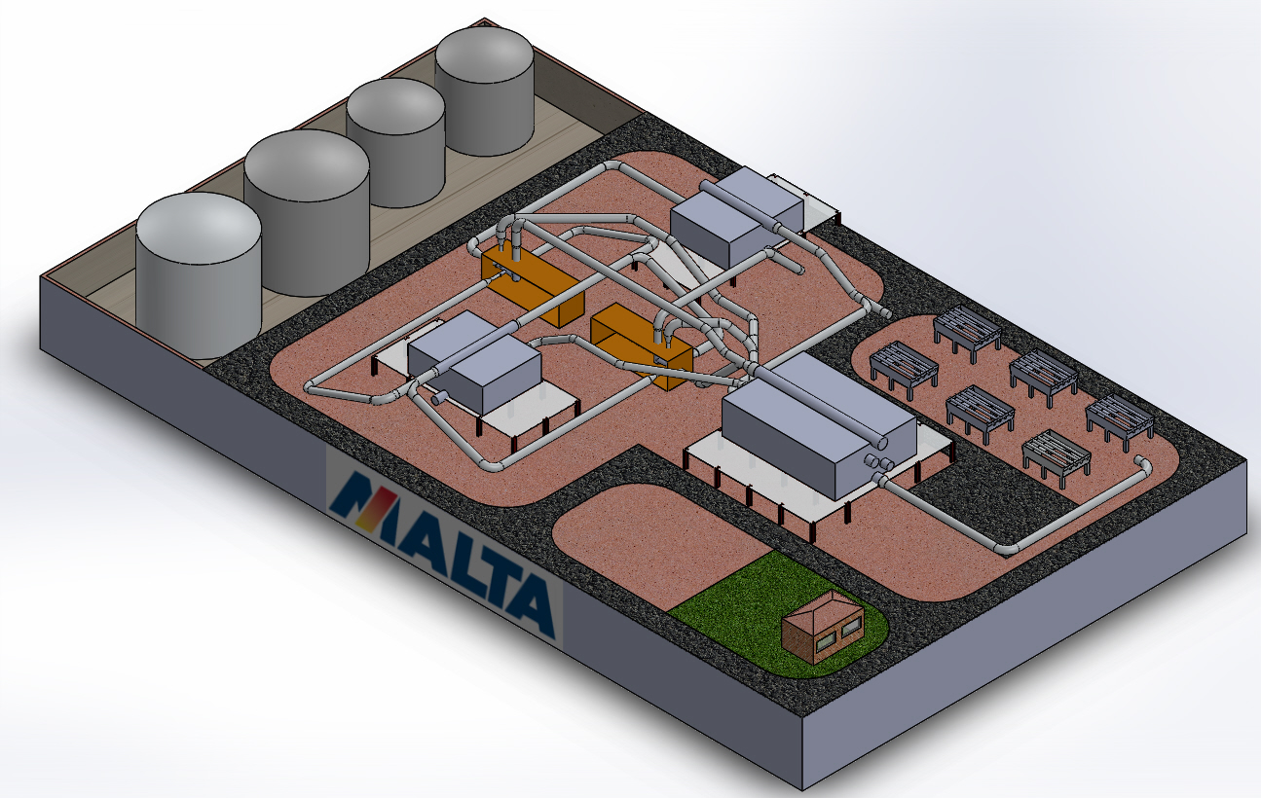
Preliminary Plant layout
10
9
8
7
4
1
6
Charge Power Train
Generation Power Train
Salts-Air HX Station
Maltini-Air HX Station
Recuperator HX Station
Air Coolers
Hot Salt Tank
Warm Salt Tank
Warm Maltini Tank
Cold Maltini Tank
Control Room
3
2
5
120 M
11
70 M

Slide 9
10 & 100 MW System Specifications
Demonstration only
Commercial product

Slide 10
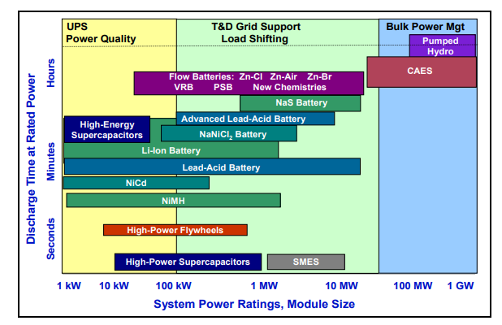
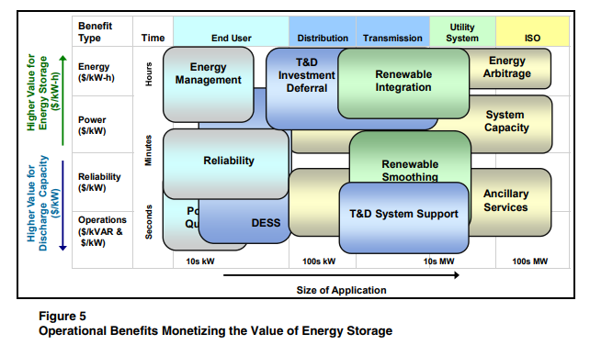
Malta Applications
Malta seeks to fill the gap between shorter-lived batteries seeking to extend storage duration, and long-duration but inflexible pumped hydro and CAES
MALTA
MALTA

Slide 11
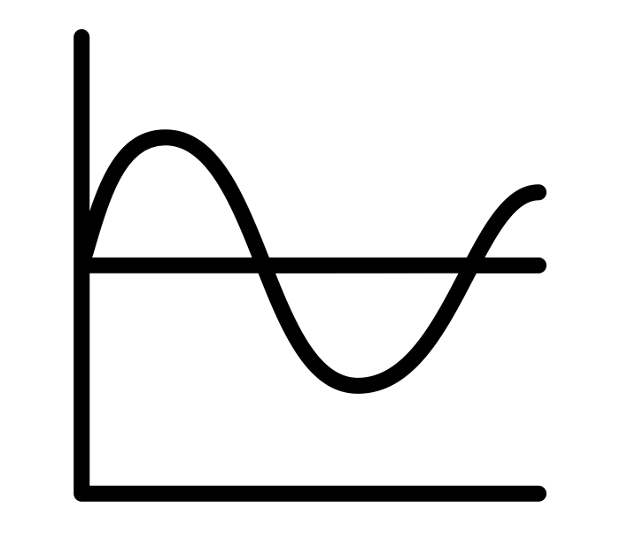

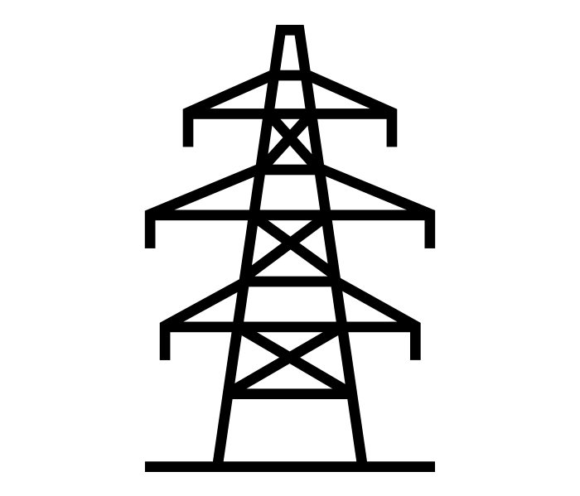
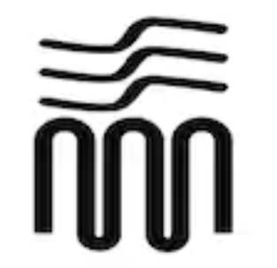
Use Cases for the Malta System
Renewables Firming
Grid-Balancing
T&D Deferral
Waste to District Heat
Creates dispatchable renewable product by pairing Malta system with renewable asset to firm / shift generation
Allows grid operator to meet resource adequacy requirements and optimize cost of generation system-wide
Delays the need to upgrade transmission and distribution system to accommodate load growth or voltage regulation by reducing loading on a specific portion of the system
Provides district heating or other industrial heat loads for new and aging applications, many in decarbonizing urban areas

Slide 12
Product Advantages of the Malta System
Long Duration |  | 8+ hours of storage Most utilities are noting that 4-hour storage is insufficient for full capacity value Low marginal cost to increase the duration of storage by adding larger storage tanks
Low Cost |  | First system installation is cost-competitive with mature Li-ion battery technologies Significant cost declines as the systems are built at scale Expected ~30-year operating life No degradation in performance
Reliable |  | Well-understood technology – operates in a very similar way to existing natural gas infrastructure Customers are familiar with the technology, grid integration, O&M Focus on implementation through existing manufacturing ecosystem, not new R&D Well-understood materials – manufactured based on readily available raw materials and commodity products Does not rely on any rare earth materials or critical minerals in limited supply Easy to replace worn-out parts and enforce warranties
Versatile |  | Siteable anywhere Can be charged with electricity from any source Wide range of traditional grid attributes – rotating machinery provides traditional grid attributes, such as inertia, that are valued by grid operators

Slide 13
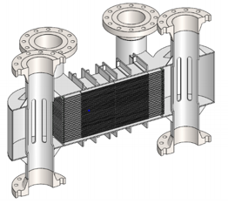
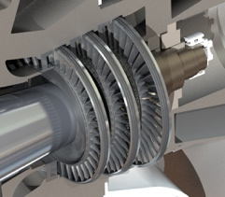
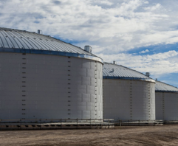
Risk Reduction and Product Scale
2018
2019
2020
2021
2022
Key features:
Reduces major technical risks in first year
10 MW plant demonstrates feasibility of 100 MW large-scale product
The pre-production prototype plant doubles as a first product line
Detail Design and Testing
Series A
10 MW Prototype Plant Build and Test
Series B
Commercialize
Can we accelerate 100MW system development?
NewCo Formation

Slide 14
Long-Term Deployment Plan
2019:
  Currently negotiating a hosting agreement for a 10 MW pre-production prototype with two shortlisted partners
  In-depth discussions with at least 24 potential partners through the pre-production prototype process
  Those potential partners are being converted into early adopters of initial commercial units
2022 - 2024:
  The pre-production prototype will allow Malta to perfect technology, develop larger system installation and validate the use cases and revenue streams
  2022: Following construction of the pre-production prototype, advance sales of commercial units
2024 – 2028
  Sale of 10 MW and 100 MW Malta projects to customers worldwide

