Slide 1
Enhancing Wholesale Power Market Efficiency, Reliability and Transparency – the origins of CAISO and future directions relevant to LDES
January 13, 2023
John Flory

Slide 2
Overview
Relevant Flory Background
Background Economic Policy
Power System Ops History
CAISO Formation/ 2000-2001 Meltdown
Discussion:
Questions
Implications for LDES
E.g., Reliability/Resilience vs GHG
2

Slide 3
Flory Indicative Background
B.S. Math, M.S. Ecology (Ecosystem Resilience)
Calif Energy Commission
Consulting
Real-Time Pricing
Utility Rate Design & Analysis
Customer Response Strategies
CAISO-CalPX
North American Energy Credit & Clearing
Integrating Physical & Financial Reliability
FERC/CFTC/CCRO
The Alliance Risk Group
Resilience – Tail Risk Management
DR for Retailers in TX
Optimal ”DER dispatch” – storage, EV, PV (vs GHG & cost)
Resilience WG for CEBA
Clean Hydrogen Hub
TransAtlantic TSO/ISO on DER
3

Slide 4
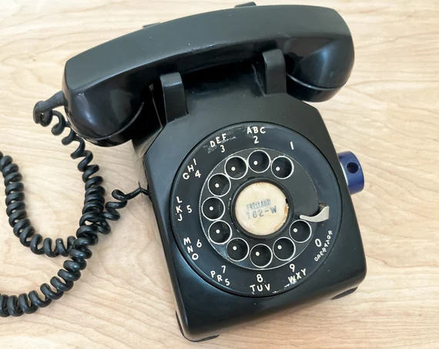
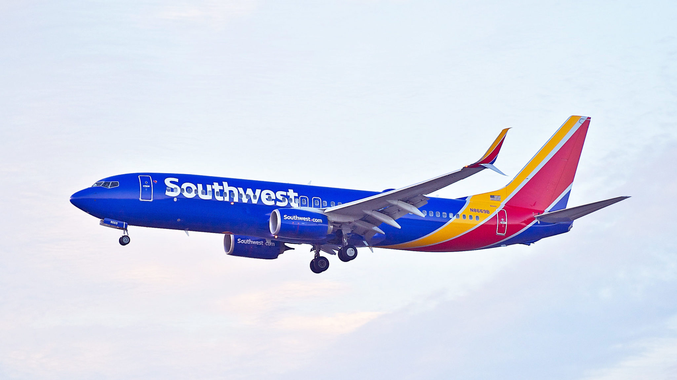
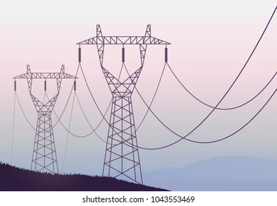
Background Economic Policy – Deregulation Push
PURPA
4

Slide 5
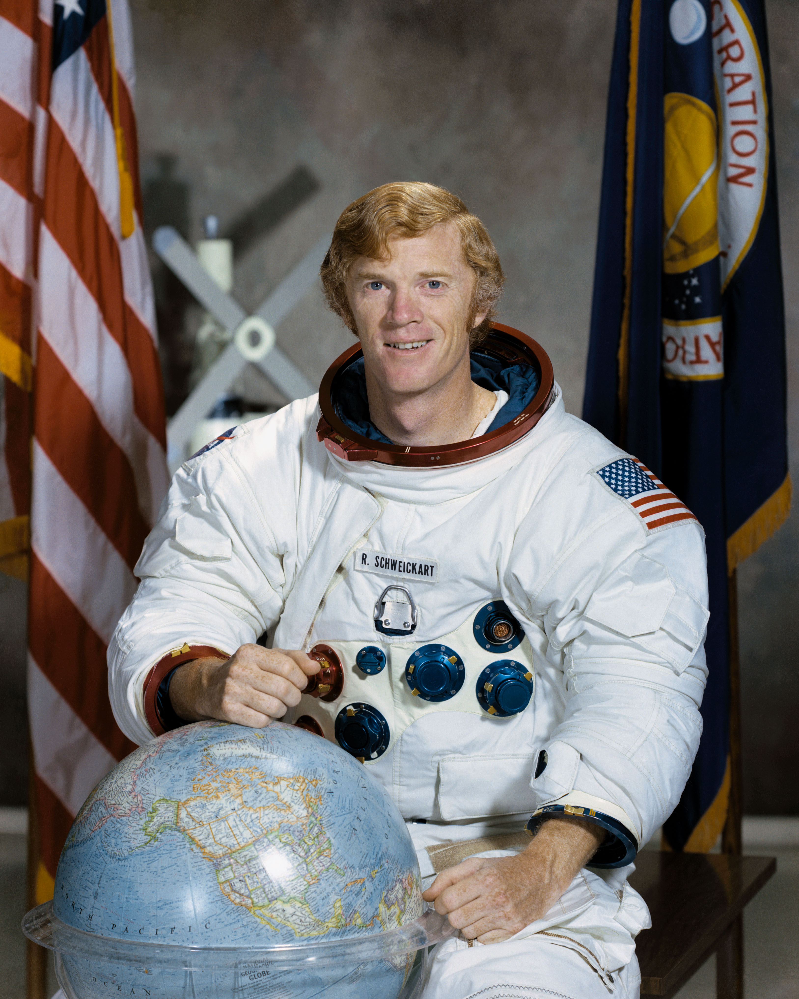

Power Systems Ops
5

Slide 6

CAISO Formation
PoolCo Vs Bilateral Debate
Result
CalPX (Day Ahead for IOU Transparency)
+
CAISO (Congestion & RT)
Stakeholder Processes
- Yellow Book
- Blue Book
6

Slide 7
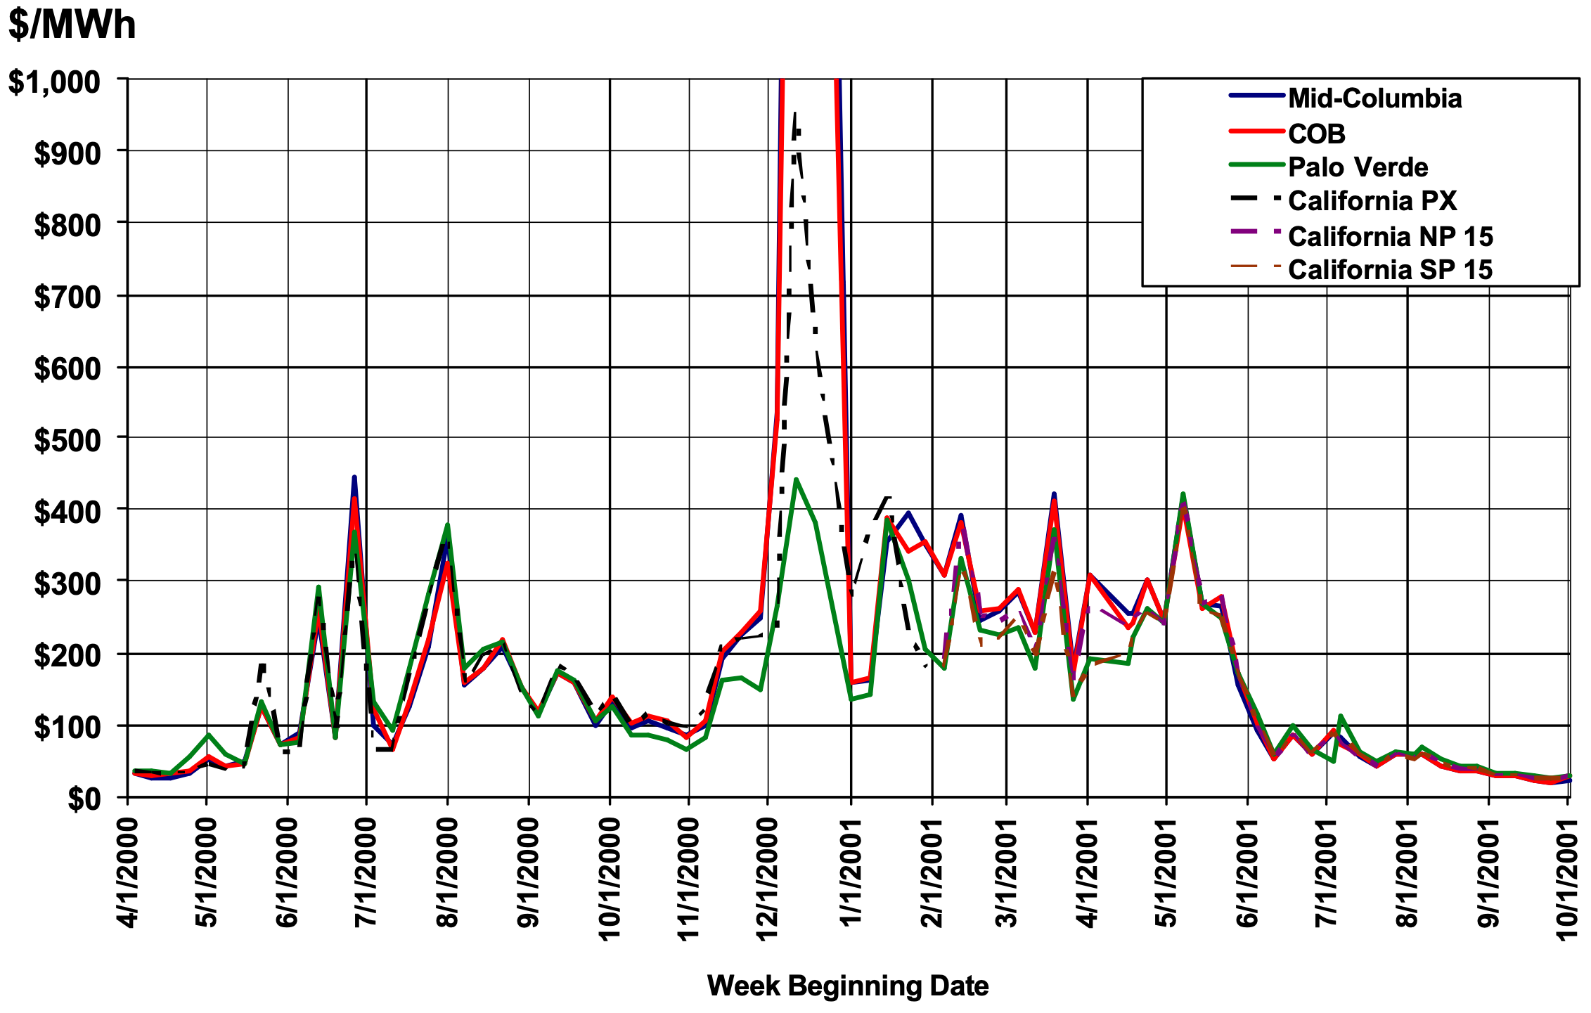
2000-2001 California Power Market Meltdown
Short Supply
No Forward Contracts
Market Structure
7

Slide 8
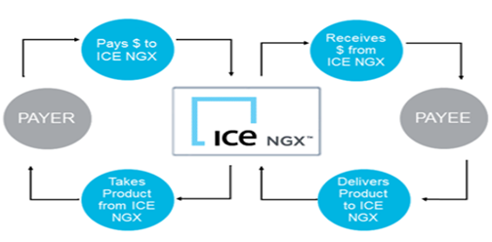
North American Energy Credit & Clearing
Physical Reliability <----> Financial Reliability
Physical Power Reserves or Cash Reserves as Back-Stop
Market Price Volatility
Power has “long fat price distribution tails”
Power Trading -- Opportunity vs Risk
Storage is a type of Reserve
8

Slide 9
Discussion
LDES:
Reliability/Resilience vs Decarbonization?
Other?
John.Flory@theallianceriskgroup.com
+1-530-304-8441
9

