Slide 1
Net Zero Heat Webinar
Heat decarbonization and the role for Thermal Storage
LDES Council
Ppt for Dr. Kurtz and team – 10/17/22

Slide 2
Agenda
Introduction to LDES Council (5 min)
Perspective on net-zero heat (20 min)
Q&A (10 min)

Slide 3


Opening remarks
Julia Souder
Executive Director

Slide 4





































~60 leading companies have joined the LDES Council to accelerate decarbonization
Technology start-ups
Anchors
Key principles of the LDES Council
Industry and services customers
Capital providers
Executive-led
Global
Equipment manufacturers
Fact-based
For societal benefit
All types of energy storage, not just electrochemical
Low-carbon energy system integrators & developers
The LDES Council is an independent body with its own governance structure, with the mission to accelerate energy decarbonization through the scale-up of LDES
Membership overview as of July 2022

Slide 5



Flagship 2021 net-zero power report
Net-zero power: Long duration energy storage for a renewable grid
LDES plays a major role in net-zero systems
Renewable penetration and LDES cost-down potential…
… leads to widescale LDES deployment and positive business cases
60-70%
1.5-2.5 TW
USD 1.5-3 TR
% renewables of overall capacity for widespread LDES deployment
Total deployed
LDES by 2040
Total investment in LDES capex required by 2040
~60%
3-15%
>50%
LDES cost reduction expected by 2040, driven by scale, innovation and supply chain improvements
IRR range for example modelled LDES applications¹
LDES as portion of all installed power flexibility capacity in 2040
Source: LDES Council report on 24/7 clean PPAs
https://www.ldescouncil.com/assets/2205_ldes-report_247-ppas.pdf

Slide 6








Net-zero heat perspective forms a substantial component of the overall 2022 LDES Energy systems flexibility landmark publication at COP27
Focus of Webinar
2022 Net-zero Power (refresh)
Energy storage cost / performance benchmarking
Revised LDES market projection
24/7 PPA LDES opportunities
2022 LDES Net-zero
Energy Report
2022 Net-zero Heat¹ (heating / cooling)
LDES has an integral
role in global energy system flexibility beyond renewable energy power systems for grids
Co₂
Industrial applications for LDES in
  Chemicals
  Steel + metals
  Cement
Comprehensive
heat decarbonization perspective
Net-zero heat pathway and business cases for thermal flexibility
1. Heat includes both heating and cooling applications

Slide 7
Agenda
Introduction to LDES Council)
Perspective on net-zero heat (20 min)
Q&A (10 min)

Slide 8



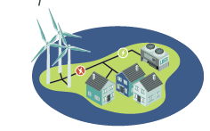
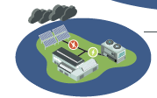
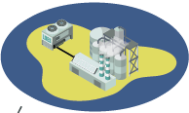

Within this system based on variable renewables, flexibility is needed to align supply & demand
Illustrative example
…and this is especially applicable to heat
Energy shifting
Flexibility can align peak demand with intermittent renewable supply by energy shifting
Energy shifting
Industrial heat demand
Peak solar generation
Industrial heat demand is stable, with very limited demand flexibility
Midnight
Noon
Midnight
By aligning supply and demand, flexibility can play a critical role in energy systems by…
Industrial & residential heat is electrifying rapidly
Heat is shifting from local production to the power system, adding to T&D burden
Providing stability services to correct for grid instability
Supporting non-traditional grids and cross-industry integration
Optimizing grid utilization as peak power supply isn’t curtailed
Notes:
As we move to a world that is more and more dependent on variable renewables, for example the diurnal cycle of PV generation, we will need energy systems that can deal with this variability. Especially in the case of heat, which often has a highly stable demand (e.g., industrial processes) but is electrifying rapidly, our systems will need some form of flexibility to deal with this.
What is especially important with heat is that it is often generated locally, through Natural Gas or coal, which do not burden the power systems. In the future however, as heat electrifies, this will further add a burden to our already strained T&D systems.

Slide 9
Heat consumption accounts for ~50% of global energy demand and represents a critical abatement opportunity for buildings and industry
2019 global fuel consumption, EJ % of total
End-use demand by heat grade, %
District Heating
Buildings
Industry¹
426 EJ
18%
2%
100%
25%
Machinery,
appliances, lighting
5%
4%
4%
2%
4%
28%
Transport
10%
3%
2%
2%
Heat networks
35%
22%
Buildings:
Heating & Cooling
47%
23%
Industry¹:
Heating & Cooling
12%
~50%
of global fuels is consumed to produce heat
Cooling
Space heating
Hot water
<60 C
60-80 C
80-100 C
100-150 C
150-200 C
200-500 C
500-1000 C
1000-1500 C
>1500 C
Total
Low
temperature heat
Medium temperature heat
High
temperature heat
²
Includes Refining
High temperature heat in buildings is used for cooking (e.g., Gas flame is ~1000C)
Source: McKinsey Global Energy Perspective
Notes:
- Heat is ~50% of our final energy consumption currently, decarbonizing this will be critical to achieve climate targets. It has often been overlooked, as it also is more complex than electricity with heat of all kinds of temperatures and different media required for in various processes

Slide 10
Heating is still largely coal & gas based, with ~70% of heat produced by fossil fuels
Renewables
Heat
Bioenergy
Oil
Electricity
Natural Gas
Coal
Global fuel consumption for heating & cooling by fuel source and temperature¹, EJ
The pressure to shift away from fossil fuels as foundation of our heating supply is increasing
Climate impact is every increasing, creating further urgency
Prices are rising due to invasion of Ukraine by Russia
Energy supply is increasingly becoming an issue of energy security, with countries wanting to reduce dependence
37 EJ
29 EJ
33 EJ
3 EJ
1%
0%
6%
1%
4%
4%
~70%
from fossil fuels
12%
6%
15%
17%
21%
11%
18%
11%
5%
~60%
of high T heat from coal
23%
91%
25%
60%
28%
26%
~90%
of cooling electrified
10%
2%
High Temperature (>500°C)
Medium
Temperature
(100-500°C)
Low
Temperature
(<100°C)
Cooling
Excluding steel & iron
Source: McKinsey Global Energy Perspective
Notes:
Heat is also still very fossil-based, with ~70% of heat currently produced by oil, gas or coal. The shift away from these to electrified heating will only add to our already strained power production.

Slide 11
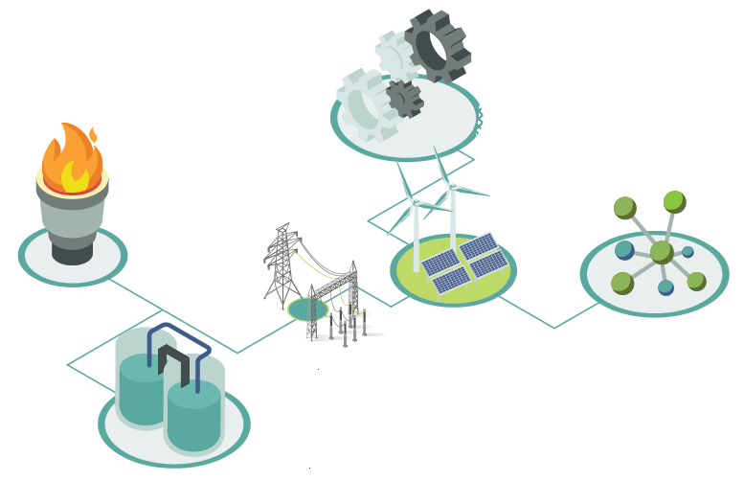





Thermal energy storage can provide part of the integration & flexibility, converting power to heat
Energy storage technology categorization
What is thermal storage?
Thermal flexibility via thermal energy storage (TES) can unlock unique benefits:
Thermal energy storage systems use thermal energy to store and release electricity and heat through 3 types of technologies:
  Sensible heat
  Latent heat
  Thermochemical heat
Ability to serve multiple end uses across sector applications
Roles of thermal energy storage:
Provision of heat grade flexibility (e.g., ability to upgrade heat sources or discharge at various temperatures)
Thermal
Direct (high) heat to process. >1000 C possible
Chemical
Mechanical
Heat storage to bridge time
Diversification of energy resources to include heat
Electrochemical
optimization of waste heat recovery
Notes:
Thermal storage can provide part of this integration, adding flexibility to the system to provide heat. This can already happen
Across heat grades, at > 1000 C
Using waste heat from existing processes
Whilst storing the heat over periods of time, depending on the type of solution chosen
3 key types of thermal storage are :
Sensible heat, only a temperature change
Latent heat, where the storage medium changes phase
Thermochemical, where the medium undergoes a reversible chemical reaction

Slide 12















Thermal energy storage (TES) technologies can be broadly categorized by energy storage medium and make up a diverse technology landscape
Technology landscape
Category
Subcategories
Examples
Example players
Sensible heat storage (SHS)
Solids
  Ceramics, sand, silica, rocks
  Concrete
  Metals and carbon-based materials
234 GWh
Thermal energy storage via temperature change of material
Liquids
  Water (water tank TES)
  Molten salts, metals (e.g., aluminum), or inorganic materials (e.g., silicon)
of thermal storage used
in 2019¹
Latent heat storage (LHS)
Solid-liquid
  Organic (paraffin wax, fatty acids)
  Inorganic (salts, metals)
  Composite
Thermal energy storage through phase change materials (PCM)
<1%
Liquid-gas
  Liquid air energy storage
of global storage in 2019 was thermal storage¹
Solid-solid (change in crystalline structure or encapsulated micro-particles)
  Salt hydrates
  Micro-encapsulated materials (e.g., paraffins, metals) or macro-encapsulated materials
Thermochemical storage (TCS)
Thermochemical
  Metal carbonites & oxides
  Zeolites (e.g., hydrated alkalis)
  Absorption systems
Use of reversible chemical reactions to store thermal energy
1. IEA data (assuming 3.3 GW of storage in 2019 was used 100% of the time for 29,908 GWh in 2019)
Source: IEA, press search, Council members
Notes:
Within these 3 broad categories, we see a diverse range of materials being used, both solids like Concrete & Silica in Sensible storage & liquids like Fatty acids
Thermal storage currently is a very small part of total storage, with <1% of energy storage as thermal

Slide 13
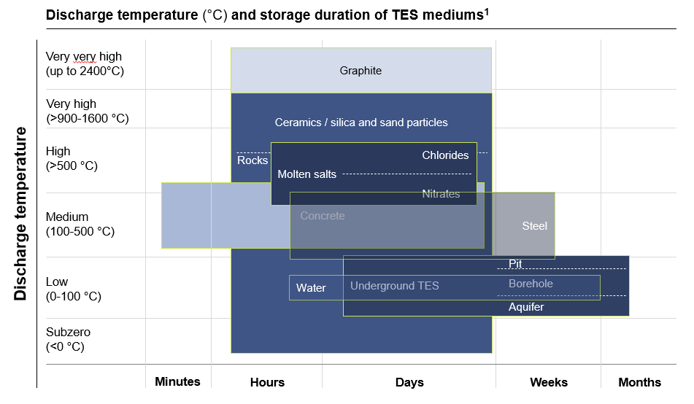
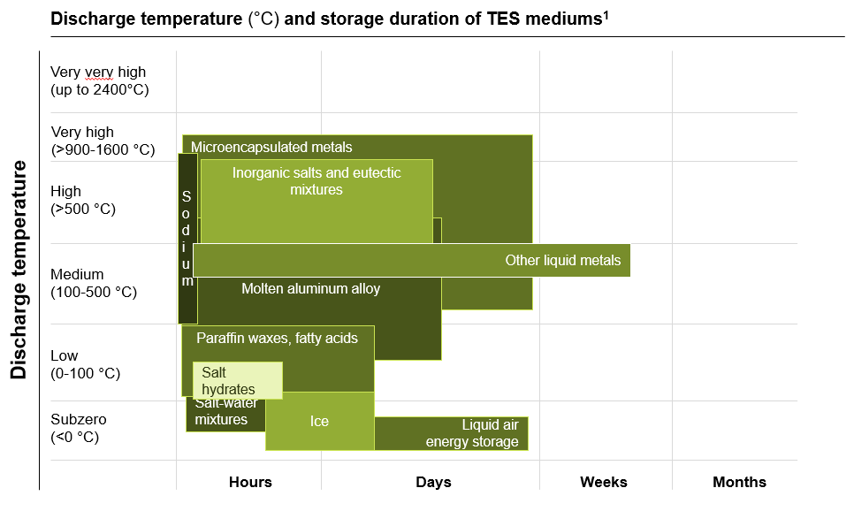
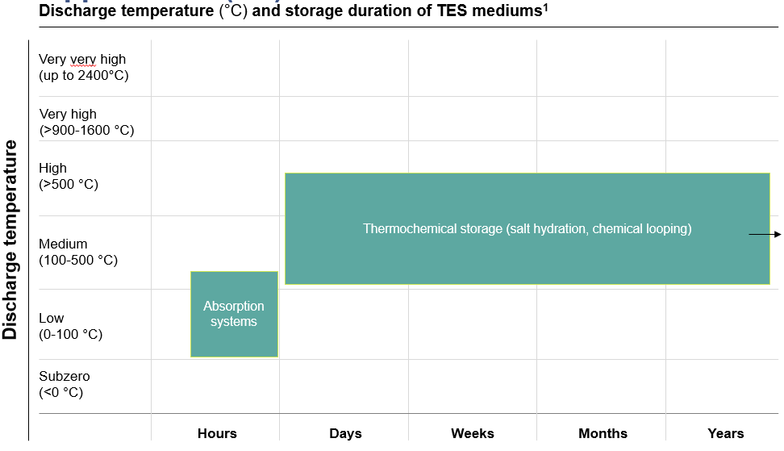
Thermal storage solutions can already provide temperatures of > 1000C and store heat for multiple years, depending on the solution
SHS
LHS
Thermochemical
Storage duration and discharge temperature influence storage technology use-cases
Source: Council members
Notes:
In our work on Net Zero Heat, we work with providers of Thermal Energy Storage solutions to help provide these heat demands.
One of the eye-opening things for me has been the range of solutions available, not just low-temperature hot water but solutions that can provide heat of >2000C or solutions that can store it for years

Slide 14




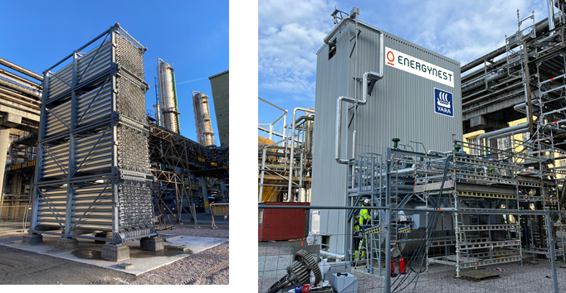
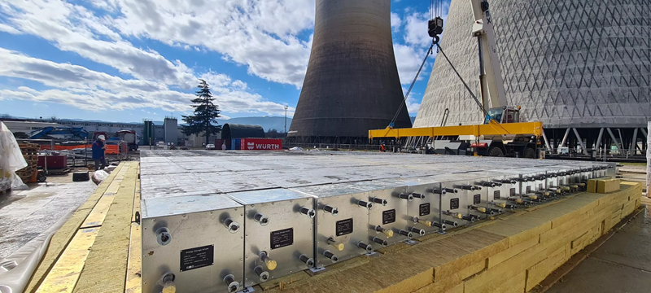
Thermal Energy Storage is getting commercially deployed already, with large industrial players
Thermal storage in action
Modules & system of a 45 MWh_{th} providing 400C steam to Yara’s Porsgrunn plant
Modules for installation of a 4MW / 23 MWh system to optimize heat use within a CCGT power plant
Source: LDES Council members
Notes:
The Thermal Energy Storage systesm are also getting commercially deployed, at full-scale sites.
One of our members, Energynest, is collaborating with Yara in providing stability to the 400 degree steam system at their Porsgrunn fertilizer plant in Norway
Another one, Brenmiller, is optimizing the use of heat in a CCGT power plan with Enel, the Italian utility

Slide 15




We have defined 5 different archetypes of thermal storage in which we benchmark the various solutions
Technological setup defintion for cost data collection
Charging
Storage
Discharging
Archetypes
Industrial
Application
Utility²
(Illustrative)
1 barg saturated steam
A
~120°C
Steam used for food processing, cleaning, sterilization
Electric heating
Black box¹ (tech. dependent)
Black box¹ (tech. dependent)
10 barg saturated steam
B
~180°C
Typical value for medium-pressure industrial steam,
25 barg saturated steam
C
~230°C
Petroleum processing
Storage
Hot air
Oil shale and oil sand processing
D
~450°C
Heating can be a separate module, or it could be integrated in the storage system
Very hot air
Various chemical processes (e.g, ethylene cracking furnace)
E
~900°C
1. Technology provider-dependent pathway of charging or discharging. Required for like-for-like comparison of costs
2. Five types of specific outputs should cover majority of industrial heat demand use cases making benchmark relevant for all industry players
Notes:
As part of our Net Zero Heat work within the Council, we developed a world-first thermal storage benchmarking together with our members. In this, we explored 5 different types of heat outputs to align to existing heat grades used in industry.
In our benchmarking, we examined the round-trip cost, so charging (based on resistive heating), storage & discharging. Most of the solution have a 90+ % round-trip efficiency, so making them some of the most efficient storing mechanisms out there.. For reference, most power storage systems have a 60-80% round trip efficiency

Slide 16
Thermal storage costs 4.5 – 8 $/MWh, making power prices driver of LCOH_{e} across thermal archetypes
2025 Top Quartile LCOH_{e}¹ for low-cost scenario, $/MWh_{th,}
xx
Thermal Storage participation
Charging electricity cost
Thermal storage costs³
Archetype²
LCOH_{e} by electricity cost
Commentary
25 $/MWh
30,8
23%
LCOH_{e} ranges between ~30-58 $/MWh across archetypes, driven by assumption of electricity price
Incorporating thermal storage adds between 4.5-8 $/MWh to LCOH
1barg
50 $/MWh
56,6
13%
25 $/MWh
31,9
28%
10barg
50 $/MWh
57,7
15%
25 $/MWh
31,9
28%
25barg
50 $/MWh
57,7
15%
25 $/MWh
29,5
18%
450 °C
50 $/MWh
55,2
10%
Assuming 10 MWh storage, 1MW discharge power, and 1 discharge cycle per day; charging capex 100kUSD/MW
The mix of technologies could vary for each archetype
Includes Charging Capex, Fixed O&M charging, Storage capex, Fixed O&M storage, Discharging capex, Fixed O&M discharging
Notes:
Total costs, when analyzed as Levelized Cost of Heat (LCOH) is also very low, with the local power price being 75+ % of the costs and the storage only adding 4.5 – 8 $ / MWh stored.
One of the reasons for this low cost is the storage media used as mentioned, with highly abundant materials like concrete, silica or salts

Slide 17
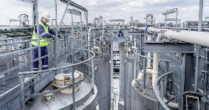
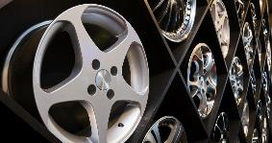








Thermal storage can be used in a variety of processes, as illustrated through an Alumina refining business case example
Fictive company context
Process and end product impressions
Company A-class-Alumina is a typical sized alumina refinery. They produce ~2 million metric tons of alumina powder every year. Of the three different Bauxite types, which have different temperature requirements, Boehmite is used. The two main heat consuming process steps in the Bayer process are the digestion and calcination.
  Refinery steam demand: required at 325°C and 104 bar, main consuming process 80% digestion, 15% evaporation, 5% other e.g., cleaning, ~4-8 GJ/t-alumina, provided by 4x 120 MW gas fired boilers (incl. not run at full capacity or maintenance)
  Circulating Fluid Bed Calcination: ~1,000°C, atmospheric pressure combustion gas, ~3-4 GJ/t-alumina, ~200-250 MW gas fired burner
  There is enough space on-site to integrate thermal storage. Significant increase of electricity demand would require grid infrastructure upgrades.
  As they phase increasing pressure from aluminum product producers like car makers, they are looking for the most competitive option to decarbonize their production.
Drivers for change of heat supply
Cost
Customer ESG
Regulation
Public pressure
This business case was jointly developed and verified by:
17
Notes:
When we analyzed how these results could impact a business case in an industrial setting, we explored Alumina refining, a process requiring significant amounts of heat at a very stable load. With our industry partners, we developed a fictious alumina refinery, representative of many around the world.
Within the refining process, we explored how thermal storage could be implemented to provide steam for the refining, at > 300C and at around 100 bar .

Slide 18
In our alumina case, thermal storage is a competitive decarbonization option and can compete with fossil heat on cost through CO2 tax
Archetype
C
Low-cost fossil fuels and low-cost renewables¹
Levelized cost of heat for selected technologies¹, $/MWh
Levelized cost of heat for selected technologies¹, $/MWh
Thermal storage enabled decarbonized heating solutions could be cost competitive to fossil in certain scenarios
Current comparison shows long-term Natural gas price at 19 $ / MWh, with current TTF at >120 $ / MWh
Decarbonization option based on thermal storage seems to be the cheapest option across the most prevalent solutions
CO2 emissions cost
Heating element
Fuel
Storage
2.1 $/kg of H₂
70
61
3
2
51
1
41
30
3
1
5
Fossil boiler
Biomass boiler
Hydrogen boiler
Electric boiler w/ RES and battery
Electric boiler RES and thermal storage
Main assumptions: fossil and RES prices as per Archetype C (19 $/MWh fossil, 23 $/MWh RES, 28% capacity factor), CO2 100 $/t, battery storage 250$/kWh, thermal storage 25$/kWh
Source: Net Zero Heat storage business case calculation, LDES Council Net Zero Heat storage industry benchmark 2022
Notes:
What we saw is that thermal storage, when based on renewables of 25$ / kwh
The most cost-competitive decarbonization option at the moment, when compared to
Biomass, which also is available in limited quantities
Hydrogen at ~2$ / kg
Electric heating with storing of electrons in a battery
Cost-competitive with natural gas when a carbon tax is in place (the grey stacked bar represents a 100$ / ton carbon costs) OR when gas prices rise (now assumed at 19$ / MWh in this example

Slide 19
Agenda
Q&A (10 min)

Slide 20
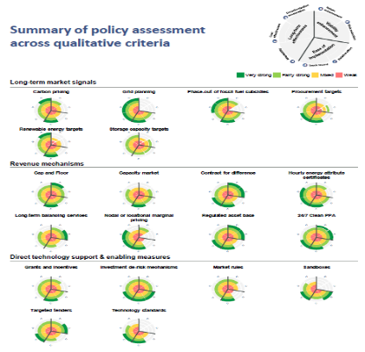
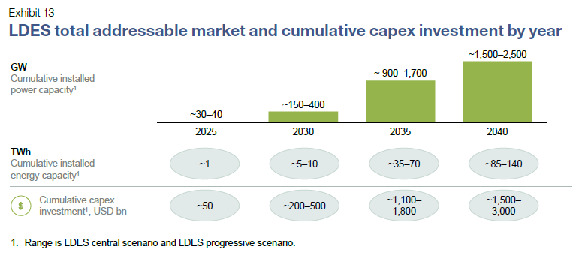
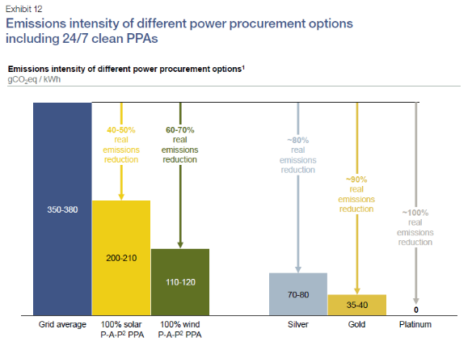



Ways to engage the LDES Council
Partner with the Council to accelerate net-zero
Unlock potential of LDES market
Drive industry standards for 24/7 clean PPAs
Create awareness of policy options
Explore becoming a member or partner of the Council
Visit us or follow us on the web
  Visit https://www.ldescouncil.com/members
  Reach out via email: info@ldescouncil.com
www.ldescouncil.com
/LDES-Council
@LDESCouncil
Note: Full insights and reports available at www.ldescouncil.com/insights/

