Slide 1


Modeling of Long Duration Storage for Decarbonization of California Energy System
EPC-19-060 - UC Merced
CPR #2 January 21, 2022

Slide 2

Agenda
Introductions (5 min)
Project Overview & Status (30 min)
Project Timeline
How the project will inform current and future energy storage goals
Results from the 2nd Workshop to present proposed scenarios for the preliminary analysis
Objective of the preliminary analysis
Preparation of data and modeling capabilities to meet the objective
Project Approach (25 min)
Approach to conducting the preliminary analysis
How the final analysis will differ from the preliminary analysis
How the project team is engaging with stakeholders to produce meaningful and useful results
Questions (30+ min)
CPR Determination February 11, 2022

Slide 3
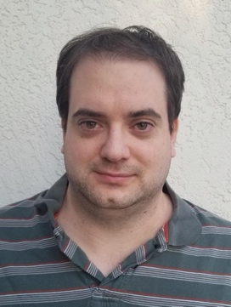

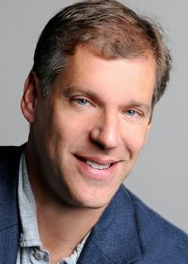

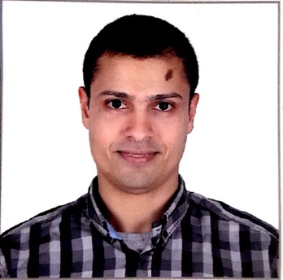


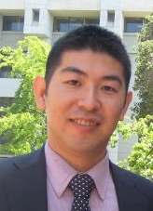



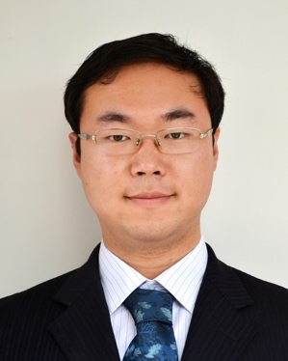
Introduction to research team
University of California Merced
Sarah Kurtz
University of
California Berkeley
Dan Kammen
Sergio Castellanos
University of California San Diego
Patricia Hidalgo-Gonzalez
University of North Carolina Chapel Hill
Noah Kittner
Not all students are pictured

Slide 4
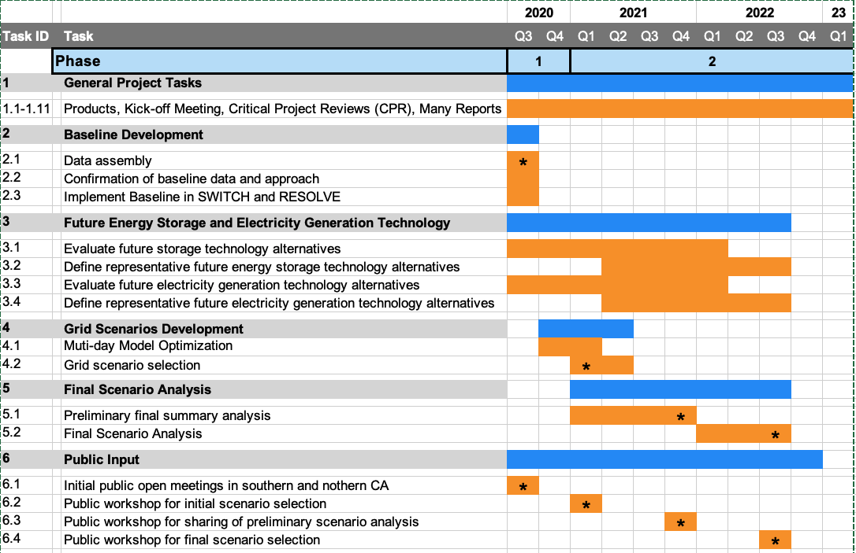
PROJECT SCHEDULE
Technology Evaluation Team
Modeling Team
Baseline definition
Technology assessment
Scenario analysis

Slide 5
PROJECT SCHEDULE
Task 3:
Technology Evaluation
Draft reports completed
Task 4:
Grid scenario selection
Primary discussion today
Task 5:
Final scenario analysis
Describe expected outcomes

Slide 6
HOW THE PROJECT INFORMS CURRENT STORAGE GOALS
Exploratory studies completed so far do not give final answers, but give useful guidance – talk about these today

Slide 7
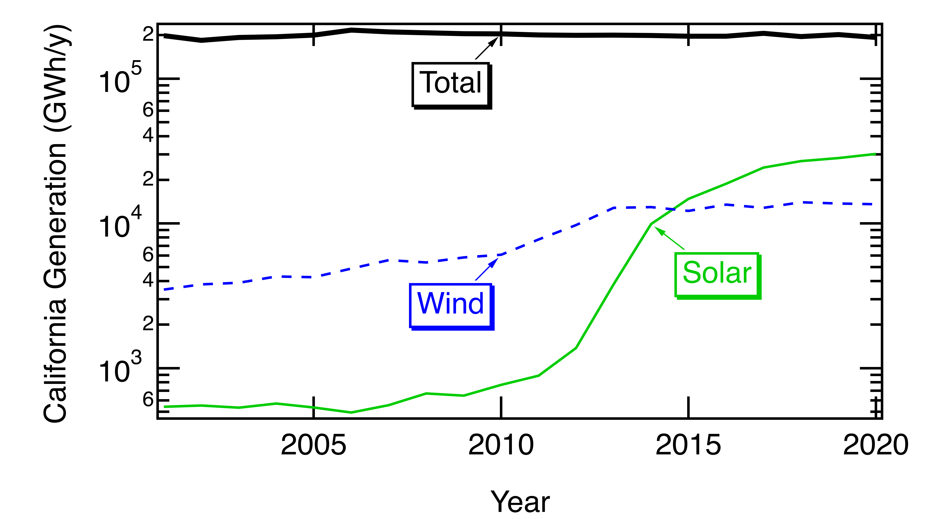
How the project informs storage goals – generation mix
Storage goals will depend on generation mix
A roadmap for growth of wind, solar, & transmission will provide a foundation for plan for storage
Identify “flavors” of wind and solar
Solar provides more emphasis on frequently used 6-to-10-h storage
Wind may provide more emphasis on less frequently used 10-to-20-h storage
A 50% reduction in hydropower increases average storage duration from 6 to 23 h in the six WECC load zones that use most hydropower

Slide 8
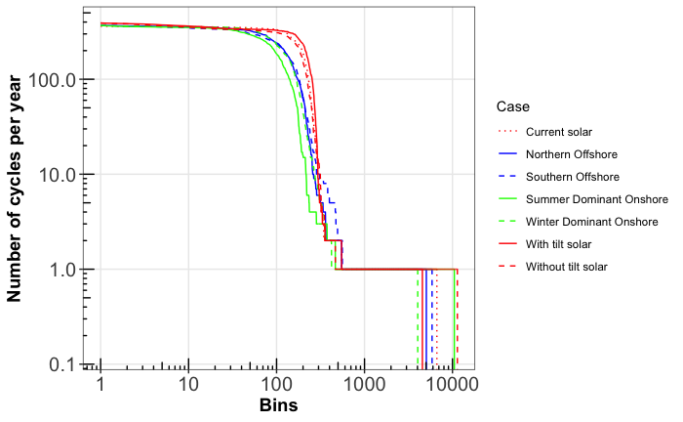
Data as basis of our recommendations
Solar
Curves assume perfect transmission within CAISO
(more study is planned)
Once per 2 days
Onshore wind
Offshore wind
Solar more clearly differentiates applications
Wind has less above the top line (“diurnal”) and more between the two lines (“cross-day”)
Twice per year
1 GWh

Slide 9

Conclusions from data – solar-powered grid
Solar emphasizes frequently used 6-10-h storage
Wind emphasizes less frequently used >10-h storage
Priorities for solar-powered grid
Diurnal storage is well defined – get through the night
Power needed: Storage should be capable of powering entire grid (about 50 GW today – will grow with EV and heat pump demand)
Energy needed: Through the night (> 0.3 TWh may grow to 1 TWh) motivates new scalable technology with longer life (lower cost is always better)
Efficiency is important because almost half of our electricity will be stored before use
Resilience and seasonal is best met by cross-sector storage
Cost targets for dedicated storage that is cycled once per year is difficult
A large storage and distribution system that is used for transportation, industrial applications, etc. may share with power sector at a relatively low cost
Market will need new mechanisms

Slide 10
Lifetime is a special challenge for frequently used storage
Storage that is cycled every day may wear out quickly
Long-duration storage could help:
What if only cycle partially each day?
1 GWh

Slide 11
Long-duration storage can increase lifetime
Lifetime measured by number of cycles could increase from 10 yrs to almost 30 yrs when duration increases from 1 hr to 10 hrs.
This is an attractive option for storage with small energy capex but fast degradation
Daily cycling may help to pay for long-duration battery

Slide 12
Conclusions from data – added wind
Solar emphasizes frequently used 6-10-h storage
Wind emphasizes less frequently used >10-h storage
Priorities for wind-powered grid – combining wind and solar decreases stored kWh (still need similar power capacity, but less electricity is stored. This means that cost needs to be lower, but efficiency is less important)
Diurnal storage has wider range of energy-capacity needs
Storage should be capable of powering entire grid (about 50 GW)
Useful to have about 0.05 TWh that could cycle every day with high efficiency (like solar)
Need more (maybe 0.1 TWh) that will cycle 1X per 2 or 3 days
Efficiency & lifetime are less important because a smaller fraction of electricity is cycled and the less frequent use can enable longer storage lifetime
Need even more (maybe 0.4 TWh) that will cycle less frequently (3 to 50 cycles/y)
The attributes of this storage are challenging – may be advantageous to use cross-sector storage?
Resilience and seasonal is best met by cross-sector storage – need new market features
Storage for wind-driven grid may have more income from capacity value than from sales of kWhs

Slide 13
Big need – robust diurnal storage for most days
Define power and energy – may be met by a range of durations:
Need storage with power to meet peak load (50 GW and growing)
Won’t require 50 GW for entire night, so to supply a 12-h night, may use a 6-h battery operated at half power for 12 hours.
Consider using a mixture of 4-h batteries to meet peak and 12-h batteries for entire night vs using 6-h or 8-h batteries for entire night and saving 4-h batteries only for the most challenging nights.
Primary need currently is to derisk new technologies for frequent use (able to cycle every day without wearing out) at low cost and high efficiency
Technology should project pathway to meeting targets:
Low cost, long life, and high efficiency to give low LCOS
Scalable to meaningful size (0.1 TWh)

Slide 14
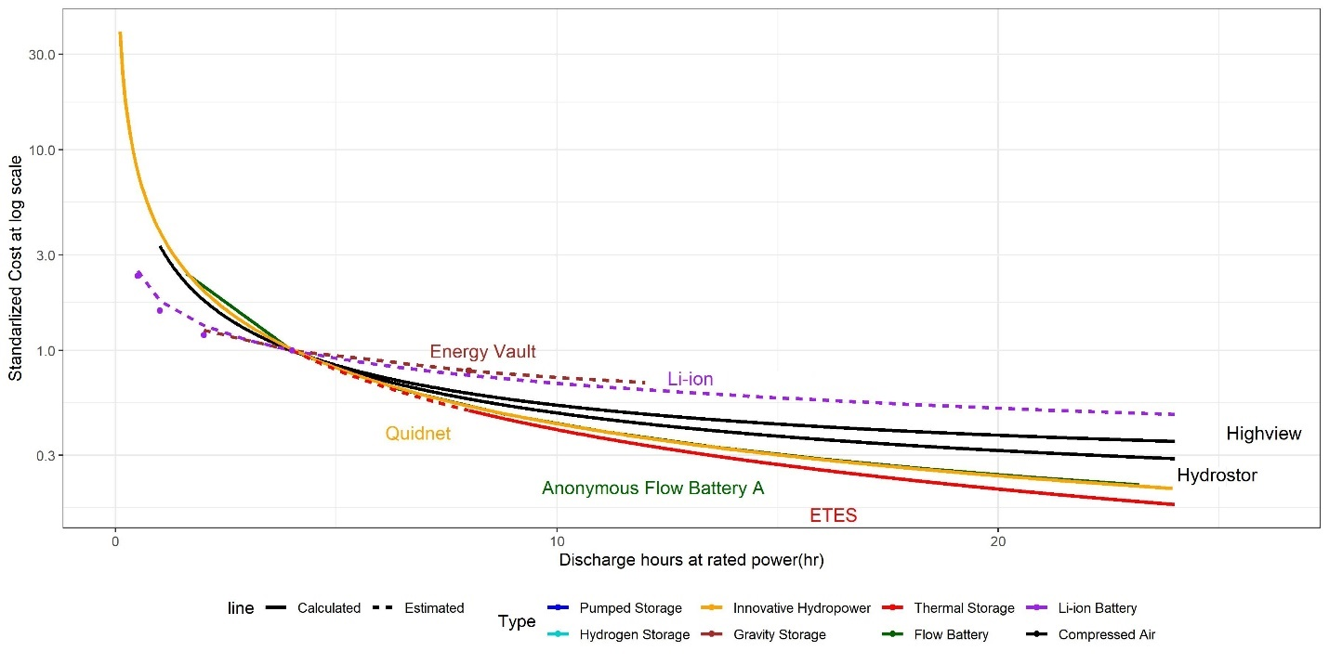
Benefit of storage’s marginal capex energy cost varies with application
Diurnal applications are not so affected by the energy capex
Applications that cycle infrequently depend more on energy capex

Slide 15
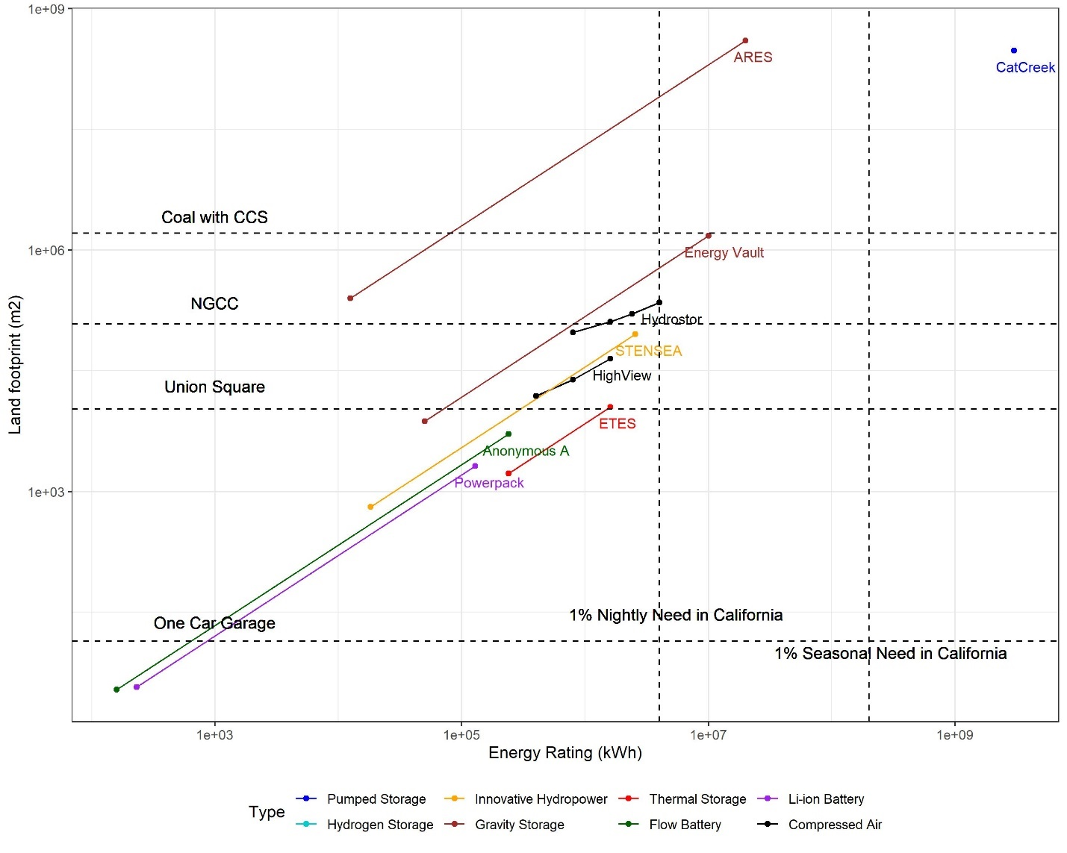
Many attributes should be considered
Jobs, environmental impact, etc.
Footprint may guide applications
Small footprints are needed for distributed systems (especially residential)

Slide 16
Many attributes should be considered
Jobs, environmental impact, etc.
Footprint may guide applications
Small footprints are helpful when space is constrained even for large systems

Slide 17
Many attributes should be considered
Jobs, environmental impact, etc.
Footprint may guide applications
When space isn’t constrained and footprint doesn’t matter, some storage may be able to reach larger energy ratings

Slide 18
Second big need – cross-sector storage
All scenarios need seasonal storage – suggest cross-sector is best
Identify energy source for other energy sectors: Hydrogen, ammonia, syn gas, or ?
Derisk and scale to low cost
Start with electrolyzers that can use surplus electricity to provide hydrogen for a local application
Consider projects that could power ports, rail or other fuel-cell applications
Goal is to be able to first use surplus electricity, then create a large flexible load that makes demand management a real part of the solution
Develop infrastructure
Start with projects that only need short pipelines and small-size storage

Slide 19
Third need – less-frequently used storage
Self-contained
Long-d. storage
Need is highly dependent on generation mix and weather (needed for wind-rich scenarios)
Is part of 50 GW of storage
Use may be highly variable and difficult to predict – maybe 10 cycles/y (range down to 3 cycles/y)
Primary need currently is to derisk new technologies with very low cost (efficiency is less important, though idle losses must be low)
For solar-only scenarios, may use cross-sector storage for < 10(?) cycles/y and diurnal storage capability for > 10(?) cycles/y
Short-duration storage
Cross-sector
storage
Short peak
Diurnal storage
Cross-day storage
Seasonal
storage
1 GWh

Slide 20
HOW THE PROJECT WILL INFORM FUTURE STORAGE GOALS
Completion of final scenario analysis will better define:
Cost targets for each storage product (with defined efficiency, duration, and degradation)
Expected usage of those storage products
Timeline for needed storage deployment and cost targets
Better understanding of effects of imports on need for storage
Better understanding of effects of “flavor” of wind and solar resources
Better understanding of role of hydrogen including trade-off between using more electrolyzers to reduce curtailment and desired high capacity factors for those electrolyzers
All the above can help inform the next generation of storage mandates for California

Slide 21
Additional priorities/needs
Electrification of transportation is critical
Charging structure is required
Charging structure that results in charging at night will require more storage
Charging structure that enables daytime charging will enable solar deployment
→ Therefore, identifying strategies for daytime charging is critical
Identification of flexible loads
Electrolyzers may end up being biggest flexible load
Factories that can turn off or other (recall the ships that unplugged in the harbor)
Data centers that shift calculations to other sites
Electrification of seasonal industries
Leverage results of CalFlexHub and other CEC- funded projects
Biogas, geothermal, and other renewable sources

Slide 22
Agenda
Introductions (5 min)
Project Overview & Status (30 min)
Project Timeline
How the project will inform current and future energy storage goals
Results from the 2nd Workshop to present proposed scenarios for the preliminary analysis
Objective of the preliminary analysis
Preparation of data and modeling capabilities to meet the objective
Project Approach (25 min)
Approach to conducting the preliminary analysis
How the final analysis will differ from the preliminary analysis
How the project team is engaging with stakeholders to produce meaningful and useful results
Questions (30+ min)
CPR Determination February 11, 2022

Slide 23
Public Input from 2nd workshop
Input can be found at: https://efiling.energy.ca.gov/Lists/DocketLog.aspx?docketnumber=20-MISC-01
Southern California Gas Company
Green Hydrogen Coalition
Form Energy
CESA (received by email)
Two key inputs:
Define more about plan for hydrogen (following slides will include a response)
Share results with E3 (coordination is ongoing – input may be shared with E3)

Slide 24
Modeling approach
Will use both RESOLVE and SWITCH to compare results
Define long-duration storage adoptions
RESOLVE key explorations (subset):
Generation mix (tilted/untilted solar; various wind additions; transmission)
Assumptions about pumped hydro storage, hydrogen price
SWITCH key explorations (subset):
WECC-wide impacts on LDES deployment/operation varying: new transmission, LDES energy capacity CapEx, generation mix (solar vs wind), hydropower availability, federal mandates for LDES energy capacity deployed
Infrastructure and economic opportunities for California to leverage WECC resources to achieve 100% RE by 2045
Impacts of re-designing planning and operational reserves rules on capacity expansion and operation

Slide 25

Modeling approach – define LDES adoption
Create baseline scenario then evaluate storage products
1. Define storage product:
• Efficiency
• Hours of duration
2. Create price target graphs for each by varying price to see when it is adopted (see right)
Market is “ripe”
Market not yet demanding LDES so price must be extra low
Market is maturing and competing technologies are lower in price
This sort of analysis can help companies align their product design with market entry timing

Slide 26
Modeling approach – storage matrix
Efficiency | Duration (h) | Idle loss | Relevant technologies
80% | 8, 16, 32, sometimes 128 | About 0 | pumped hydro, gravity, flow battery
70% | 8, 16, 32, sometimes 128 | About 0 | geomechanical, flow battery, metal-air, exfoliated-metal, gravity
60% | 8, 16, 32, sometimes 128 | 1%/day | flow battery, metal-air, exfoliated-metal, compressed air, liquid air, thermal
50% | 8, 16, 32, sometimes 128 | 1%/day | thermal
Storage product description will be selected from this matrix.
A single cost is assigned, then varied to create the graph on the right; repeat
Market is “ripe”
Market not yet demanding LDES so price must be extra low
Market is maturing and competing technologies are lower in price

Slide 27
Modeling approach - hydrogen
Generation of hydrogen
Allow model to build and schedule electrolyzers to create new demand as a flexible load (this plays a similar role to storage even if H₂ is used for transportation)
Storage and distribution of hydrogen
Very complicated, so simplify it:
Sell H₂ for $2/kg (or $1/kg or $3/kg) when generated
Buy H₂ for $?/kg if want to generate electricity ($2/kg to $12/kg)
This allows us to look at multiple storage/distribution scenarios by adding $x/kg according to desired scenario
Electricity from hydrogen
Using fuel cells
Cross sector
Dedicated
Using turbines

Slide 28
Baseline definition
Baseline
Define expected storage options for each evaluation
Li Batteries
Pumped hydro – include all known projects
Hydrogen – enable build of electrolyzers and sell H₂ for $2/kg
Costs from NREL 2021 ATB
Include electricity generation from hydrogen using either fuel cell or combustion
Software adjusted to do 365-day modeling (will try to use multiple years)
Add new solar/wind generation options (model can select or not)
Sensitivities
No new pumped hydro – what difference would this make?
Different hydrogen prices (selling and buying combinations)
EV charging scenarios
High geothermal
Natural gas with Allam cycle and carbon sequestration
Self-contained
Long-d. storage
Short-duration storage
Cross-sector
storage
Short peak
Diurnal storage
Cross-day storage
Seasonal
storage

Slide 29
Software strategy for RESOLVE
Use new software that E3 is developing
Use ability to do full 8760 hours/year
Add ability to use variable time steps to hit most challenging hours
Use two-step approach to do capacity expansion plan followed by hourly dispatch
Add ability to select electrolyzers and monetize hydrogen generated
Include new pumped hydro storage as baseline (then explore effects of removing it)
Add new storage to see if adopted, then repeat with lower cost

Slide 30
Status
Exploratory analysis has been very fruitful
5 documents published
4 documents under review
2 documents being written
2 oral presentations at virtual conferences; 5 posters presented by students
Additional oral presentations
Currently transitioning from exploratory analysis to final analysis
E3 made first release of RESOLVE on Jan. 9, 2022
Have begun developing inputs and software modifications to RESOLVE
Have begun second round of studies using SWITCH
Expenditure rate was slowed while waiting for RESOLVE development; request a NCE to be able to fully explore modifications to RESOLVE

Slide 31
Agenda
Introductions (5 min)
Project Overview & Status (30 min)
Project Timeline
How the project will inform current and future energy storage goals
Results from the 2nd Workshop to present proposed scenarios for the preliminary analysis
Objective of the preliminary analysis
Preparation of data and modeling capabilities to meet the objective
Project Approach (25 min)
Approach to conducting the preliminary analysis
How the final analysis will differ from the preliminary analysis
How the project team is engaging with stakeholders to produce meaningful and useful results
Questions (30+ min)
CPR Determination February 11, 2022

Slide 32
Preliminary analysis vs Final analysis
Preliminary analysis will
Optimize the approach for analyzing 365-day scenarios to enable hundreds of calculations while still retaining accuracy
Identify the most interesting storage products to study
Compare results from RESOLVE
Final analysis will
Explore effects of each of the sensitivities (including any new options that are identified)
Goal is to be able to quickly complete calculation for many scenarios in order to better assess confidence

Slide 33
Engagement with stakeholders
Publications/presentations
5 documents published
4 documents under review
2 documents being written
2 oral presentations at virtual conferences; 5 posters presented
Expert briefing organized by CCST “Technologies for Renewable Energy Storage”
Assembly Select Committee on California’s Clean Energy Economy hearing (Chair Quirk)
Panel discussion participation at Energy Storage North America (Long Beach)
Presentation at UC Davis
Two draft reports posted for public comment with engagement with those who responded
Have invited guest speakers and shared our results in about ten meetings/year
TAC includes CAISO, CESA, Gridlab, LDES Assoc. of CA, NREL, TURN

Slide 34
Engagement with stakeholders
Have met with many organizations including:
Antora Energy
Augwind
Bakersfield College
Blue Marble
Cat Creek
CCST
Disigno
E3
EDF
Energy Vault
ETES
Form Energy
GE Renewables
GKN
Gridlab
Gridworks
H2B2
Harvard University
Heliogen
Highview Power
Hydrostor
Invinity
Lawrence Berkeley Natl Lab
Lawrence Livermore Natl Lab
Malta, Inc
NREL
Quidnet
Plus Energy Storage
Reascend
Renewell
Rondo Energy
SGRE COG IS EST TE SI (Siemens)
Sinton Instruments
Solar Turbines
Strategen
TURN
UC Irvine
Xcel Energy
Zinc8 Energy
As our results from the final scenario analysis become available, we plan to meet with the companies again to discuss the implications for them and identify whether additional calculations would be useful

Slide 35
Agenda
Introductions (5 min)
Project Overview & Status (30 min)
Project Timeline
How the project will inform current and future energy storage goals
Results from the 2nd Workshop to present proposed scenarios for the preliminary analysis
Objective of the preliminary analysis
Preparation of data and modeling capabilities to meet the objective
Project Approach (25 min)
Approach to conducting the preliminary analysis
How the final analysis will differ from the preliminary analysis
How the project team is engaging with stakeholders to produce meaningful and useful results
Questions (30+ min)
CPR Determination February 11, 2022

Slide 36
Discussion

