Slide 1


Long Duration Energy Storage
Public Workshop #2
Public Input and Responses

Slide 2
Public Input
Input can be found at: https://efiling.energy.ca.gov/Lists/DocketLog.aspx?docketnumber=20-MISC-01
Southern California Gas Company
Green Hydrogen Coalition
Form Energy
CESA

Slide 3
Southern California Gas
A broader view of a hydrogen transportation and storage network in California can enable long-duration hydrogen storage as required to help California provide greater grid resilience
Understanding and building upon previous studies and real-world applications is needed to help California manage a balanced portfolio of energy resources
Analyzing the costs and accessibility of storing hydrogen underground in various geologic formations in the UCM Draft Storage Technology Summary, such as depleted gas fields and hard rock caverns
Modeling cross-sector hydrogen storage is crucial for evaluating the decarbonization and resiliency capabilities of the gas system
Any assessment of long-duration storage should consider future changes to the hydroelectric system to provide a comprehensive understanding of challenges and opportunities in long-duration storage strategies for California

Slide 4
Southern California Gas a)
Broader view of hydrogen transportation and storage network
https://www.socalgas.com/sites/default/files/2021-10/Roles_Clean_Fuels_Full_Report.pdf
October 2021 report includes a wealth of information
Study includes:
  Cross-sectoral integration (integration of electricity and fuels systems)
  Fuels system infrastructure and flexibility (consider value of natural gas infrastructure)
  Assessing other critical factors – particularly resiliency (extreme weather)
Key findings:
  Clean fuels (e.g. hydrogen, biogas, methane from CO2, etc.) can reduce cost of overall solution
  Clean fuels will be important for hard-to-electrify energy sectors
  Clean thermal generation is critical to maintain the affordability and resilience of grid
  Clean fuels network supports decarbonization and electrification and hard-to-abate sectors
  Pipelines to enable carbon management are a critical element of a clean fuels network
  Diversification lowers risk

Slide 5
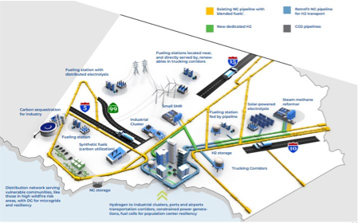
Southern California Gas a)
Broader view of hydrogen transportation and storage network

Slide 6
European Hydrogen Backbone
European Gas Transmission System Operators initiative: European Hydrogen Backbone
https://gasforclimate2050.eu/news-item/european-hydrogen-backbone-grows-to-40000-km/
Assessed potential for retrofitting natural gas infrastructure for hydrogen (note: this is similar to study presented by Jeff Reed from UC Irvine)
Use of excess electricity to generate hydrogen contributes to flexible grid while providing needed hydrogen for non-electrified energy needs
Cost of handling hydrogen will be reduced by using pipelines, leveraging current infrastructure can reduce costs

Slide 7
Southern California Gas b)
Balanced portfolio of energy resources
Include hydrogen in IRP modeling methodology
http://www.apep.uci.edu/PDF_White_Papers/Integrating_Clean_Energy_013020.pdf
Need for long-duration and seasonal storage that can be delivered anywhere will increase
Hydrogen can meet this need
https://www.researchgate.net/publication/326049153_Net-zero_emissions_energy_systems
https://www.sciencedirect.com/science/article/pii/S254243511830583X

Slide 8
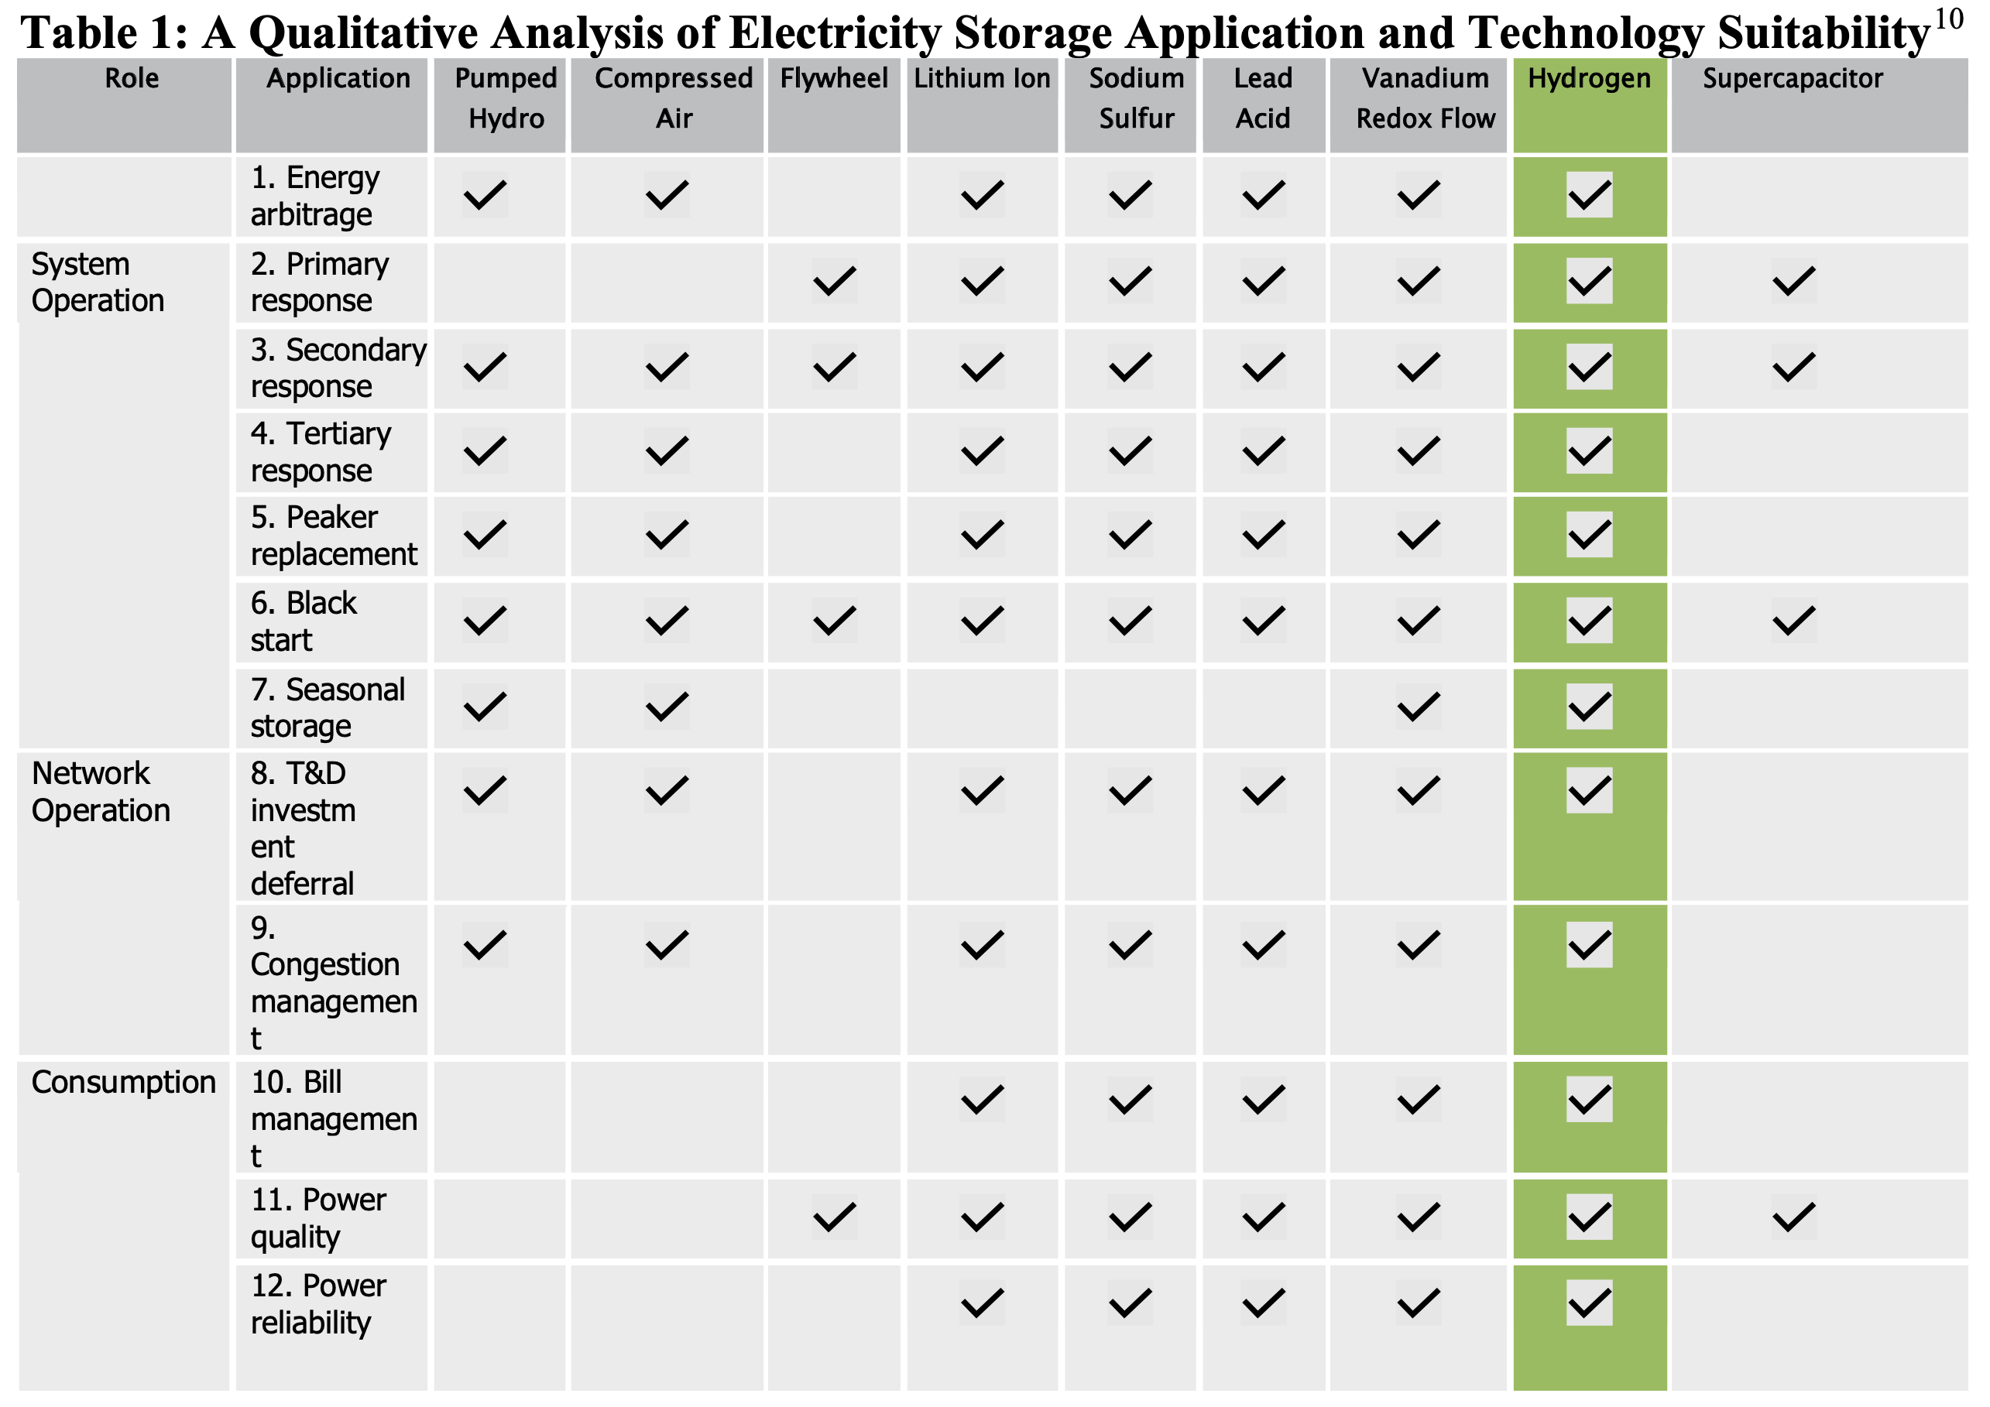
Southern California Gas b)
Hydrogen is a versatile form of LDES
https://www.sciencedirect.com/science/article/pii/S254243511830583X

Slide 9
Southern California Gas c)
Analyze costs and accessibility of storing hydrogen
UCM statement of “[hydrogen] underground storage can be relatively inexpensive, but it is not readily available in many locations” is unclear or inaccurate – a more complete discussion is desired as shown in next slide.
Recommendation is for UCM to study the cost discrepancies seen in the next slides
Especially for depleted oil and gas fields and hard rock caverns

Slide 10
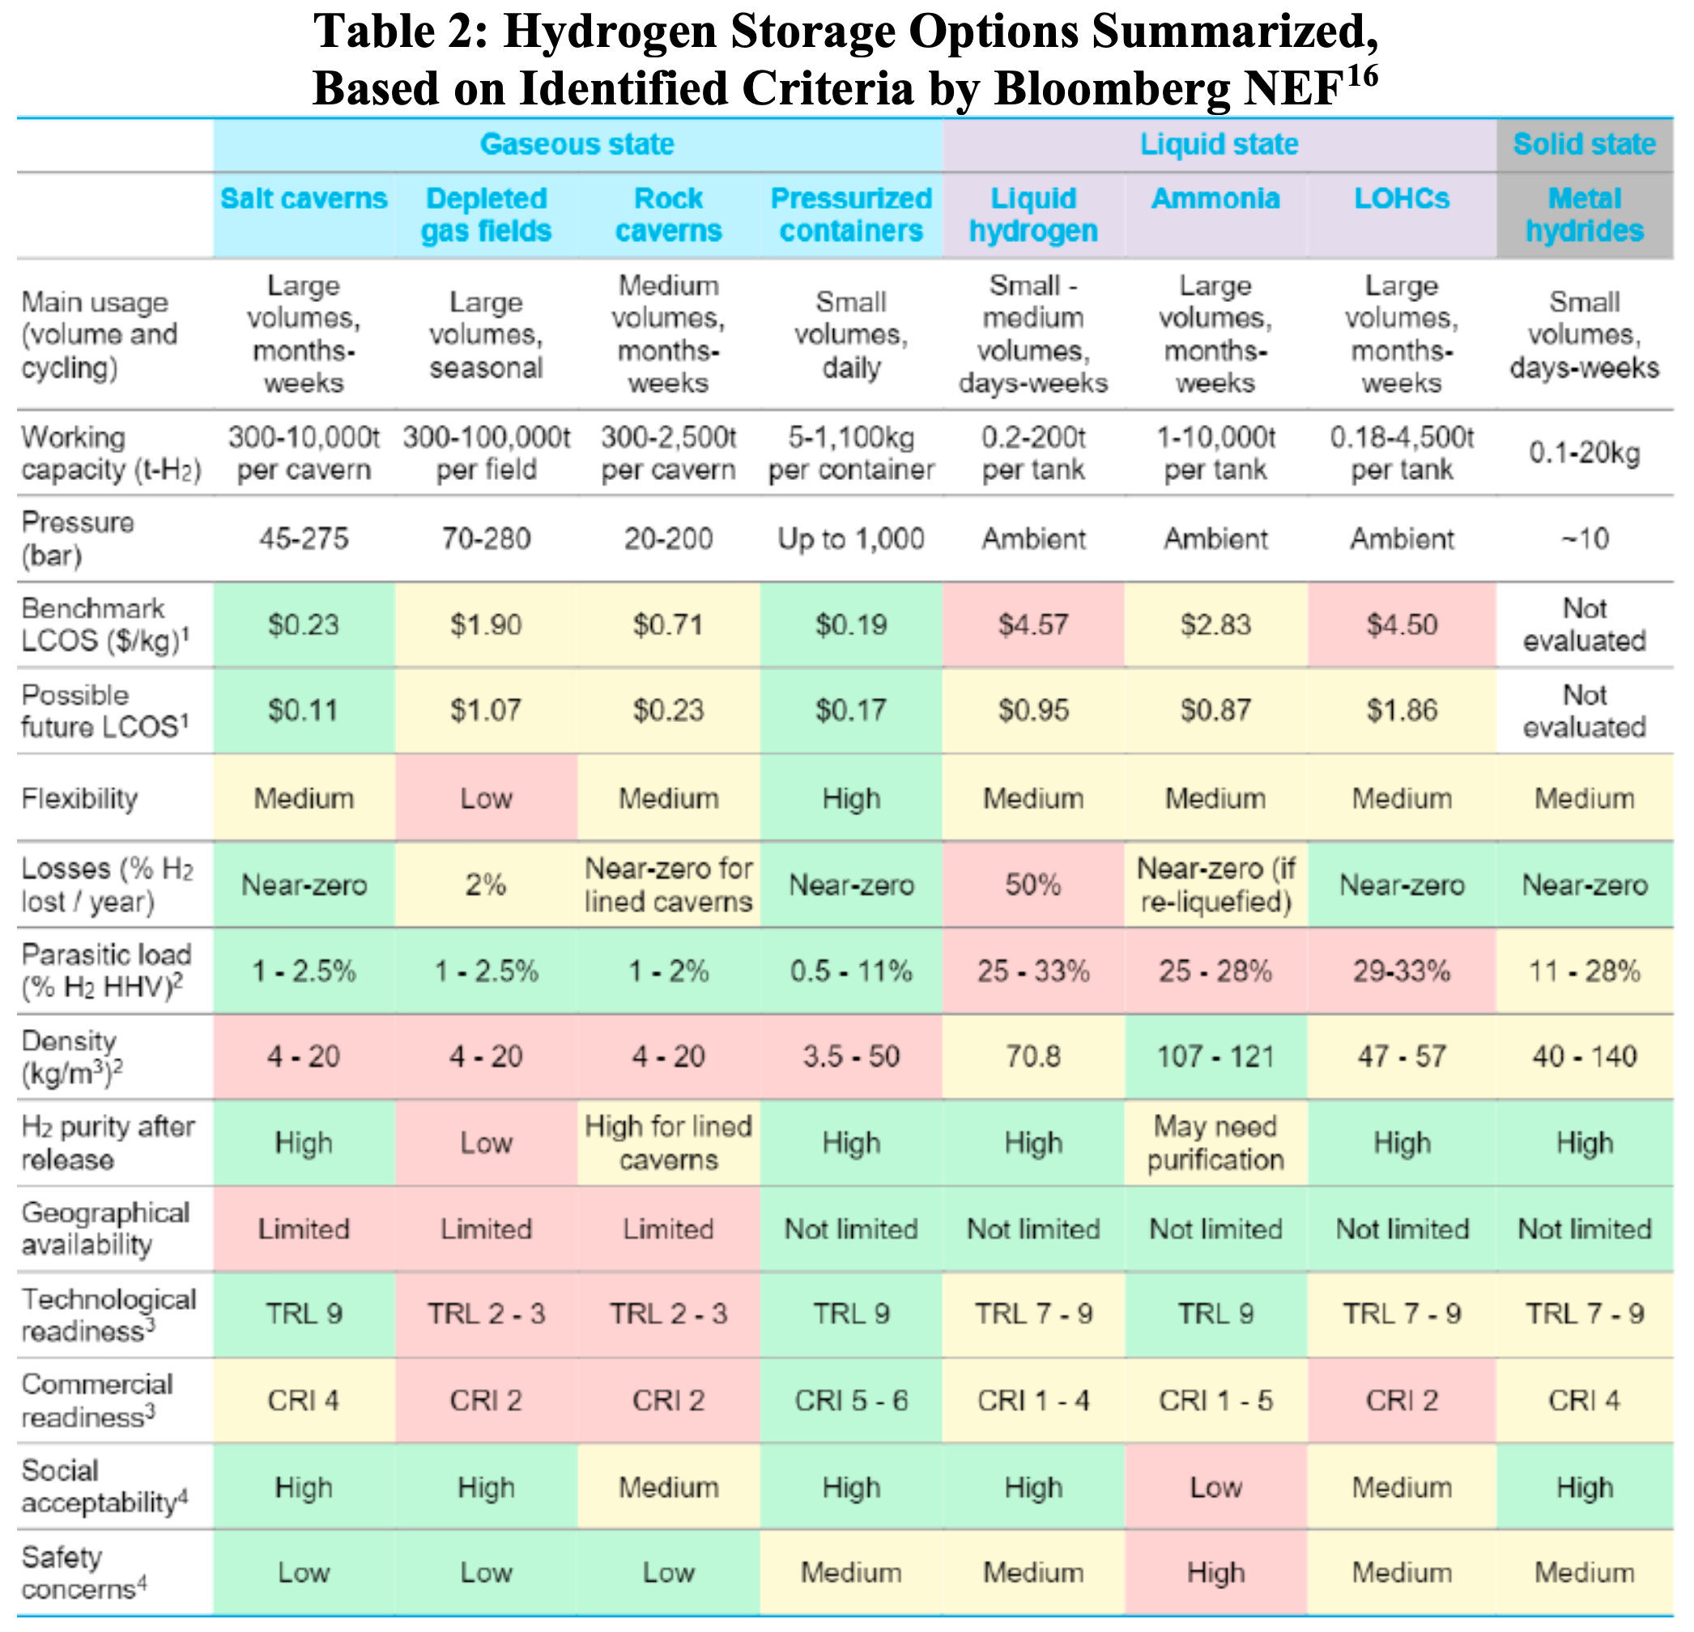
Southern California Gas c)
For discussion:
The UCM statement appears to be consistent with Table 2
Salt caverns are projected to be lowest cost
Pressurized vessels are considered lowest cost now, but this does not include the cost of transportation.
Hydrogen: The Economics of Storage, Full Report, Bloomberg NEF

Slide 11
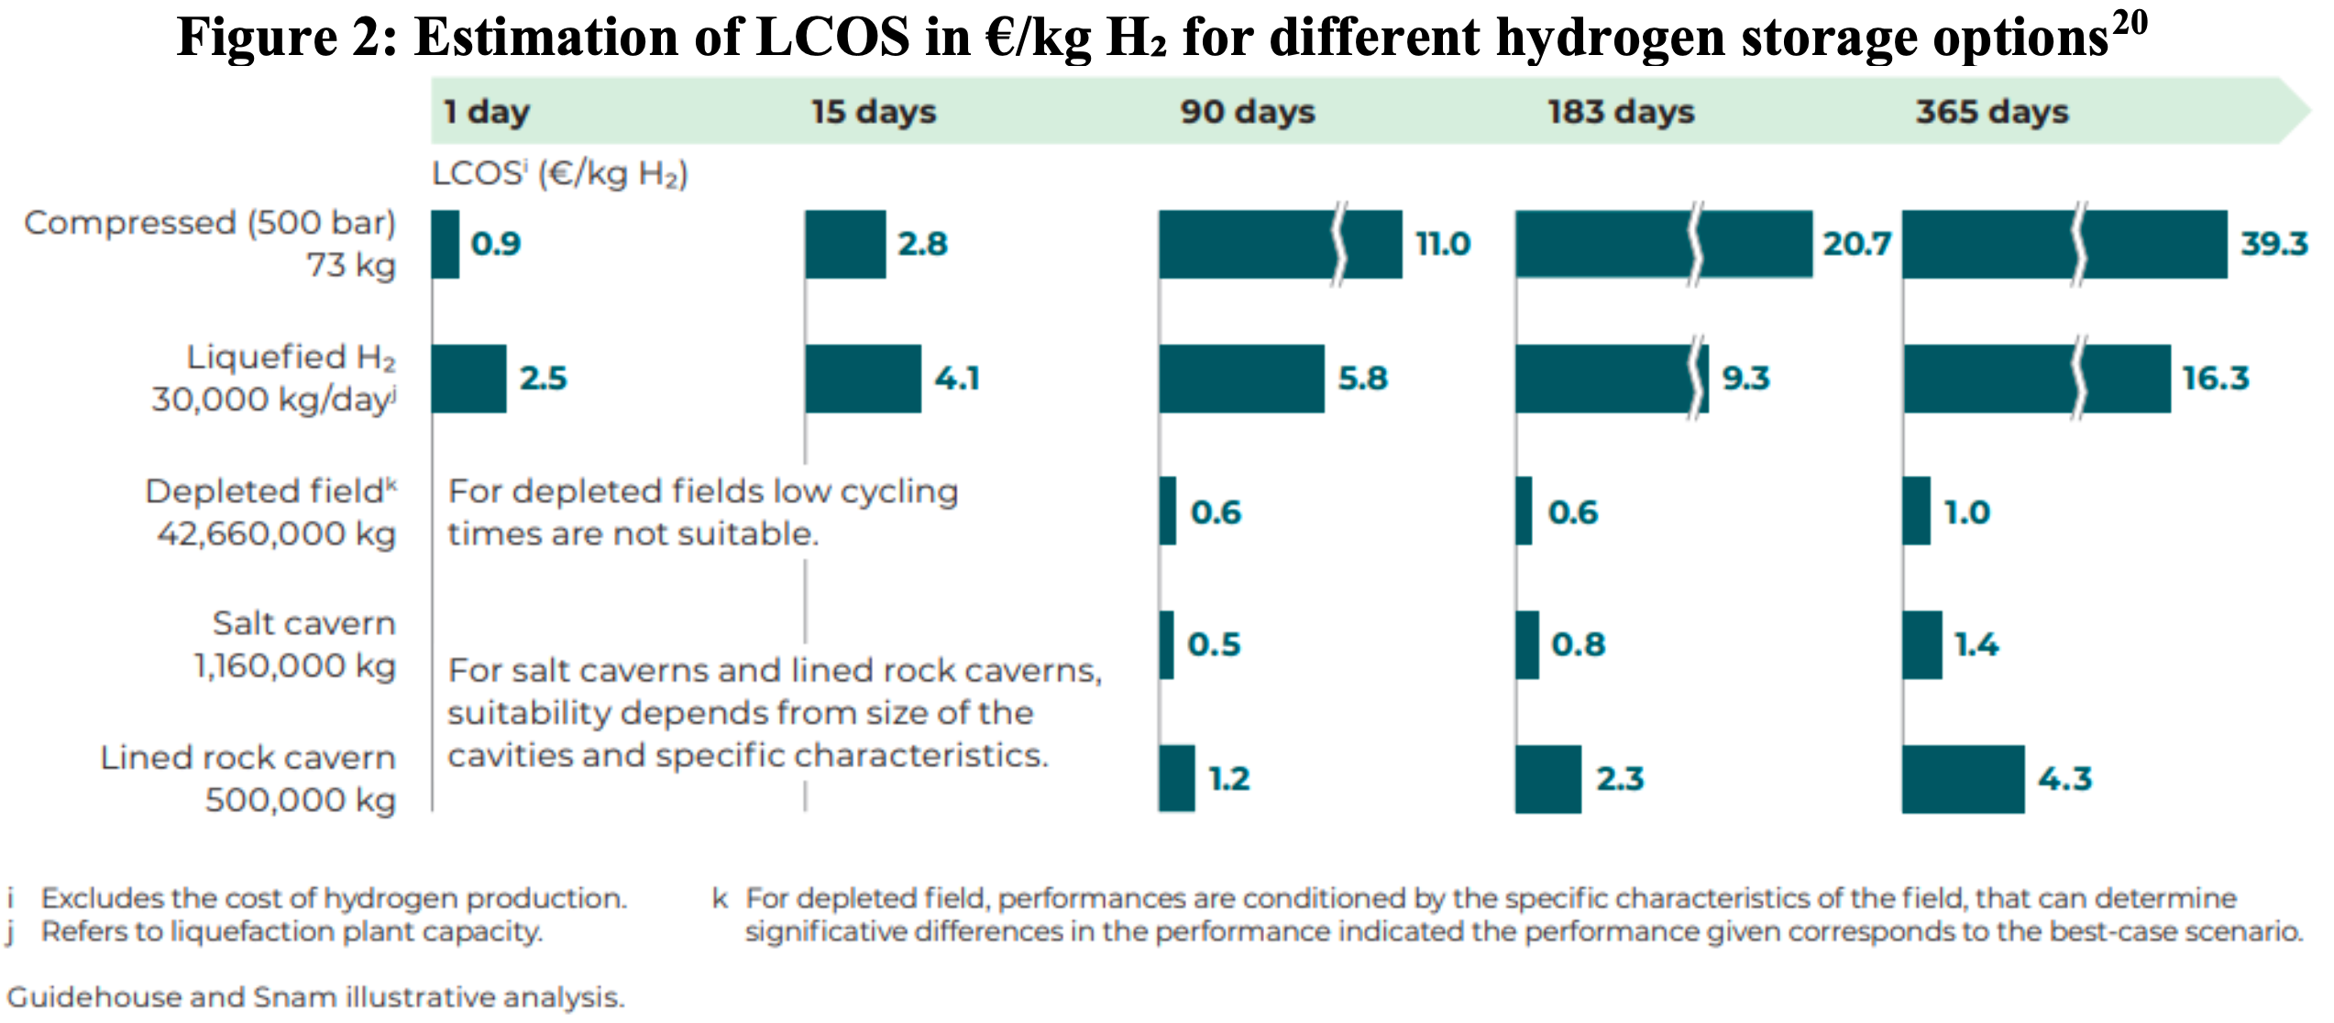
Southern California Gas c)
Costs are higher than found by Bloomberg
https://gasforclimate2050.eu/wp-content/uploads/2021/12/Gas-for-Climate-Market-State-and-Trends-report-2021.pdf

Slide 12
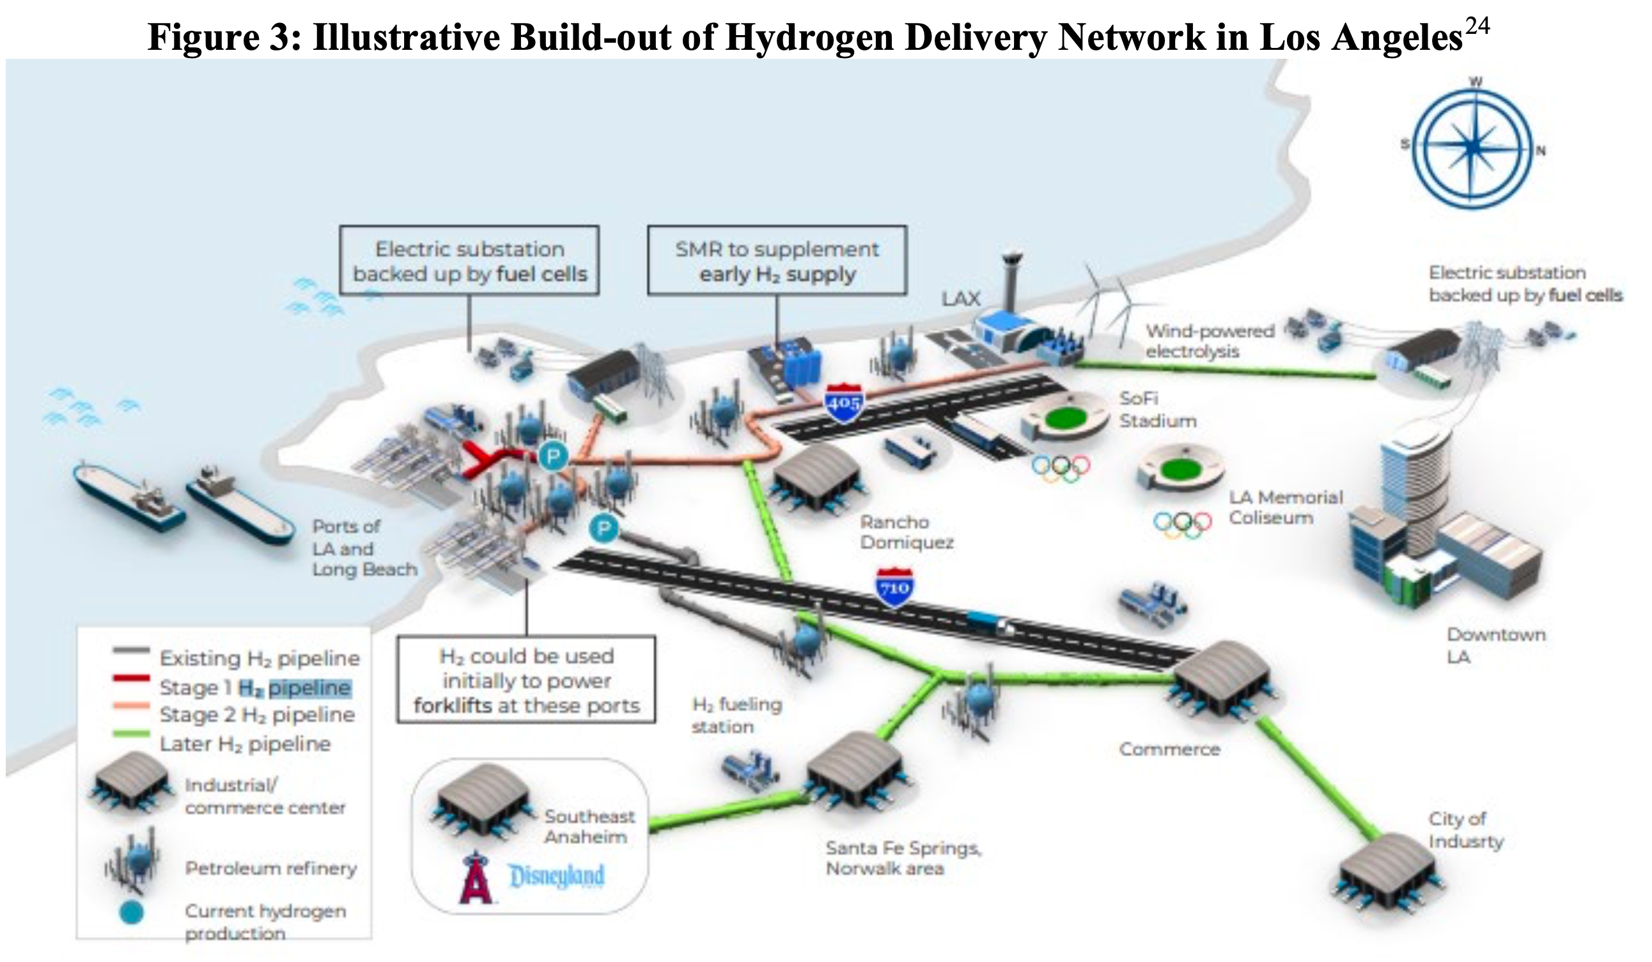
Southern California Gas d)
Modeling cross-sector hydrogen storage is crucial
Biogas may be considered either generation or storage
State incentives directed to a narrow label may miss opportunities
https://www.socalgas.com/sites/default/files/2021-10/Roles_Clean_Fuels_Full_Report.pdf

Slide 13
Southern California Gas d)
Modeling cross-sector hydrogen storage is crucial
Recommendations:
  Use a more complete model that would calculate the cost of using hydrogen (that is being stored for transportation or chemical use) to generate electricity when electricity is in short supply
  Incorporate results from https://www.edf.org/sites/default/files/documents/SB100%20clean%20firm%20power%20report%20plus%20SI.pdf (specifically include clean firm resources)

Slide 14
Southern California Gas e)
Consider future changes to the hydroelectric system
Climate may change (https://www.calrecycle.ca.gov/organics/slcp):
  Droughts may decrease availability of hydropower (especially in late summer, effectively reducing the “natural” long-duration storage)
  Droughts may increase wildfires
  Hotter temperatures may reduce transmission line capacity
  https://www.gao.gov/assets/gao-21-423t.pdf
  Severe weather is already causing outages (like Texas in Feb ’21)

Slide 15
Responses to SoCalGas – for discussion
Agree that hydrogen is important. Plan already includes:
A broader view of a hydrogen transportation and storage network in California can enable long-duration hydrogen storage as required to help California provide greater grid resilience
  Model build out of electrolyzers to monetize value of excess electricity used to generate green hydrogen – may need to add to RESOLVE
  Use of hydrogen in either fuel cells or thermal generators anticipated to be a part of RESOLVE as E3 presents
Understanding and building upon previous studies and real-world applications is needed to help California manage a balanced portfolio of energy resources
  We appreciate being introduced to additional resources and apologize for not including all of the papers we read in the bibliography – we will update the bibliography as well as reading additional sources
Analyzing the costs and accessibility of storing hydrogen underground in various geologic formations in the UCM Draft Storage Technology Summary, such as depleted gas fields and hard rock caverns
  We would like to discuss this: our understanding is that pipelines are the lowest cost way to transport hydrogen and that hydrogen storage should be coordinated with transportation
Modeling cross-sector hydrogen storage is crucial for evaluating the decarbonization and resiliency capabilities of the gas system
  See above under a)
Any assessment of long-duration storage should consider future changes to the hydroelectric system to provide a comprehensive understanding of challenges and opportunities in long-duration storage strategies for California
  We propose to use extreme historical years to evaluate the challenges. Extending that is a next step

Slide 16
Green Hydrogen Coalition
Applauds inclusion of hydrogen; response focuses on hydrogen
RESOLVE electrolyzer CapEx costs of 900 Euro/kW by 2025 to 430 Euros/kW by 2045 are too high.
RESOLVE should include hydrogen combustion turbines as a candidate resource
Study should include an analysis of green hydrogen LDS for power sector applications
Study should provide more detail regarding its approachfor modeling cross-sector hydrogen storage

Slide 17
Green Hydrogen Coalition
Applauds inclusion of hydrogen; response focuses on hydrogen
RESOLVE electrolyzer CapEx costs of 900 Euro/kW by 2025 to 430 Euros/kW by 2045 are too high.
https://www.ghcoalition.org/hydeal-la
$500/kW by 2025 and $400/kW by 2030 would be better numbers.
https://www.dh2energy.com/project-hydeal
Alkaline electrolyzers are dropping in cost (like solar and wind) with 18% ±6% drop in cost for every doubling of cumulative installed capacity
BloombergNEF optimistic: $400/kW by 2025 and $115/kW by 2030 (next slide for graphs)
BloombergNEF conservative: $1000/kW by 2025 and $135/kW by 2030

Slide 18
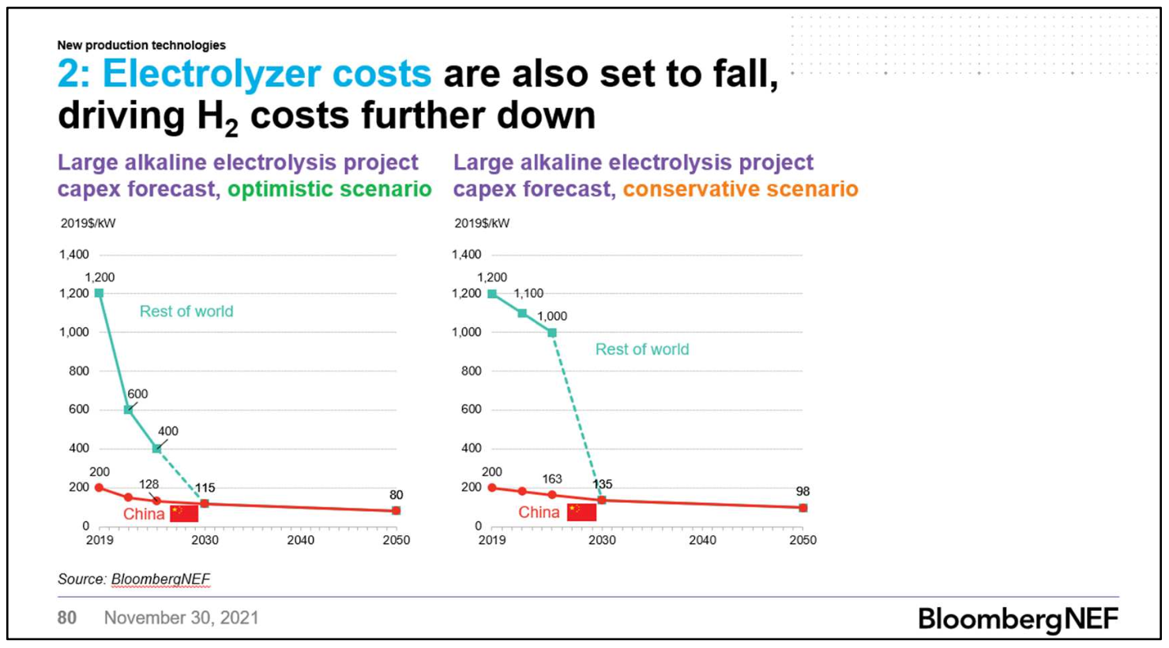
Green Hydrogen Coalition
https://about.bnef.com/new-energy-outlook/

Slide 19
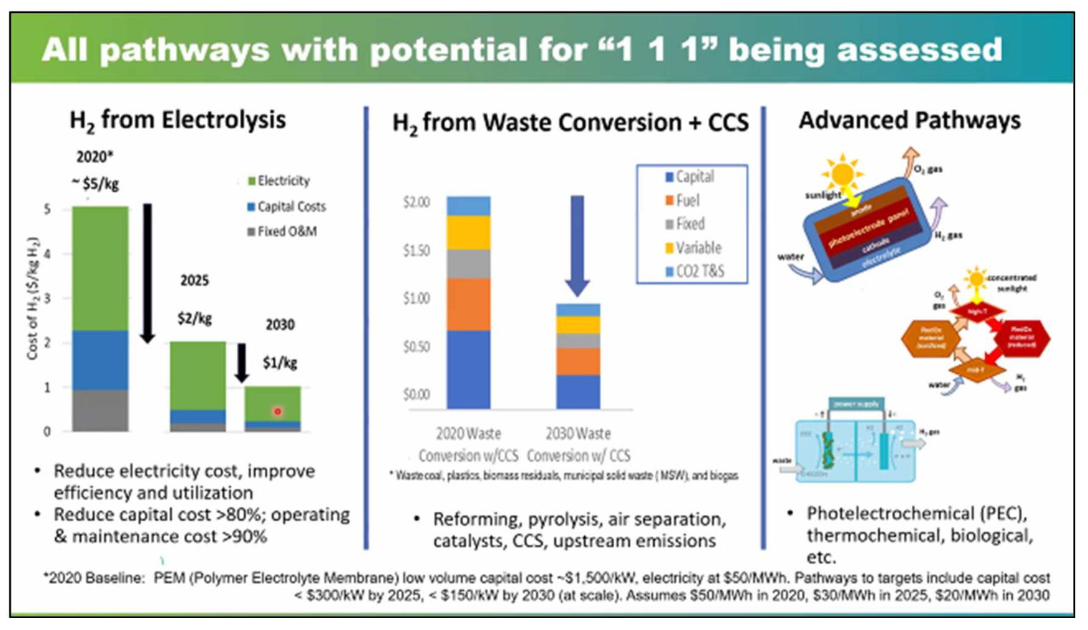
Green Hydrogen Coalition
Satyapal, Sunita. DOE Hydrogen & Fuel Cell Technologies Office presentation at the GHC Fall Event. December 1, 2021.

Slide 20
Green Hydrogen Coalition
RESOLVE should include hydrogen combustion turbines as a candidate resource
  Should be added in addition to fuel cell
Study should include an analysis of green hydrogen LDS for power sector applications
  Should do a deep dive into this
  Consider repurposing existing power plants with green hydrogen
  NREL/TP-6A20-79444, Executive Summary, p. 14, available at: https://maps.nrel.gov/la100/report.
Study should provide more detail regarding its approach for modeling cross-sector hydrogen storage
  Suggests another workshop

Slide 21
Green Hydrogen Coalition - discussion
Applauds inclusion of hydrogen; response focuses on hydrogen
  Agree
RESOLVE electrolyzer CapEx costs of 900 Euro/kW by 2025 to 430 Euros/kW by 2045 are too high.
  Yes, these should be adjusted
RESOLVE should include hydrogen combustion turbines as a candidate resource
  What type of turbine? Is there a study showing that this is the preferred approach?
Study should include an analysis of green hydrogen LDS for power sector applications
  Why not use cross-sector with V2G?
Study should provide more detail regarding its approach for modeling cross-sector hydrogen storage
  Agreed

Slide 22
Form Energy
On page 19 – separate metal-air batteries from flow batteries
Form Energy is developing a rechargeable iron-air battery capable of continuously dispatching electricity at rated capacity for 100 hours. The primary active material is iron, one of the most abundant elements on Earth. The principle of operation is reversible rusting: while discharging, the battery takes in oxygen from the air and converts iron metal to rust; while charging, the application of an electrical current converts the rust back to iron and the battery releases oxygen. The cells consist of electrodes and iron anodes submerged in an aqueous, alkaline, non-flammable electrolyte. The key advantages of the iron-air technology include:
● Low cost - projected system installed costs of $10/kWh (one-tenth the cost of lithium-ion systems)
● Safety - chemistry has no mechanism for thermal runaway and exhibits no dendrite formation
● Scalability - iron is the most globally abundant metal and can be found on every continent
● Durability - iron has been demonstrated to be stable across thousands of cycles

Slide 23
CESA input
CESA has extensive expertise
See CESA report:
  https://static1.squarespace.com/static/5b96538250a54f9cd7751faa/t/5fcf9815caa95a391e73d053/1607440419530/LD ES_CA_12.08.2020.pdf
Concludes need for 45-55 GW of LDES by 2045
Modeling is valuable to inform both IRP and SB100
Four key areas – see next slide
Consistent theme – increase collaboration with E3

Slide 24
CESA input – four areas
The University of North Carolina, Chapel Hill’s (“UNCCH”) exploration of LDES technologies should be considered when creating new candidate resources for RESOLVE
Including geographic specificity for renewable generation candidate resources should be considered for the next round of RESOLVE updates
The iterative process proposed by the University of California (“UC”) Merced can provide significant insight regarding the cost targets for emerging storage technologies
The results from modeling that covers all of the Western Electricity Coordinating Council (“WECC”) modeling demonstrate the importance of extending RESOLVE’s optimization horizon

Slide 25
CESA input – first area
The University of North Carolina, Chapel Hill’s (“UNCCH”) exploration of LDES technologies should be considered when creating new candidate resources for RESOLVE: The findings regarding the types of LDES available and the key drivers behind specific business models (e.g., land footprint, idle losses, and average capital costs) should be utilized by Energy + Environmental Economics (“E3”) in order to develop new, technology-neutral, candidate resources for the RESOLVE model. These updates should be incorporated as soon as possible to the planning venues where RESOLVE is used, such as the California Public Utilities Commission’s (“CPUC”) IRP proceeding and the Joint Agencies’ SB 100 reports.

Slide 26
CESA input – second area
Including geographic specificity for renewable generation candidate resources should be considered for the next round of RESOLVE updates: The results presented during the workshop confirm that the generation mix, particularly the variable energy resource (“VER”) mix, has a significant impact on the amount and type of storage required on a systemwide basis. Given the role of the IRP proceeding in the procurement of new assets, CESA echoes the researchers’ recommendation of including geographic specificity for VERs in order to ensure the market is incented to procure the resources that best contribute to reliability.
Solar should not be limited to 1-axis-tracked, 0-degree tilt
Wind should be considered to include options that may vary both across seasons and during the day.
Should ask E3 to include these in the IRP, especially when considering transmission of wind from offshore and out of state

Slide 27
CESA input – third area
The iterative process proposed by the University of California (“UC”) Merced can provide significant insight regarding the cost targets for emerging storage technologies: CESA supports UC Merced’s proposed approach to better understand the cost targets storage resources with different characteristics must achieve in order to successfully enter the market. This technology-neutral approach is consistent with what CESA has advocated for by pointing out to Long Duration Energy Storage for California’s Clean, Reliable Grid (2020), as well as recent research from the Massachusetts Institute of Technology (“MIT”).
Add scenarios for extreme weather
2011 saw the biggest challenge from a prolonged cloudy event

Slide 28
CESA input – fourth area
The results from modeling that covers all of the Western Electricity Coordinating Council (“WECC”) modeling demonstrate the importance of extending RESOLVE’s optimization horizon: During the workshop, UC San Diego underscored that utilizing longer optimization horizons (i.e., using increasingly longer ranges of consecutive days for storage balancing) in capacity expansion models results in the selection of higher and higher storage durations. These findings demonstrate the urgency of improving E3’s RESOLVE model, which currently looks at 24-hour snapshots and is utilized in the key planning venues across California.
Recommend helping E3 to move to modeling capturing inter-day optimization for the coming IRP.

Slide 29
January 11, 2022
10:00 AM – 11:30 AM
Introductions (5 min)
Project Overview & Status (30 min)
  Project Timeline
  How the project will inform current and future energy storage goals
  Results from the 2nd workshop to present proposed scenarios for the preliminary analysis
  Objective of the preliminary analysis
  Preparation of data and modeling capabilities to meet the objective
Project Approach (25 min)
  Approach to conducting the preliminary analysis
  How the final analysis will differ from the preliminary analysis
Need 2 hours instead?
  This item is prompted by Mike G’s discussions with you
  How the project team is engaging with stakeholders to produce meaningful and useful results
Questions (30+ min)
CPR Determination January 25, 2022

