Slide 1
Optimizing the Configuration of Photovoltaic Plants to Minimize the Need for Storage
Russ Jones
December 2021

Slide 2

Sun geometry and PV orientation
Tilting a solar collector by the latitude angle aligns its surface with the Earth polar axis
Sun is at normal incidence at noon on the equinoxes for a latitude-tilt collector
Minimizes cosine loss throughout the year
cos 23.5° = 0.917
Tilt angle can be biased to favor summer or winter collection
Summer tilt = latitude – 15°
Winter tilt = latitude + 15°
cos 8.5° = 0.989
Horizontal orientation is an extreme summer tilt
Sun never reaches normal incidence
In mid-winter: at 35° latitude → cos 58.5° = 0.522
Summer Solstice
June 21
Equinoxes
Spring Mar 21/22
Autumn Sep 21/22
Lat
Winter Solstice
Dec 21
Lat – 23.5°
Lat + 23.5°
Lat
Horizontal
summer tilt
latitude tilt
winter tilt
Solar irradiance on the collector = diffuse + direct × cos (incidence angle)
On a sunny day, direct is about 85% of the irradiance when the sun is normal to the collector

Slide 3
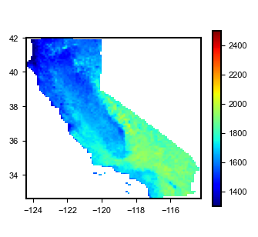
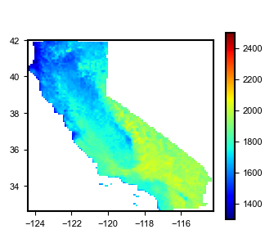

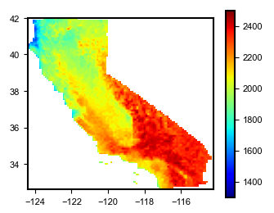
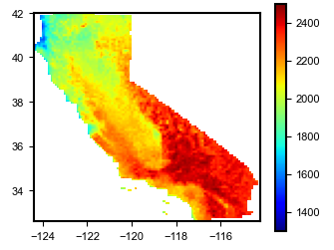
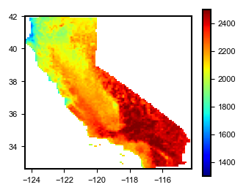
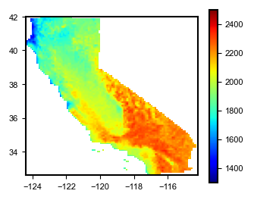
Annual generation of each configuration throughout California
Fixed winter tilt
Fixed latitude tilt
Fixed summer tilt
Point-by-point simulations using PVWATTS
NSRDB TMY irradiance
DC:AC ratio=1.3
mono-Si
bifaciality=0.7
1-axis tracking winter tilt
1-axis tracking latitude tilt
1-axis tracking summer tilt
1-axis tracking zero tilt

Slide 4
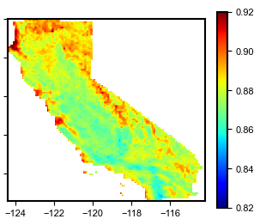
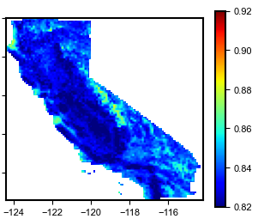
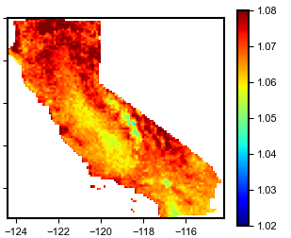
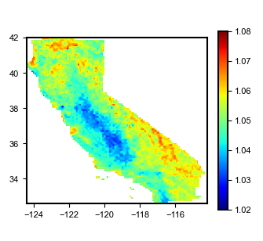
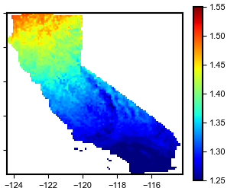
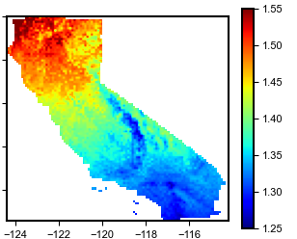
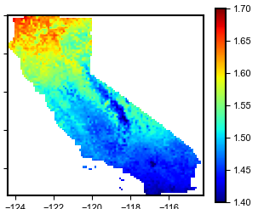
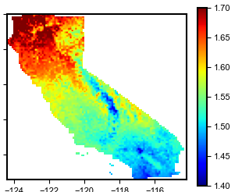








Comparing typical generation annually
Fixed
Tracking
$$\frac{\text{fixed} \text{latitude} \text{tilt}}{\text{1−}\text{axis} \text{zero} \text{tilt}}$$
$$\frac{\text{fixed} \text{winter} \text{tilt}}{\text{1−}\text{axis} \text{zero} \text{tilt}}$$
Compares the ratio of annual generation for different configurations, treating 1-axis tracking zero tilt as the baseline
Fixed latitude tilt generates 8% to 14% less annually compared to 1-axis zero tilt, fixed winter tilt generates 14% to 18% less
$$\frac{\text{1−}\text{axis} \text{latitude} \text{tilt}}{\text{1−}\text{axis} \text{zero} \text{tilt}}$$
$$\frac{\text{1−}\text{axis} \text{winter} \text{tilt}}{\text{1−}\text{axis} \text{zero} \text{tilt}}$$
Annual
Annual
Annual
Annual
$$\frac{\text{fixed} \text{latitude} \text{tilt}}{\text{1−}\text{axis} \text{zero} \text{tilt}}$$
$$\frac{\text{fixed} \text{winter} \text{tilt}}{\text{1−}\text{axis} \text{zero} \text{tilt}}$$
$$\frac{\text{1−}\text{axis} \text{latitude} \text{tilt}}{\text{1−}\text{axis} \text{zero} \text{tilt}}$$
$$\frac{\text{1−}\text{axis} \text{winter} \text{tilt}}{\text{1−}\text{axis} \text{zero} \text{tilt}}$$
December
December
December
December

Slide 5
Comparing typical generation annually
Fixed
Tracking
… but the deficit is due to tracking gain, not orientation
This compares the ratio of annual generation for the same orientations with tracking
Tracking latitude tilt generates 5% to 8% more annually compared to 1-axis zero tilt, tracking winter tilt generates 2% to 7% more
$$\frac{\text{fixed} \text{latitude} \text{tilt}}{\text{1−}\text{axis} \text{zero} \text{tilt}}$$
$$\frac{\text{fixed} \text{winter} \text{tilt}}{\text{1−}\text{axis} \text{zero} \text{tilt}}$$
$$\frac{\text{1−}\text{axis} \text{latitude} \text{tilt}}{\text{1−}\text{axis} \text{zero} \text{tilt}}$$
$$\frac{\text{1−}\text{axis} \text{winter} \text{tilt}}{\text{1−}\text{axis} \text{zero} \text{tilt}}$$
Annual
Annual
Annual
Annual
$$\frac{\text{fixed} \text{latitude} \text{tilt}}{\text{1−}\text{axis} \text{zero} \text{tilt}}$$
$$\frac{\text{fixed} \text{winter} \text{tilt}}{\text{1−}\text{axis} \text{zero} \text{tilt}}$$
$$\frac{\text{1−}\text{axis} \text{latitude} \text{tilt}}{\text{1−}\text{axis} \text{zero} \text{tilt}}$$
$$\frac{\text{1−}\text{axis} \text{winter} \text{tilt}}{\text{1−}\text{axis} \text{zero} \text{tilt}}$$
December
December
December
December

Slide 6
Comparing typical generation annually and in December
Fixed
Tracking
$$\frac{\text{fixed} \text{latitude} \text{tilt}}{\text{1−}\text{axis} \text{zero} \text{tilt}}$$
$$\frac{\text{fixed} \text{winter} \text{tilt}}{\text{1−}\text{axis} \text{zero} \text{tilt}}$$
$$\frac{\text{1−}\text{axis} \text{latitude} \text{tilt}}{\text{1−}\text{axis} \text{zero} \text{tilt}}$$
$$\frac{\text{1−}\text{axis} \text{winter} \text{tilt}}{\text{1−}\text{axis} \text{zero} \text{tilt}}$$
Annual
Annual
Annual
Annual
Focusing just on the month of December, when PV generation is least able to satisfy the load
Tracking latitude tilt generates 40% to 60% more annually compared to 1-axis zero tilt, tracking winter tilt generates 45% to 70% more
$$\frac{\text{fixed} \text{latitude} \text{tilt}}{\text{1−}\text{axis} \text{zero} \text{tilt}}$$
$$\frac{\text{fixed} \text{winter} \text{tilt}}{\text{1−}\text{axis} \text{zero} \text{tilt}}$$
$$\frac{\text{1−}\text{axis} \text{latitude} \text{tilt}}{\text{1−}\text{axis} \text{zero} \text{tilt}}$$
$$\frac{\text{1−}\text{axis} \text{winter} \text{tilt}}{\text{1−}\text{axis} \text{zero} \text{tilt}}$$
December
December
December
December

Slide 7
Comparing typical generation annually and in December
Fixed
Tracking
$$\frac{\text{fixed} \text{latitude} \text{tilt}}{\text{1−}\text{axis} \text{zero} \text{tilt}}$$
$$\frac{\text{fixed} \text{winter} \text{tilt}}{\text{1−}\text{axis} \text{zero} \text{tilt}}$$
$$\frac{\text{1−}\text{axis} \text{latitude} \text{tilt}}{\text{1−}\text{axis} \text{zero} \text{tilt}}$$
$$\frac{\text{1−}\text{axis} \text{winter} \text{tilt}}{\text{1−}\text{axis} \text{zero} \text{tilt}}$$
Annual
Annual
Annual
Annual
… and even without tracking gain, fixed latitude tilt in December generates 25% to 50% more, and fixed winter tilt generates 30% to 55% more
$$\frac{\text{fixed} \text{latitude} \text{tilt}}{\text{1−}\text{axis} \text{zero} \text{tilt}}$$
$$\frac{\text{fixed} \text{winter} \text{tilt}}{\text{1−}\text{axis} \text{zero} \text{tilt}}$$
$$\frac{\text{1−}\text{axis} \text{latitude} \text{tilt}}{\text{1−}\text{axis} \text{zero} \text{tilt}}$$
$$\frac{\text{1−}\text{axis} \text{winter} \text{tilt}}{\text{1−}\text{axis} \text{zero} \text{tilt}}$$
December
December
December
December

Slide 8
Comparing typical generation annually and in December
Fixed
Tracking
Compares typical generation for PV systems with latitude tilt or winter tilt compared to 1-axis zero tilt tracking systems
Simulated with PVWATTS version 7 and NSRDB TMY data
DC/AC ratio=1.3
Mono-Si module quality
bifciality=0.7
$$\frac{\text{fixed} \text{latitude} \text{tilt}}{\text{1−}\text{axis} \text{zero} \text{tilt}}$$
$$\frac{\text{fixed} \text{winter} \text{tilt}}{\text{1−}\text{axis} \text{zero} \text{tilt}}$$
$$\frac{\text{1−}\text{axis} \text{latitude} \text{tilt}}{\text{1−}\text{axis} \text{zero} \text{tilt}}$$
$$\frac{\text{1−}\text{axis} \text{winter} \text{tilt}}{\text{1−}\text{axis} \text{zero} \text{tilt}}$$
Annual
Annual
Annual
Annual
$$\frac{\text{fixed} \text{latitude} \text{tilt}}{\text{1−}\text{axis} \text{zero} \text{tilt}}$$
$$\frac{\text{fixed} \text{winter} \text{tilt}}{\text{1−}\text{axis} \text{zero} \text{tilt}}$$
$$\frac{\text{1−}\text{axis} \text{latitude} \text{tilt}}{\text{1−}\text{axis} \text{zero} \text{tilt}}$$
$$\frac{\text{1−}\text{axis} \text{winter} \text{tilt}}{\text{1−}\text{axis} \text{zero} \text{tilt}}$$
December
December
December
December

Slide 9
How well can PV generation temporally match the load?
Mahmoud Y. Abido, Kenji Shiraishi, Pedro Andrés Sánchez-Pérez, Russell K. Jones, Zabir Mahmud, Sergio Castellanos, Noah Kittner, Daniel M. Kammen, and Sarah R. Kurtz, “Seasonal Challenges for a Zero-Carbon Grid in California”, IEEE PVSC-49, 2020
Prior analysis showed that the challenge for a largely solar-powered grid is insufficiency of winter generation to satisfy the load
Drives a need for a lot of storage
Can the PV configuration be selected to better match the load and reduce the need for storage?

Slide 10
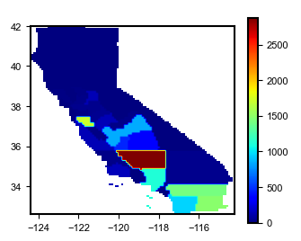
Simplified analysis framework using normalized statewide PV generation and load profiles
Solar capacity in California by county for 2019
Generation of each PV configuration was represented by a single statewide annual generation profile using 2019 NSRDB solar resource data
Statewide PV generation profiles were created by spatially averaging solar resources in each county and computing generation in each county using PVWATTS.
Countywide PV generation profiles were capacity-weighted to make a single statewide generation profile for each PV configuration
The load was represented by a single statewide load profile, from CAISO 2019 historical load data
Both the PV capacity and load are normalized:
PV capacity = 1 W_{DC}
Average load = 1W (load = 8760 Wh annually, in proportion to the California statewide load)
Effectively assumes future PV will be geographically distributed like it is today
Capacity-weighted latitude = 35.2°
2019 Capacity (MW)
Santa Clara
Fresno
Kings
Tulare
Kern
Los Angeles
Riverside
Imperial
Shorthand notation for PV configurations:
Tr0 = 1-axis tracking, zero tilt (horizontal)
TrL–15 = 1-axis tracking, summer tilt = latitude – 15°
TrL = 1-axis tracking, latitude tilt
TrL+15 = 1-axis tracking, winter tilt = latitude + 15°
San Diego
FxL–15 = fixed, summer tilt = latitude – 15°
FxL = fixed latitude tilt
FxL+15 = fixed winter tilt = latitude + 15°

Slide 11
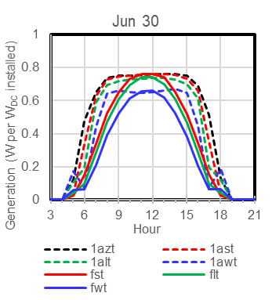
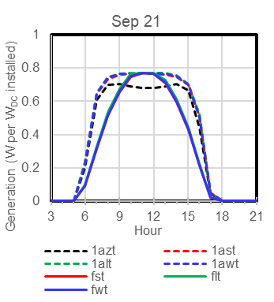
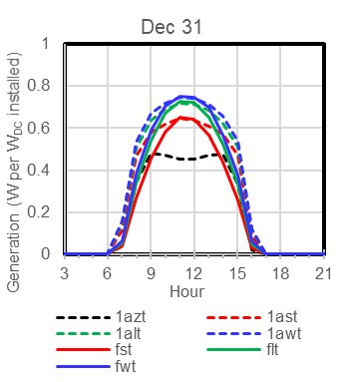
Daily solar generation for different collector configurations in summer, autumn, and winter
Legend
0°
L–15°
L
L+15°
Fixed
Tracking
Shows statewide profiles for selected clear-sky days (tracking provides almost no benefit on overcast days)
All configurations generate more energy in the summer because days are longer

Slide 12
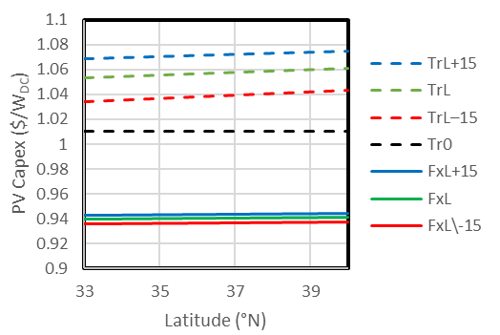
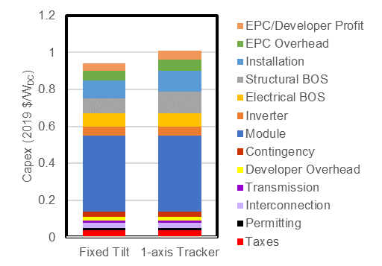
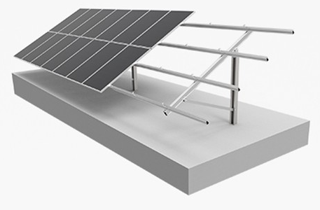
PV cost model (2019 costs)
Q1 2020 US benchmark utility-scale PV total cost,
2019 $/W_{DC}
Modeled cost of PV systems as a function of latitude
Capacity-weighted latitude
Cost estimates based on NREL benchmark (basis for the 2021 ATB)
Assumed only the structural BOS is affected by latitude, proportionally to sin(lat)
Fixed — 33% of structural BOS
Tracking — 66% of structural BOS
Land use cost is treated as O&M (lease cost)
Fixed tilt —
Single column pile mounting
1-axis tracking — summer tilt

Slide 13
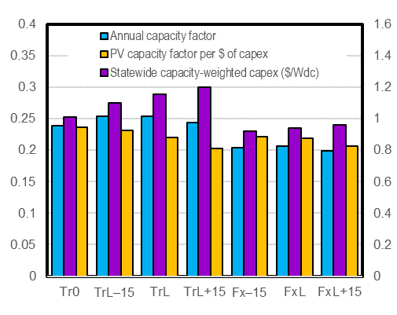
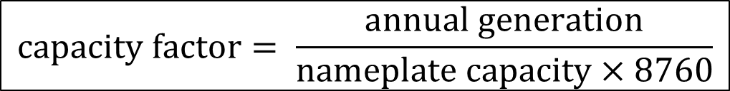
Statewide analysis of PV cost-effectiveness without regard to the timing of energy delivery
$$\text{capacity} \text{factor}= \frac{\text{annual} \text{generation}}{\text{nameplate} \text{capacity}×8760}$$
Capacity factor uses the conventional PV definition: “Nameplate capacity” = DC rating of modules at 1000 W/m², 25°C
Capacity factors were calculated from the statewide capacity-weighted PV generation profiles
Ratio of capacity factor / cost = “bang for the buck” and Tr0 is the clear winner if we want the cheapest electricity and don’t care when it’s generated

Slide 14
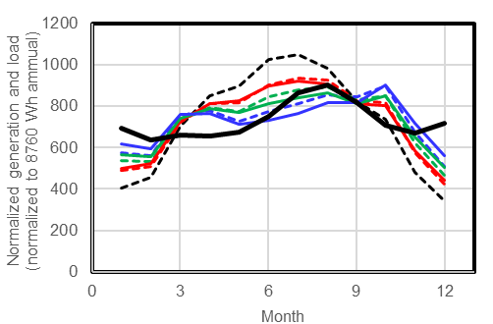
Monthly solar statewide generation profile versus the statewide load for 2019
Profiles normalized to an annual sum of 1
None of the generation profiles match the load very well but winter tilt matches the best
Normalized tracking vs fixed is lower in winter, higher in summer because winter is dominated by overcast days with little tracking gain
None of the profiles match the load at night!
Legend
0°
L–15°
L
L+15°
Fixed
Tracking

Slide 15
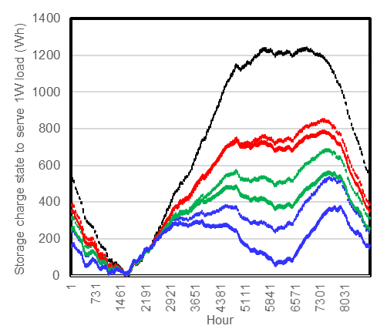
How much storage is required to serve the load?
Normalized energy balance
Statewide load is normalized to an average 1 Wh per h (8760 Wh per year)
Statewide PV generation is normalized to 1 W_{DC} PV nameplate capacity
PV capacity = (capacity factor)^{–1} exactly matches the annual load, by definition
But this is not enough because some of the generated energy is stored and used later with storage losses
Assumed: 80% RTE, 0.2%/day self-discharge
Minimum PV capacity and maximum storage when the energy balance has:
minimum charge state = 0
starting charge = ending charge
Zero energy curtailed
Winter tilt requires more PV capacity but a lot less storage compared to Tr0
Legend
0°
L–15°
L
L+15°
Fixed
Tracking

Slide 16
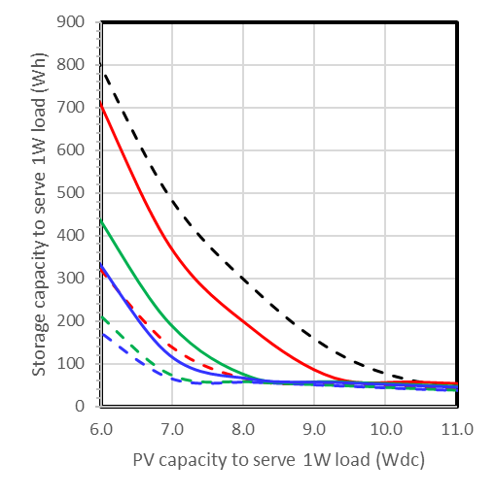
Adding PV capacity reduces required storage
Infinite generation would reduce storage required to whatever is the largest nighttime load in the year from sunset to sunrise
Winter tilt requires a lot less storage for the same capacity or conversely, a lot less capacity for the same storage
Legend
0°
L–15°
L
L+15°
Fixed
Tracking
10 days

Slide 17
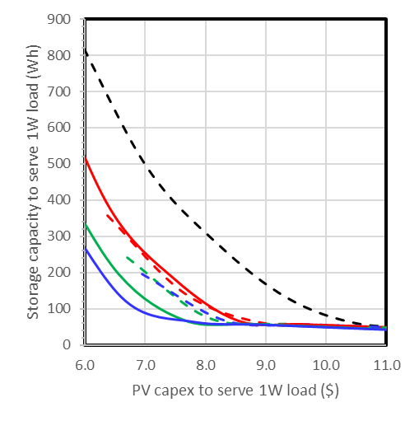


Better matching the load means a given storage limit can be achieved with reduced PV capex, reduced total cost
Reduction in PV capex more than offsets loss in capacity factor
Legend
0°
L–15°
L
L+15°
$$\frac{\text{capacity} \text{factor}\text{(}\text{Tr}\text{0)}}{\text{capacity} \text{factor}\text{(}\text{FxL}\text{+15)}}=1.2$$
Fixed
Tracking
$\frac{\text{PV} \text{capex} \text{for}\text{ 10 }\text{days} \text{storage}\text{(}\text{Tr}\text{0)}}{\text{PV} \text{capex} \text{for}\text{ 10 }\text{days} \text{storage}\text{(}\text{FxL}\text{+15)}}≈1.$4
1-axis winter tilt requires the least PV capacity to satisfy the load with a given amount of storage
But because fixed winter tilt capacity is cheaper, fixed winter tilt requires the least capex to satisfy the load with a given amount of storage
No matter what the cost of storage is, fixed winter tilt is the cheapest option to satisfy the load — despite being the least cost effective when the timing of energy delivery is ignored
10 days

Slide 18
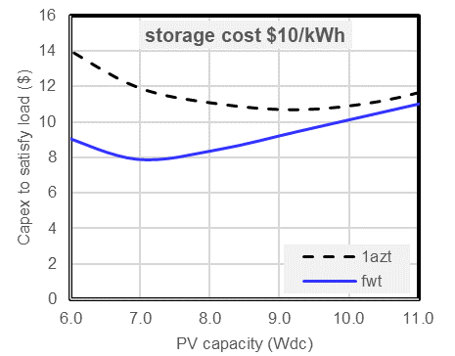
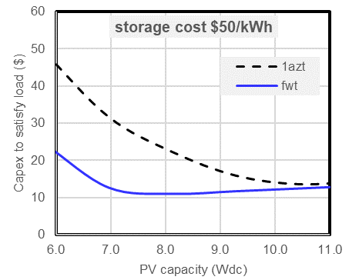
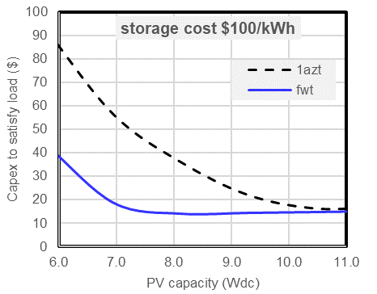
Total cost comparison
When storage is expensive, the lowest cost solution is to overbuild PV, and the total cost is dominated by storage cost … but lowest cost is achieved with less PV capacity for FxL+15 compared to Tr0
At $50/kWh storage cost, FxL+15 is ~10% cheaper and achieved with ~40% less PV capacity
At $10/kWh storage cost, FxL+15 is ~30% cheaper and achieved with ~30% less PV capacity
Storage must be <$0.01/kWh to make Tr0 cheaper than FxL+15!

Slide 19
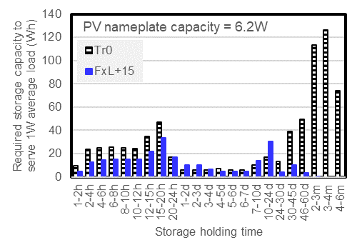
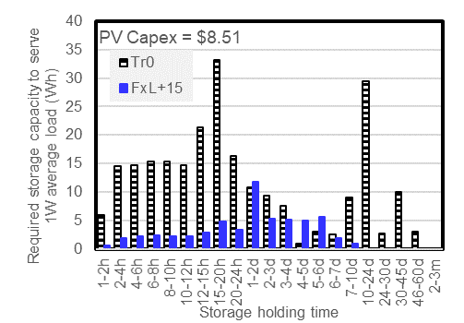
Comparison of storage holding time
Storage holding time can be interrogated by aggregating the generation and load over successively longer intervals and calculating the energy balance
Any imbalance over intervals shorter than the aggregation time is not seen
For each comparison above, the storage holding time is longer for Tr0 than for FxL+15 (even when both have the same total storage requirement)
Longer storage holding time = fewer cycles per year = higher cost per cycle to amortize the storage capital cost
Equal nameplate capacity
Equal capex

Slide 20
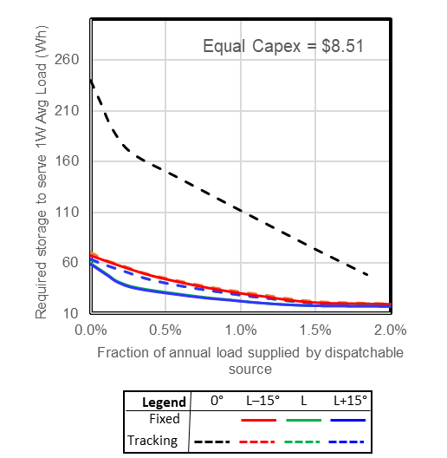
Reducing required storage with dispatchable energy source
Getting to a carbon-free grid with renewables + storage alone is hard to do
Storage need is heavily driven by brief (few days) episodes of very low renewable resource
This need can be reduced dramatically by the availability of dispatchable generation to supplement renewables during just those episodes
Could be natural gas, with or without CCS, or stored hydrogen from electrolysis
Once again, FxL offers a decisive advantage over Tr0 — serving the load with ≈ 1 day of storage and 1% of annual load supplied by a perfectly dispatched source

Slide 21
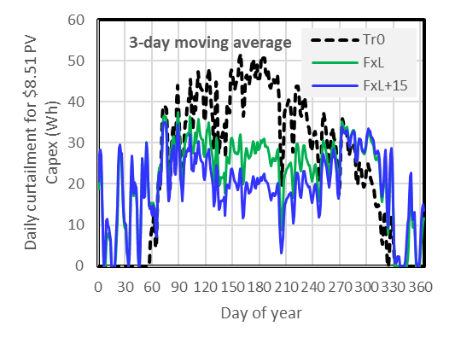
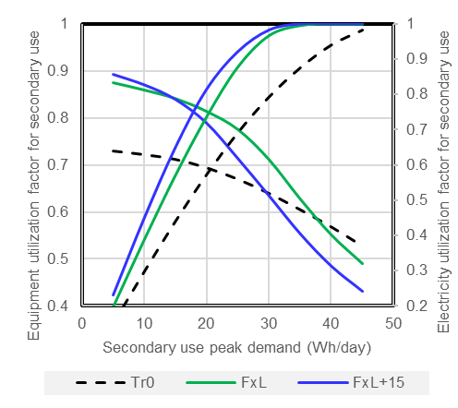



Curtailment and secondary use
Consider a secondary use for PV generation in excess of what’s required to satisfy the load
e.g., process heat, hydrogen electrolysis
The secondary use has a maximum capacity C to utilize the surplus electricity E_{d} (any more energy must be discarded)
FxL or FxL+15 can achieve quite high equipment and electricity utilization factor
Higher utilization factor = faster amortization of secondary use capital= lower levelized cost of secondary use
Higher electricity utilization factor = faster amortization of PV plant capital = lower levelized cost pf PV plant (if surplus electricity is otherwise considered lost)
$$U_{d}\text{ = }\text{utilization} \text{per} \text{day}=\left\{\begin{matrix}E_{d} \text{when} E_{d} <C \\ C \text{when} E_{d}≥C\end{matrix}\right.$$
$$\text{Equipment} \text{utilization} \text{factor}\text{ =}\frac{\sum_{d=1}^{365}{U_{d}}}{C×365}$$
$$\text{Electricity} \text{utilization} \text{factor}\text{ =}\frac{\sum_{d=1}^{365}{U_{d}}}{\sum_{d=1}^{365}{E_{d}}}$$
,

Slide 22
Incentivizing winter tilt PV plants
Winter tilt is superior to horizontal tilt by every measure except the one that every decision-maker uses … price per kWh without regard to timing of generation
What price differential for winter generation (9 Nov–1 Feb ) is required to incentivize PV plants to be built for winter generation? → 240%
This would be rational, considering the system benefits of winter generation
Parameter | Tr0 | FxL+15 | Δ
Capex ($ per W_{DC}) | $1.01 | $0.96
Annual generation (Wh per W_{DC}) | 2090 | 1814 | 15%
Winter generation (Wh per W_{DC}) | 257 | 316 | 23%
Base price per kWh (for example) | $0.025
Premium for winter delivery | 240%
Annual revenue/$ Capex | $0.067 | $0.067 | 0

Slide 23
Conclusions
The analyses presented use several key simplifying assumptions (including but not limited to):
Considers PV generation and load in isolation, whereas the real grid has other generators (wind, biomass, hydro, “clean firm energy”, etc.) all with their own generation profiles
Compares cases for all PV generation of the same flavor
Collapses the geographic diversity of generation and load to a single statewide pool
… but the results clearly suggest the potential to improve the grid design with more renewables more affordably
…and more generally, should alert us to the possibility that judicious selection of renewable sources (e.g., winter-dominant and night-dominant wind plant locations) can engineer out a lot of required storage
This is apparently not widely recognized today, and could be a significant contribution from our team
Next step: incorporate PV orientation options in Resolve and Switch

