Slide 1
How to model lithium batteries
Sept 28, 2021

Slide 2
Overview
Energy- vs power-related costs
This ratio is primary determinant of “long-” vs “short-duration” storage
O&M costs
Primary cost may be replacing batteries from decreased capacity with aging
Is this the best strategy?
Efficiency
Sensitivity analysis?

Slide 3
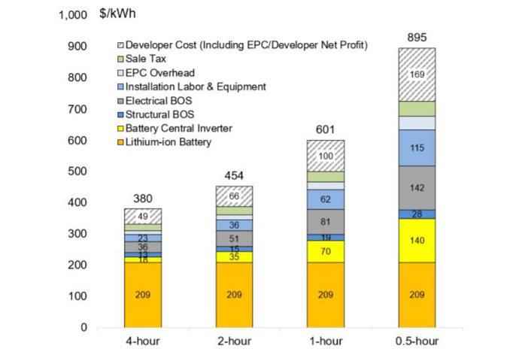
Analysis differentiates cost origins
This suggests that we are MUCH better off installing 1 four-hour battery rather than 8 half-hour batteries
The half-hour batteries could be charged or discharged more rapidly, but if the goal is long duration storage…
https://www.nrel.gov/docs/fy19osti/71714.pdf

Slide 4
Trends
Source | Year | Power cost (upfront in $/kW or annualized in $/kW/y) | Energy cost (upfront or annualized) | Ratio of $/kWh to $/kW
R. Fu, et al (see Fig. 2.3) | 2018 | 294 $/kW | 307 $/kWh | 1.04
NREL 2020 ATB | 2018 | 292 $/kW | 317 $/kWh | 1.15
NREL 2020 ATB | 2020 | 260 $/kW | 299 $/kWh | 1.15
NREL 2020 ATB | 2030 | 146 $/kW | 168 $/kWh | 1.15
RESOLVE 2018 RSP | 2020 | 23 $/kW/y | 42 $/kWh/y | 1.8
RESOLVE 2018 RSP | 2030 | 10.3 $/kW/y | 20 $/kWh/y | 1.9
SB100 study | 2030 | 162 $/kW | 224 $/kWh | 1.38
NREL 2021 ATB (utility scale) | 2020 | 257 $/kW | 277 $/kWh | 1.08
NREL 2021 ATB (utility scale - moderate) | 2030 | 197 $/kW | 147 $/kWh | 0.75
NREL 2021 ATB (commercial- moderate) | 2020 | 444 $/kW* | $236 $/kWh* | 0.53
NREL 2021 ATB (commercial- moderate) | 2030 | 324 $/kW** | $108 $/kWh** | 0.33
2021 PSP | 2022 | 19.8 $/kW/y | 24.5 $/kWh/y | 1.23
2021 PSP | 2030 | 14.2 $/kW/y | 13.7 $/kWh/y | 0.96

Slide 5
Trend: lithium ion is looking more like LDES
Ratio of $/kWh to $/kW have been decreasing
Compare E3 projections for 2030:
2018 RSP: 1.9
SB100: 1.38
2021 PSP: 0.96
When the projected ratio varies into the future it decreases
As Li-ion costs for $/kWh drop, is it looking more like LDES?
Experience of solar industry was similar: project costs were relatively small, then module prices dropped, then other costs needed to drop
Other prices are more dependent on project size, etc. Different learning curve

Slide 6
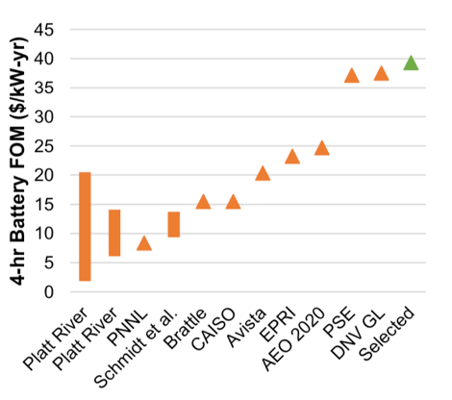
O&M costs: ATB uses 2.5% of capital cost
Better to replace or overbuild in the first place?
Large variability
ATB reports it as $/kW, but RESOLVE/SWITCH should use both $/kW and $/kWh

Slide 7
CAISO battery data

Slide 8
Discharge-to-charge ratio estimates efficiency

Slide 9
Average value is about 80%
Thank you to Yi Hao, Socheata and others. Note: 2021 data are cleaner

Slide 10
Efficiency
RSP assumed 85% (92.2% for charge and discharge) for Li-Batteries
What does SWITCH assume?
Shall we use 80%? - Yes

Slide 11
Sensitivity
Can we use only one model and then reference everything to it?
Could report in absolute terms or might report in fraction of Li-battery cost (for same duration)
May need to revisit the question of the sensitivity analysis

