Slide 1
Summary of Pumped hydropower
September 2021

Slide 2
Documented projects – are there more?
Project name | Company | Location | Capacity (MW) | Planned start | Notes
Cat Creek Energy and Water Storage | Cat Creek Energy | Idaho | 720 | 2028 | 110 MW wind; 150 MW solar
Eagle Mountain | Eagle Crest Energy | Desert Center (Southern California) | 1300 (up to 18 h) | 2028 | Closed loop
Mokelumne Water Battery | GreenGenStorage | Calaveras County (Central California) | 250-800 (8-10 h) | 2027 | Closed loop
Swan Lake | Rye Development | Oregon | 393 | 2026 | Closed loop
Goldendale | Rye Development | Washington | 1200 | 2028 | Closed loop
San Vicente | San Diego County Water Authority | San Diego | 500 (8 h) | 2030 | Closed loop

Slide 3
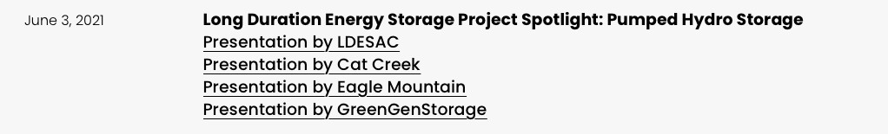
Webinar June 3, 2021
https://www.storeenergyca.org/news/#webinars

Slide 4
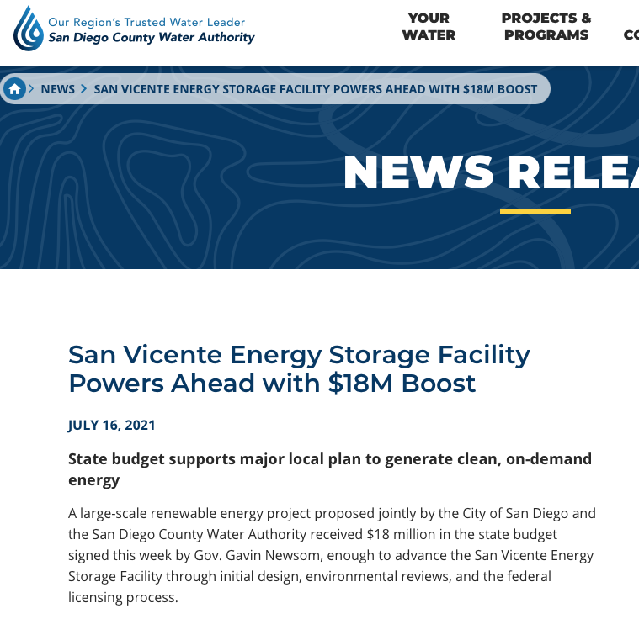
San Vicente
https://www.sdcwa.org/san-vicente-energy-storage-facility-powers-ahead-with-18m-boost/

Slide 5
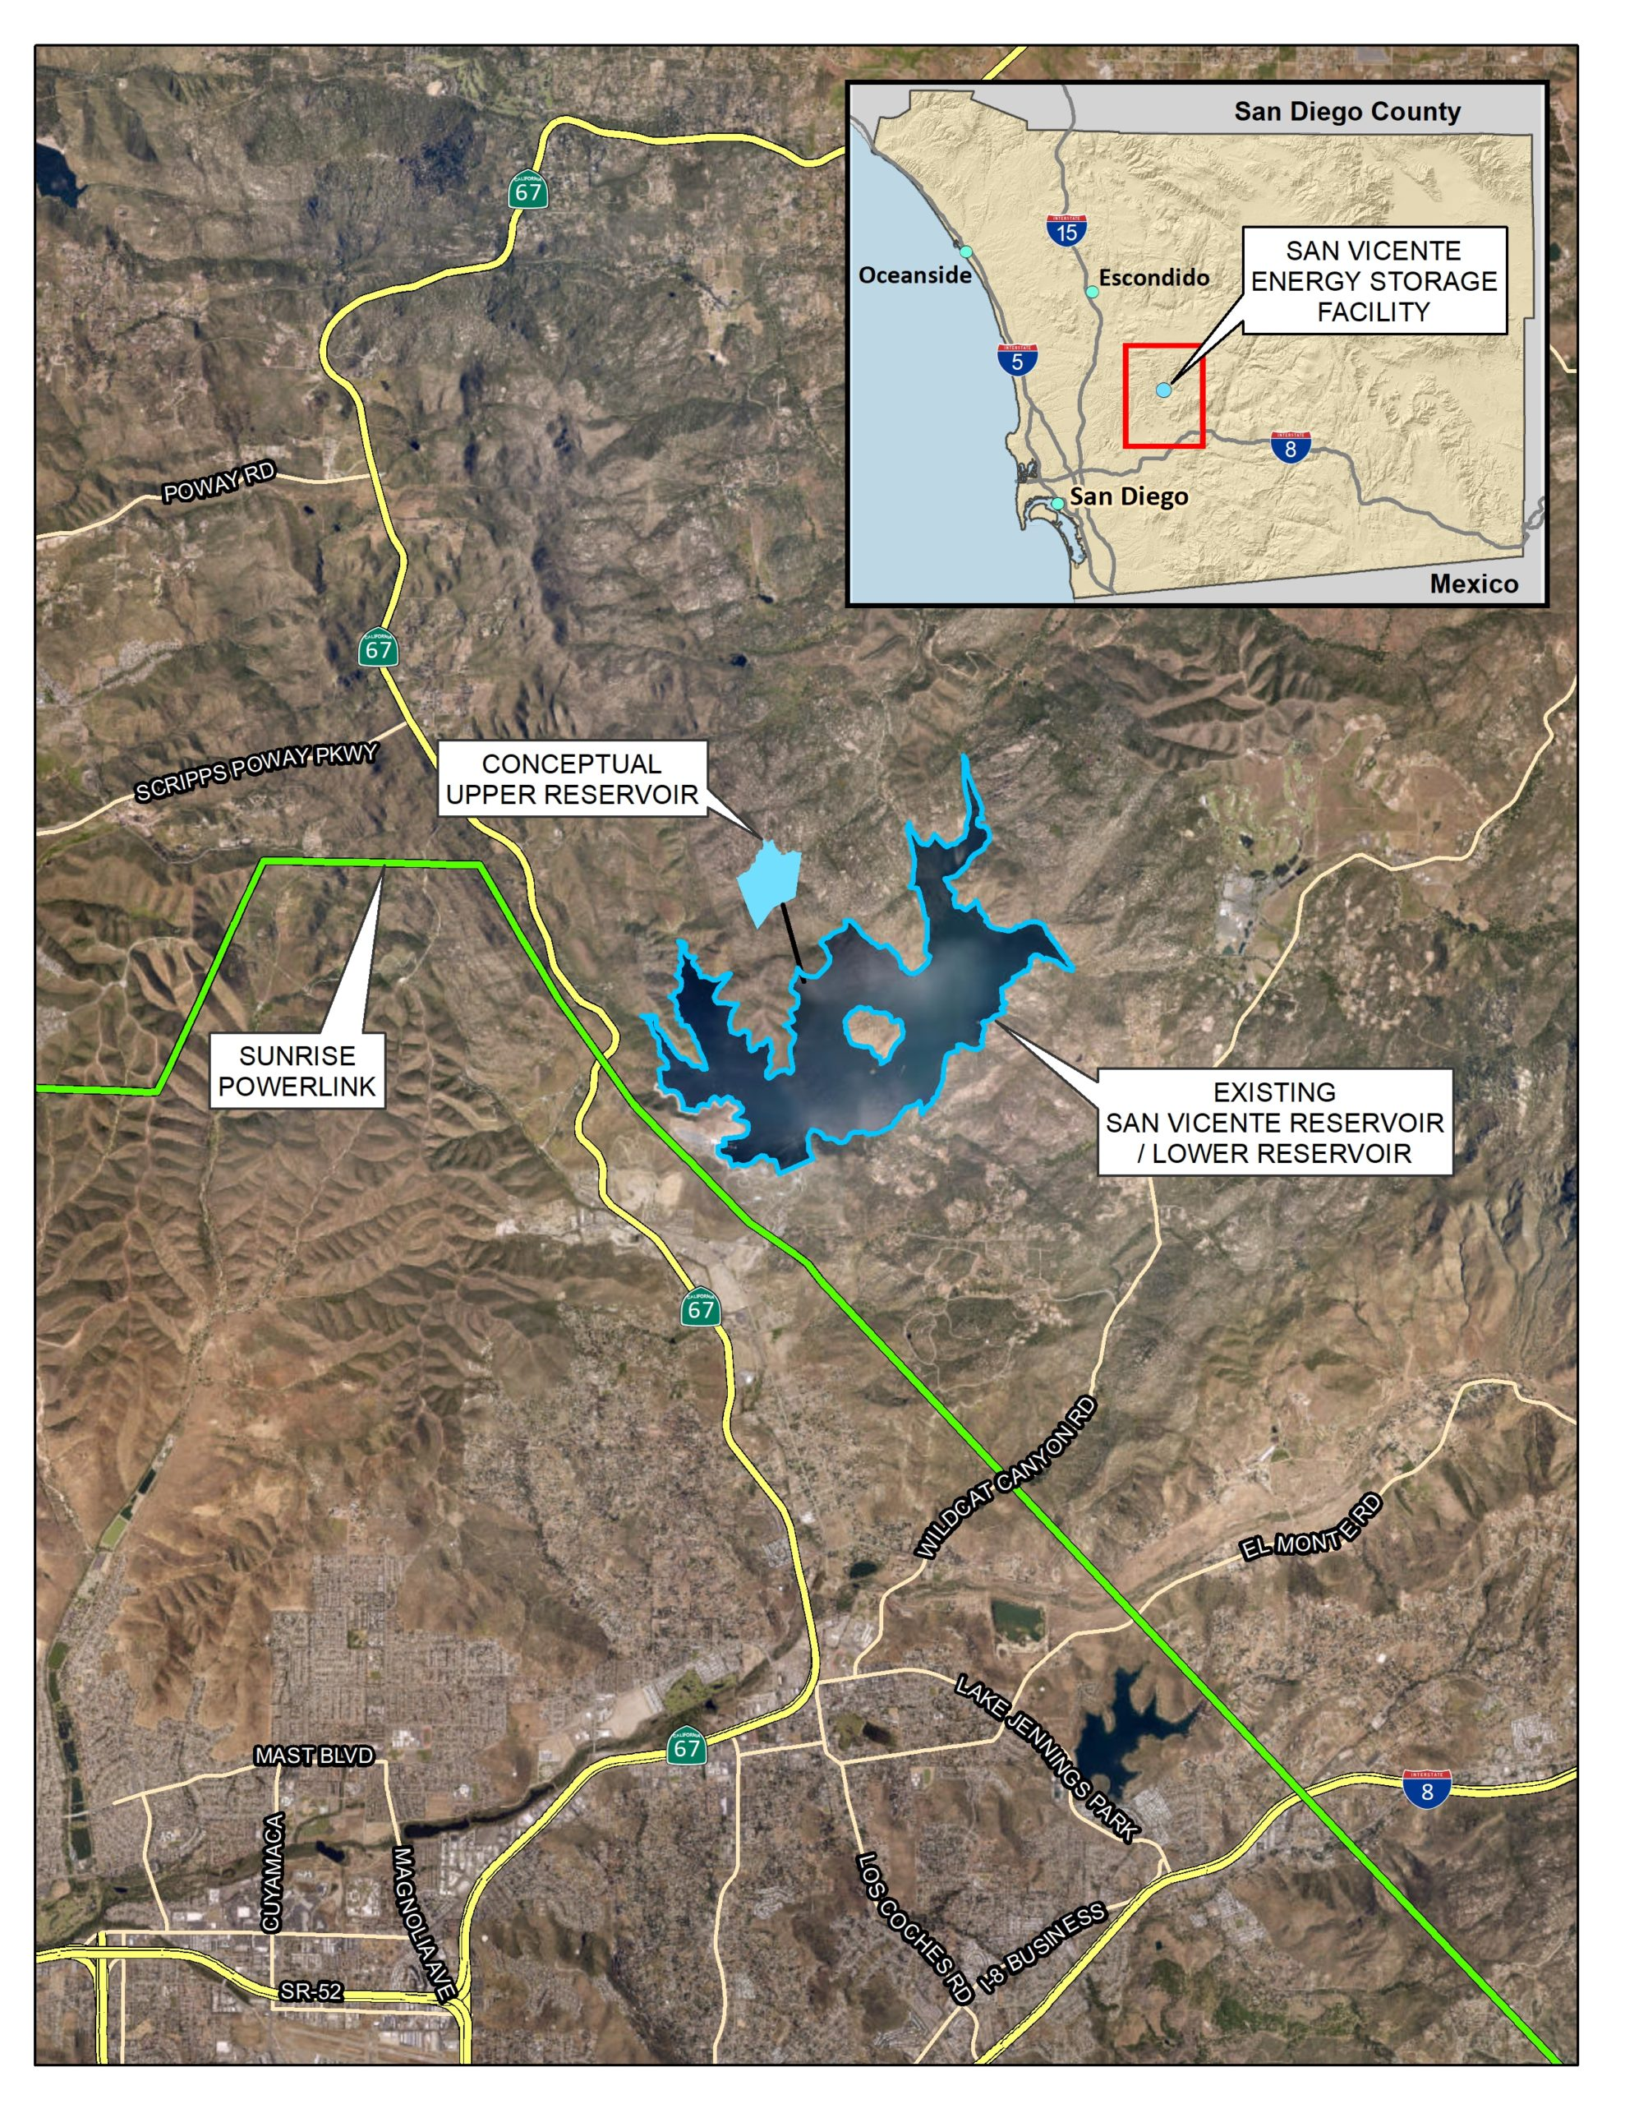
San Vicente
https://www.sdcwa.org/projects/san-vicente-pumping-facilities/
4000 MWh
500 MW for 8 h

Slide 6
How to model
Pumped hydro projects are lowest cost in the long run (100 y), but are often high cost in the short term
Pumped hydro projects are more likely to be completed with some political support
Are these projects “selected” because of lowest cost or because of public decision?
Should we ask the model to select them, or put them in as planned builds as scenarios?

Slide 7
Add all of these as a high-PHS scenario?
Project name | Company | Location | Capacity (MW) | Planned start | Notes
Cat Creek Energy and Water Storage | Cat Creek Energy | Idaho | 720 | 2028 | 110 MW wind; 150 MW solar
Eagle Mountain | Eagle Crest Energy | Desert Center (Southern California) | 1300 (up to 18 h) | 2028 | Closed loop
Mokelumne Water Battery | GreenGenStorage | Calaveras County (Central California) | 250-800 (8-10 h) | 2027 | Closed loop
Swan Lake | Rye Development | Oregon | 393 | 2026 | Closed loop
Goldendale | Rye Development | Washington | 1200 | 2028 | Closed loop
San Vicente | San Diego County Water Authority | San Diego | 500 (8 h) | 2030 | Closed loop

Slide 8
Conclusions from discussion
Baseline scenario should include all pumped hydro projects as planned builds using the advertised size
A sensitivity analysis will cut them out to define how much more other storage would be needed if they can’t be built
We anticipate that these will first be included in the 2030 period
We will use whatever costs they have suggested without too much concern for whether these are correct
We should ask the companies what the plan is for connection into the transmission grid

