Slide 1
Impact of Solar Orientation on the Need for Storage in the Grid
Russ Jones
10 September 2021

Slide 2
Motivation
All scenarios we’ve studied for the future zero-carbon grid show the lack of winter generation drives the need for storage, and particularly interseasonal storage
It’s well-known (to those who know it well!) that PV tilt angle can modify the annual generation profile
Can we make it match the load better to reduce the storage requirement?
Mahmoud Y. Abidoa, Kenji Shiraishi, Pedro Andrés Sánchez-Pérez, Russell K. Jones, Zabir Mahmud, Sergio Castellanos, Noah Kittner, Daniel M. Kammen, and Sarah R. Kurtz, “Seasonal Challenges for a Zero-Carbon Grid in California”, IEEE PVSC-48, June 2020

Slide 3
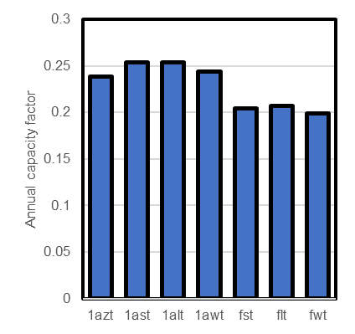
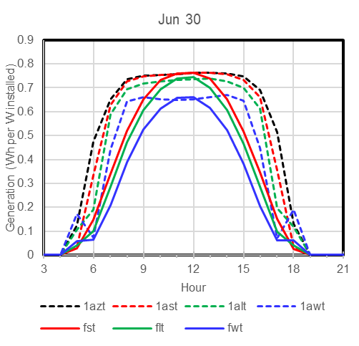
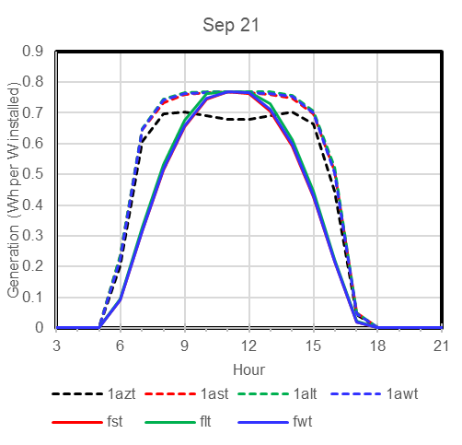
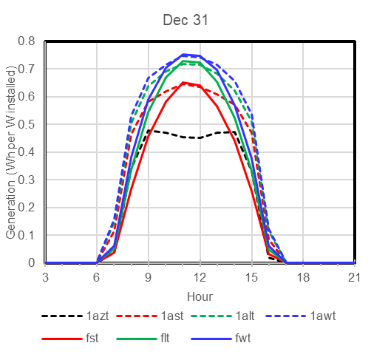
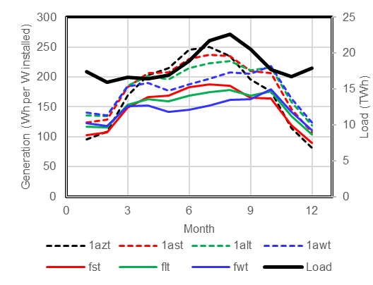
Tilt and Tracking Effects on Generation Profile
Tracking increases the generation each day (capacity factor)
Tilting affects the seasonal generation
Configurations:
1azt 1-axis tracking with zero tilt (horizontal)
1ast 1-axis tracking with summer tilt (latitude – 15°)
1alt 1-axis tracking with latitude tilt
1awt 1-axis tracking with winter tilt (latitude + 15°)
fst fixed summer tilt (latitude – 15°)
flt fixed latitude tilt
fwt fixed winter tilt (latitude + 15°)
Monthly aggregated

Slide 4
Cost Model — Overnight Cost
Cost benchmark basis for ATB costs
Land cost $0/W
All land cost is accounted as opex (lease)
Structural BOS
$0.08/W for flt
$0.12/W for 1azt
ref: David Feldman, Vignesh Ramasamy, Ran Fu, Ashwin Ramdas, Jal Desai, and Robert Margolis, U.S. Solar Photovoltaic System and Energy Storage Cost Benchmark: Q1 2020, NREL/TP-6A20-77324.

Slide 5
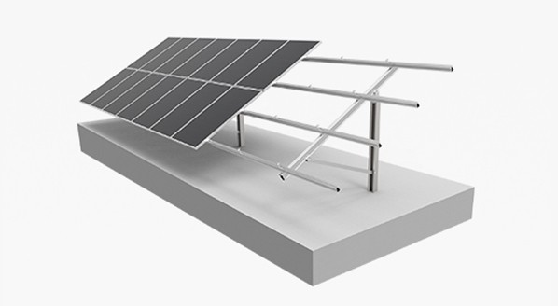
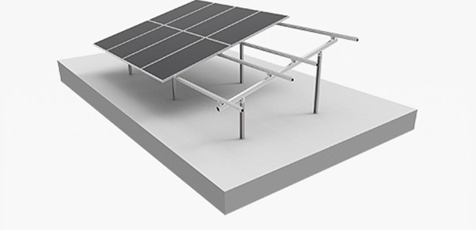
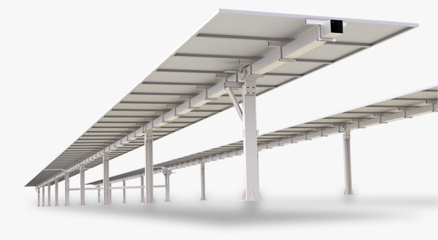

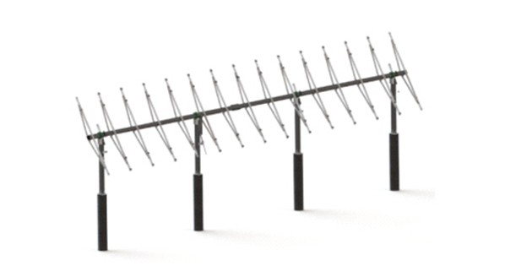
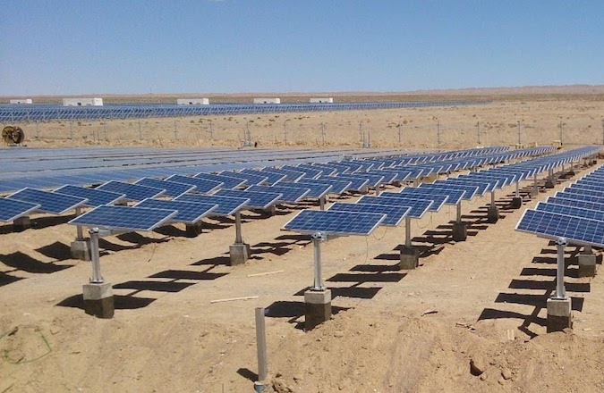
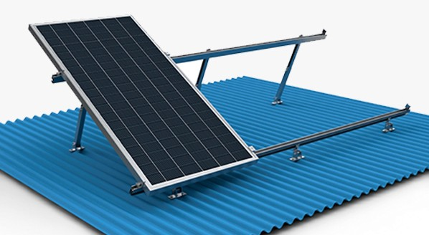
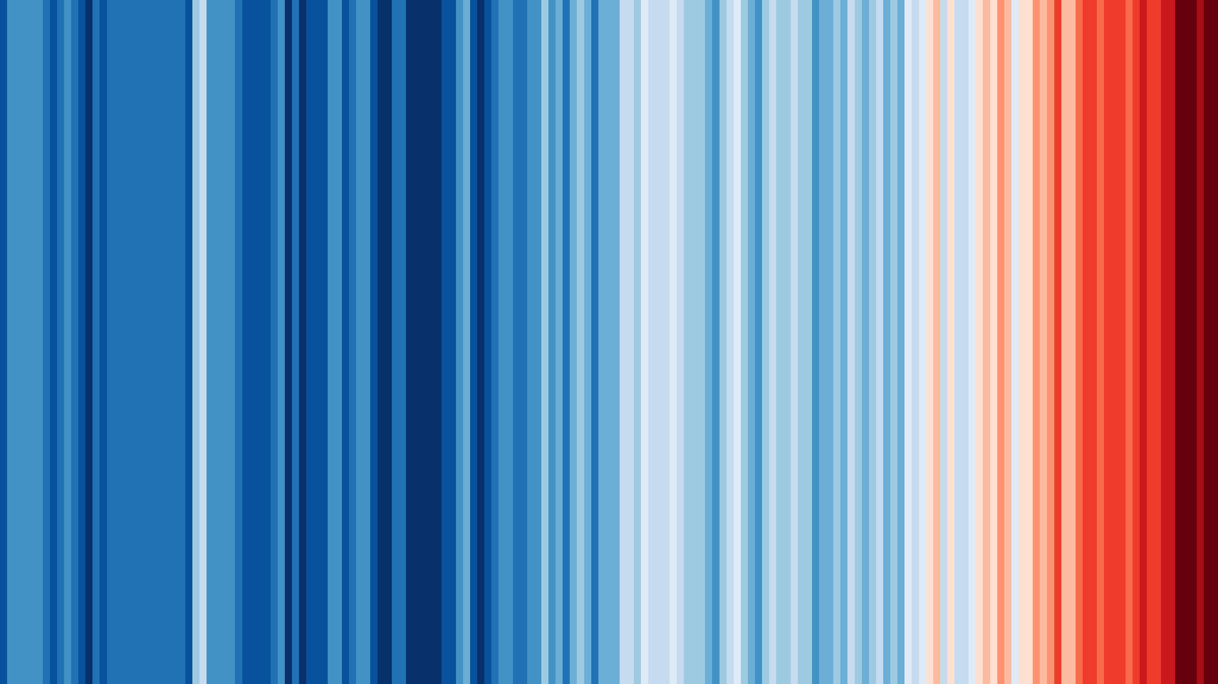

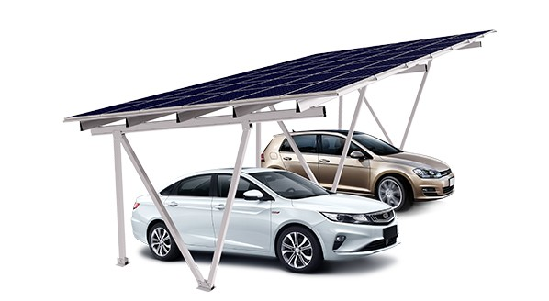
Some examples of structural BOS
Single column pile mounting
Double column pile mounting
Double row linkage single axis horizontal tracking
Multi-linkage single axis tilted tracking
Adjustable tilt mounting
Adjustable tilt roof mounting
Multi-linkage single axis horizontal trackers with tilted modules
http://www.gracesolar.com/product/show-124.html
Azimuth tracking
Car port mounting
Fixed
Tracking

Slide 6
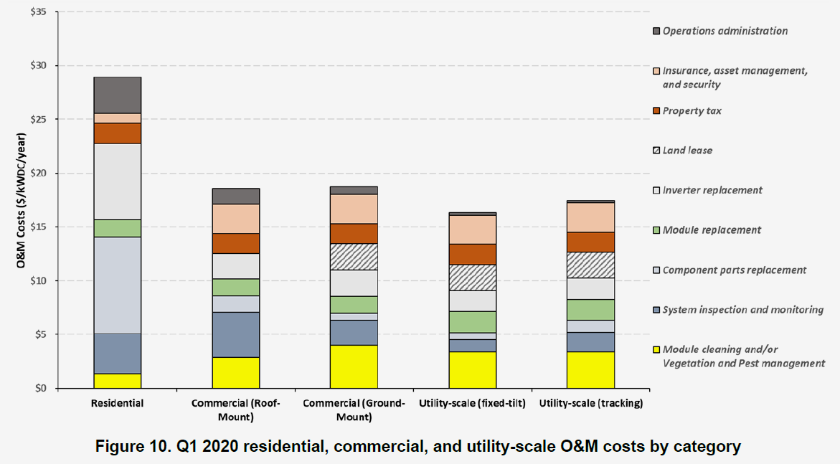
Cost Model — O&M Cost
Assumed directly proportional to land area
Questionable whether opex must include both property tax and lease cost
Assumed50% of this element is directly proportional to land area
ref: David Feldman, Vignesh Ramasamy, Ran Fu, Ashwin Ramdas, Jal Desai, and Robert Margolis, U.S. Solar Photovoltaic System and Energy Storage Cost Benchmark: Q1 2020, NREL/TP-6A20-77324.

Slide 7
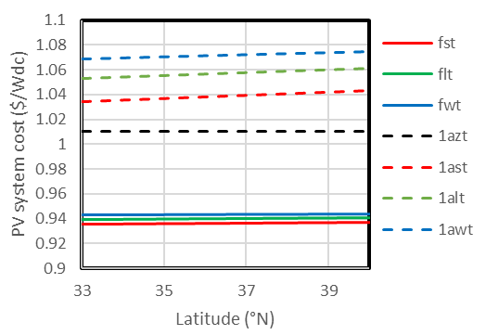
Cost model – Capex vs latitude
L
L sin θ
θ
Capex model assumes
  The tilt-dependent part of structural BOS cost varies with sin θ
  33% of structural BOS is tilt-dependent for fixed tilt systems
  66% of structural BOS is tilt-dependent for tracking systems
  All other PV capex costs remain the same

Slide 8
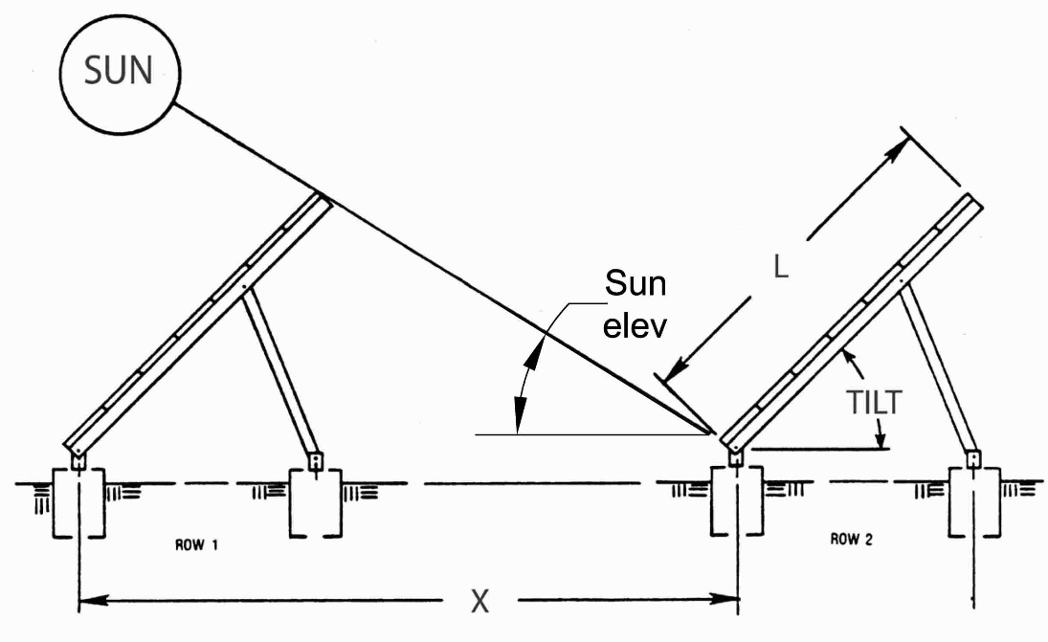
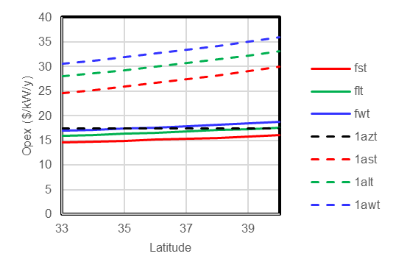
Cost model — Opex
Assumes row-to-row spacing (in the north-south direction) is per criteria given by the Arizona Solar Center
  https://azsolarcenter.org/pv-row-to-row-spacing
Resulting land use directly scales the cost of property tax and land lease, and partially scales cost of cleaning and vegetation/pest management
Tilted tracking greatly increases land use because spacine both north-south and east-west is necessary

Slide 9
Backup

Slide 10
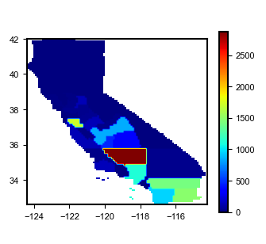
Capacity-weighted solar resources
2019 Capacity (MW)
Santa Clara
NSRDB gridded solar resource files were aggregated by county to produce 58 county solar resource files, at geographic centroid of the county
CEC data on total solar installations by county was used to produce a capacity-weighted average latitude for solar plants in California
  https://ww2.energy.ca.gov/almanac/renewables_data/solar/index_cms.php
pvwatts used to calculate generation profiles for each county and each PV configuration
CEC county data was used to produce calacity-weighted statewide profiles for each PV configuration
Fresno
Kings
Tulare
Kern
Los Angeles
Riverside
Imperial
San Diego
Fig. 1. Solar generation in California by county for 2019.

Slide 11
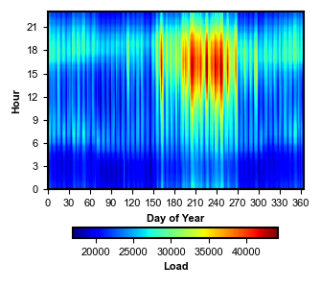
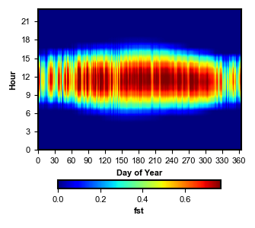
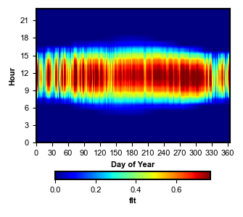
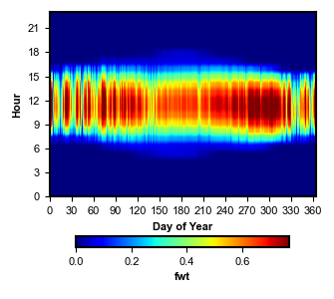
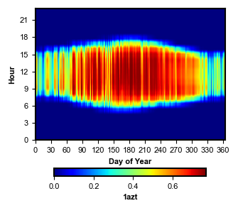
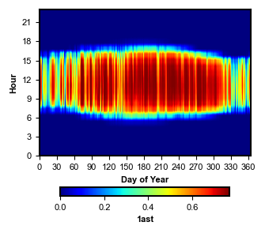

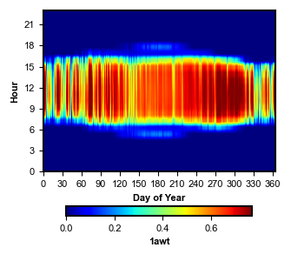
Heat map of load compared to the PV generator configurations

Slide 12
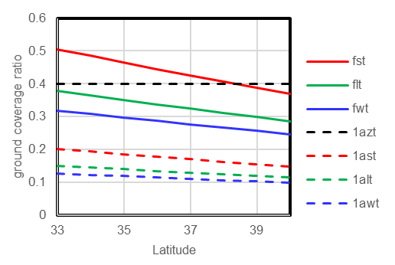
Cround coverage ratio is strongly impacted by tilt, especially for tracking systems
Increasing tilt increases the required inter-row (north-south) spacing to avoid shading at noon in mid-winter
Tilted trackers also require inter-row spacing for the same reason, and also require intra-sow spacing for east-west tracking

