Slide 1
Financial Concepts
Russ Jones
27 August 2019

Slide 2
Topics
Compound interest
Compound annual growth rate (CAGR)
Loan amortization
Net present value (NPV)
Discount rate
Return on Investment (ROI) or internal rate of return (IRR)
Payback interval (simple and discounted)
Leverage
Levelized Cost of Energy (LCOE)
Corporations and special purpose entities
Debt service coverage ratio (DSCR)

Slide 3
Compound interest
Excel example
General formula: “time value of money”
FV = PV (1 + i) ^{n} compounding
PV = FV / (1 + i) ^{n} discounting
PV = present value
FV = future value
i = periodic interest
n = number of periods

Slide 4
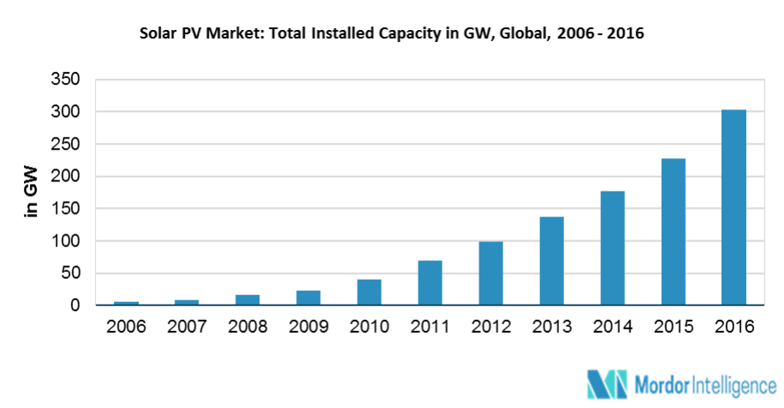
Compound annual growth rate (CAGR)
CAGR is used to describe the growth rate in market size, sales, etc
It is a simple application of the compound interest formula, solving for i
Example: Given this figure — what is the CAGR from 2010 to 2016 ?

Slide 5


Compound annual growth rate (CAGR)
CAGR is used to describe the growth rate in market size, sales, etc
It is a simple application of the compound interest formula, solving for i
Example: Given this figure — what is the CAGR from 2010 to 2016 ?
$${\left(\frac{300}{40}\right)}^{\frac{1}{6}}−1=39.9\%$$
$$300=40{\left(1+i\right)}^{6}$$
solve for i …

Slide 6
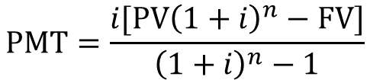
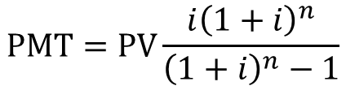
Loan amortization
What is Amortization?
Amortization is an accounting technique used to periodically lower the book value of a loan over a set period of time through regular principal and interest payments over time. An amortization schedule is used to reduce the current balance on a loan, for example a mortgage or car loan, through installment payments.
Amortization formula:
https://www.investopedia.com/terms/a/amortization.asp
https://financeformulas.net/Loan_Balloon_Balance.html
Excel example
$$\text{PMT}=\frac{i[\text{PV}{\left(1+i\right)}^{n}−\text{FV}]}{{\left(1+i\right)}^{n}−1}$$
PMT = periodic payment
PV = initial loan amount
FV = future value or “balloon payment”
n = number of payments
i = periodic interest rate
with “balloon payment”
$$\text{PMT}=\text{PV}\frac{i{\left(1+i\right)}^{n}}{{\left(1+i\right)}^{n}−1}$$
without “balloon payment”

Slide 7

Net present value (NPV)
Net present value (NPV) is the difference between the present value of cash inflows and the present value of cash outflows over a period of time. NPV is used in capital budgeting and investment planning to analyze the profitability of a projected investment or project.
The following formula is used to calculate NPV:
FV_{j} = net cash flow (cash in – net cash out) during a single period j
d = Discount rate or return that could be earned in alternative investments
n = number of periods analyzed​
$$\text{NPV}= \sum_{j=1}^{n}{\frac{{\text{FV}}_{j}}{{\left(1+d\right)}^{j}}}$$

Slide 8
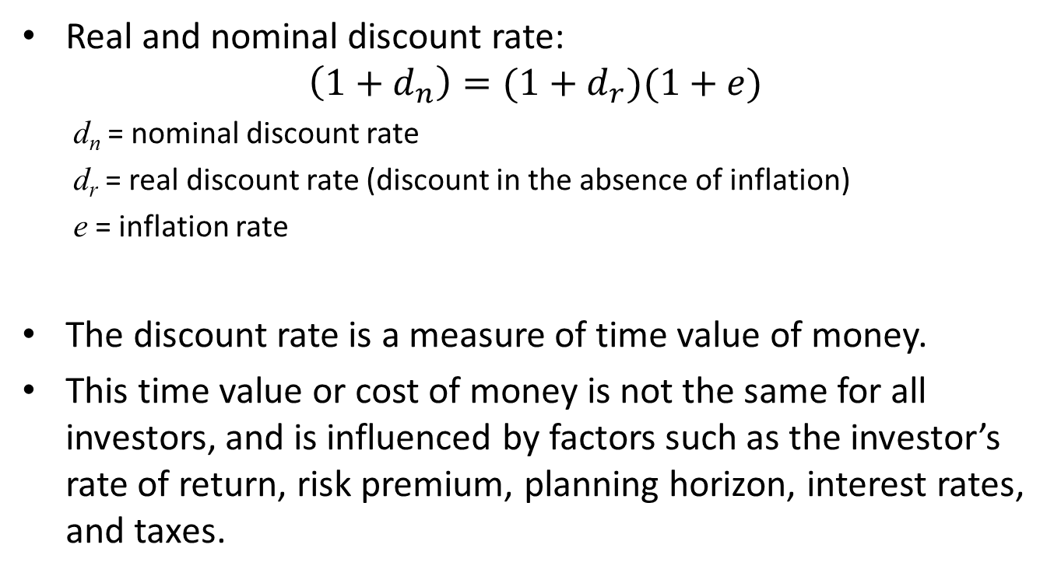
Discount Rate
Real and nominal discount rate:
$$\left(1+d_{n}\right)=(1+d_{r})(1+e)$$
d_{n} = nominal discount rate
d_{r} = real discount rate (discount in the absence of inflation)
e = inflation rate
The discount rate is a measure of time value of money.
This time value or cost of money is not the same for all investors, and is influenced by factors such as the investor’s rate of return, risk premium, planning horizon, interest rates, and taxes.

Slide 9
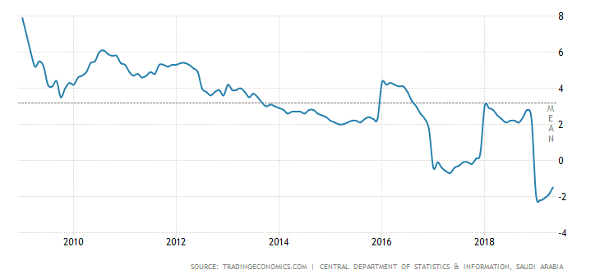
Discount Rate for Government
The US Federal Government uses a real discount rate of 3.0% for energy projects¹
Historical inflation rate trend
Ref: NISTIR 85-3273-27, Energy Price Indices and Discount Factors for Life-Cycle Cost Analysis –2012 Annual Supplement to NIST Handbook 135 and NBS Special Publication 709, http://dx.doi.org/10.6028/NIST.IR.85-3273-27

Slide 10
Discount Rate for Companies
For a company, the discount rate should be the opportunity cost of capital = the rate of return on the best alternative investment available.
Unfortunately, this is not easily determined.
A good estimate is the Weighted Average Cost of Capital (WACC)
The average cost of capital to U.S. industry from 1976 to 1989 (based on historical returns to equity investors and after-tax interest paid on debt) is approximately 7% real (before taxes)
Walter Short, Daniel J. Packey, and Thomas Holt, A Manual for the Economic Evaluation of Energy Efficiency and Renewable Energy Technologies, NREL Report, 1995

Slide 11
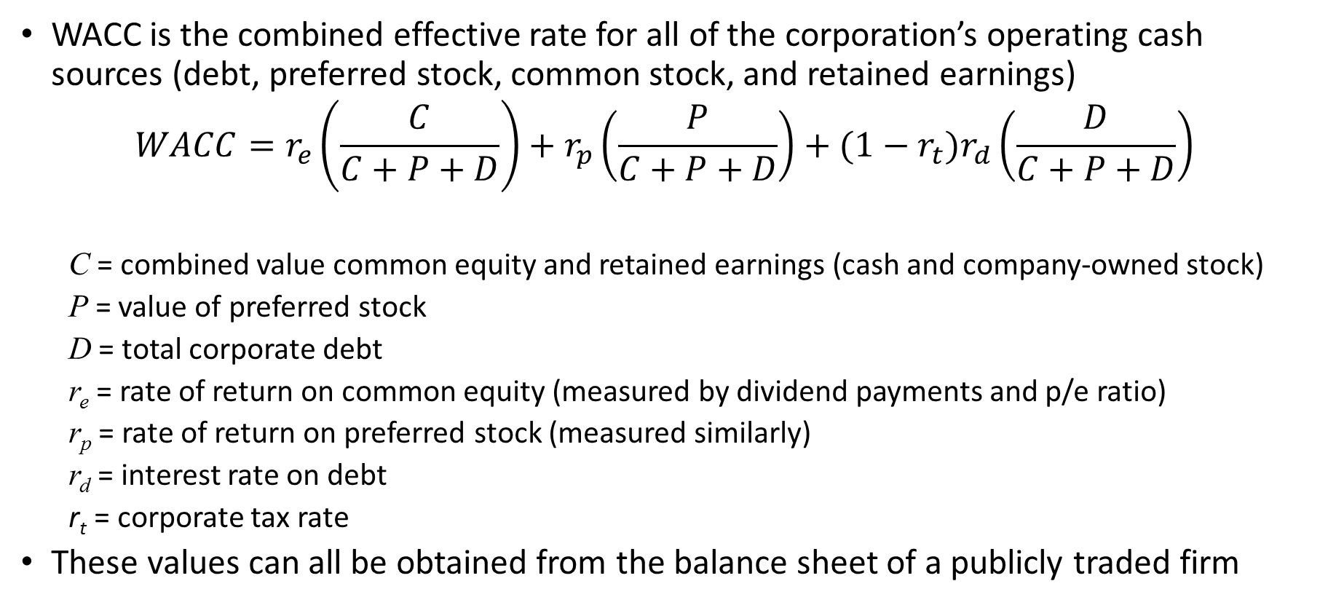
Weighted Average Cost of Capital (WACC)
WACC is the combined effective rate for all of the corporation’s operating cash sources (debt, preferred stock, common stock, and retained earnings)
$$WACC=r_{e}\left(\frac{C}{C+P+D}\right)+r_{p}\left(\frac{P}{C+P+D}\right)+(1−r_{t})r_{d}\left(\frac{D}{C+P+D}\right)$$
C = combined value common equity and retained earnings (cash and company-owned stock)
P = value of preferred stock
D = total corporate debt
r_{e} = rate of return on common equity (measured by dividend payments and p/e ratio)
r_{p} = rate of return on preferred stock (measured similarly)
r_{d} = interest rate on debt
r_{t} = corporate tax rate
These values can all be obtained from the balance sheet of a publicly traded firm

Slide 12
Some example WACCs (circa 2015)
This website has an online calculator to calculate weighted average cost of capital (WACC) for any corporation traded on the US exchanges: http://thatswacc.com/
Here are the WACCs for a few interesting corporations:
First Solar 17%
Sunpower 25%
Boeing 10.0%
Google 10.9%
Consolidated Edison 3.2%
Duke Energy 3.5%
Citigroup 6.2%
Bank of America 11.3%
Goldman Sachs 3.9%
JP Morgan Chase 5.3%
Solar companies
Large, financially strong companies
Regulated utilities
Large financial institutions

Slide 13
Return on Investment
Simply put: Return on investment is the discount rate for which NPV = 0
Return on investment (ROI) is also called Internal rate of return (IRR)
There is no closed form formula to calculate it — must be solved by iteration
Excel example

Slide 14
Payback interval (simple and discounted)
Simple payback interval:
How many years does it take for the sum of the returns (revenues and/ savings) to equal the initial investment?
Discounted payback interval:
How many years does it take for the sum of the discounted returns (revenues and/ savings) to equal the initial investment?

Slide 15
Leverage
In finance, “leverage” means “making money on someone else’s money”
Simple example:
You buy a house for 1 million SAR
You borrow 80% of the cost at 3% interest, no payments for 3 years
The house gains 10%/year in value
You sell the house after 3 years and pay your bank loan in full
House value at sale = 1000k × (1.1)³ = 1331k SAR
Loan value = 800k initially, 800k × (1.03)³ = 874k SAR
Your initial investment = 200k SAR
Your profit = (1331k – 874k) / 200k = 2.285 × your initial investment
Your annual rate of return on investment = (2.285)^{1/3} = 31.7% !!

Slide 16
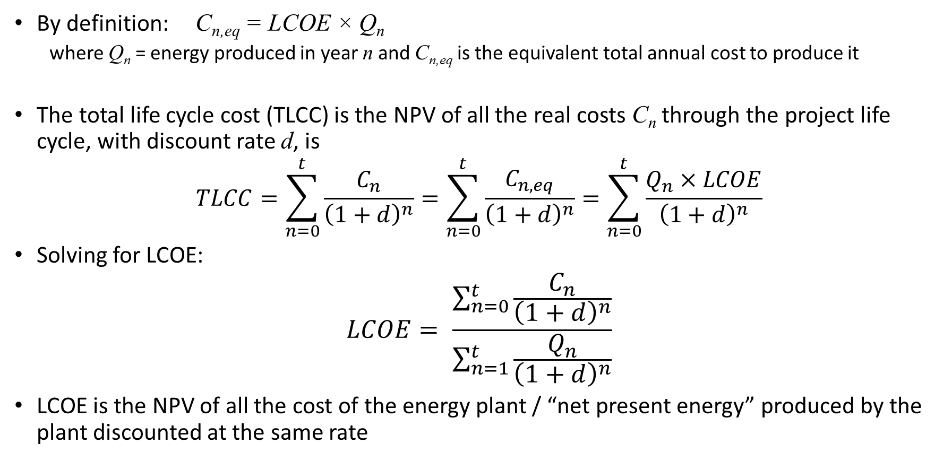
Levelized Cost of Electricity (LCOE)
By definition: C_{n,eq} = LCOE × Q_{n}
where Q_{n} = energy produced in year n and C_{n,eq} is the equivalent total annual cost to produce it
The total life cycle cost (TLCC) is the NPV of all the real costs C_{n} through the project life cycle, with discount rate d, is
$$TLCC=\sum_{n=0}^{t}{\frac{C_{n}}{{\left(1+d\right)}^{n}}}=\sum_{n=0}^{t}{\frac{C_{n,eq}}{{\left(1+d\right)}^{n}}}=\sum_{n=0}^{t}{\frac{Q_{n}×LCOE}{{\left(1+d\right)}^{n}}}$$
Solving for LCOE:
$$LCOE= \frac{\sum_{n=0}^{t}{\frac{C_{n}}{{\left(1+d\right)}^{n}}}}{\sum_{n=1}^{t}{\frac{Q_{n}}{{\left(1+d\right)}^{n}}}}$$
LCOE is the NPV of all the cost of the energy plant / “net present energy” produced by the plant discounted at the same rate

Slide 17
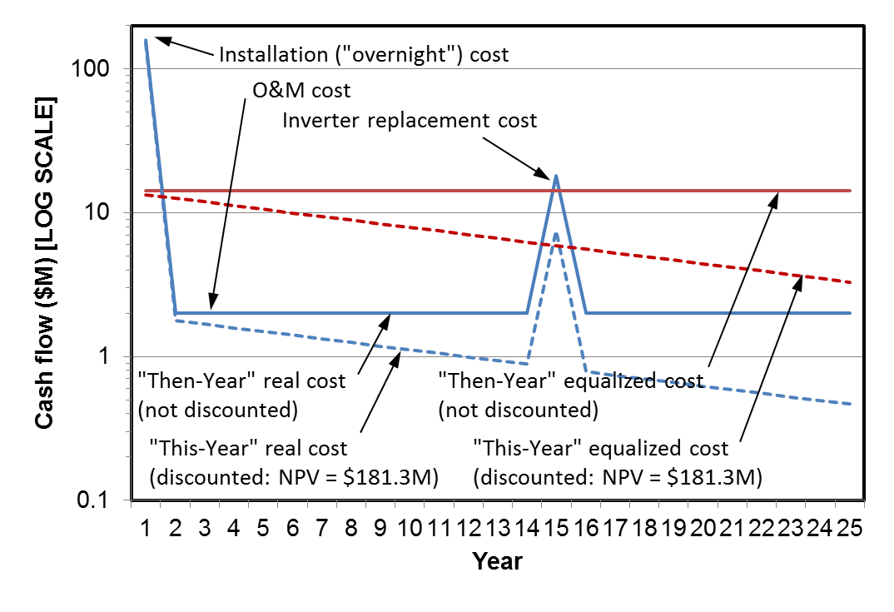
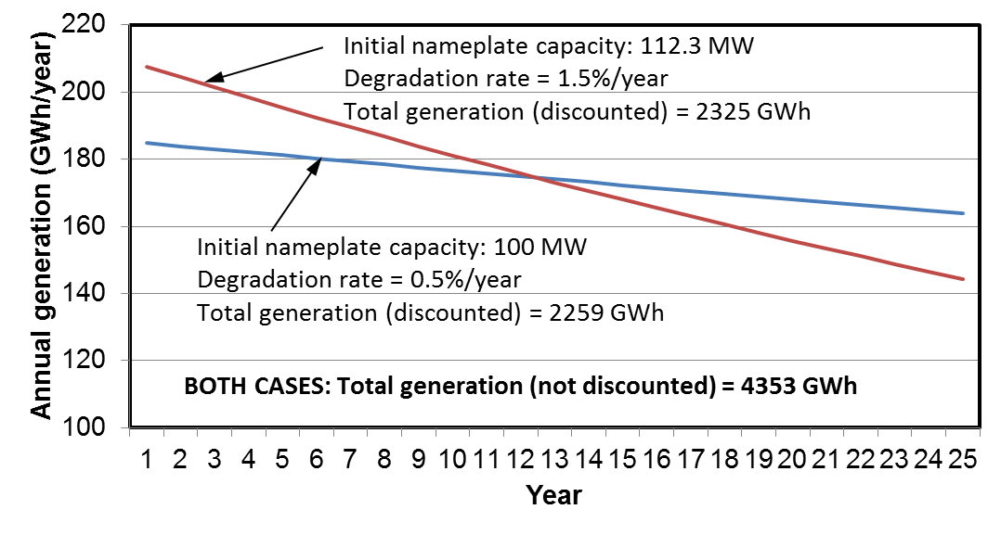
Illustrative Example
Nameplate capacity:
100 MW
Installed cost: $1.60/W
Discount rate: 6%
O&M cost: $20/kW/year
Inverter replacement cost:
10% of installed cost
The red and blue curves have equal NPV
Both systems generate the same total lifetime energy but the red system delivers more energy earlier
If both have the same cost over time, the red system has lower LCOE
I. Equivalence of discounted cash flows
The cost in period n is levelized by the generation in period n and the time value of money
II. Effect of generation profile

Slide 18
Corporations
What Is a Corporation?
A corporation is a legal entity that is separate and distinct from its owners. Corporations enjoy most of the rights and responsibilities that individuals possess: they can enter contracts, loan and borrow money, sue and be sued, hire employees, own assets and pay taxes. Some refer to it as a "legal person."
A corporation's most important aspect is limited liability. (the “corporate veil”)
This means that shareholders may take part in the profits through dividends and stock appreciation but are not personally liable for the company's debts.
The legal life of a corporation can be terminated by “liquidation” — a company (or court) appoints a liquidator who sells the corporation's assets, then the company pays any creditors and gives any remaining assets to the shareholders.
The creditors of an insolvent corporation may trigger liquidation as a result of bankruptcy of the corporation.
In bankruptcy, the creditors have priority over the shareholders!
https://www.investopedia.com/terms/c/corporation.asp

Slide 19
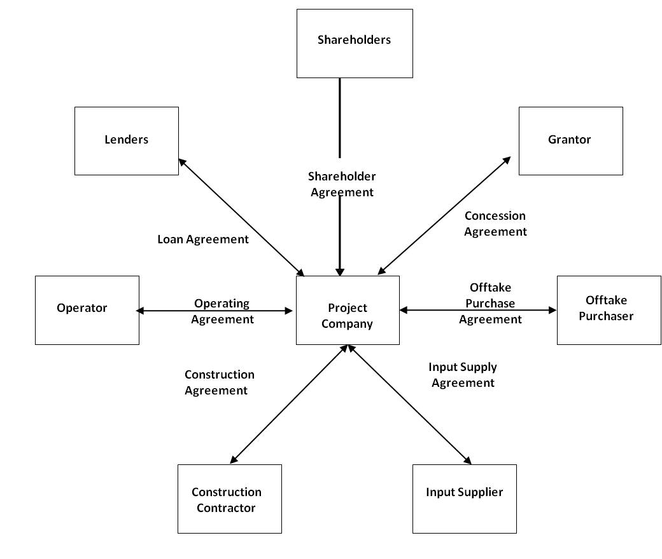
Special purpose entities (special purpose vehicles)
Project Finance – Key Concepts
Project financing provides for off-balance-sheet financing of the project, which will not affect the credit of the shareholders, and shifts project risk to the lenders in exchange for higher margin than for normal corporate lending.
Typical Project Finance Structure
Special purpose vehicle (SPV) project company
Sole activity of project company is to carry out the project – it then subcontracts most aspects through construction and operations contracts;
No revenue stream during the construction phase; debt service will only be possible once the project is online (parties therefore take significant risks during construction)
Sole revenue stream is under an off-take or power purchase agreement;
Limited or no recourse to the project owners (shareholders of project company are only liable up to the extent of their shareholdings);
Project remains off-balance-sheet for the parent shareholders.
Non-Recourse Financing
Recourse financing gives lenders full recourse to the assets of the shareholders for repayment of the loan in the case of default by the SPV. If the project or SPV fails to make loan payments required, the lenders will have recourse to the assets of the shareholders, with no limitation.
Project financing, by contrast is “limited” or “non-recourse” to the shareholders — the lenders' recourse will be limited to the project assets (including completion and performance guarantees and bonds) in the case of default of the project company.
(non-recourse)
SPV
(fuel, maintenance, etc)
EPC
“Bankability” refers to quality of project technical information sufficient to obtain non-recourse financing
https://ppp.worldbank.org/public-private-partnership/financing/project-finance-concepts

Slide 20
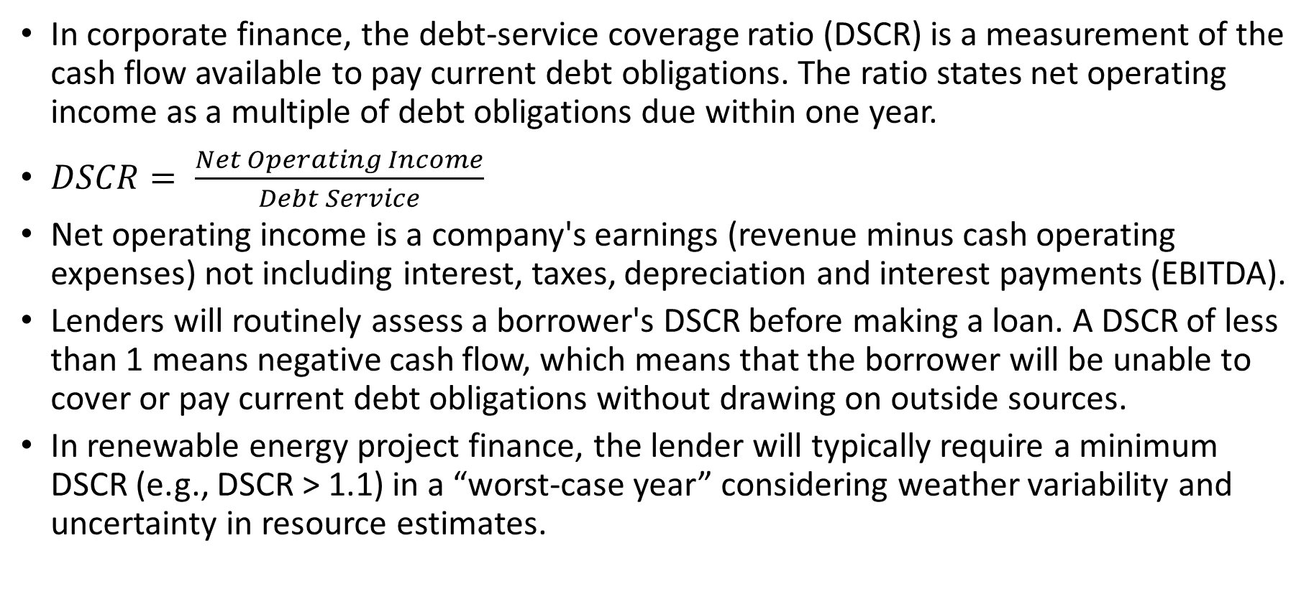
Debt Service Coverage Ratio (DSCR)
In corporate finance, the debt-service coverage ratio (DSCR) is a measurement of the cash flow available to pay current debt obligations. The ratio states net operating income as a multiple of debt obligations due within one year.
$DSCR= \frac{Net Operating Income}{Debt Service}$
Net operating income is a company's earnings (revenue minus cash operating expenses) not including interest, taxes, depreciation and interest payments (EBITDA).
Lenders will routinely assess a borrower's DSCR before making a loan. A DSCR of less than 1 means negative cash flow, which means that the borrower will be unable to cover or pay current debt obligations without drawing on outside sources.
In renewable energy project finance, the lender will typically require a minimum DSCR (e.g., DSCR > 1.1) in a “worst-case year” considering weather variability and uncertainty in resource estimates.

Slide 21
How does this relate to technical performance modeling?
Project developers typically put equipment at the project site to obtain measurements of solar (and wind) resources (for ~1 year or more if possible).
Typical practice is to “adapt” (calibrate) long-term satellite solar resource models (e.g. NSRDB) to match high-quality but shorter-term ground measurements
The long-term resource is statistically analyzed to determine
Typical (50th percentile) weather and solar conditions at the site, for baseline revenue prediction of the project.
Worst-case (90th percentile) weather and solar conditions at the site, for worst-case revenue prediction and DSCR determination.
This sets the upper limit of the bank loan for the project
The greater this upper limit, the greater the “bankability” of the project.
High quality resource data enhances the bankability of renewable energy projects

Slide 22
Supplemental … if we have time
Extra Credit

Slide 23
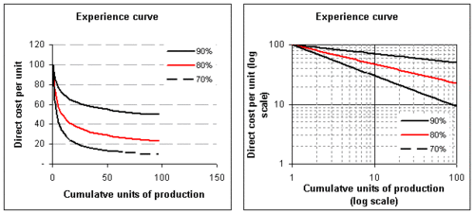
Learning curve concept
Learning curve = increase in production efficiency (“learning”) with cumulative scale of production
Also called “experience curve”
An exponential relationship — straight line on a log-log scale

Slide 24
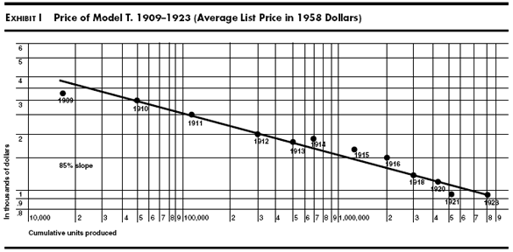
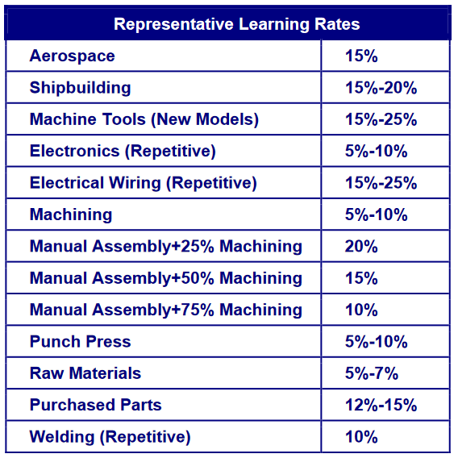
The “learning curve” phenomenon is observed across all industries
The “learning rate” is related to the slope of the line
“Moore’s Law” for semiconductors is a special case of the learning phenomenon, where cost reduction is driven by both conventional learning but also by technology advances in feature size reduction, enabling a combined effect resulting in very rapid cost declines

Slide 25
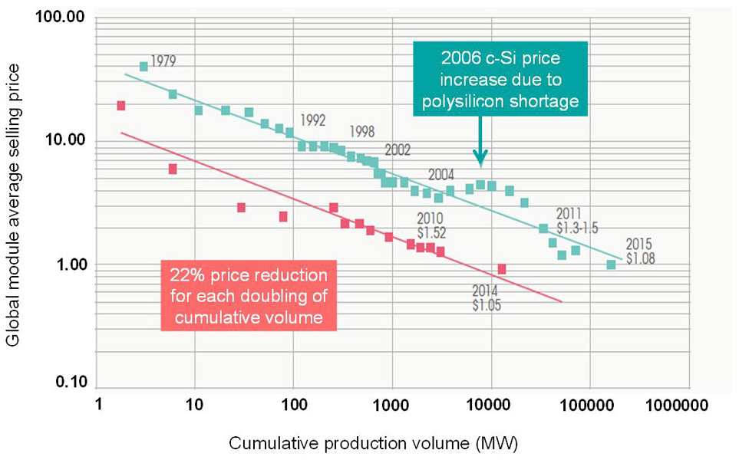
Some important examples — PV industry
C-Si
Thin film
“78% learning curve”

Slide 26
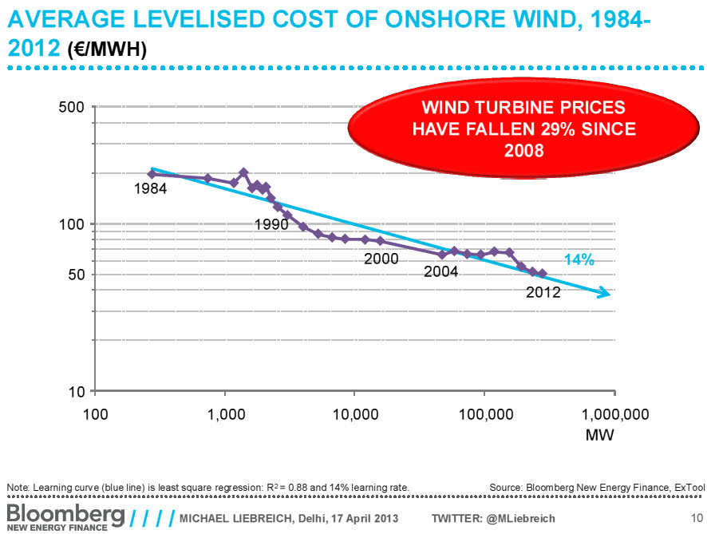
Some important examples - Wind
“86% learning curve”

Slide 27
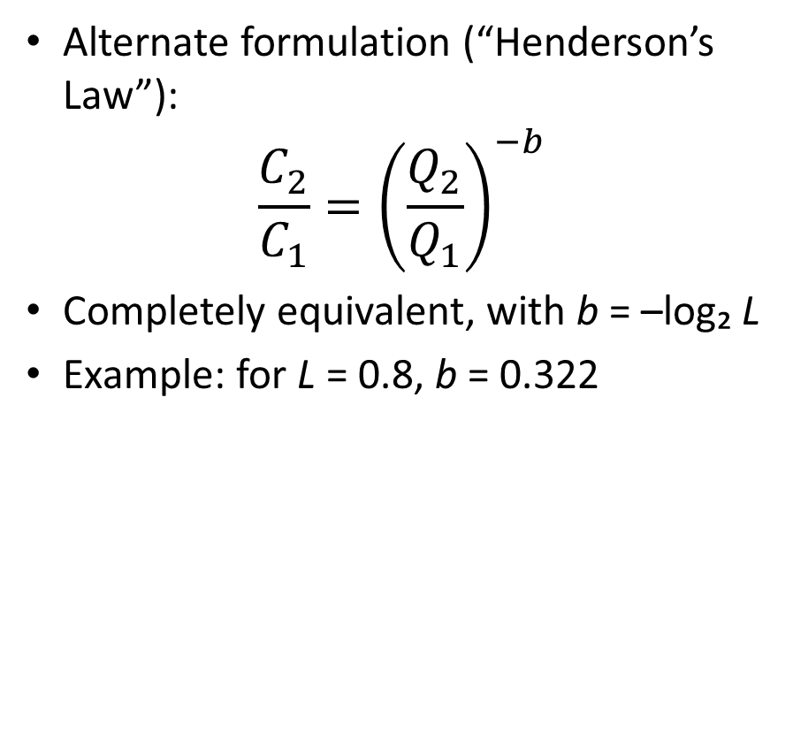
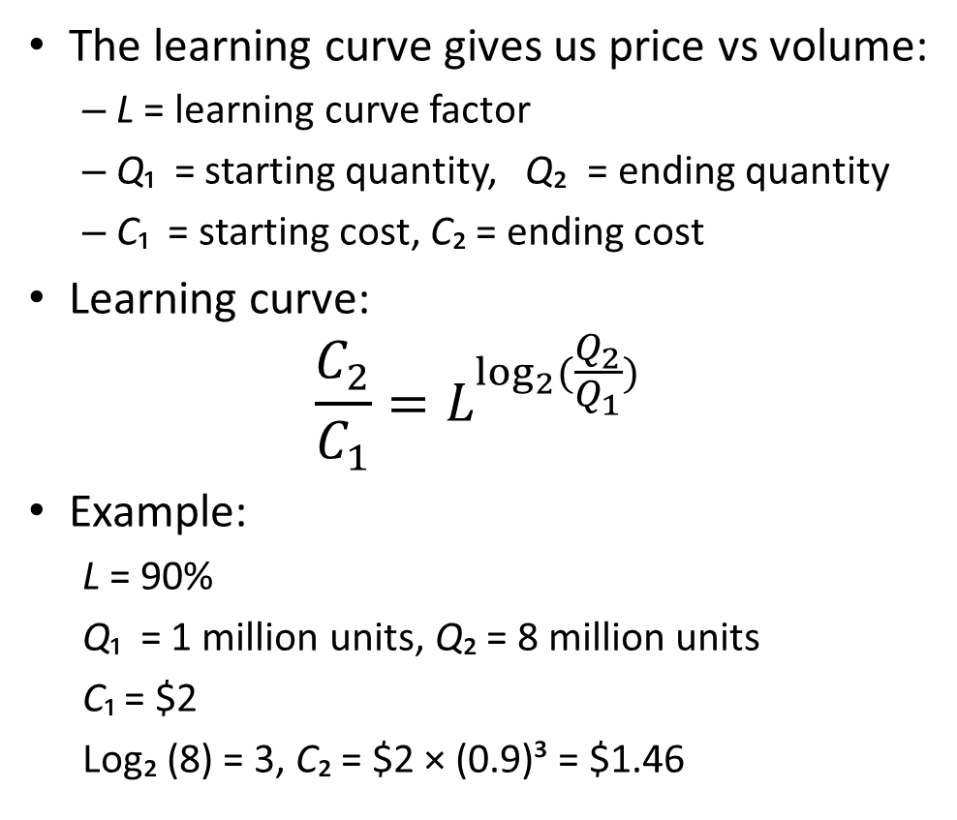
Learning curve mathematics
The learning curve gives us price vs volume:
L = learning curve factor
Q₁ = starting quantity, Q₂ = ending quantity
C₁ = starting cost, C₂ = ending cost
Learning curve:
$$\frac{C_{2}}{C_{1}}=L^{\log_{2}{(\frac{Q_{2}}{Q_{1}})}}$$
Example:
L = 90%
Q₁ = 1 million units, Q₂ = 8 million units
C₁ = $2
Log₂ (8) = 3, C₂ = $2 × (0.9)³ = $1.46
Alternate formulation (“Henderson’s Law”):
$$\frac{C_{2}}{C_{1}}={\left(\frac{Q_{2}}{Q_{1}}\right)}^{−b}$$
Completely equivalent, with b = –log₂ L
Example: for L = 0.8, b = 0.322

Slide 28
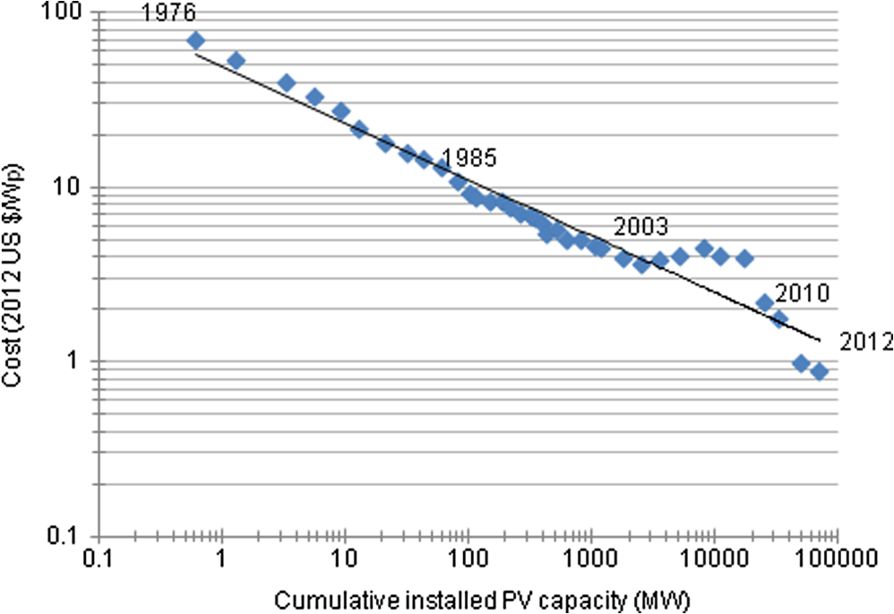
Calculating the learning curve factor
Q₁ = 0.95 MW, C₁ = $50/W
Q₂ = 19,950 MW, C₂ = $2/W
(2/50) = L^{log₂ (19950/0.95)}
0.04 = L^{14.3581}
Solve for L:
log_{L}(0.04)
= ln(0.04)/ln(L)
=14.3581
L = exp[ln(0.04)/14.3581]
= 0.8

Slide 29
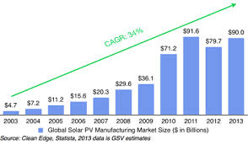
How can we use the CAGR and the learning curve to forecast future prices?
We need to know the industry future growth rate
Then we can use the learning curve to forecast prices vs. time
We can use the CAGR and learning curve together to forecast both volume and price
We could use this, but be careful of units!
This graph is given in $B, but the price of modules is changing with time, so to get production volume we need to divide the sales ($) by the cost ($/W)
$90.0 = $4.7 × (1 + r)¹⁰
Solve for r:
R = (90/4.7)^{0.1} = 34%
CAGR and the learning curve together provide a mathematical basis for annual price projections

Slide 30
Estimate of future PV module prices
CAGR Learning Factor
Low estimate 10.5% 82%
Medium estimate 15% 80%
High estimate 20% 78%
Combine the CAGR and learning factor to project the price
Example: medium estimate
Q₂ /Q₁ = 1.15 ➔ C₂ /C₁ = 0.8^{log₂(1.15)} = 0.956
If 2018 price is $0.33/W ➔ 2019 projected to be $0.315/W
Forecasted PV prices (price decline per year):
Low estimate (CAGR=10.5%,L=82%) –2.8%
Medium estimate (CAGR=15%, L=80%) –4.4%
High estimate (CAGR=20%, L=78%) –6.3%

