Slide 1
Discussion of financial inputs
Sept. 7, 2021

Slide 2
Things to discuss for generation technologies
Financials (cost, etc.) – emphasis of today
Generation profiles (we’ve already talked a lot about this. Note: the generation profiles may affect the CapEx and O&M in some cases)
Availability (how many can be built?)
Fuel costs, etc.

Slide 3
Why do we care about financials?
If I buy a house for $360,000 and pay for it over 30 years, the total I pay will be
In the case of zero interest - $1000 per month
In the case of 10% interest - $3159 per month
It is common for the financial cost to dominate the cost of a project
Which is better, a 10-year mortgage or a 100-year mortgage?
For a $1 million purchase @ 10% interest
10-year mortgage would require $163k/year; total payment $1.63 million
100-year mortgage would require $100k/year; total payment of $10 million

Slide 4
The calculation – do you understand it?
If y is the annual payment, then after year 1, we owe
After Year 1 we owe = Cost X (1 + interest) – y
After Year 2 we owe = Cost X (1 + interest)² – y X (1 + interest) – y
Can rewrite the series…

Slide 5
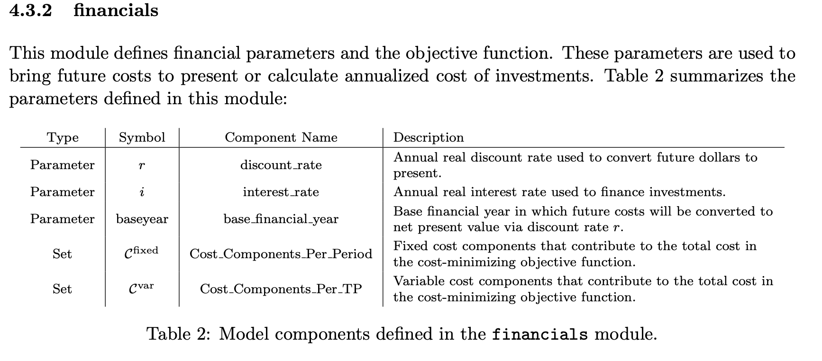
SWITCH definitions – calculation is a step

Slide 6
RESOLVE uses annualized costs
We take input values and calculate the annualized cost as an input
Makes it difficult to compare. The Capital expenditure (CapEx) may be the same, but if we use different financing times or different interest rates we will get different numbers.

Slide 7
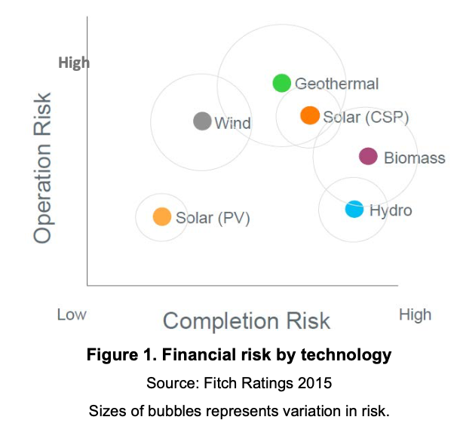
Risk can affect financing
How should offshore and onshore wind be rated?
If you are investing your money, do you expect a higher or lower interest rate when the risk is higher?
Should interest rates vary with technology maturity?
At NREL, we set the goal to reduce PV interest rates from 7% to 4%

Slide 8
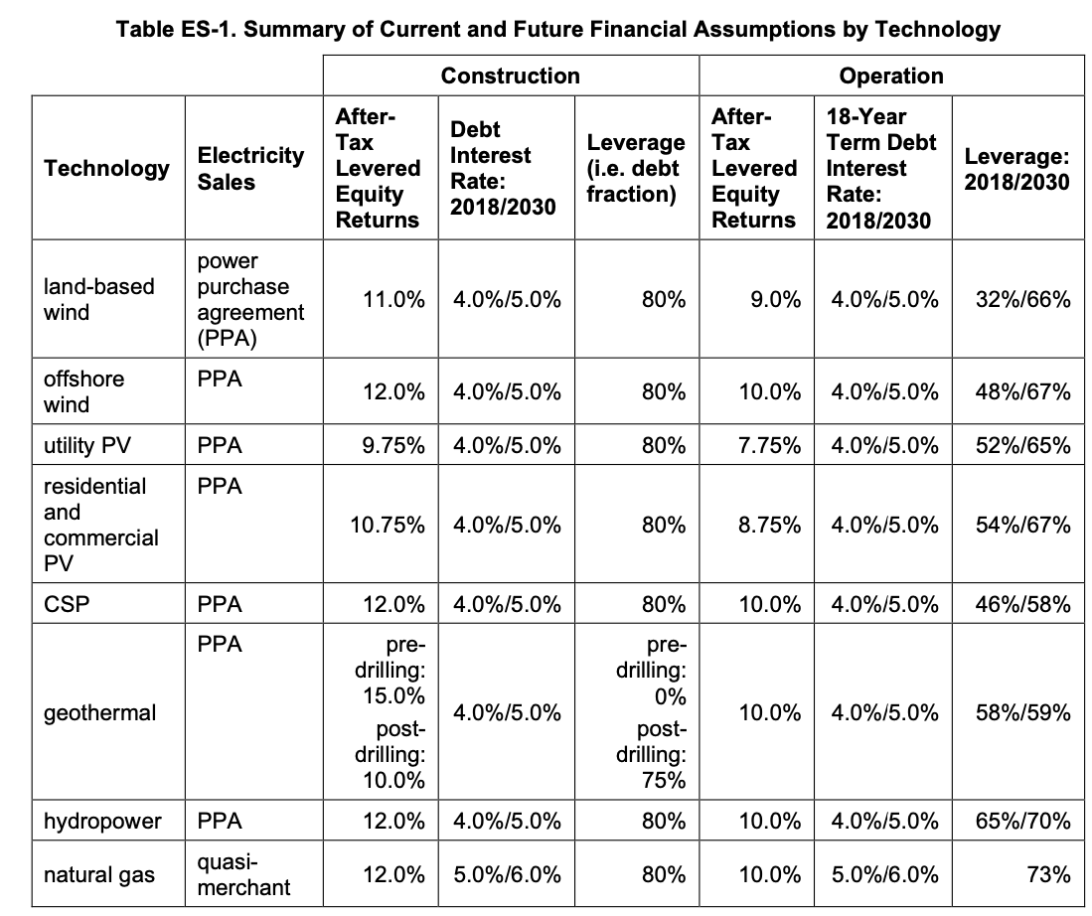
ATB interest rates summary
Debt – borrow money and pay it back
Equity – investor owns shares in company – typically is associated with higher rate
Question: should interest rates go up (historically, rates have been higher) or down (as technology matures, the rates should go down)

Slide 9
ATB interest rates summary
Technology | Cap. Recovery period (years) | Interest rate nominal -moderate | Calculated interest rate real - moderate | Interest during construction | Rate of return on equity nominal – moderate | Calculated rate of return on equity real – moderate | Debt Fraction - Moderate | WACC Nominal – Moderate | WACC real - moderate
Offshore wind | 30 | 4.0% | 1.5% | 4.0% | 10.0% | 7.3% | 68.5% | 5.2% | 2.6%
Onshore wind | 30 | 4.0% | 1.5% | 4.0% | 9.0% | 6.3% | 67.1% | 5.0% | 2.4%
Solar | 30 | 4.0% | 1.5% | 3.5% | 7.8% | 5.2% | 73.5% | 4.3% | 1.7%
Geothermal | 30 | 4.0% | 1.5% | 4.0% | 10.0% | 7.3% | 73.7% | 4.8% | 2.3%
Hydropower | 30 | 4.0% | 1.5% | 4.0% | 10.0% | 7.3% | 71.9% | 4.9% | 2.4%
Biopower | 30 | 5.0% | 2.4% | 3.5% | 10.0% | 7.3% | 67.0% | 5.9% | 3.2%
Solar +battery | 30 | 4.0% | 1.5% | 3.5% | 7.8% | 5.2% | 73.5% | 4.3% | 1.7%
Natural gas | 30 | 5.0% | 2.4% | 5.0% | 10.0% | 7.3% | 55.0% | 6.5% | 3.9%
Pumped hydro | 100 | 4.0% | 1.5% | 4.0% | 10.0% | 7.3% | 71.9% | 4.9% | 2.4%
Questions: Which interest rate should we be using? How many years?

Slide 10
SWITCH summary
Technology | Cap. Recovery period (years) | Interest rate nominal -moderate
Offshore wind | 30 | 5.0%
Onshore wind | 20 | 5.0%
Solar | 20 | 5.0%
Geothermal | 20 | 5.0%
Hydropower | N/A | 5.0%
Biopower | 20 | 5.0%
Solar +battery | ? | 5.0%
Natural gas | ? | 5.0%
Pumped hydro | N/A | 5.0%
SWITCH is programmed to use the same interest rate for everything, right?

Slide 11
Wind and Solar Generation profiles
Storage locations
Need to define where to store data for RESOLVE
SWITCH already has data base
Time frame
Hourly data
2015-2020 for RESOLVE; use CAISO data for current fleet
For SWITCH – as many years as possible
Wind
Need to identify general locations (Do we want to stick with current sites in RESOLVE and SWITCH?)
Need to calculate generation profile from a cluster of locations
Any modifications to build limits?
What needs to be done?
Solar
Include one-axis tracked horizontal tilt (Default for RESOLVE now; default for ATB)
Continue to include fixed latitude tilt in SWITCH? (How to adjust cost?)
Include one-axis tracked latitude tilt – how much do we adjust the cost by?
Russ will present information about cost variation by installation geometry on Friday

Slide 12
Actions?
Ask about whether it’s intentional to ignore the financial assumptions from ATB in SWITCH
Note – Sarah wrote 4% when we are using 5% in SWITCH

Slide 13
Schedule
Sept. 10: Cost for solar variations
Sept. 14: Biogas
To be scheduled:
Solar-battery hybrid
What have we missed on the generation technology side?
Publications of deliverables?
Storage technologies

