Slide 1
California Load Forecasting
Russ Jones
March 2021

Slide 2
Documents
Main document for review today:
California Energy Commission Final Project Report, “California Investor-Owned Utility Electricity Load Shapes”, April 2019, CEC-500-2019-046
Related:
California Energy Commission Report, “Final 2019 Integrated Energy Policy Report”, February 2020, CEC-100-2019-001-CMF
California Energy Commission Report, “California Energy Demand 2018-2030 Revised Forecast”, February 2018, CEC-200-2018-002-CMF
California Energy Commission Report, “Energy Demand Forecast Methods Report”, Companion Report to the California Energy Demand 2006-2016 Staff Energy Demand Forecast Report, June 2005, CEC-400-2005-036
David W. Pierce and Daniel R. Cayan, “Future projections of hourly surface temperatures in California”, Scripps Institution of Oceanography Division of Climate, Atmospheric Sciences, and Physical Oceanography, La Jolla, CA 92093-0230, 24 May 2019
NREL demand model used in EFS
Hale, Elaine, Henry Horsey, Brandon Johnson, Matteo Muratori, Eric Wilson, et al. 2018. The Demand-side Grid (dsgrid) Model Documentation. Golden, CO: National Renewable Energy Laboratory. NREL/TP-6A20-71492. https://www.nrel.gov/docs/fy18osti/71492.pdf.
Building America House Simulation Protocols
Robert Hendron and Cheryn Engebrecht, Building America House Simulation Protocols, National Renewable Energy Laboratory, Revised October 2010
Documents online at the LDES project google drive https://drive.google.com/drive/folders/12zUc0vRXczNdxFTqz4-2Rr2DosAorcaM

Slide 3
Load Shapes for California IOUs
CEC Demand Analysis office funded ADM Associates Inc. for this study
Updated traditional end-use load shapes for six energy sectors
Developed PV system, EV, and energy efficiency load impact profiles
Developed updated Hourly Electric Load Model (HELM) 2.0 written in R
CEC uses the HELM to cast annual energy demand forecast elements into hourly demands, from which projected annual peak loads are forecasted for the Integrated Energy Policy Report (IEPR)
HELM 2.0 includes weather-sensitive and weather-insensitive load shapes at the end-use, planning area, and forecast zone level for the residential and commercial sectors, and at the whole-building level for other sectors.
The project updated end-use load shapes by blending publicly available load shapes from market and metering studies with building simulations in EnergyPlus.
The load shapes and profiles can respond to relevant factors such as weather data, macroeconomic data, and in some cases, price signals from utility time of use rates.

Slide 4
Project objectives
Updated base end-use load shapes from secondary data and reconciled those shapes with aggregated whole-building hourly billing data, provided by utility companies.
Developed key energy efficiency load impact profiles analysis and building energy simulations.
Developed load profiles to represent electric vehicle charging, and to enable scenario analysis related to customer price response due to time-of-use rates.
Developed load profiles to represent PV residential and non-residential generation.
Developed a software infrastructure to adapt load shapes to particular scenarios within the CED Model. This software replaces a portion of the software in the CED Model.

Slide 5
Project data produced
Residential sector — 2 main building types (single family and multifamily) and 24 end-uses including 6 weather-sensitive HVAC end-uses.
HVAC load shapes were generated using utility provided hourly advanced metering infrastructure (AMI) data and regression analysis to isolate typical non-HVAC loads during weekdays and weekends.
Commercial sector — 12 different building types, 10 end-uses — 3 HVAC-related and 7 non-HVAC-related.
HVAC-related end-use load shapes were generated using EnergyPlus building simulation models
Because the building models in EnergyPlus reflect individual buildings while the load shapes reflect aggregates of buildings, a regression-based calibration method was used in which multiple simulations were aggregated to create more representative load shapes.
Non-HVAC end-uses were sourced from the last California Commercial End-use Survey (CEUS) (Itron, Inc. 2006) and current AMI data.
For the residential and commercial sectors, a residual load shape was developed to capture the systematic differences between the modeled load shapes and the observed AMI data.
Agricultural, industrial, mining and extraction, and TCU (Transportation, Communications and Utilities) sectors — whole building level only
The load shapes were modeled via a regression model which included temporal factors, as well as other predictors such as cooling degree hours (CDH), economic predictors, and linear growth terms.
Street lighting — Most street lighting remains unmonitored. Street lighting load shape depends only on sunset/sunrise; traffic lights assumed constant load.
Behind-the-meter PV — Shapes generated using SAM for a selected city in each forecast zone, at different orientations over a typical meteorological year (TMY). Data from the California Solar Initiative (CSI) was used to aggregate across panel orientations.
Electric Vehicles — Load shapes were created using data from ChargePoint for household vehicles (charging at residential and non-residential locations), commercial fleet vehicles, and government vehicles.
A separate model known as the EV Infrastructure Load Model (EVIL Model) was used to model price elasticity with time of use (TOU) rates.
Energy efficiency load impact profiles — generated using EnergyPlus building simulations
Efficiency measures described by 13 efficiency profiles drawn from the last Additional Achievable Energy Efficiency (AAEE), .

Slide 6
Project approach
Load shape generators — regression models and coefficients in place of static load shapes to respond to weather, economic inputs, TOU/tariff inputs
Secondary data sources — 8 different secondary sources cited
Tuning shapes to AMI data — to account for gains in building efficiency since 2005 data was collected (for commercial loads), an hour-by-hour matching of normalized load was used to re-shape end-use load profiles
Batch simulations — hundreds of EnergyPlus simulations were run with varying parameters to match the IOU meter data
Residual modeling — segmented by month, day of week (or holiday), and hour for residential sectors, and then regressed (CDH = cooling degree hours, HDH = heating degree hours)
Energy efficiency impact — 11 archetypal energy efficiency load impact profiles, expands to 1400 unique profiles with variants of building types and forecast zones, mostly generated using EnergyPlus
Economic adjustments — included correlation to economic growth figures and linear year-to-year load growth

Slide 7
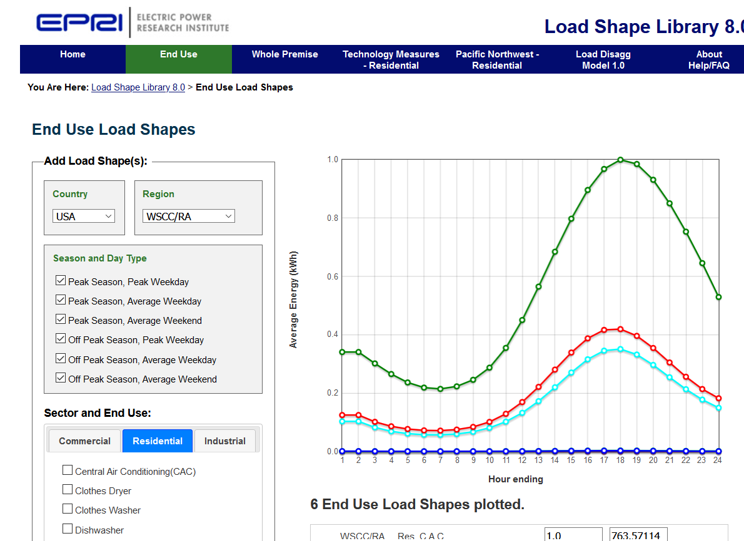
EPRI load shape library
https://loadshape.epri.com/

Slide 8
Residential load shapes
AMI (Advanced Metering Infrastructure) Data — aggregated data from each IOU in each forecast zone, segregated by single-/multi-family, high/med/low consumption, gas vs electric heat
Residential Energy Demand Forecast Model — a separate CEC model that derives total energy use by each end-use, and by IOU territory. ADM modeled by forecast zone using population data
Weather Data — weather from 2014–2016 was used for each forecast zone, from airport weather stations
Load shapes were taken from multiple sources
Source selection/weighting methodology — shapes from multiple sources were combined to produce shapes for weekdays & weekends in winter, spring, summer, fall

Slide 9
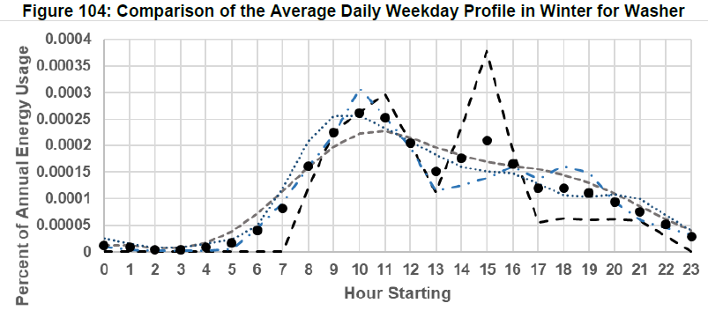
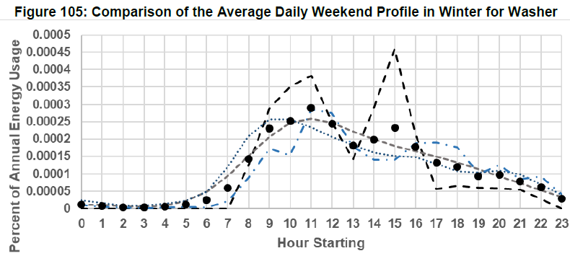
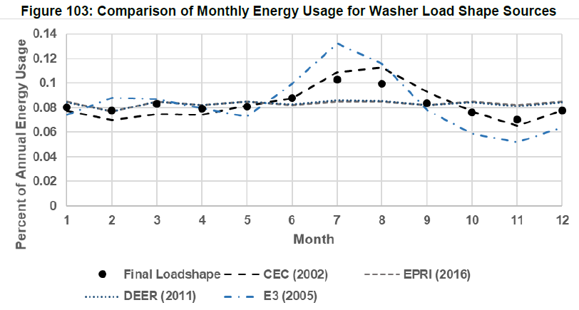
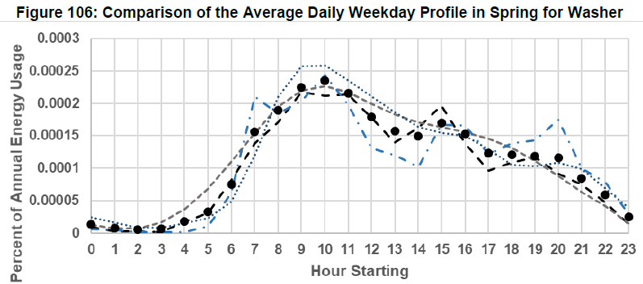
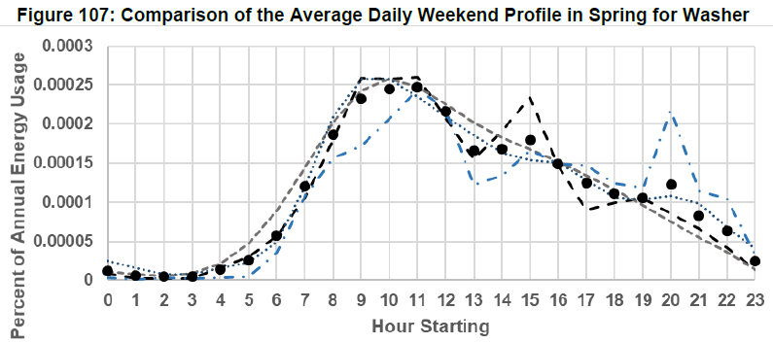
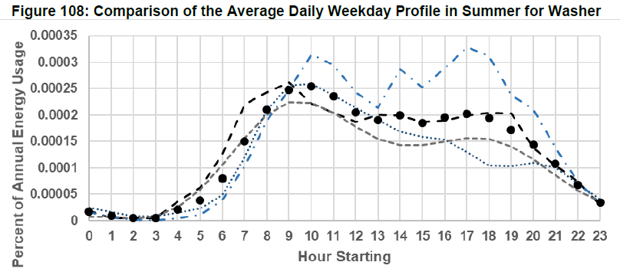
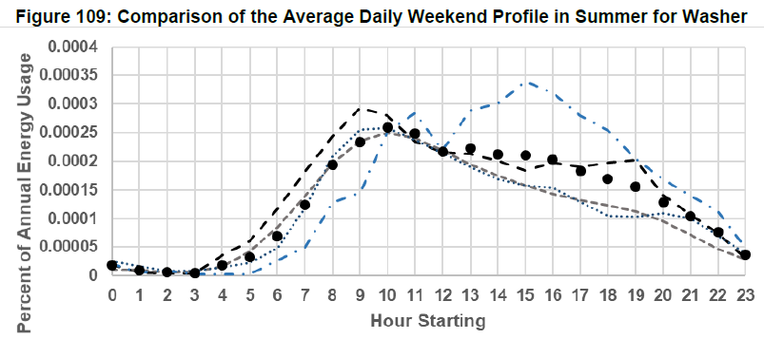
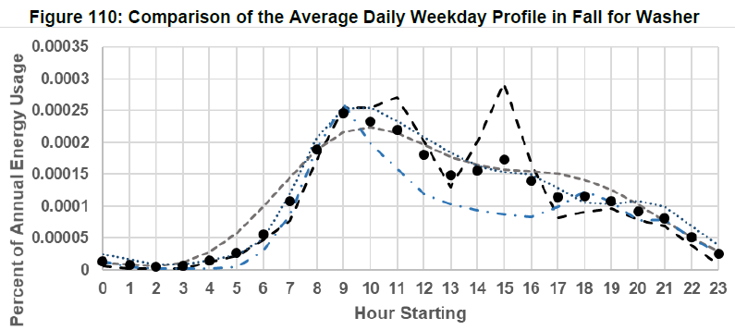
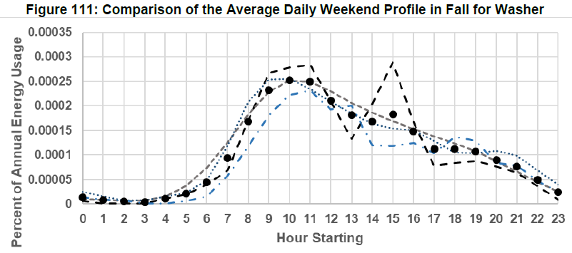
Example: Washer
Normalized monthly fraction of annual load
Normalized hourly fraction of annual load
For winter, spring, summer, and fall
For weekday and weekend
Similar data for 18 different non-HVAC end uses — cooking, dryer, dishwasher, refrigerator, TV, etc.

Slide 10
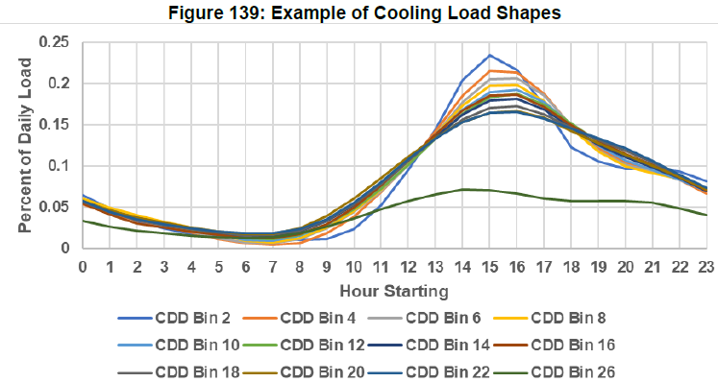
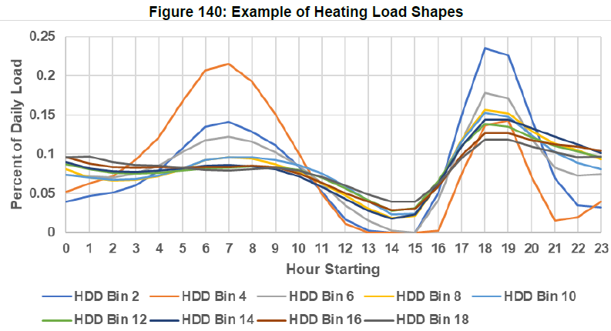
HVAC load shapes
Load data was binned in 2° steps
Bin with minimum daily load assumed to have no HVAC and was used as the load shape for all non-HVAC loads
The non-HVAC load shape was subtracted from the load to get the heating or cooling load shapes in bins of 2 cooling degree days (CDD) or heating degree days (HDD)
Fitting equation coefficiencts not given in the report

Slide 11
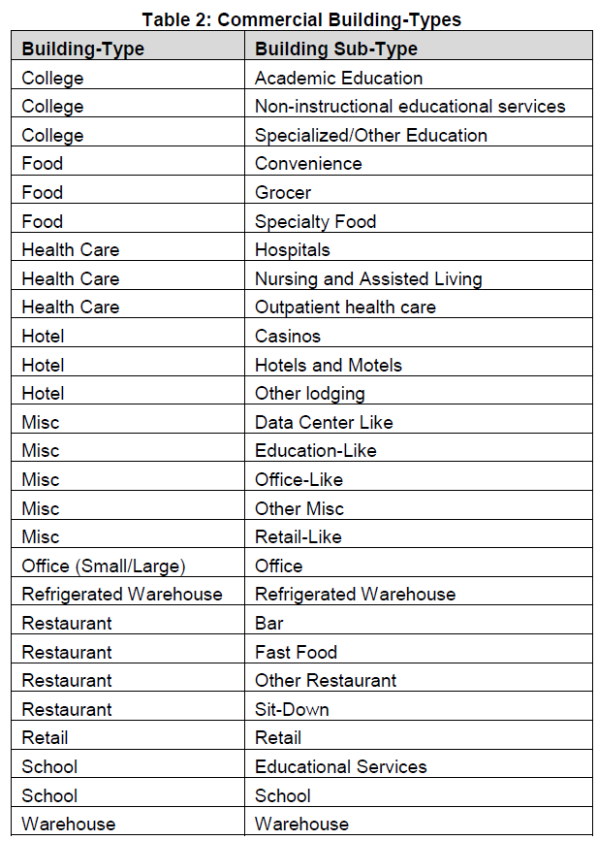
Commercial load shapes
Disaggregation approach for HVAC loads used for residential won’t work for commercial, because commercial buildings can have both cooling and heating operating simultaneously
Modeled 27 building subtypes in EnergyPlus and for each, ran multiple simulations with varied building parameters and HVAC setpoint schedules, fit aggregation of the simulations to aggregate profile via regression, and then aggregated results back to the 12 CEC standard commercial building types
EnergyPlus models sourced from DOE commercial prototype building models
Batch simulations and regression using R
Commercial Energy Demand Forecast Model — a separate CEC model that derives total annual energy use by each end-use and building type, and by forecast zone
Some special adjustments made for schools to account for reduced summer loads
Residual load shape determined for each building type based on day type (weekday/weekend), CDH, HDH
Additional empirically determined seasonal adjustments to match IOU data

Slide 12
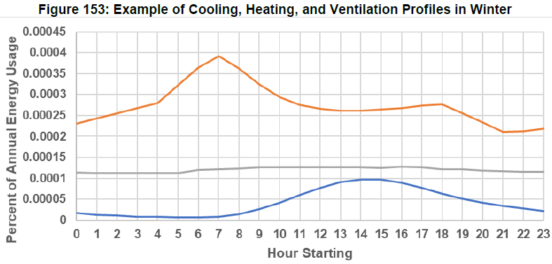
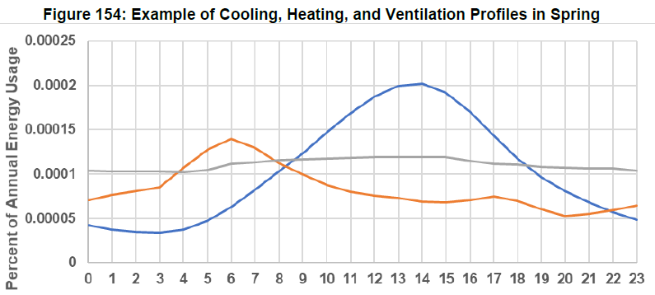
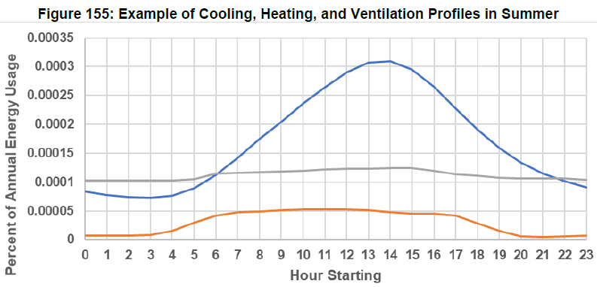
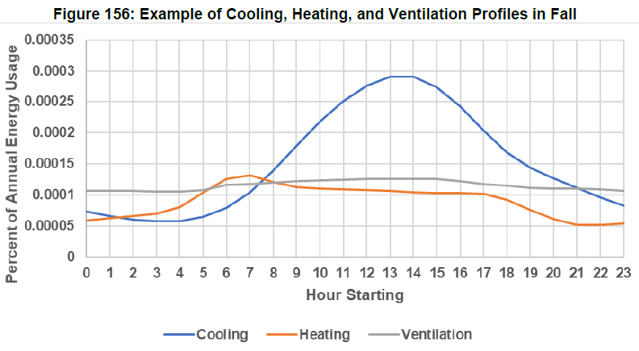
Commercial HVAC loads
HVAC loads were segregated from the weighted EnergyPlus simulations and aggregated by the 12 CEC commercial building types
Then regression models were developed for cooling, heating, and ventilation loads
For cooling
For heating
For ventilation

Slide 13
Agricultural, Industrial, Mining & Extraction, and Telecommunications, Construction & Utilities (TCU) load shapes
Not determined by end use but rather aggregated by facility type
There are four facility types represented in the agricultural sector, 15 for industrial, 3 for mining & extraction, 13 for TCU
Regression modeling used to fit diurnal and annual variation (for agriculture)
β₂ allows for linear load growth as observed in the data
Industrial and mining & extraction regression also includes economic growth since production is correlated

Slide 14
EV Charging Load Shapes
Data sources — Charge station data from ChargePoint, as well as CEC and IOU reports
ChargePoint operates the largest public charging network and also sells and collects data from residential chargers
Also modeled price response
TOU% = fraction of vehicles with TOU tariff
e = price elasticity
PR_{h} = price ratio in hour h (relative to lowest)

Slide 15
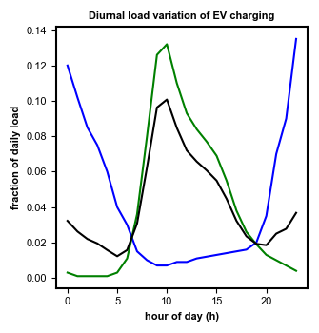
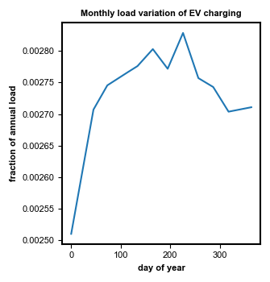
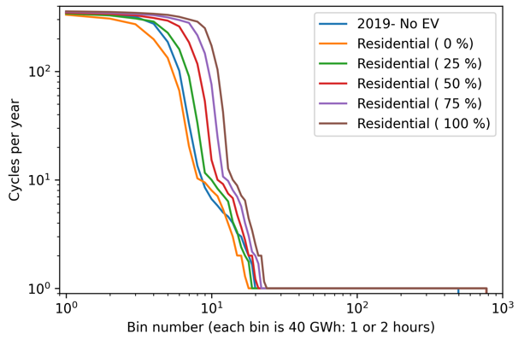
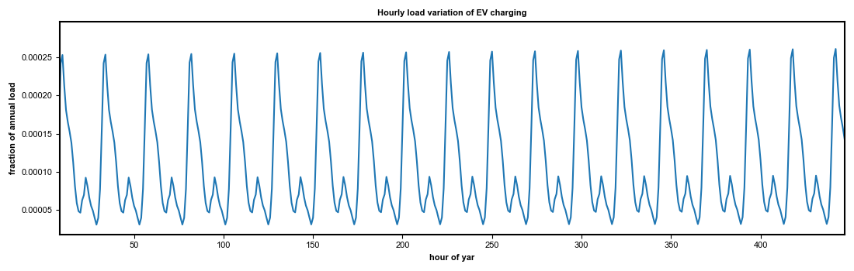
Application of the EV load shapes to our work
Monthly demand was derived from California gasoline consumption data (from EIA)
Solar: 80% of the load
Ashling and Russ have used the EV load data to make a simple annualized load profile generator under different assumptions of residential vs. nonresidential charging, and applied it to see the impact on storage requirements using our simple storage model

Slide 16
Energy Efficiency Load Impact Profiles
Used to model Committed Savings and Additional Achievable Energy Efficiency (AAEE) measures and scenarios
Gains mostly due to utility-sponsored initiatives, or more stringent building and appliance standards
Examples:
Synchronous measures — reduced lighting wattage by substitution of LEDs
Near-synchronous measures — HVAC interaction with reduced lighting wattage
Asynchronous measures — replacing gas furnace with heat pump
Biggest potential savings are in the commercial sector
Load shape impacts determined primarily by before-and-after EnergyPlus simulations

Slide 17
Nice but what’s missing?
Detailed description of most load shapes but many (particularly HVAC) are incompletely described … missing data
The report covers only the normalized load shapes, and not how they are added up to the total load shape (i.e., the weights of each shape in the total)
For that you have to go to other CEC reports:
Energy Demand Forecast Methods Report (June 2005, CEC-400-2005-036) describes methods for determining total annual loads with equations used for 5 sectoral energy demand forecast models (residential, commercial, industrial, agricultural, and water pumping)
Provides equations based on population, number of households, etc. but also does not provide the data
California Energy Commission Report, “California Energy Demand 2018-2030 Revised Forecast”, February 2018, CEC-200-2018-002-CMF
Gives total annual demand by IOU, sector, and climate zone, but no breakdown by end use

Slide 18
Future projections of hourly surface temperatures in California — Scripps Institute of Oceanography
An analog matching method is developed to produce projections to the end of this century of hourly temperatures at selected stations in California using daily minimum and maximum temperature (Tmin and Tmax).
Results from 10 general circulation models that do well simulating the regional climate show an extensive decrease in the number of chill hours in the state, which could have significant impacts on agriculture.
Most locations also show a strong increase in the number of hours above thresholds of 100 and 110 °F, sometimes by more than an order of magnitude. Such increases would drive a strong increase in cooling electricity demand.
The climate change effects have been incorporated in the most recent IEPR.

Slide 19
dsgrid documentation (Electricity Futures Study) — NREL
Model for the whole US, much more complete with load shapes, equations, and tables of load components
From the author:
“The dsgrid work for EFS was more proof-of-concept—we demonstrated the bottom-up development of hourly load profiles by county, but only for historical year 2012. We are currently working on national-level, high-resolution modeling again, with plans to publish an alpha-version projection in Fall 2021 (very simple demand projection for every sector except electrified light duty vehicles, which will have more detail). “

Slide 20
Building America House Simulation Protocols — NREL 2010
The DOE Building America Program has been a source of innovations in residential building energy performance for more than 20 years. The program partners with industry to bring cutting-edge innovations and resources to market.
Building America's House Simulation Protocols report is designed to assist researchers in tracking the progress of multiyear, whole-building energy reduction against research goals for new and existing homes. These protocols are preloaded into BEopt and use a consistent approach for defining a reference building, so that all projects can be compared to each other
Provides lots of useful engineering data tables, equations, and load shapes

Slide 21
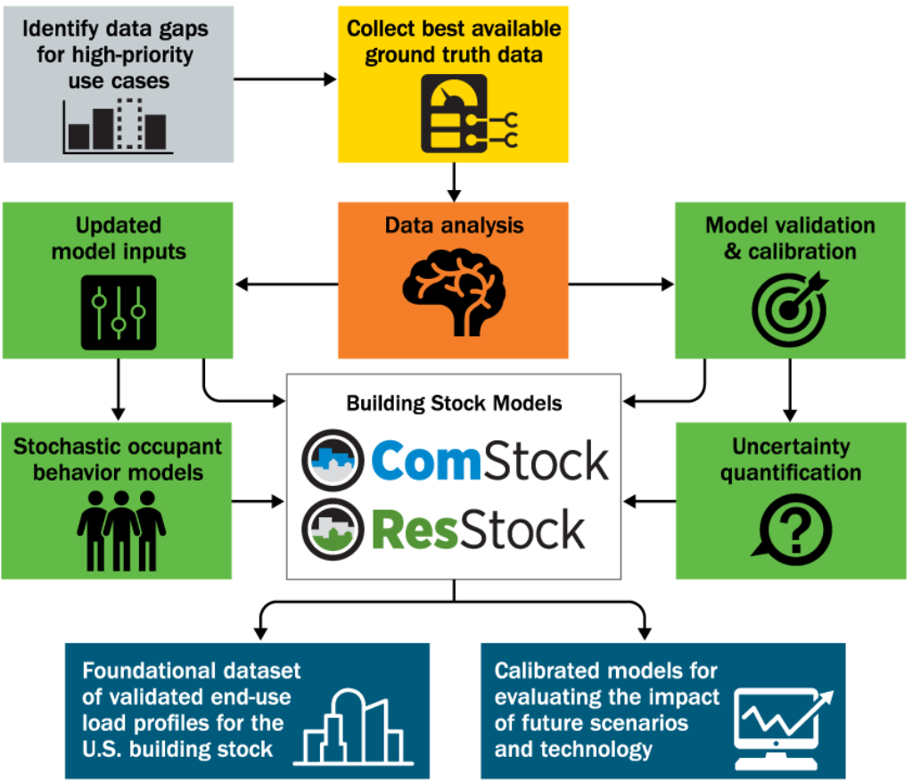
End-Use Load Profiles for the U.S. Building Stock
Multiyear study to develop a database of end-use load profiles representing all major end uses, building types, and climate regions in the U.S. commercial and residential building stock
Team of NREL, LBNL, and Argonne National Lab
Upon concluding in 2021, will result in:
Validated end-use load profiles for the U.S. building stock at both aggregate and individual building scales, representing all major end uses, building types, and climate regions in the U.S. building stock
Calibrated open-source building stock end-use models with the ability to estimate energy efficiency and demand response savings profiles for existing and emerging technologies
Documentation of load profile use cases, critical gaps, model methodology, and user guide.

Slide 22
HELM 2.0 software
In response to my inquiry, the CEC Demand Analysis Office has agreed to provide the HELM 2.0 software for our use
Mitch Tian — Mitch.Tian@energy.ca.gov
It has not been provided yet — awaiting completion of a user manual which was originally expected by 19 March (more to come)

Slide 23


