Slide 1
Storage Futures Study
The Four Phases of Storage Deployment: A Framework for the Expanding Role of Storage in the U.S. Power System
Paul Denholm, Wesley Cole, A. Will Frazier, Kara Podkaminer, and Nate Blair
Date: 03/06/2021

Slide 2
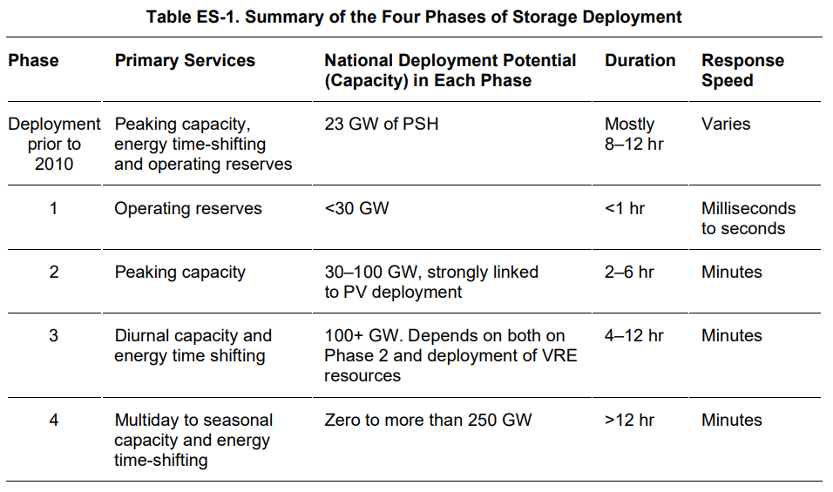
* This concept of phases in the evolution of the power system is similar to that proposed by the IEA: Six phases that are aligned with increased levels of VRE deployment, and each phase requires different measures to address.

Slide 3
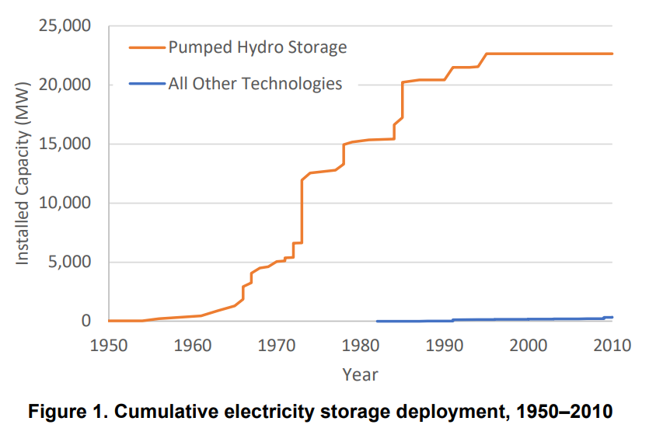
Phase 0:
Deployment prior to 2010
Mostly Pump Hydro (24 GW)
multiple grid services that span all the four phases framework
Built in response to low-cost baseload power being provided primarily by nuclear and coal plants
in response to expensive sources of traditional peaking capacity such as steam plants burning natural gas.
Pumped storage provided a means to increase the flexibility of baseload resources, enabling charging with off-peak energy and discharging during higher demand, thus offsetting the need for (then) higher-cost oil- and gas-fired capacity.
Hiatus after 1990 is because the advent of more cost-effective gas turbines.

Slide 4
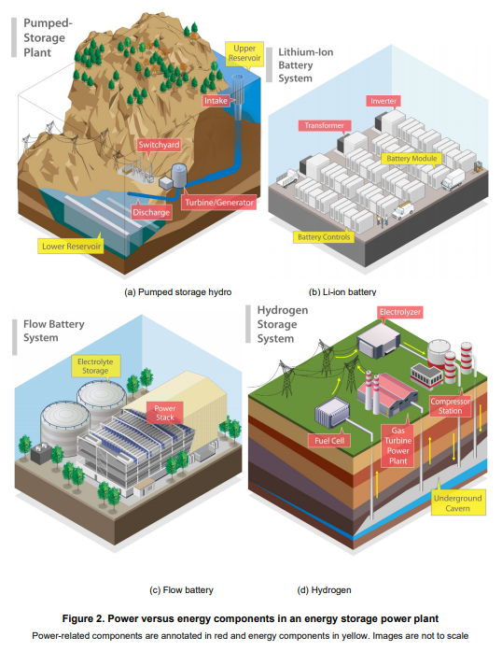
Storage Costs
A major difference: Storage has two components:
power and energy.
Because electricity is almost always stored in another form (e.g., potential energy of water, electrochemical bonds, or kinetic energy), power conversion equipment is required. This process represents the power component of a storage plant and associated costs.
The energy component of storage is associated with the storage medium (e.g., water, chemicals, or rotating mass) and the container that holds the medium

Slide 5
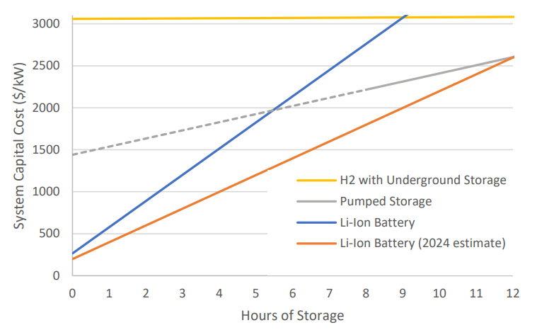
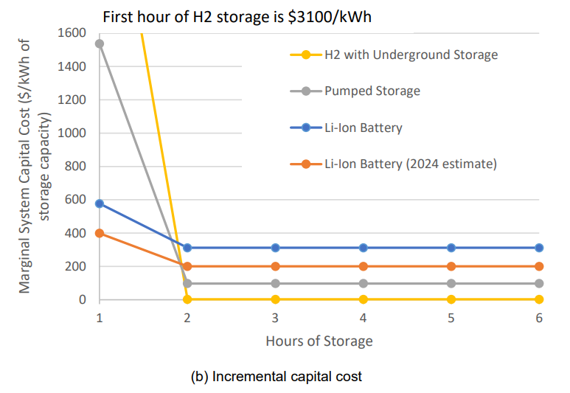
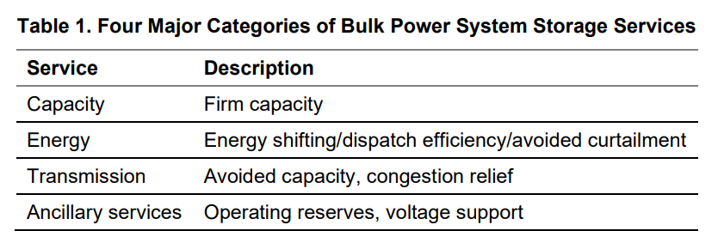
Because storage plants have both a power component and an energy component, the cost of a storage power plant increases continuously as a function of duration for most technologies.
Energy component, shown in bottom, which starts with the first hour and includes the power cost, and then each additional hour requires only the energy-related costs.
Storage Benefits and Values
Metrics: LCOE and LCOS: The limitations : they provide no indication of the value of the energy or other services potentially provided

Slide 6
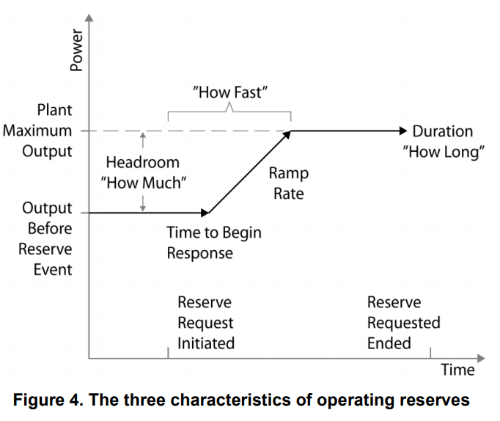
Phase 1: Short-Duration Storage for Providing Operating Reserves
After 2000: wholesale markets: operating reserve products (in response to random variations in supply and demand at various time scales)
→ characterized by three factors: How much (MW), How fast (MW/second), How long (MWh)
Spinning contingency reserves are used to respond rapidly to address the failure of large power plants or associated transmission lines.
Regulating reserves are used to address smaller, random variations in supply or demand.
Prices for operating reserves are often measured in units of capacity available during 1 hour (MW-hr).
A key aspect of these services is that once the minimum duration requirement (“how long”) is met, there is no additional value for additional duration (stored energy) for a given market service.

Slide 7
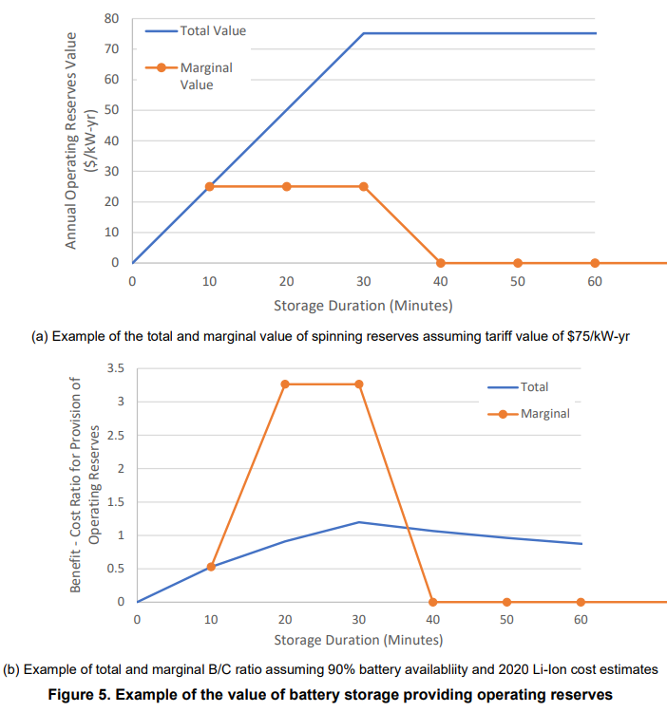
Figure 5a shows a specific example of the value of a device providing spinning reserves of ($75/kW-yr) for spinning reserves and a 30-minute requirement. A 10-minute battery would need to be derated to one-third of its capacity to provide 30 minutes of service, and therefore this battery would receive about $25/kW-year (with 100% availability). Each dot on the “marginal” curve shows the value of an incremental 10 minutes of storage. The total value increases as storage duration is added until the battery reaches 30 minutes of duration, at which point the value of adding additional duration for this service is zero

Slide 8
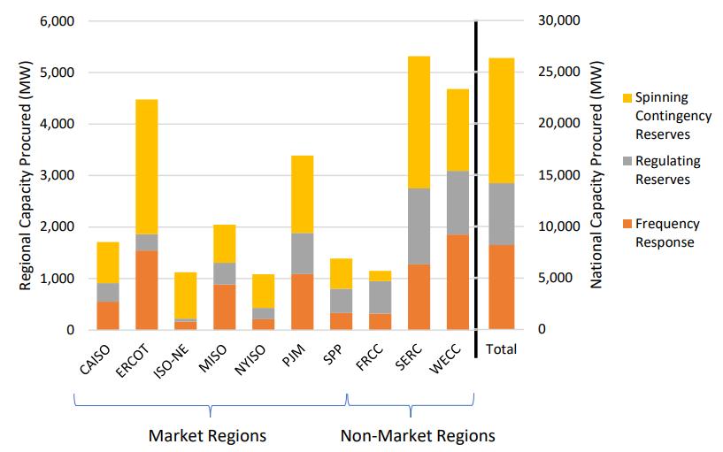
Overall, this total results in a technical potential of short-duration operating reserves of less than 26 GW (Figure 6), with an economic opportunity for storage in Phase 1 likely being substantially less than this, particularly with competition from demand response including controlled EV charging, and existing PSH.
This means these markets have the potential to quickly saturate.
One factor could extend Phase 1: potential growth in regulating reserves that may result from increased deployment of VRE resources.

Slide 9
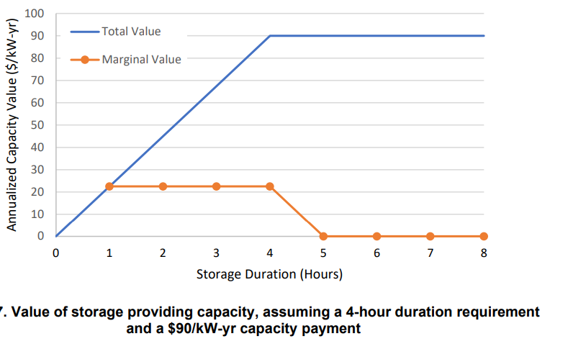
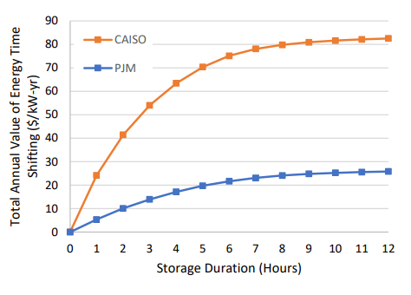
Phase 2: The Rise of Battery Peaking Power Plants
Deployment of batteries with about 2–6 hours of duration for providing peaking capacity.
Continued decline in the costs of Li-ion batteries has increased their competitiveness over gas turbines
Phase 1 typically provides only 1 service but phase 2 provides multiple services,
Two factor to evaluate: physical capacity (capacity credit), the value of energy time-shifting
physical capacity value
energy time-shifting value

Slide 10
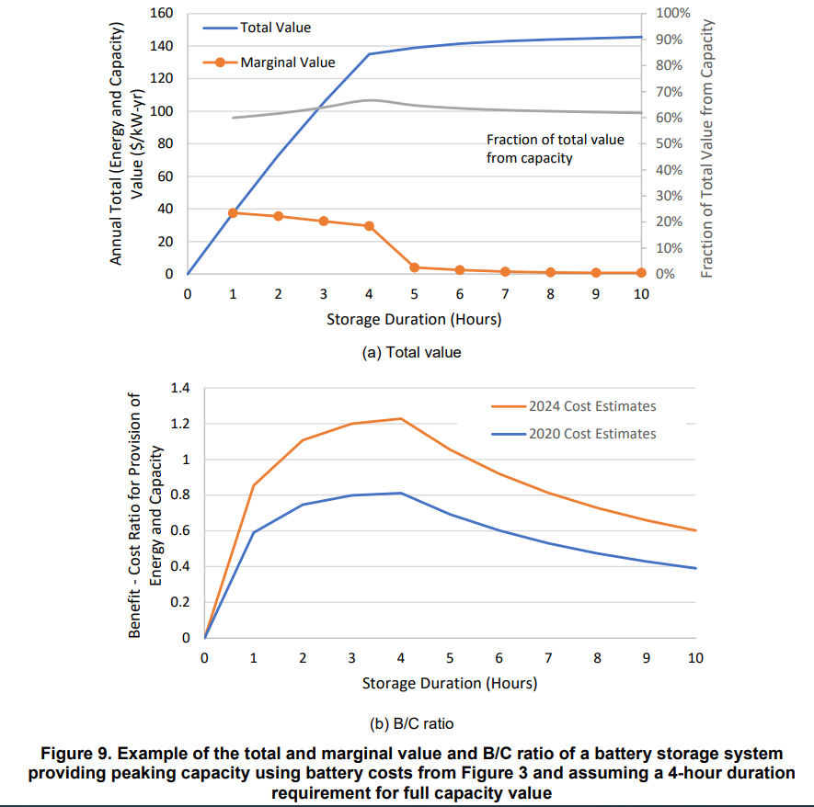
Total value: combination of the value components
In this example, most of the revenue is derived from capacity value instead of energy time-shifting, as demonstrated by the gray line
In addition, the lower value of energy time-shifting, particularly beyond 4 hours, results in a very small incremental total value once capacity duration requirements have been met.
This combination drives the economic performance of storage as a function of duration as illustrated in Figure 9b, in terms of its B/C ratio as a function of storage duration, using the cost curves for a Li-ion battery

Slide 11
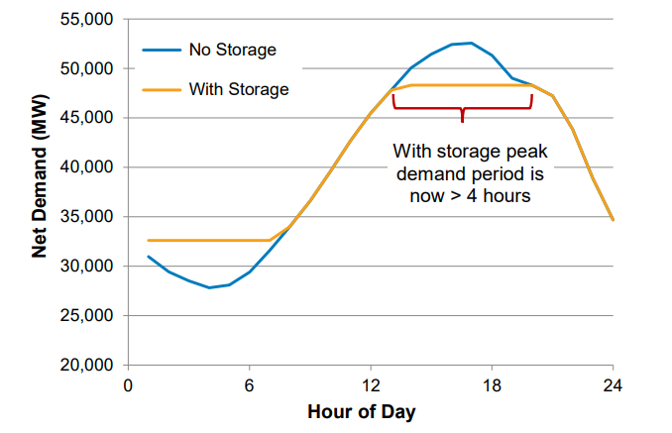
Limits to Phase 2: Declining Energy and Capacity Value, and the Impact of Renewable Energy Deployment
There are about 261 GW of dedicated peaking capacity in the United States, and hundreds of GW of plant retirements are expected in coming decades that include a large amount of peaking capacity
The potential for 6-hour-or-less batteries is only a fraction of this capacity due to the declining value of storage as a function of deployment. As more energy storage is deployed, the peaks become wider and energy storage is less able to meet the resulting longer periods of peak demand.
At the same time, additional storage reduces the difference between onpeak and off-peak prices, thus reducing arbitrage/time-shifting benefits.

Slide 12
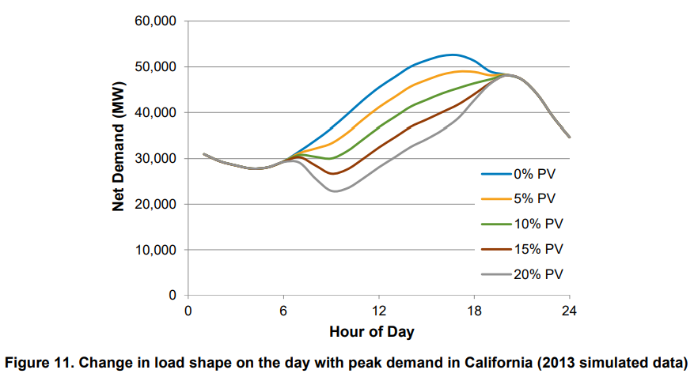
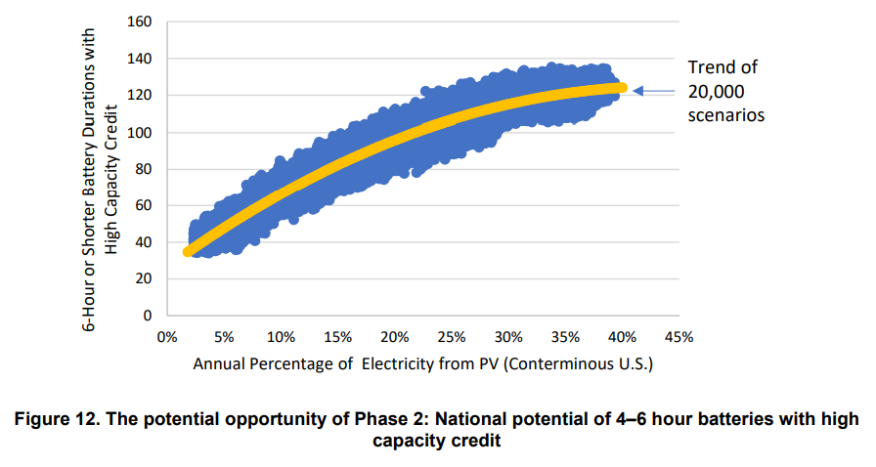
illustrates how PV could narrow the net load peak and thus counteract the widening that occurs with increased storage deployment.
how PV deployment can increase the amount of 4–6 hour storage offsetting capacity requirements and extending Phase 2 considerably

Slide 13
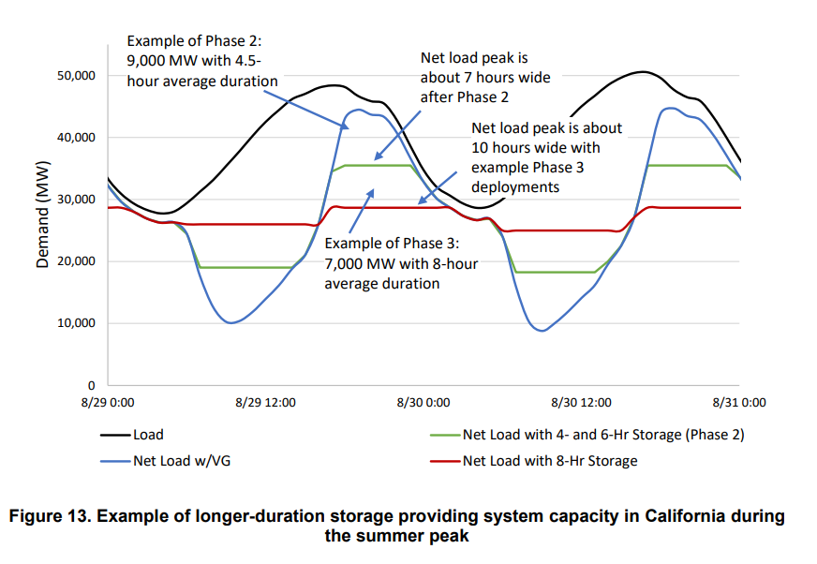
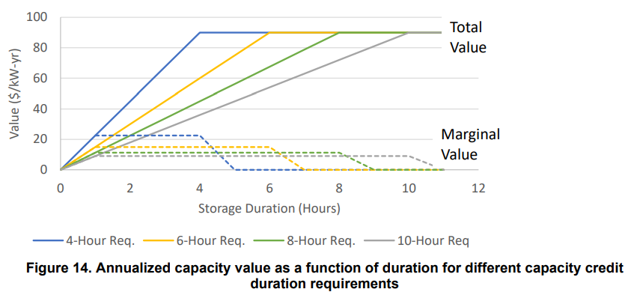
Phase 3: The Age of Low-Cost Diurnal Storage
Longer peak periods increase the competitiveness of technologies with lower duration related costs, including new battery chemistries, additional pumped storage
Development depends on the degree to which storage costs decline and VRE deployments increase.
← how the marginal value of capacity falls as the length of the peak period moves from 4 to 10 hours

Slide 14
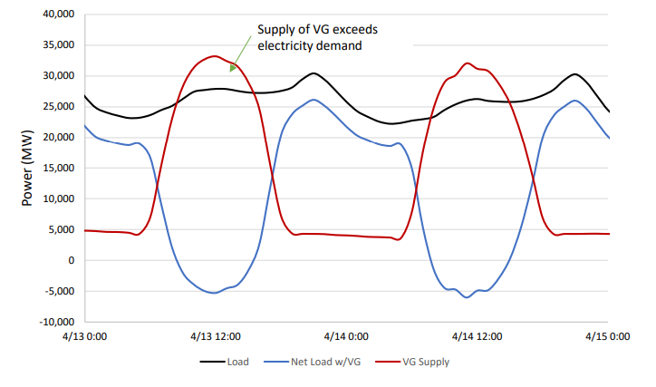
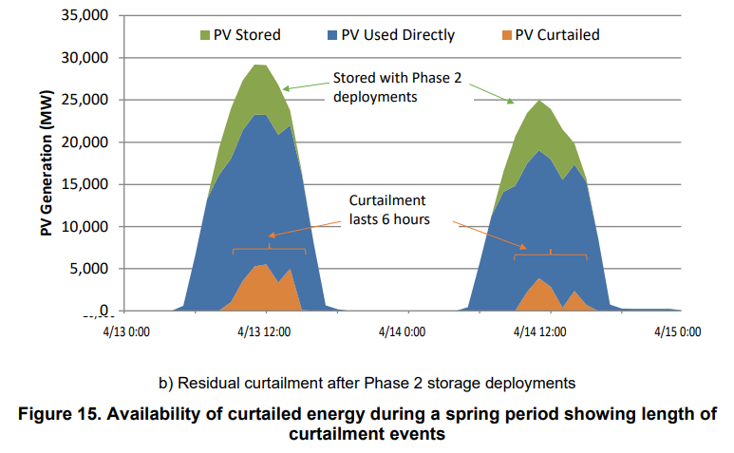
For example, to reduce the net load by 100 MW at the point where the peak net load is 8 hours, we would need 800 MWh of stored energy.
We could achieve this by adding a 100-MW device with 8-hours of capacity.
Alternatively, we could add a 133-MW device with 6-hours of capacity (meaning the plant would operate at less than full power output when discharging to reduce the peak by 100 MW).
Both options provide the same amount of stored energy.
For assuming the same storage technology, the 133-MW storage plant would almost certainly cost more than the 100-MW storage plant,
But the additional power capacity might provide additional energy shifting opportunities and thus depending on the value of energy shifting or other value streams, different configurations may be cost-effective.
As a result, it is possible that shorter-duration storage may still be deployed in Phase 3 to capture the high-power curtailment events in the high-solar scenario.
Alternatively, longer-duration storage is potentially more suited to capturing curtailed energy in high-wind scenarios that do not feature high-power, short-duration curtailment events

Slide 15
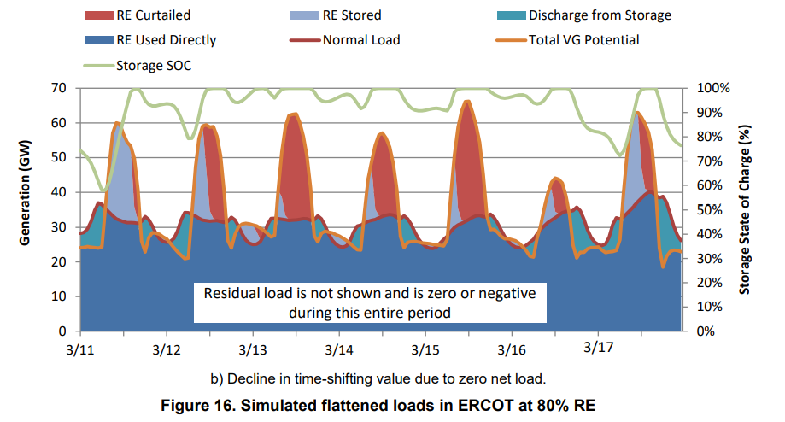
Limits to Phase 3: Flattened Loads and the Impact of Seasonal Mismatch
longer net load peaks can result from the addition of substantial 2–6 hour storage deployed in Phase 2. Deployment in Phase 3 could include a variety of new technologies
The technology options for Phase 3 include next-generation compressed air and various thermal or mechanical-based storage technologies
Also, storage in this phase might provide additional sources of value, such as transmission deferral
Our scenario analysis identified 100 GW or more of potential opportunities for Phase 3 in the United States
Additional VRE, especially solar PV, could extend the storage potential of Phase 3, enabling contributions of VRE exceeding 50% on an annual basis.
Deployments associated with hybrid plants, where storage can take advantage of tax credits

Slide 16
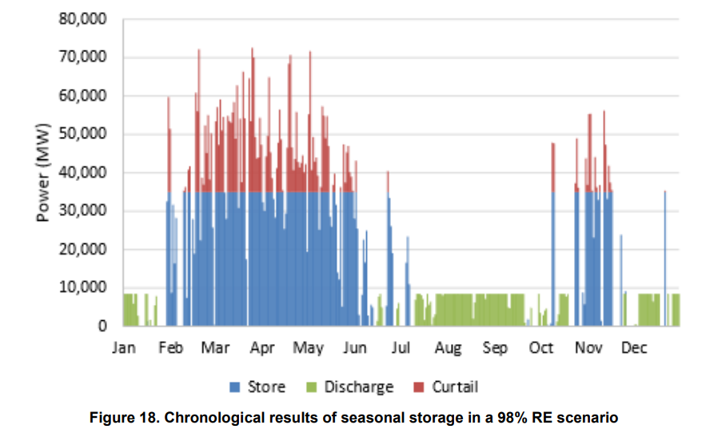
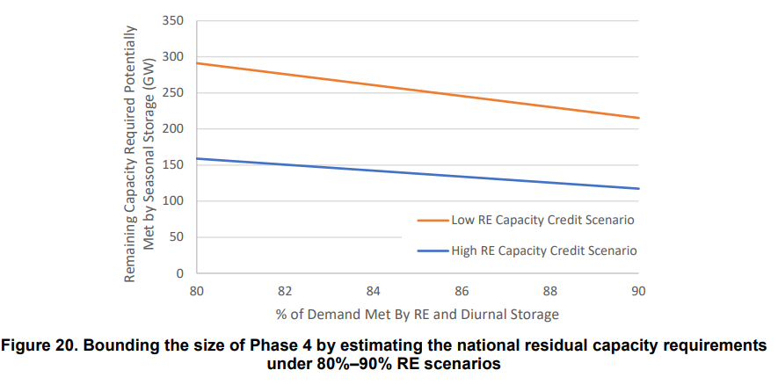
Phase 4: The End Game—Multiday to Seasonal Storage
Phase 4 is the most uncertain of our phases. It characterizes a possible future in which storage with durations from days to months is used to achieve very high levels of renewable energy
Phase 4 technologies are generally characterized by high power-related costs associated with fuel production and use but with very low duration-related costs. Thus, traditional metrics such as cost per kilowatt-hour of storage capacity are less useful, and when combined with the potential use of fuels for non-electric sector applications, makes comparison of Phase 4 technologies with other storage technologies more difficult.
The potential opportunities for Phase 4 technologies measure in the hundreds of gigawatts in the United States

