Slide 1
Journal Club Review of
Electrification Futures Study:
Scenarios of Power System Evolution and
Infrastructure Development for the United States
NREL Report
Russ Jones

Slide 2
Executive Summary
Fifth in a series of reports analyzing the potential impacts of widespread electrification on the evolution of the U.S. electricity system.
  Others at https://www.energy.gov/eere/analysis/analysis-publications
  Others:
    Electrification Futures Study: End-Use Electric Technology Cost and Performance Projections through 2050
    Electrification Futures Study: Scenarios of Electric Technology Adoption and Power Consumption for the United States
    The Demand-Side Grid (dsgrid) Model Documentation
    Electrification Futures Study: Methodological Approaches for Assessing Long-Term Power System Impacts of End-Use Electrification
Supply-side scenarios are simulated using the NREL Regional Energy Deployment System (ReEDS) model (Cohen et al. 2019). ReEDS is a capacity expansion model that identifies least-cost portfolios of the U.S. power system from the present through 2050
  With a nice website for results at https://cambium.nrel.gov/?project=fc00a185-f280-47d5-a610-2f892c296e51 )
  All the results are downloadable from the website including hourly profiles from all scenarios

Slide 3
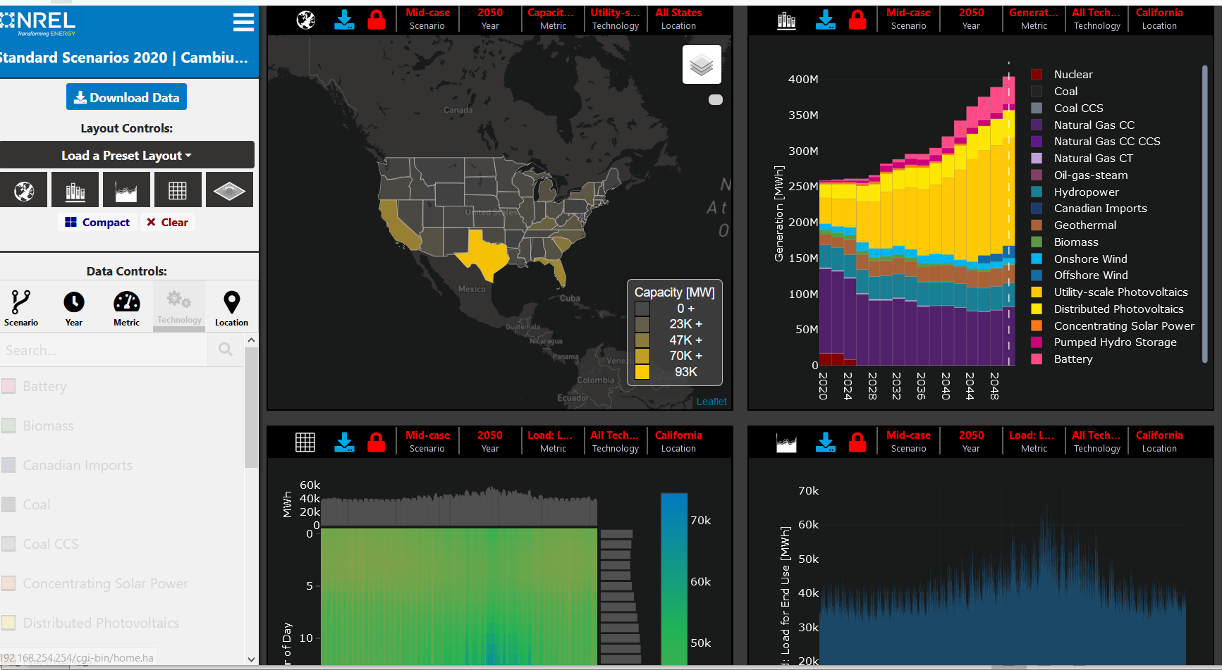

Slide 4
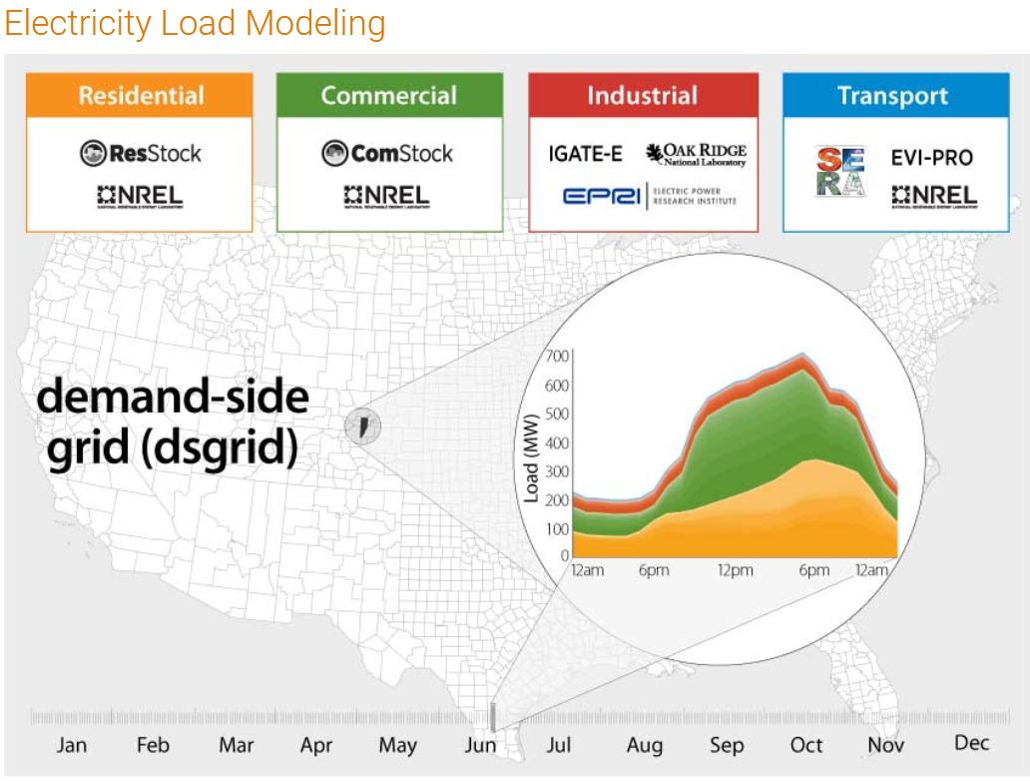
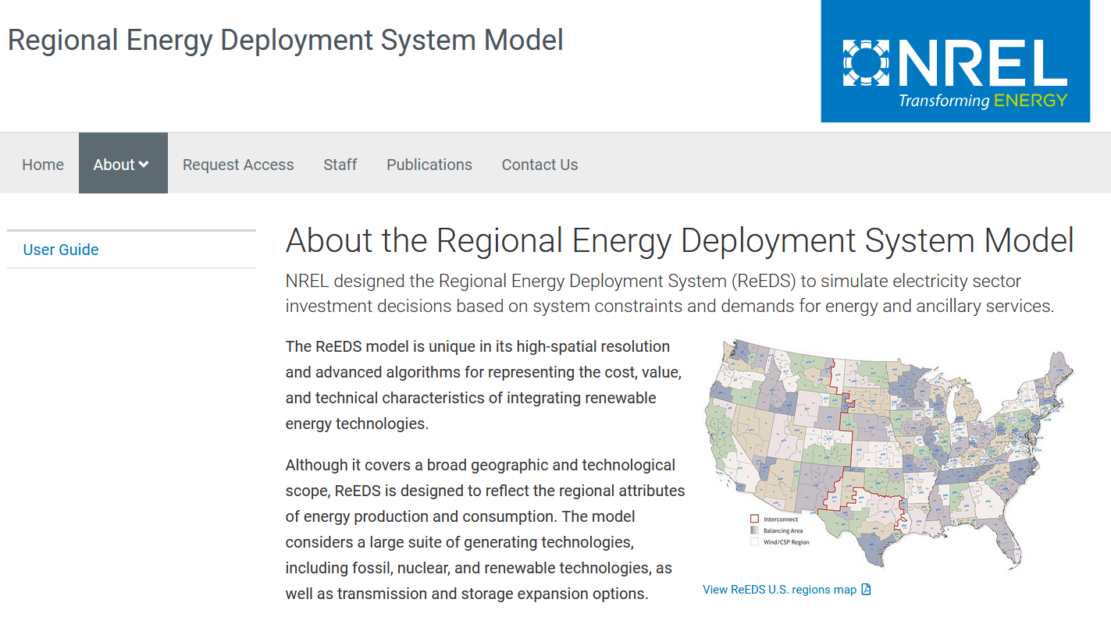
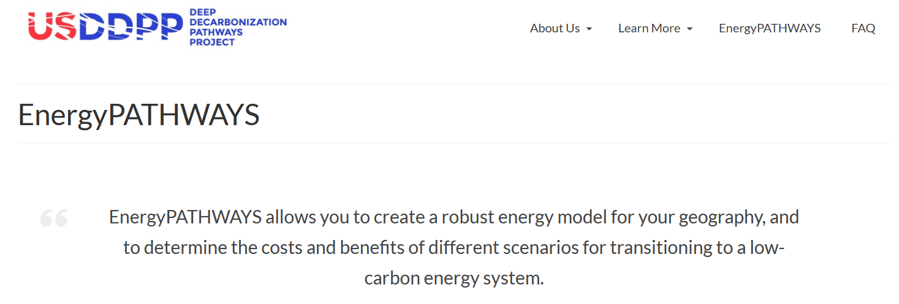
Models used in the Energy Futures Study
dsgrid - electric load modeling
ReEDS — optimal capacity planning and dispatch model for USA
EnergyPATHWAYS — overall energy system model

Slide 5
Executive Summary
Key findings of the study:
  Electrification drives substantial growth in renewables, gas, and storage in policy-dependent proportions (doubling by 2050 in high-electrification scenario)
  Increased reliance on demand flexibility (e.g. EV charging) to make the supply system more cost-effective
  The US has ample resources (renewables and gas) to accommodate growth in the electricity sector
  Cost growth in the electricity sector may occur due to increased T&D capacity, but this depends on pace of technology improvement for end-use efficiency
  Overall, by shifting demand for transportation and heating energy use to electrification, total energy sector consumption and emissions are reduced
Limitations and caveats:
  The analysis only included system costs and does not include any consumer costs for electrification or demand flexibility
  The analysis omits any consideration for hydrogen fuel generation as a displacement for natural gas

Slide 6
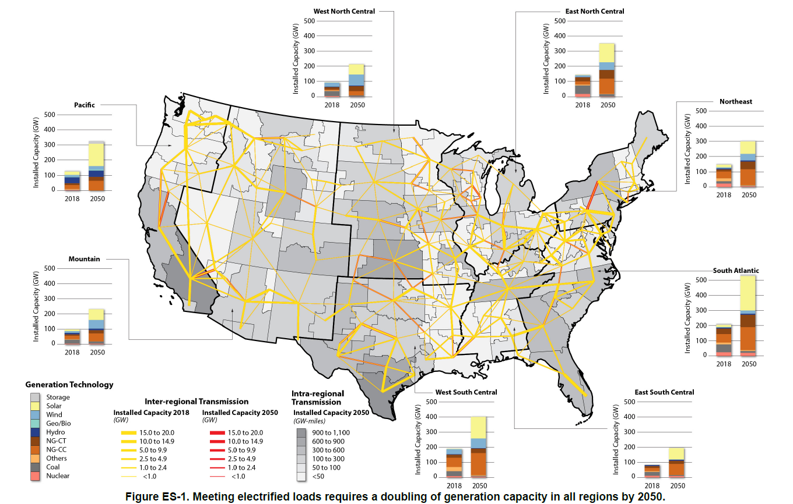
Electricity Sector Growth to meet High Electrification Scenario
by Region

Slide 7
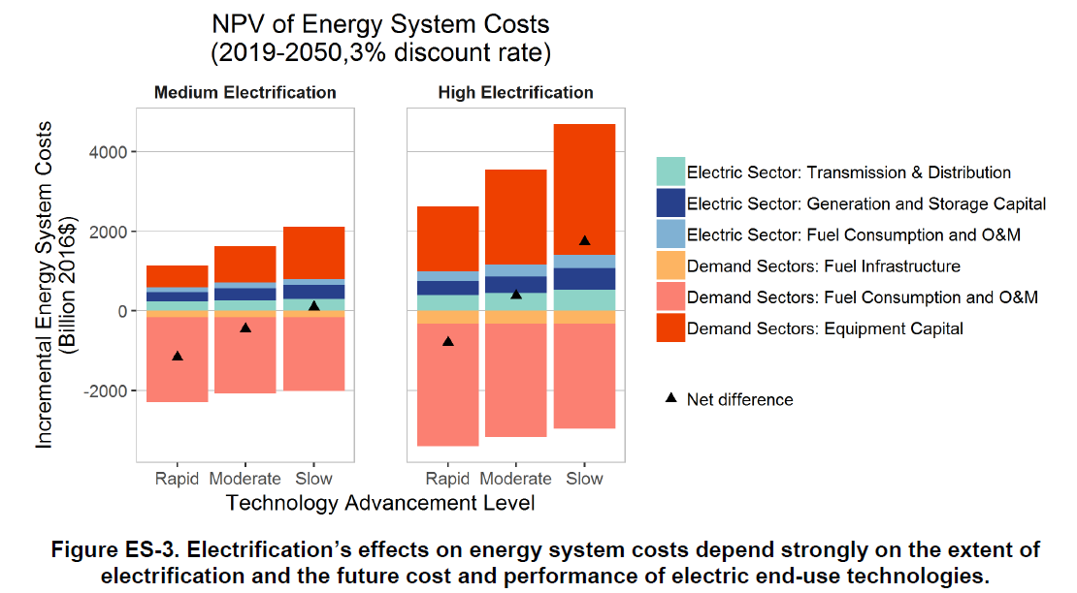
Net Costs of Electrification

Slide 8
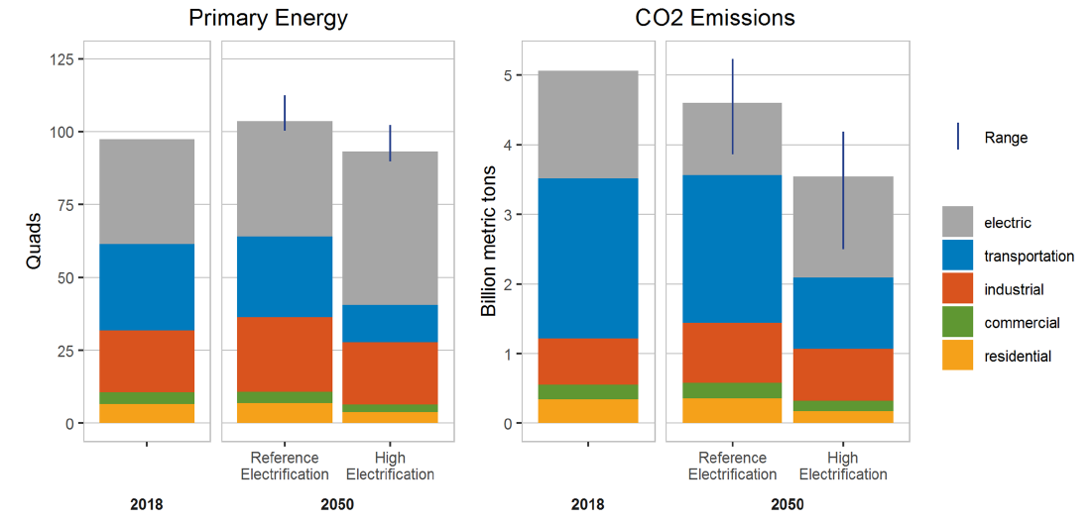
Total Energy Use and Emissions

Slide 9
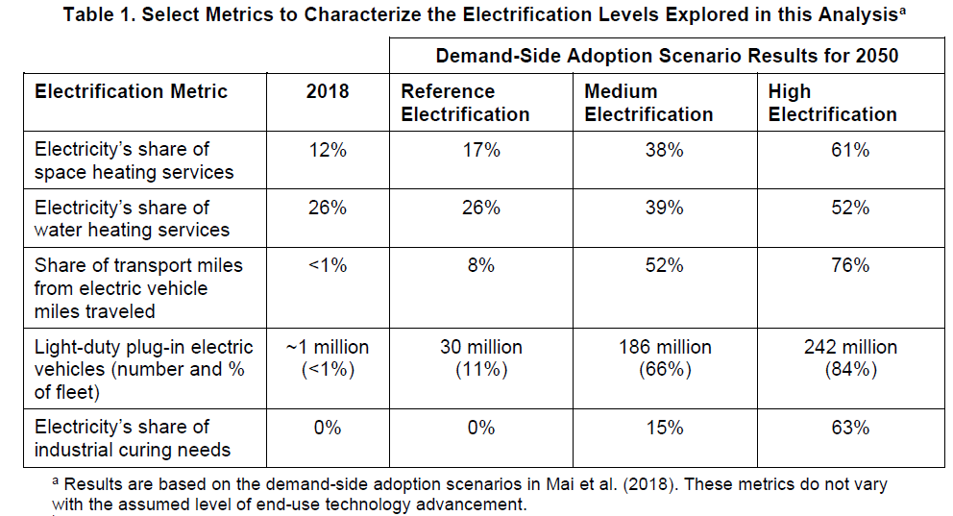
Scenarios
Reference electrification represents the least incremental change in electrification through 2050, which serves as a baseline of comparison to the other scenarios.
Medium electrification represents widespread electrification in select sub-sectors with potentially lower barriers, but it does not result in transformational change.
High electrification represents transformational change in electricity’s share of final energy consumption, such as that which could result from a combination of technology advancements, policy drivers, and consumer enthusiasm for electric technologies.

Slide 10
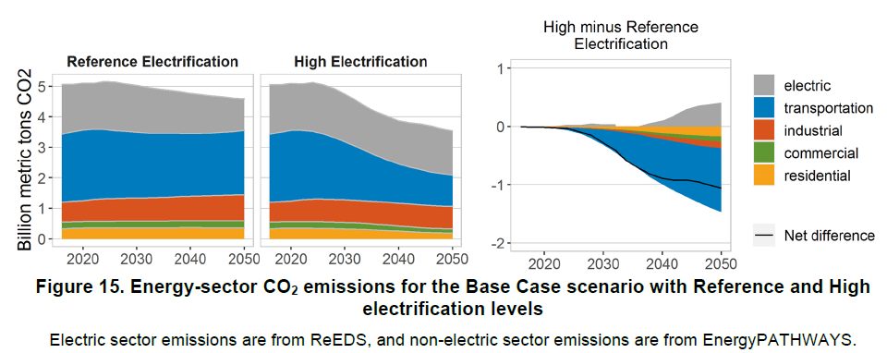
Effect on Emissions
Still melting the polar ice caps in 2050 without strong policy intervention

Slide 11
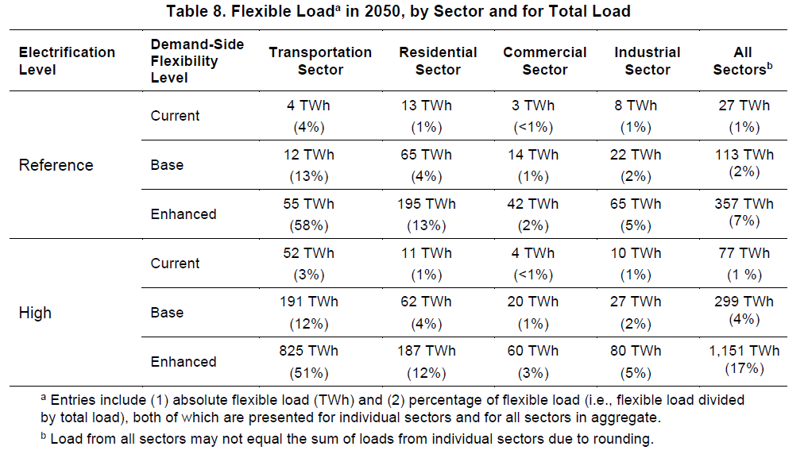
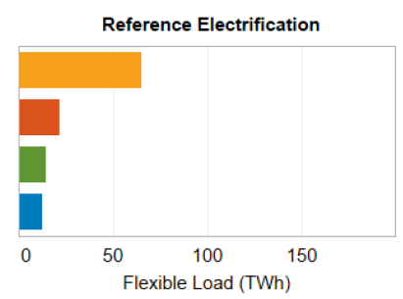
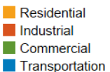
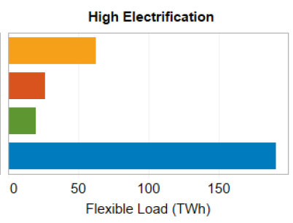
Demand-side flexibility scenarios

Slide 12
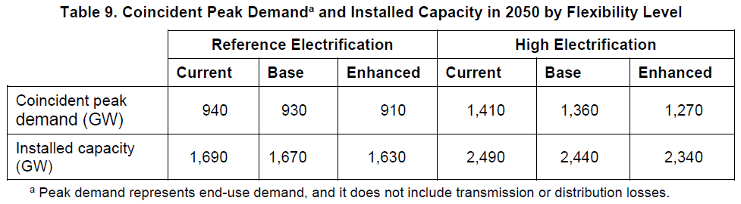
Demand side flexibility impact

Slide 13
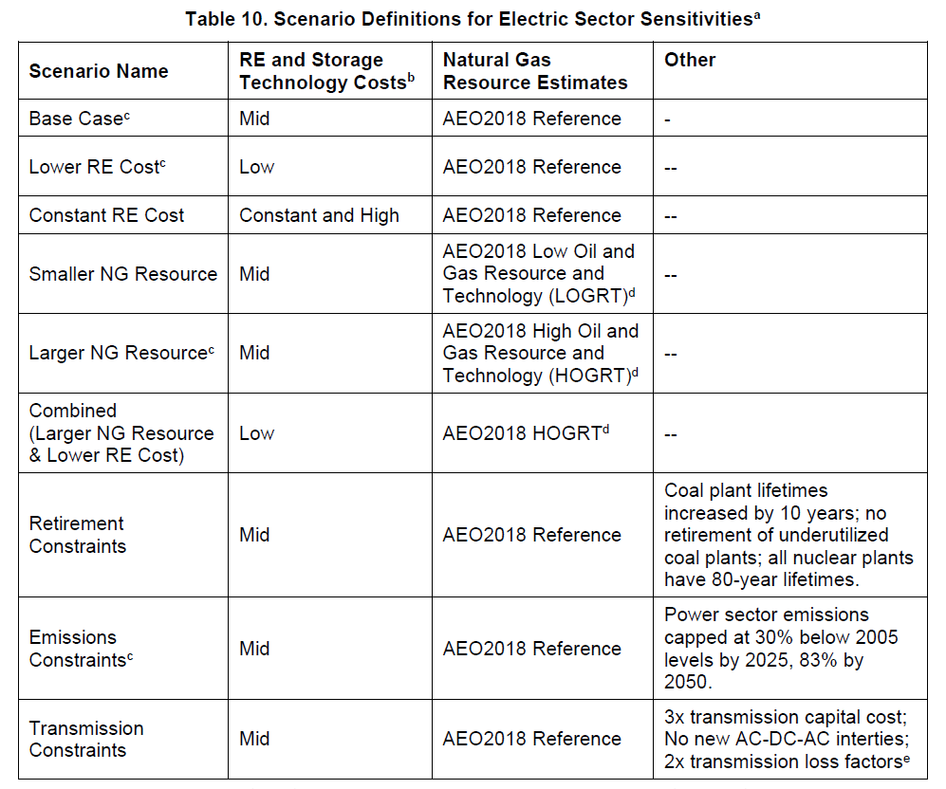
Power Sector Evolution Scenarios

Slide 14
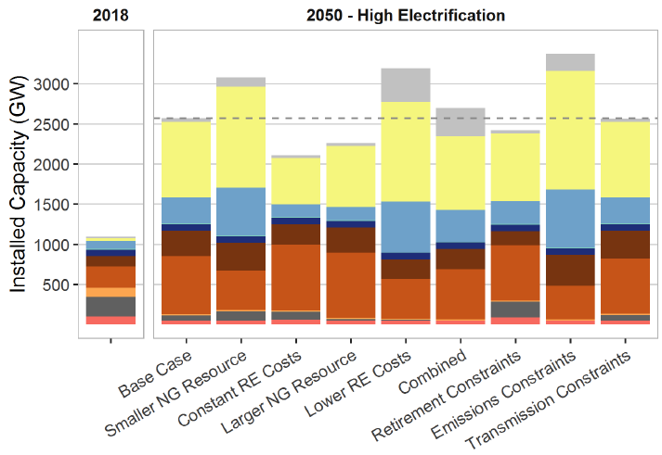
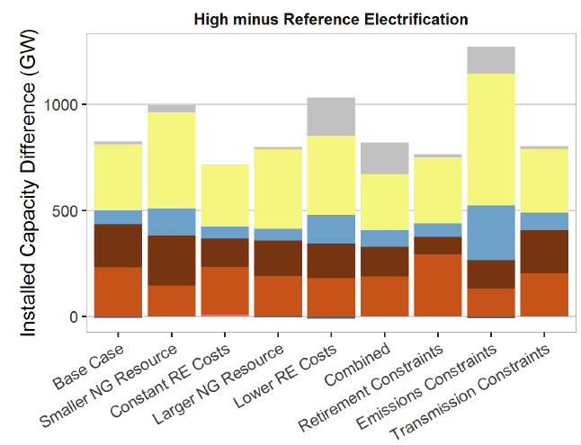
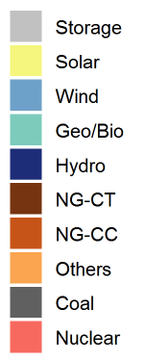
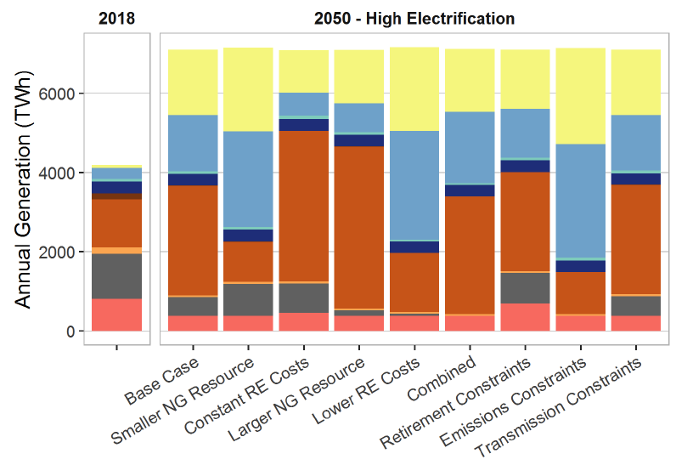
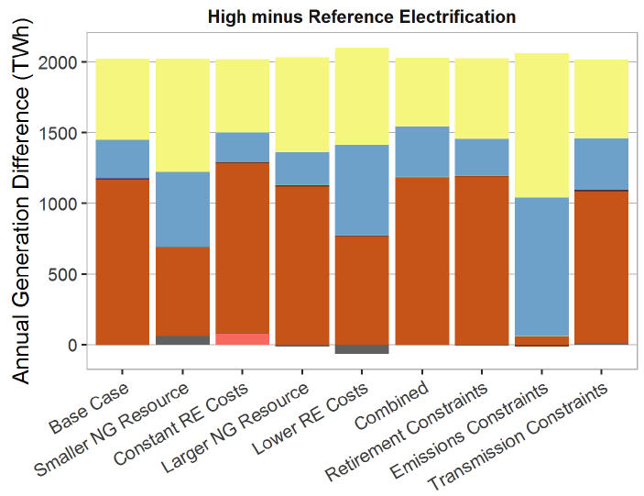
Supply-side scenarios and impacts

Slide 15
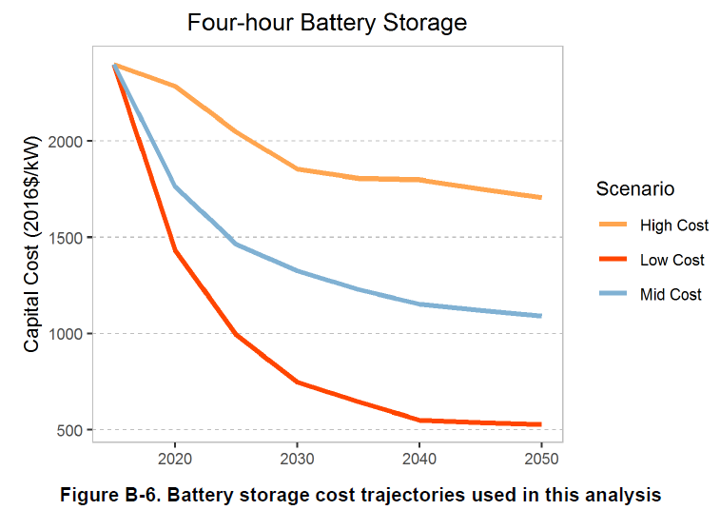
Battery cost assumptions
Assumed $270/kWh in 2050

