Slide 1


Long Duration Energy Storage
Technical Advisory Committee
December 11, 2020

Slide 2

OVERVIEW
Introductions
CEC’s goals
Project plans
Noah Kittner – Technology evaluation
Paty Hidalgo – Modeling
Sergio Castellanos – Inclusion of equity
Asking your advice
What outcomes do you think will be most useful?
How can the results be most effectively communicated?

Slide 3
INTRODUCTIONS TO TAC
Erin Childs (CESA)
Paul Denholm (NREL)
Jennifer Dowdell (TURN) (would like to listen by recording)
Shucheng Liu (CAISO)
Keith Parks (Xcel Energy)
Julia Prochnik (LDES Association of California)
Ron Sinton (Sinton Instruments)
Priya Sreedharan (GridLab)
David Williams (dissigno)

Slide 4





Introductions to core team
University of California Merced
Sarah Kurtz
University of
California Berkeley
Dan Kammen
Sergio Castellanos
University of California San Diego
Patricia Hidalgo-Gonzalez
University of North Carolina
Chapel Hill
Noah Kittner

Slide 5
PROJECT OBJECTIVES – CEC GUIDANCE
Solicitation Directed: Study Value of Long-Duration Storage
What role(s) will long-duration storage play?
What cost target must a storage technology reach to be competitive?
EPIC Funding Directs: Provide value to ratepayers
Low electricity prices
Reliable electricity
Meet SB100 and other CA targets
Technical societal goals
Address climate change
Reduce air & water pollution
Adequate clean-water supplies
Broader societal goals
Stability of jobs
Social justice – move toward a more equitable world…

Slide 6
PROJECT OBJECTIVES – CEC GUIDANCE
Solicitation Directed: Study Value of Long-Duration Storage
What role(s) will long-duration storage play?
What cost target must a storage technology reach to be competitive?
EPIC Funding Directs: Provide value to ratepayers
Low electricity prices
Reliable electricity
Meet SB100 and other CA targets
Technical societal goals
Address climate change
Reduce air & water pollution
Adequate clean-water supplies
Broader societal goals
Stability of jobs
Social justice – move toward a more equitable world…
NOT desired: a new modeling tool.
CEC doesn’t want to fund us to document a publicly available tool

Slide 7
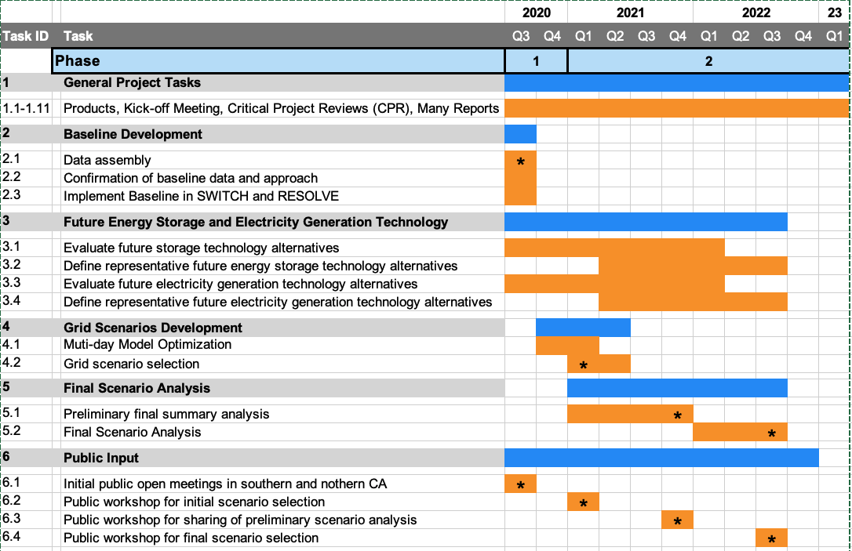
PROJECT SCHEDULE
Technology Evaluation Team
Modeling Team
Baseline definition
Technology evaluation
Scenario analysis

Slide 8
Methodology: Coordinated, 2-prong approach
Technology evaluation
Modeling
Study storage and RE technologies
RESOLVE & SWITCH
Long-duration Storage
Cost analysis (power & energy)
Learning curve analysis
Other metrics:
Efficiency (round trip & loss rate)
Market entry strategy
Jobs creation
Response time
Footprint (energy density)
Permitting – environmental concerns
Geographical flexibility
Modifications of RESOLVE
Coordinate with E3 to update RESOLVE for long-duration storage
Select scenarios and implement in RESOLVE and SWITCH
Analyze results

Slide 9
Project Team Organization
CEC and Technical Advisory Committee (TAC) Oversight
Technology Evaluation
Modeling
University of North Carolina
UC Berkeley & UC San Diego (SWITCH)
UC Merced (RESOLVE)
Storage Advisory Board

Slide 10
Two Biggest Challenges
1. Computational
Must include seasonal effects
Modeling a full year is computationally demanding
RESOLVE looks at one day at a time. Code needs to be updated to address long-duration storage.
2. Complexity
Many inputs
Many inputs are highly uncertain
Many inputs have large effect on storage
Many outputs – need to derive meaningful metrics
Note: plan to use RESOLVE, SWITCH, etc.

Slide 11
Challenge of Communicating Results
Running an optimization model defines a lowest cost solution
From that solution, how do we define:
Roles of storage
Cost targets for storage

Slide 12
Technology Assessment and Learning Curve Analysis
Survey emerging companies and technologies
Challenge: Develop relevant metrics
$/kW
$/kWh
Duration (hours)
Levelized cost of storage
Use multi-factor approach

Slide 13
Multi-factor learning with limited deployment
New factors to consider for cost reductions
Materials science
Business model and entry strategy
Geographic limits
R&D budget
Example Storage Options
Flow batteries
Primus, Form, ESS
Thermal storage
Malta, Antora, NREL
Gravity and geomechanical storage
Energy Vault, ARES, Quidnet

Slide 14
Validate learning
Assess technology roadmap for long-duration storage
Estimate future LCOE, LCOS based on results
Inform models to identify technology readiness level
Estimate impact of cumulative deployment on overall cost reductions for investment decisions
Environmental impact and job creation
Evaluate probability of achieving cost target

Slide 15
Modeling
Some research questions we will explore:
Effect of consecutive days modeled and role of storage (i.e., investment and operation decisions based on time scope)
Differences in capacity expansion from having two geographical scopes (i.e., CA and WECC)
Transmission deployment
Storage deployment
Solar and wind resource
Impacts of strongly limiting transmission deployment
Which storage technologies get deployed instead?
How does the renewable energy mix change with transmission constrained? (location and type of resource)
Cost sensitivity analysis for different storage technologies
Study how coordinated changes can lead to positive feedback opportunities, hastening the energy transition
Incorporating equity into our data acquisition and scenarios modeling

Slide 16
Modeling: Time-sampling methods
Objectives of different sampling methods
Identify role of different storage technologies depending on time length for energy balance:
4-hour arbitrage
Intra-day
Intra-week
Within 2 months
Seasonal (yearly)
Identify breakpoint where adding more hours to the optimization does not change results (e.g. 2 months of consecutive hours instead of 8760).

Slide 17
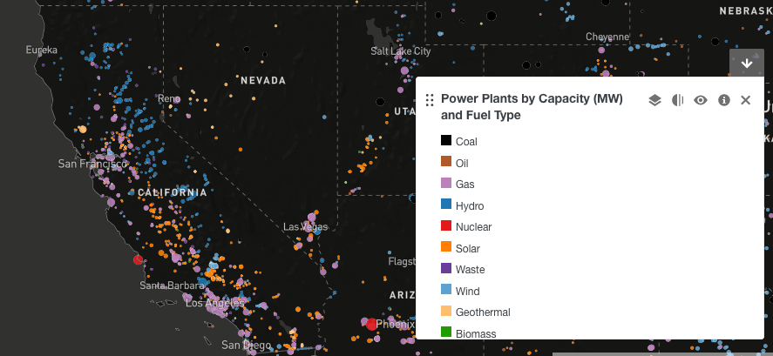

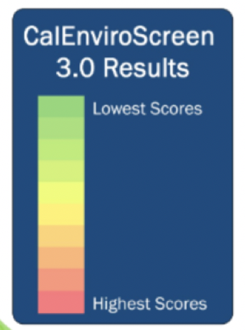
Incorporating Equity in our Modeling
LDES and its intersection with disadvantaged communities
Question: How do we link this research with the goal of pushing for an equitable future?
(Many ways…)
Prioritized Decommissioning vs.
Prioritized Transitioning
Criteria A
Criteria B
…
*
Modeling equitable portfolio:
- $, GHG, …
*
*TAC input

Slide 18
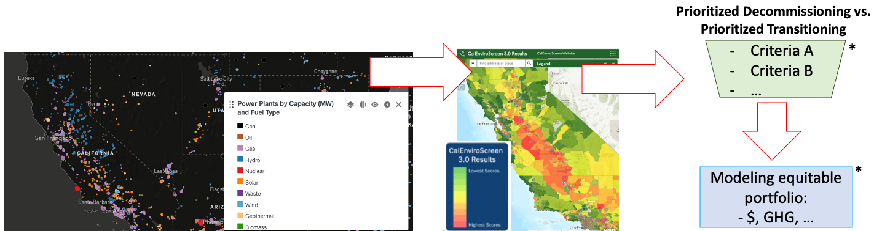
Incorporating Equity in our Modeling
QUESTIONS / ADVICE
Operationalizing equity in planning decisions?
Realistic criteria to transition or decommission? (CA-focused or elsewhere)
Most important metrics to compare results?
What other elements to consider (either in parametrizing in inputs, or quantifying in results)?

Slide 19
Possible approach for one output
1. Define roles according to:
• Each storage application
• Hours of duration
• Efficiency
2. Create price target graphs for each (see right)
Does the TAC have better suggestions?
Market is “ripe”
Market not yet demanding LDES so price must be extra low
Market is maturing and competing technologies are lower in price
This sort of analysis can help companies align their product design with market entry timing

Slide 20
Asking your advice
General
What outcomes do you think will be most useful?
How can the results be most effectively communicated?
Technical:
How should planning reserve margin increase or decrease as the resource mix changes?

Slide 21
We welcome collaboration:
Sarah Kurtz – UC Merced (skurtz@ucmerced.edu)
Dan Kammen – UC Berkeley (kammen@berkeley.edu)
Noah Kittner – U North Carolina (kittner@unc.edu)
Patricia Hidalgo-Gonzales – UC San Diego (phidalgogonzalez@eng.ucsd.edu)
Sergio Castellanos-Rodriguez – UT Austin (sergioc@utexas.edu)
Thank you for your attention!

Slide 22
Modeling: Time-sampling methods
Method 1 (replicate current method):
2 days per month with hourly resolution: peak and median
Storage energy balance: daily
Every month for the representative year in the period
Method 2:
Two sets of ~4 consecutive days with hourly resolution to represent each month
Storage energy balance: ~4 days
Every month of one year per period
Method 3:
Two independent weeks of consecutive hours to represent each month
Storage energy balance: 7 days
Every month of one year per period
Method 4:
Two consecutive months, hourly resolution
Two months sampled per season
Storage balance: 2 months
Method 5:
8760 hours
Storage balance: 1 year

