Slide 1


Long Duration Energy Storage
Meeting with E3
Sept. 18, 2020

Slide 2

MEETING AGENDA
Introductions
Overview of respective team structures
Gain an understanding of the goals and scope of work of related CEC EPIC research grants & project timelines (UC Merced and E3)
Discuss areas of potential overlap & strategies to avoid duplicative efforts

Slide 3
Project Team Organization
Technology Evaluation
Modeling
Univ. of North Carolina (Kittner)
Learning curves, etc.
UCB (Kammen)
UCSD (Hidalgo) (Emphasis: Switch)
UC Merced (Kurtz) (Emphasis: Resolve)
Coordinated efforts are a necessity; each group has an emphasis

Slide 4
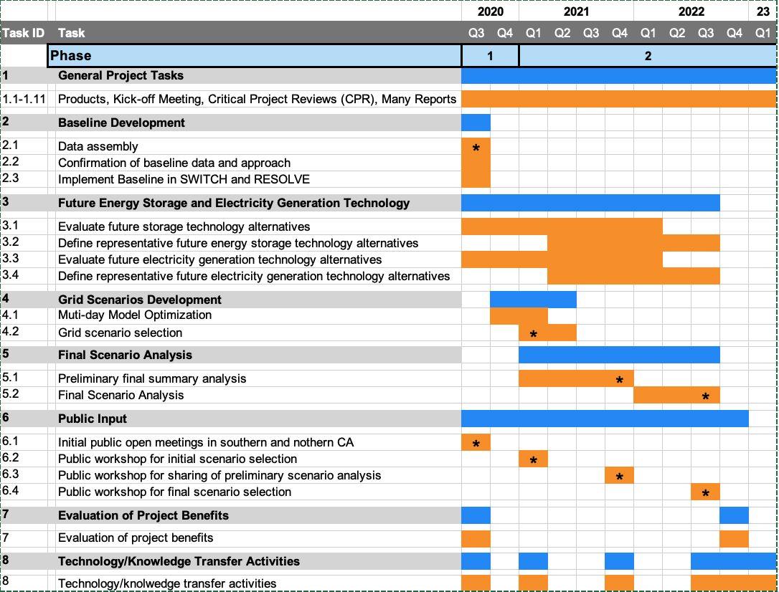
PROJECT SCHEDULE
Tech. Assessment Team
Modeling Team
Baseline definition
Technology assessment
Scenario analysis

Slide 5
Methodology: Coordinated, 2-prong approach
Technology evaluation
Modeling
Study storage and RE technologies
RESOLVE & SWITCH
Long-duration Storage
Cost analysis (power & energy)
  Learning curve analysis
Other metrics:
  Market entry strategy
  Efficiency (as function of time)
  Jobs creation
  Response time
  Footprint (energy density)
  Permitting – environmental concerns
  Geographical flexibility
Modifications of RESOLVE
  Cross-day analysis
  Separation of charging and discharging power ratings
  Add new storage resources
  Coordinate with E3
Implement Technology Assessment results into RESOLVE and SWITCH (multiple scenarios)
Analyze results

Slide 6
Scope: Understanding storage requires broader look
Variable renewables: Solar, Wind
Green Hydrogen
Long-duration Storage
Dispatchable renewables: Hydro, Geothermal, Biogas
Long-distance Transmission
Demand management
Carbon sequestration
Electrification

Slide 7
What is storage competing with?
Potential
Replace LDES
Carbon sequestration at fossil plants
Green Hydrogen
Chemical storage
Long-duration Storage
Nuclear?
Long-distance Transmission
Factor of 2?
Wind
Solar
Diminish need for LDES
Hydro, Geothermal
Electrification
Demand management
Biogas

Slide 8
Scope: Include multiple roles for storage
Ancillary services
Arbitrage (frequent) – same day every day; same day sometimes
Arbitrage (less frequent) – cross day; several weeks
Seasonal storage – cycle only once or twice per year
Resource adequacy – maybe never cycle
Resilience (during outages - microgrids)
Reduced pollution
Jobs
Environmental issues (including water usage/effects)
Innovation

Slide 9
Examples of storage candidates
Technology Role | Specific Technology | Example data source
Storage | Pumped hydro | Literature
 | Compressed air | Literature
 | Liquid air | Highview
 | Lithium ion | Literature
 | Flow battery | Harvard
 | Gravity | Energy Vault
 | Thermal | Malta; NREL
 | TPV | Antora
 | Green hydrogen | Literature
 | Geomechanical | Quidnet Energy

Slide 10
Deliverables Task 2
Task # | Task | Product | Due date*
2 | Baseline development
2.1 | Data Assembly for baseline development | Draft Baseline Description | 9/4/20
 |  | Final Baseline Description | 9/25/20
2.2 | Confirmation of baseline data and approach | Draft Modelling Approach Description | 9/4/20
 |  | Final Modelling Approach Description | 9/25/20
2.3 | Implementation of baseline data into models to create initial baseline scenario | Summary of Baseline Model Results | 10/23/20
 |  | CPR Report #1 | 10/30/20
*Due dates are from original proposal

Slide 11
Deliverables Task 3
Task # | Task | Product | Due date*
3 | Future Energy Technology Alternatives
3.1 | Evaluate and document future energy storage technology alternatives | Storage Technology Summary (draft) | 1/15/21 | 7/2/21
 |  | Storage Technology Summary (final) | 2/12/21 | 8/12/22
3.2 | Define representative future energy storage technology alternatives | Proposed Storage Scenarios Summary (draft) | 4/9/21 | 4/1/22
 |  | Proposed Storage Scenarios Summary (final) | 5/7/21 | 8/12/22
3.3 | Evaluate and document future energy electricity generation technology alternatives | Electricity Generation Technology Summary (draft) | 1/15/21 | 7/2/21
 |  | Electricity Generation Technology Summary (final) | 2/12/21 | 8/12/22
3.4 | Define representative future electricity generation technology alternatives | Proposed Electricity Generation Scenarios Summary (draft) | 4/9/21 | 4/1/22
 |  | Proposed Electricity Generation Scenarios Summary (final) | 5/7/21 | 8/12/22
*Due dates are from original proposal

Slide 12
Deliverables Tasks 4 & 5
Task # | Task | Product | due date*
4 | Grid Scenario Development
4.1 | Multi-Day Model Optimization | Summary of Multi-day Baseline Model Results | 2/12/21
 |  | CPR Report #2 | 3/5/21
4.2 | Grid Scenario Selection | Grid Scenario Summary (draft) | 6/11/21
 |  | Grid Scenario Summary (final) | 8/13/21
5 | Grid Scenario Analysis
5.1 | Preliminary Scenario Analysis | Preliminary Analysis Summary (draft) | 2/11/22
 |  | Preliminary Analysis Summary (final) | 4/15/22
5.2 | Final Scenario Analysis | Final Analysis Summary (draft) | 6/10/22
 |  | Final Analysis Summary (final) | 8/12/22
*Due dates are from original proposal

Slide 13
Development of Baseline in RESOLVE
We are reviewing inputs and will propose some changes
We would like to talk with someone at E3 about why the current inputs were chosen
After understanding E3’s reasoning, we may choose to stick with current values or propose different values.

Slide 14
Modifications to RESOLVE code
Split charge-discharge rating
Inputs/outputs handled with Python (we are mostly on Macs)
Accept variable weather files with variable day lengths using Python inputs. For example, use 7-day or 14-day weather segments to enable charging on one day and discharging several days later
Apply two-step strategies to enable full-year optimizations:
  capacity expansion planning using small number of days
  unit commitment for full-year data with fixed capacity expansion plan

Slide 15
QUESTIONS for E3
What plans does E3 have for modifying RESOLVE?
Would someone from E3 meet with us to answer questions about RESOLVE inputs
For the changes we are suggesting for RESOLVE, are there any that E3 would like to coordinate on? How can we avoid making a second branch?

Slide 16
We welcome collaboration: skurtz@ucmerced.edu
Thank you for your attention!

Slide 17
BACK UP SLIDES

Slide 18
Value of storage is a function of many things
Function of amount of wind, solar and storage

Slide 19
LEARNING CURVES ARE A KEY TOOL
Kittner, et al

Slide 20
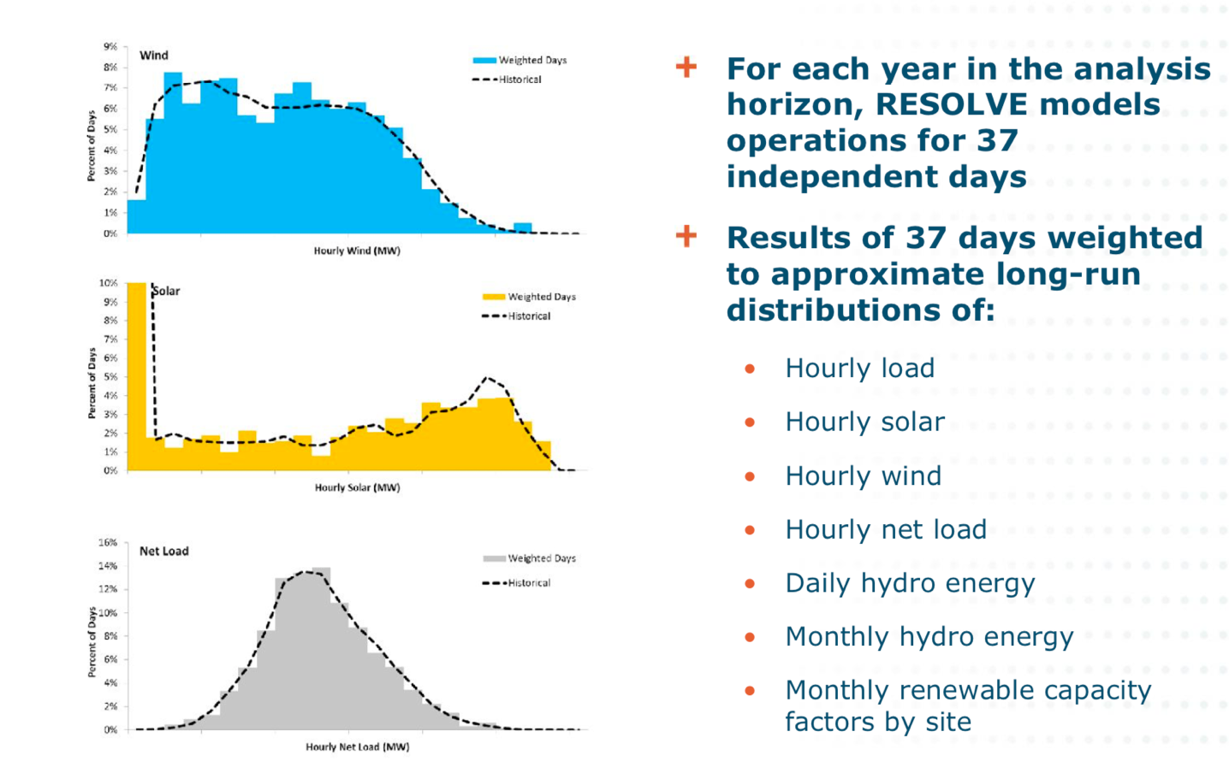
Metrics for selecting weather – extend to cross-day?
https://www.google.com/url?sa=t&rct=j&q=&esrc=s&source=web&cd=&ved=2ahUKEwj8xcHwmqTrAhXOrZ4KHQLBAcYQFjAGegQICRAB&url=https%3A%2F%2Fwww.cpuc.ca.gov%2FWorkArea%2FDownloadAsset.aspx%3Fid%3D6442451316&usg=AOvVaw0mbDD9U2xzOhtJGUFNBfvU
IRP_MAG_E3_Resolve_2016-10-20.pdf

Slide 21
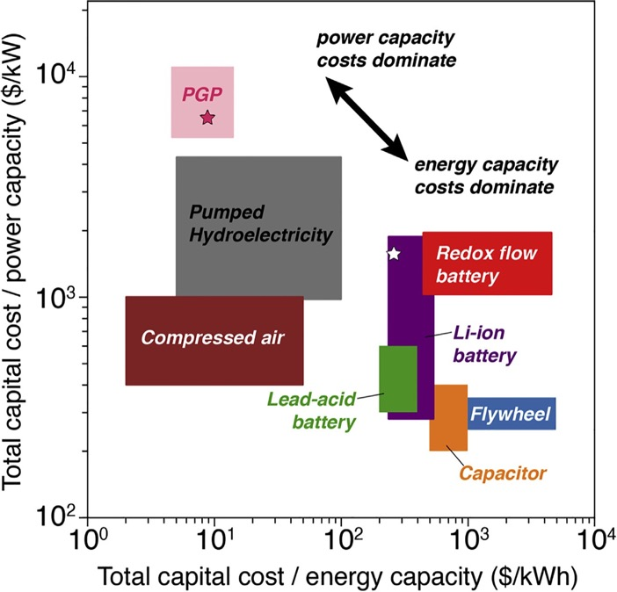
How do we differentiate storage technologies?
Key metrics:
Efficiency
$/kW
$/kWh
Dowling, et al (Joule)

Slide 22
Other Metrics
Market entry strategy – Bridge over the valley of death
Politically viable: Jobs retention
Leverage existing infrastructure
Practicality
  Dispatchability (high-T fuel cells are slow to start up)
  Footprint (energy density)
  Permitting – environmental concerns
  Geographical flexibility
  What else?
For discussion:
Modularity vs utility scale

Slide 23
Definition of terms
CEC defines long-duration storage as 10 or more hours (?)
For modeling, we may consider:
  Diurnal or intra-day storage (can model with 24-h time blocks)
  Cross-day or inter-day storage (need multi-day time blocks - probably a week or a month at a time)
  Seasonal storage (cycle 1X or 2X/year; need full-year or even 30 years of data)
  However, the results for each of these depend on the available resources, which is set in the context of Planning Reserve Margin
Electrochemical storage is short-duration
Is chemical storage “seasonal storage” or “electricity generation”?
Note: RESOLVE currently only considers diurnal or intra-day storage, which can be 10+ hours; must be modified to look at cross-day and seasonal? storage

Slide 24
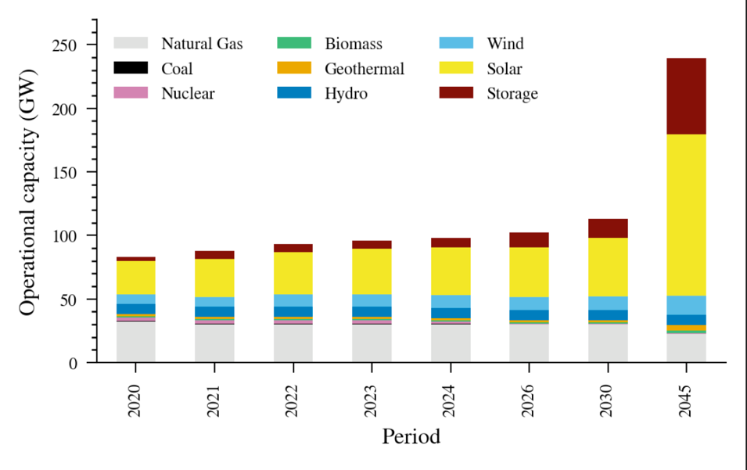
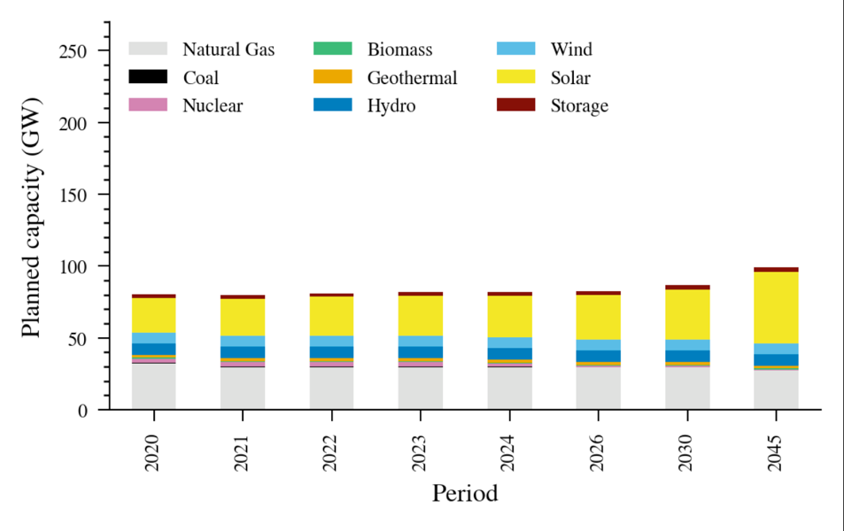
RSP Builds versus planned
Selected growth
Planned growth
Wind 97% of maximum allowed
Solar 20% of maximum allowed
RESOLVE outputs: Data for CAISO zone only

Slide 25
Reference System Portfolio – which outputs = inputs?
Solano Solar Resource
Behind-the-meter battery power capacity
Model selects > planned;
< cap
Selects planned growth
Solano Wind Resource
Behind-the-meter battery energy capacity
Planned growth
Limited by Cap
Fraction of cap that is built is a useful metric

Slide 26
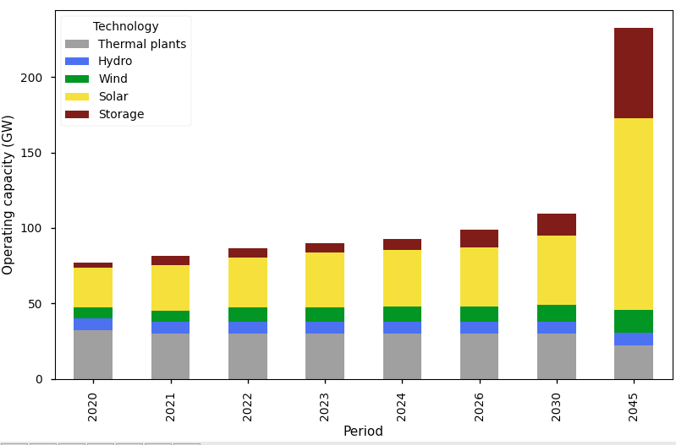
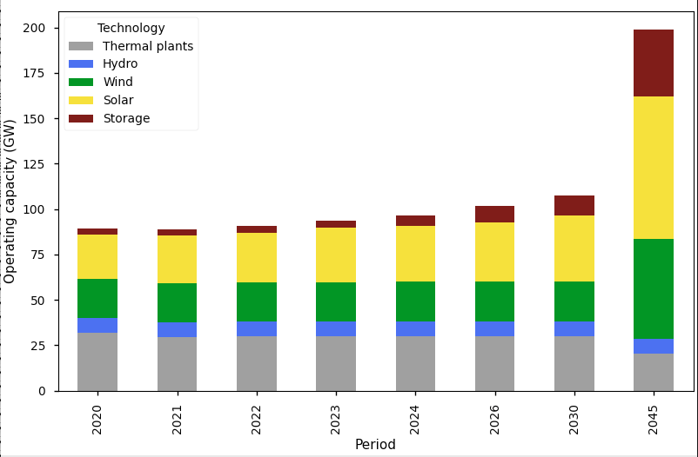
More wind requires less storage
RSP
Wind caps increased
RESOLVE outputs: Data for CAISO zone only
The wind is low because of caps – if the caps are increased, more wind is selected.
Note effect of added wind on need for storage.
Notes:
All wind caps were increased to 9 GW – transmission was needed immediately.

