Slide 1


Long Duration Energy Storage
Kick-off
September 11, 2020

Slide 2

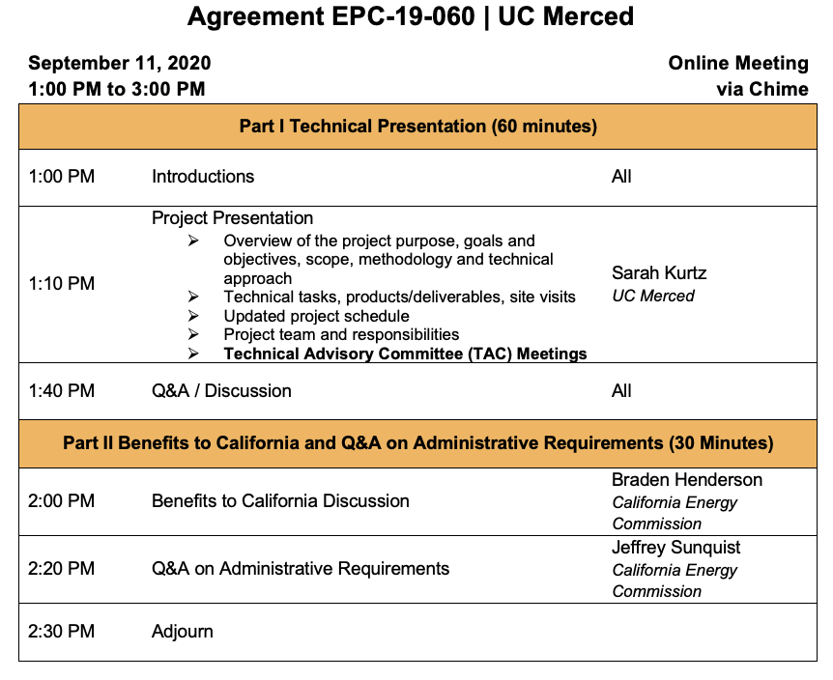
AGENDA FOR KICK-OFF MEETING

Slide 3
PROJECT PRESENTATION
Overview
Purpose, goals, objectives
Scope
Methodology
Technical approach
Technical tasks, products & deliverables
Updated project schedule (delayed one month)
Project team and responsibilities
Technical Advisory Committee (TAC) and TAC meetings
Q&A / Discussion

Slide 4
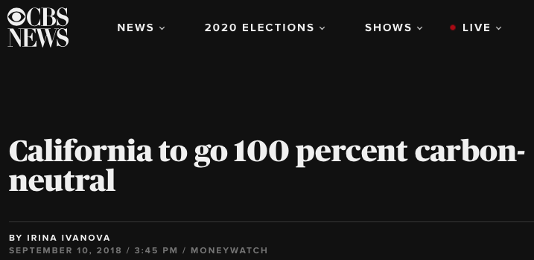
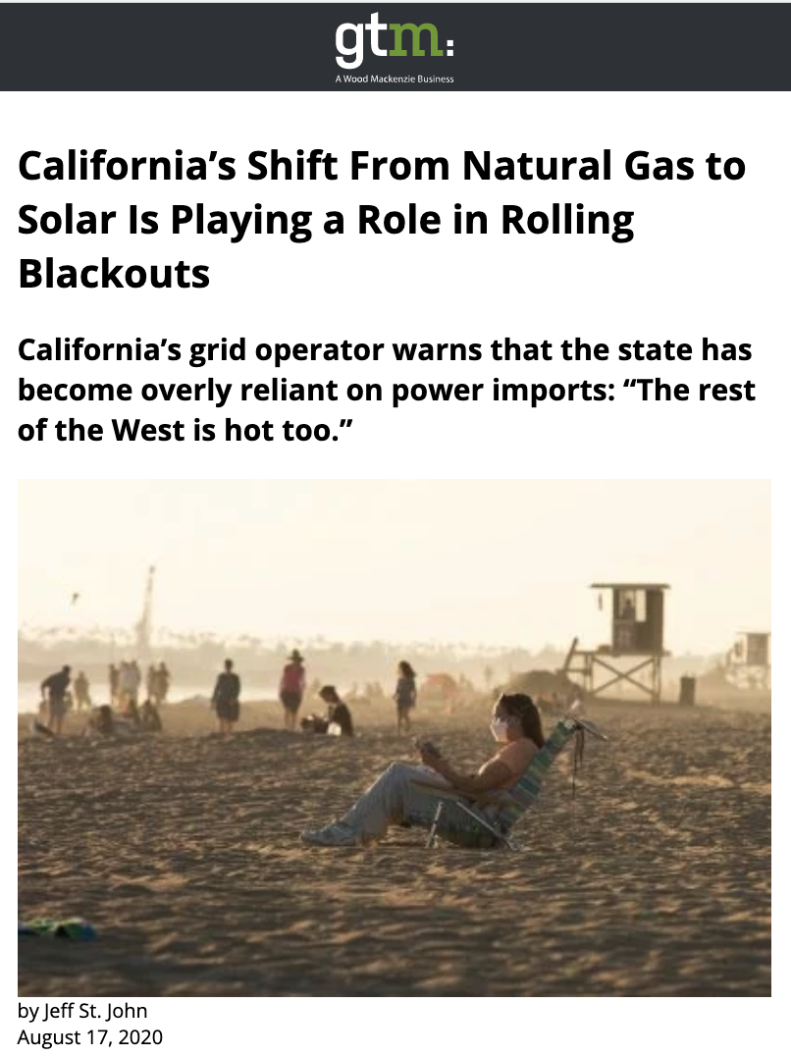
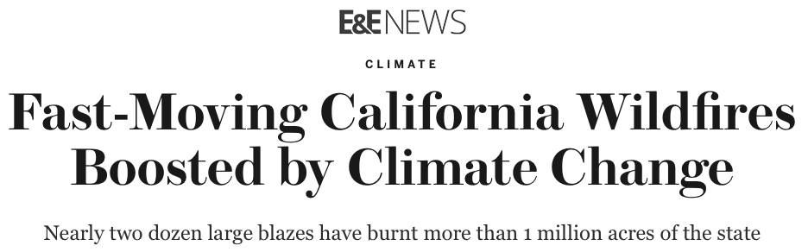
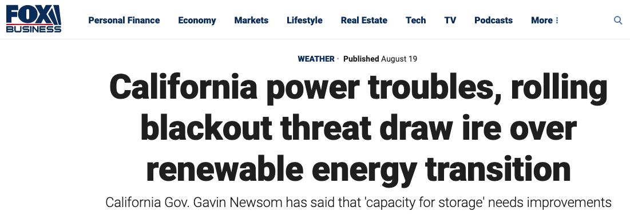
Purpose: Achieve SB100 goals gracefully
State leaders don’t blame renewables; but robust planning is essential!

Slide 5
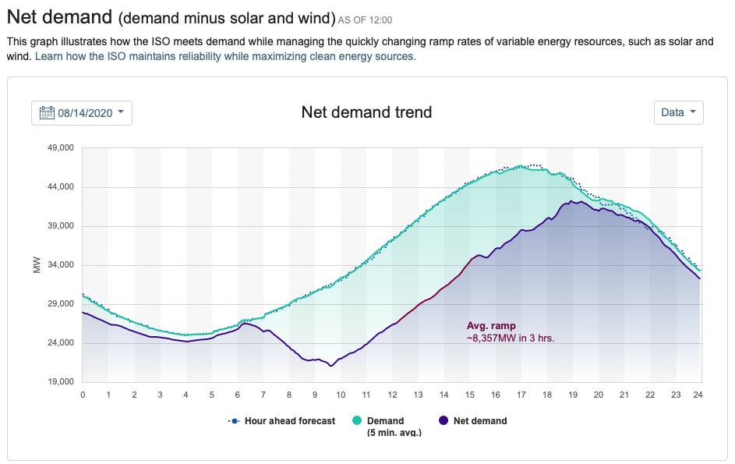
Envision Aug. 14th with no fossil fuels: Power
For Resource Adequacy (Power):
Need ~50 GW (more in 2045)
Hydro ~ 5 GW (?)
Geothermal ~ 1 GW
Biomass < 1 GW
Wind ~ ??
Solar = zero after sunset
Imports ??
May need > 40 GW of dispatchable storage (or demand management?)
Black outs
The governor will want this analyzed 100 different ways!

Slide 6
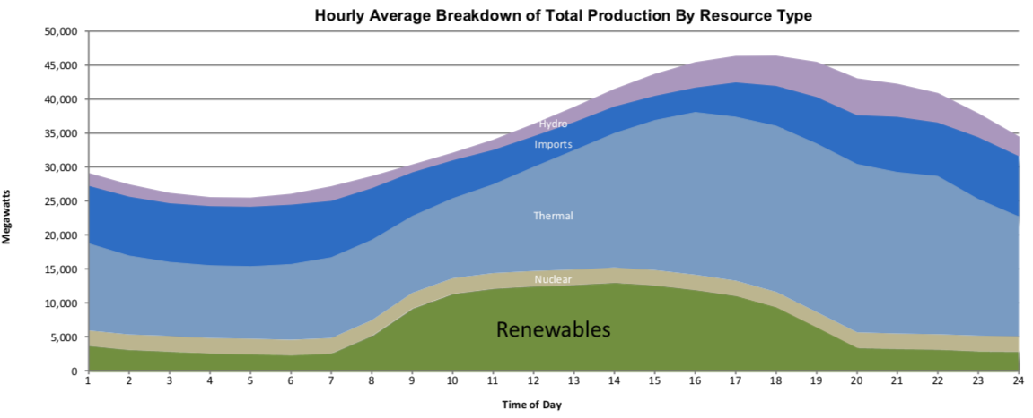
Envision Aug. 14th with no fossil fuels: Energy
August 14, 2020 – day of black outs
Energy Adequacy (one day):
Aug. 14:
• 850 GWh Total
• 100 GWh Solar
• Will imports be available?
• Need ~8 X more solar if we rely mostly on solar
Of the 850 GWh, ~ 500 GWh at night
Thus, the 40 GW of storage needs to provide ~12 h of storage
In 2045 the numbers will be bigger; How will we get there? This is our challenge!
PS What about driving heat pumps in January?

Slide 7
PROJECT OBJECTIVES
Study Value of Long-Duration Storage
What role(s) will long-duration storage play?
What cost target must a technology reach to be helpful?
Larger goal: Provide value to ratepayers
Low electricity prices
Reliable electricity
Meet SB100 targets
Technical societal goals
Address climate change
Reduce air & water pollution
Adequate clean-water supplies
Broader societal goals
Stability of jobs
Social justice – move toward a more equitable world…

Slide 8




BENEFITS TO RATEPAYERS
Happy Californians!
Happy Governor!
Clean air and water
Address climate change: SB100
Reliable electricity
Economic well being = Low cost energy + stable jobs for all

Slide 9
BENEFITS TO RATEPAYERS
Happy Californians!
Happy Governor!
Clean air and water
No black outs
Address climate change: SB100
Reliable electricity
Economic well being = Low cost energy + stable jobs for all

Slide 10
Scope: Understanding storage requires broader look
Variable renewables: Solar, Wind
Green Hydrogen
Long-duration Storage
Dispatchable renewables: Hydro, Geothermal, Biogas
Long-distance Transmission
Demand management
Carbon sequestration
Electrification

Slide 11
Scope: Emphasis
Emphasize
De-emphasize
LCOS - deliver solar electricity at night
Long-duration Storage
Short-duration storage
Resource adequacy

Slide 12
Scope: Include multiple roles for storage
Ancillary services
Arbitrage (frequent) – same day every day; same day sometimes
Arbitrage (less frequent) – cross day; several weeks
Seasonal storage – cycle only once or twice per year
Resource adequacy – maybe never cycle
Resilience (during outages - microgrids)
Reduced pollution
Jobs
Environmental issues (including water usage/effects)

Slide 13
Methodology: Coordinated, 2-prong approach
Technology evaluation
Modeling
Study storage and RE technologies
RESOLVE & SWITCH
Long-duration Storage
Cost analysis (power & energy)
Learning curve analysis
Other metrics:
Market entry strategy
Efficiency (as function of time)
Jobs creation
Response time
Footprint (energy density)
Permitting – environmental concerns
Geographical flexibility
Modifications of RESOLVE
Cross-day analysis
Separation of charging and discharging power ratings
Add new storage resources
Coordinate with E3
Implement Technology Assessment results into RESOLVE and SWITCH (multiple scenarios)
Analyze results

Slide 14
Storage candidates
Technology Role | Specific Technology | Example data source
Storage | Pumped hydro | Literature
 | Compressed air | Literature
 | Liquid air | Highview
 | Lithium ion | Literature
 | Flow battery | Harvard
 | Gravity | Energy Vault
 | Thermal | Malta; NREL
 | TPV | Antora
 | Green hydrogen | Literature
 | Geomechanical | Quidnet Energy

Slide 15
What is storage competing with?
Potential
Replace LDES
Carbon sequestration at fossil plants
Green Hydrogen
Chemical storage
Long-duration Storage
Nuclear?
Long-distance Transmission
Factor of 2?
Wind
Electrification
Diminish need for LDES
Hydro, Geothermal
Biogas
Demand management

Slide 16
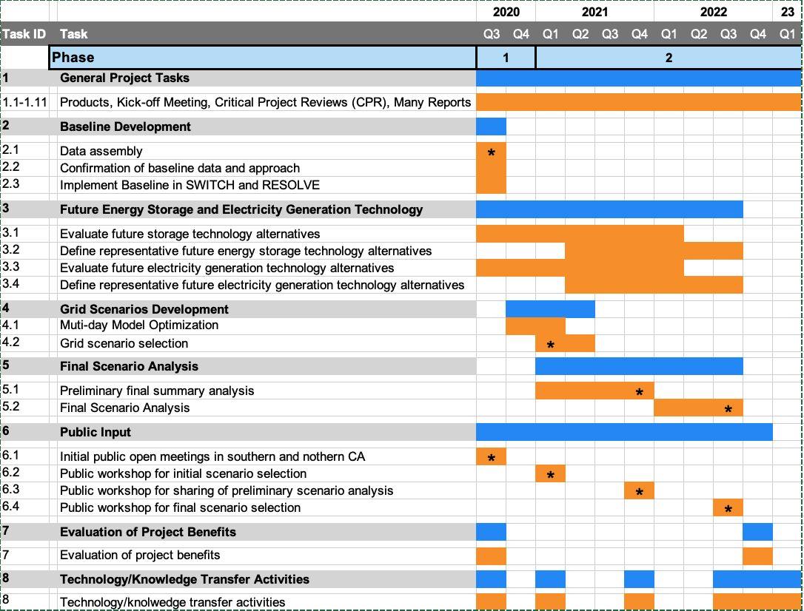
PROJECT SCHEDULE
Tech. Assessment Team
Modeling Team
Baseline definition
Technology assessment
Scenario analysis

Slide 17
Five Public Meetings
Five public meetings are planned:
Introductory workshop in northern California:
Proposed: Oct. 2, 2020 10 am (on-line)
Introductory workshop in southern California
Proposed: Oct. 8, 2020 3 pm (on-line)
Present proposed scenarios: Tentative: Aug. 15, 2021
Present preliminary analysis: Tentative: Apr. 15, 2022
Present final analysis: Tentative: Aug. 15, 2022

Slide 18
Five Public Meetings
First public meetings are planned:
Introductory workshop in northern California
Proposed: Oct. 2, 2020 10 am (on-line)
Introductory workshop in southern California
Proposed: Oct. 8, 2020 3 pm (on-line)
Action item:
Approve times?

Slide 19
Deliverables Task 2
Task # | Task | Product | Due date*
2 | Baseline development
2.1 | Data Assembly for baseline development | Draft Baseline Description | 9/4/20
 |  | Final Baseline Description | 9/25/20
2.2 | Confirmation of baseline data and approach | Draft Modelling Approach Description | 9/4/20
 |  | Final Modelling Approach Description | 9/25/20
2.3 | Implementation of baseline data into models to create initial baseline scenario | Summary of Baseline Model Results | 10/23/20
 |  | CPR Report #1 | 10/30/20
*The project started about one month late – we anticipate running about one month behind these dates

Slide 20
Deliverables Task 3
Task # | Task | Product | Due date*
3 | Future Energy Technology Alternatives
3.1 | Evaluate and document future energy storage technology alternatives | Storage Technology Summary (draft) | 1/15/21 | 7/2/21
 |  | Storage Technology Summary (final) | 2/12/21 | 8/12/22
3.2 | Define representative future energy storage technology alternatives | Proposed Storage Scenarios Summary (draft) | 4/9/21 | 4/1/22
 |  | Proposed Storage Scenarios Summary (final) | 5/7/21 | 8/12/22
3.3 | Evaluate and document future energy electricity generation technology alternatives | Electricity Generation Technology Summary (draft) | 1/15/21 | 7/2/21
 |  | Electricity Generation Technology Summary (final) | 2/12/21 | 8/12/22
3.4 | Define representative future electricity generation technology alternatives | Proposed Electricity Generation Scenarios Summary (draft) | 4/9/21 | 4/1/22
 |  | Proposed Electricity Generation Scenarios Summary (final) | 5/7/21 | 8/12/22
*The project started about one month late – we anticipate running about one month behind these dates

Slide 21
Deliverables Tasks 4 & 5
Task # | Task | Product | due date*
4 | Grid Scenario Development
4.1 | Multi-Day Model Optimization | Summary of Multi-day Baseline Model Results | 2/12/21
 |  | CPR Report #2 | 3/5/21
4.2 | Grid Scenario Selection | Grid Scenario Summary (draft) | 6/11/21
 |  | Grid Scenario Summary (final) | 8/13/21
5 | Grid Scenario Analysis
5.1 | Preliminary Scenario Analysis | Preliminary Analysis Summary (draft) | 2/11/22
 |  | Preliminary Analysis Summary (final) | 4/15/22
5.2 | Final Scenario Analysis | Final Analysis Summary (draft) | 6/10/22
 |  | Final Analysis Summary (final) | 8/12/22
*The project started about one month late – we anticipate running about one month behind these dates

Slide 22
CEC Standard Deliverables
Task 1: Reports
Task 7: Evaluation of benefits
Task 8: Knowledge transfer
Fact sheet
Knowledge transfer plan and implementation
These will be discussed in later part of Kick-off meeting

Slide 23
Outcomes
Identification of low-cost, reliable applications of long-duration storage to meet SB100 goals.
Communication of results to multiple stakeholders
Provide independent assessment to compare to others, verifying model
An example of a possible conclusion:
Electrification of vehicles using smart charging strategies (charge when electricity is abundant) is an opportunity to make a faster impact.

Slide 24
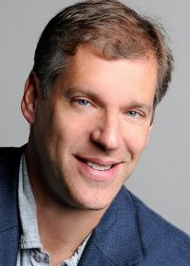
Strengths of core team
Dan Kammen has trained many students who are now well positioned to contribute:
Noah Kittner – University of North Carolina
Paty Hidalgo-Gonzalez – UC San Diego
Sergio Catellanos – University of Texas Austin
Previously used SWITCH to help California set targets:
Dan, could you add more to this slide?

Slide 25
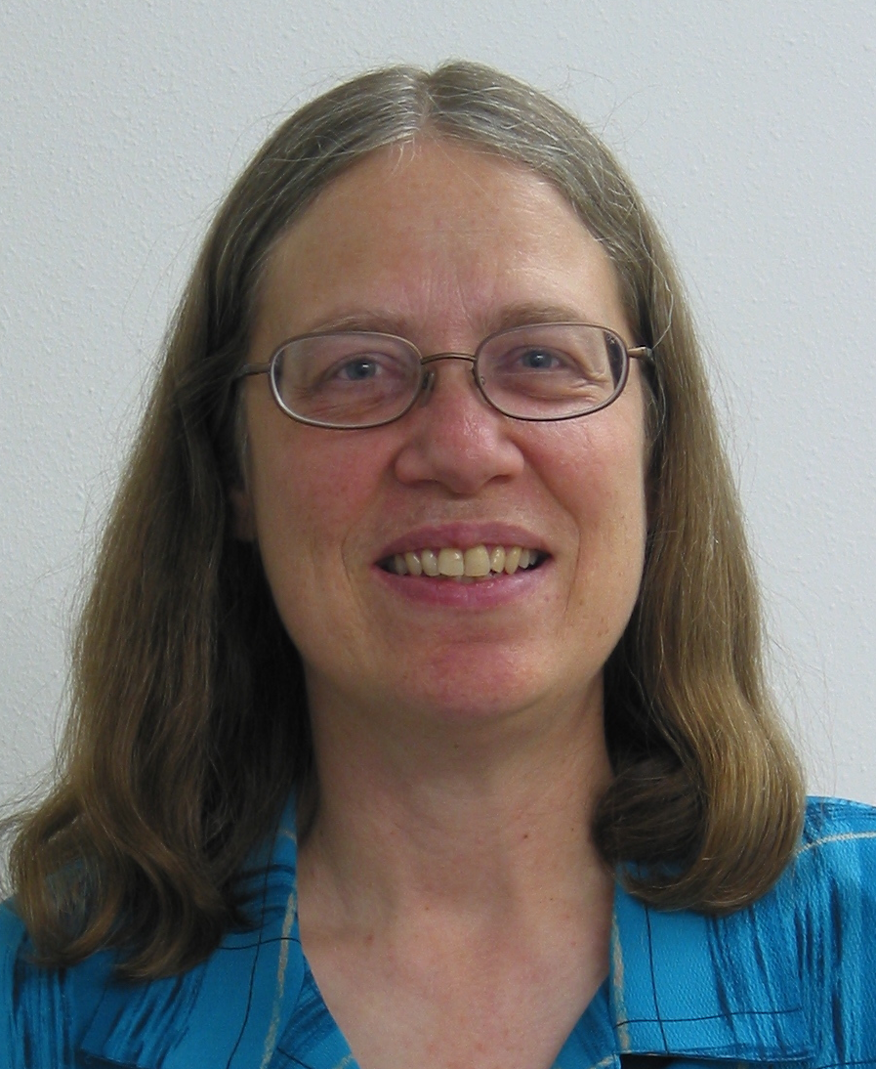
Strengths of core team
Sarah Kurtz
More than 30 years at the National Renewable Energy Laboratory (NREL)
Research focus: high-efficiency solar cells and PV module and system reliability and performance
Managed NREL’s Systems Integration Program under Kevin Lynn at D.O.E.
Managed NREL’s Photovoltaics Program
Transitioned to UC Merced in 2017 with goal of supporting California’s world-leading efforts

Slide 26
Project Team Organization
Technology Evaluation
Modeling
University of North Carolina
UC Berkeley & UC San Diego (Switch)
UC Merced (Resolve)
Coordinated efforts are a necessity; each group has an emphasis

Slide 27
Project Team Organization
Technology Evaluation
Modeling
University of North Carolina
UC Berkeley & UC San Diego (Switch)
UC Merced (Resolve)
Storage Advisory Board

Slide 28
TECHNICAL ADVISORY COMMITTEE
All have accepted:
Erin Childs (CESA)
Paul Denholm (NREL)
Jennifer Dowdell (TURN)
Shucheng Liu (CAISO)
Keith Parks (Xcel Energy)
Julia Prochnik (LDES Association of California)
Ron Sinton (Sinton Instruments)
Priya Sreedharan (GridLab)
David Williams
TAC Meetings planned:
Nov. 4, 2020
Aug. 5, 2021
Feb. 3, 2022
Nov. 2, 2022
Action item:
Set time for Nov. meeting?
Maybe Nov. 5, 10 am?
Note: these individuals have active interest and may meet with us in more than these four meetings.

Slide 29
BROADER INTERACTIONS
Collaboration with Arizona State University
ASU joint project will be funding graduate student this year
ASU is studying capacity expansion in Arizona to support energy transition
Open meetings once per month – GridLab will present Sept. 25.
Outreach to additional companies and stakeholders
Public workshops

Slide 30
QUESTIONS for CEC
SB100 vs Ratepayer benefit (e.g. Should we calculate NOx?)
Region to be studied: CAISO vs “California” vs WECC
Related question: Should we consider imports and exports
Utility vs BTM?
When should we leverage existing CEC efforts vs duplicate to provide independent perspective?
How will CEC guide our direction to complement E3’s (code vs exploration)
Which “Values” – see slide 7
Workshop materials

Slide 31
We welcome collaboration: skurtz@ucmerced.edu
Thank you for your attention!

Slide 32
BACK UP SLIDES

Slide 33
LEARNING CURVES ARE A KEY TOOL
Kittner, et al

Slide 34
Definition of terms
CEC defines long-duration storage as 10 or more hours (?)
For modeling, we may consider:
Diurnal or intra-day storage (can model with 24-h time blocks)
Cross-day or inter-day storage (need multi-day time blocks - probably a week or a month at a time)
Seasonal storage (cycle 1X or 2X/year; need full-year or even 30 years of data)
However, the results for each of these depend on the available resources, which is set in the context of Planning Reserve Margin
Electrochemical storage is short-duration
Is chemical storage “seasonal storage” or “electricity generation”?
Note: RESOLVE currently only considers diurnal or intra-day storage, which can be 10+ hours; must be modified to look at cross-day and seasonal? storage

Slide 35
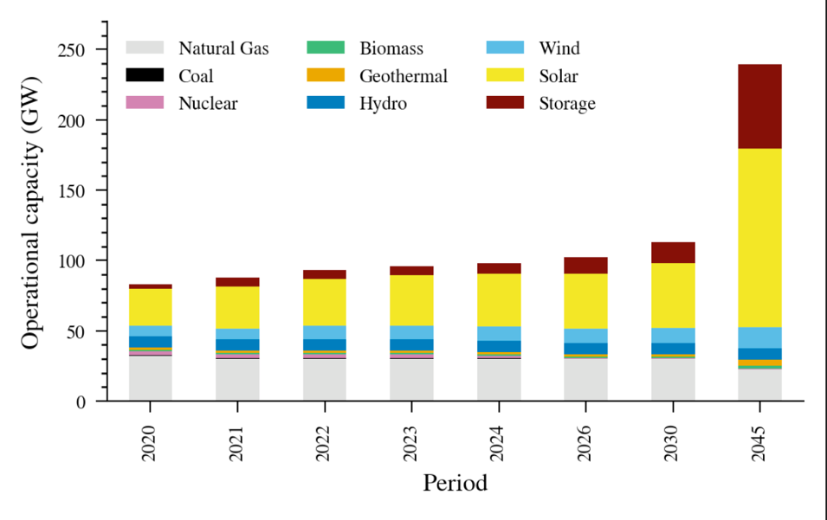
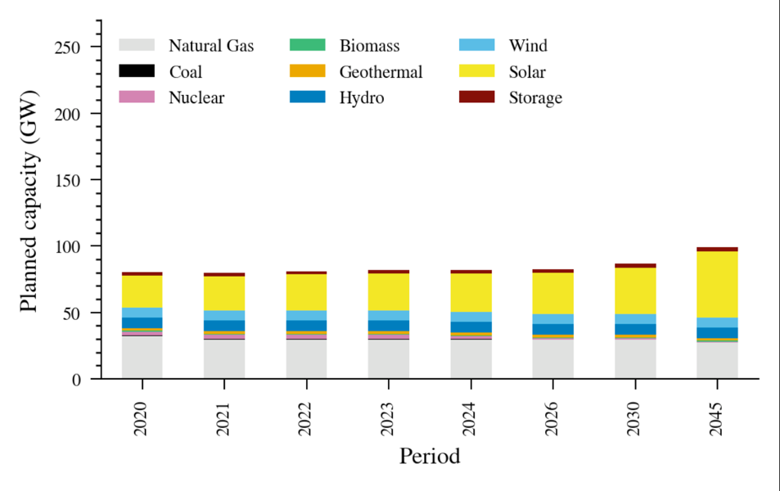
RSP Builds versus planned
Selected growth
Planned growth
Wind 97% of maximum allowed
Solar 20% of maximum allowed
RESOLVE outputs: Data for CAISO zone only

Slide 36
Reference System Portfolio – which outputs = inputs?
Solano Solar Resource
Behind-the-meter battery power capacity
Model selects > planned;
< cap
Selects planned growth
Solano Wind Resource
Behind-the-meter battery energy capacity
Planned growth
Limited by Cap
Fraction of cap that is built is a useful metric

Slide 37
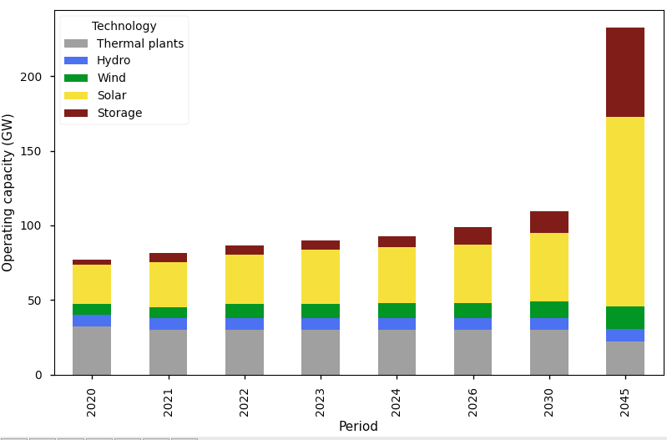
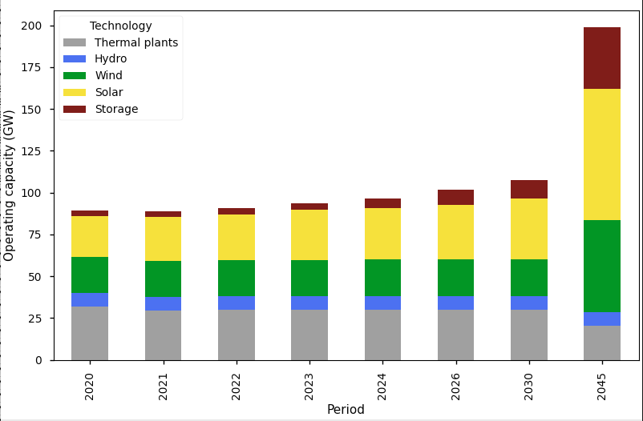
More wind requires less storage
RSP
Wind caps increased
RESOLVE outputs: Data for CAISO zone only
The wind is low because of caps – if the caps are increased, more wind is selected.
Note effect of added wind on need for storage.
Notes:
All wind caps were increased to 9 GW – transmission was needed immediately.

Slide 38
Value of storage is a function of many things
Function of amount of wind, solar and storage

Slide 39
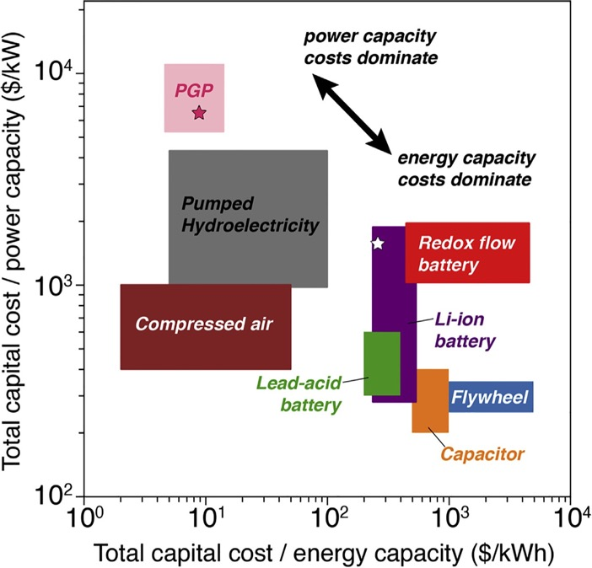
How do we differentiate storage technologies?
Key metrics:
Efficiency
$/kW
$/kWh
Dowling, et al (Joule)

Slide 40
Other Metrics
Market entry strategy – Bridge over the valley of death
Politically viable: Jobs retention
Leverage existing infrastructure
Practicality
Dispatchability (high-T fuel cells are slow to start up)
Footprint (energy density)
Permitting – environmental concerns
Geographical flexibility
What else?
For discussion:
Modularity vs utility scale

Slide 41
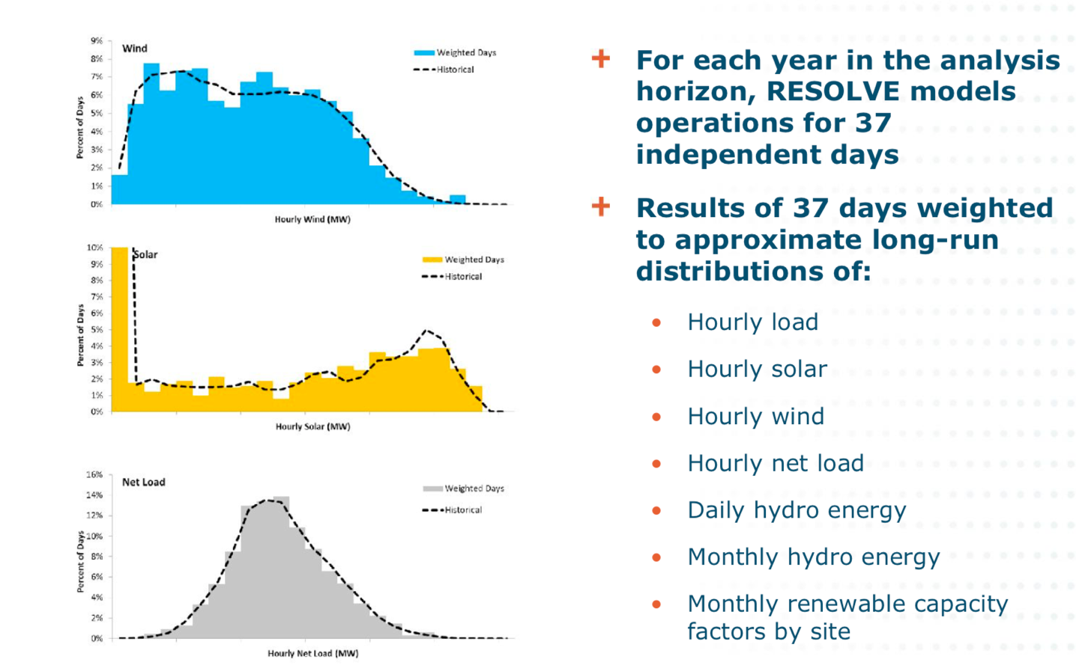
Metrics for selecting weather – extend to cross-day?
https://www.google.com/url?sa=t&rct=j&q=&esrc=s&source=web&cd=&ved=2ahUKEwj8xcHwmqTrAhXOrZ4KHQLBAcYQFjAGegQICRAB&url=https%3A%2F%2Fwww.cpuc.ca.gov%2FWorkArea%2FDownloadAsset.aspx%3Fid%3D6442451316&usg=AOvVaw0mbDD9U2xzOhtJGUFNBfvU
IRP_MAG_E3_Resolve_2016-10-20.pdf

