Slide 1


Long Duration Storage Project
September 4, 2020

Slide 2

AGENDA – Sept. 4
Agenda I have planned:
• Review the three meetings with Malta, Harvard, and Quidnet and discuss any needed action items.
• Review the agenda for the upcoming Sept. 11 Kick-off meeting and identify questions we would like to prioritize to discuss with the CEC
• Review the SB100 workshop from Wednesday (Sept. 2) – Pedro has agreed to put together a brief summary of this
• Announcements:
- meeting with E3 on Sept. 18 – opportunity to talk about coordination.
- google calendar (ldescalendar5@gmail.com) and distribution lists.

Slide 3
Brief summary of discussions with companies
Malta:
Is interested in the modeling: would like anyone to be able to run RESOLVE and ascertain the value of Malta’s technology.
Willing to share data
At meeting with other storage companies, discuss modeling
Harvard:
Hired a consultant who did an analysis – they will share
At meeting with other storage companies, would like to hear how costs are handled by RESOLVE & SWITCH or how to handle costs more generally
Quidnet:
If sent template, will supply information, though would like it treated confidentially
At meeting with other storage companies, discuss how to value storage designed for Resource Adequacy (and the general large topic of the various values storage provides

Slide 4
Follow up with companies
Format for gathering data
https://www.cpuc.ca.gov/General.aspx?id=6442451195 – is intended for new resource, not new technology
Do we want to use something different?
Action items:
Decide on template for gathering info
Send template to companies
After individual meetings with storage companies, set up a group meeting (or maybe two)

Slide 5
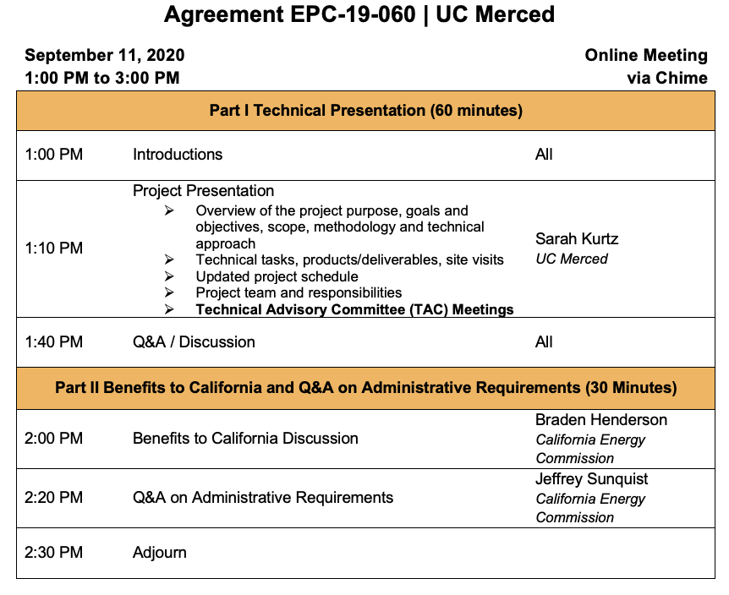
AGENDA FOR KICK-OFF MEETING

Slide 6
TECHNICAL ADVISORY COMMITTEE
Accepted:
Erin Childs (CESA) [She would like to meet with our leadership team]
Shucheng Liu (CAISO)
Keith Parks (Xcel Energy)
Julia Prochnik (LDES Association of California)
Ron Sinton (Sinton Instruments)
Priya Sreedharan (GridLab)
David Williams
No response yet:
Paul Denholm (NREL)
Dowdell
Public meetings planned:
Oct. 2, 2020
Oct. 8, 2020
Meetings planned:
Nov. 4, 2020
Aug. 5, 2021
Feb. 3, 2022
Nov. 2, 2022

Slide 7
OUTCOMES/QUESTIONS for CEC
Or do we already know these answers?
CAISO vs California vs WECC
Import-export
Utility vs BTM?
When should we leverage existing CEC efforts vs duplicate to provide independent perspective?
How will CEC guide our direction to complement E3’s (code vs exploration)
Which “Values” – see next slide

Slide 8
VALUES OF STORAGE – is CEC interested in all?
Ancillary services
Arbitrage (frequent) – same day every day; same day sometimes
Arbitrage (less frequent) – cross day; several weeks
Seasonal storage – cycle only once or twice per year
Resource adequacy – maybe never cycle
Resilience (during outages - microgrids)
Reduced pollution (should we calculate NOx?)
Jobs
Environmental issues (including water usage/effects)

Slide 9
ACTION ITEMS
Sarah will prepare draft of presentation for Kick-off meeting using notes from this meeting and circulate for comment
Need to develop a template and introductory materials to send to companies to request information to inform our studies

Slide 10
CALENDAR
Add LDEScalendar5@gmail.com to your google calendar and to your meeting invitations – that will enable you to see all of the meetings without having them clutter your personal calendar.

Slide 11
Other notes
Pedro presented a summary of SB100
From chat:
https://www.renewableenergyworld.com/2020/08/26/energy-storage-association-charts-path-for-100-gw-of-storage-in-u-s-by-2030/#gref
https://www.cpuc.ca.gov/uploadedFiles/CPUCWebsite/Content/UtilitiesIndustries/Energy/EnergyPrograms/ElectPowerProcurementGeneration/irp/2018/ServmResolveResults_20191106.pdf
Interesting how the only assume that hydrogen and offshore wind will improve in terms of LCOE between now and 2045

